Slide 2
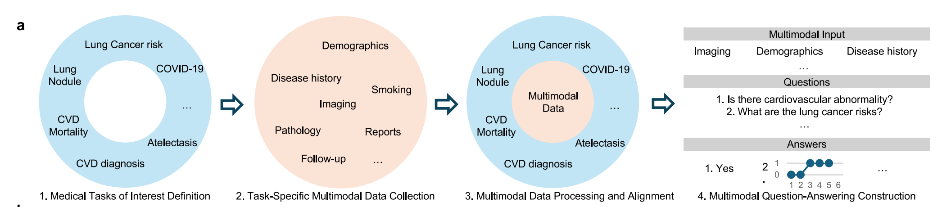
General data curation pipeline
For each task, one training, one validation and one or more tests are conducted

Slide 3
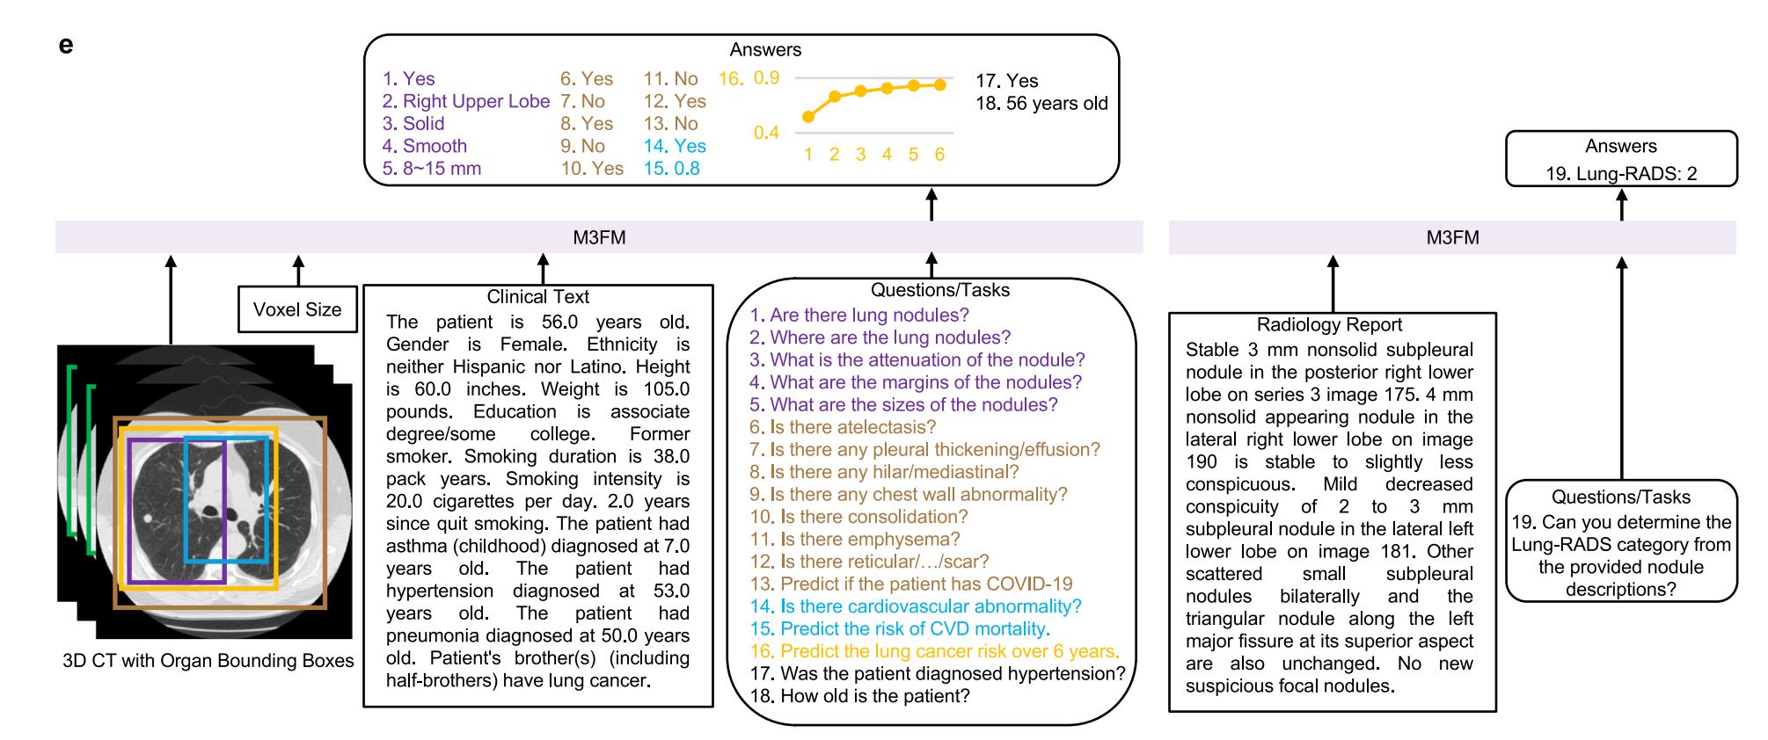
Input of M3FM

Slide 4
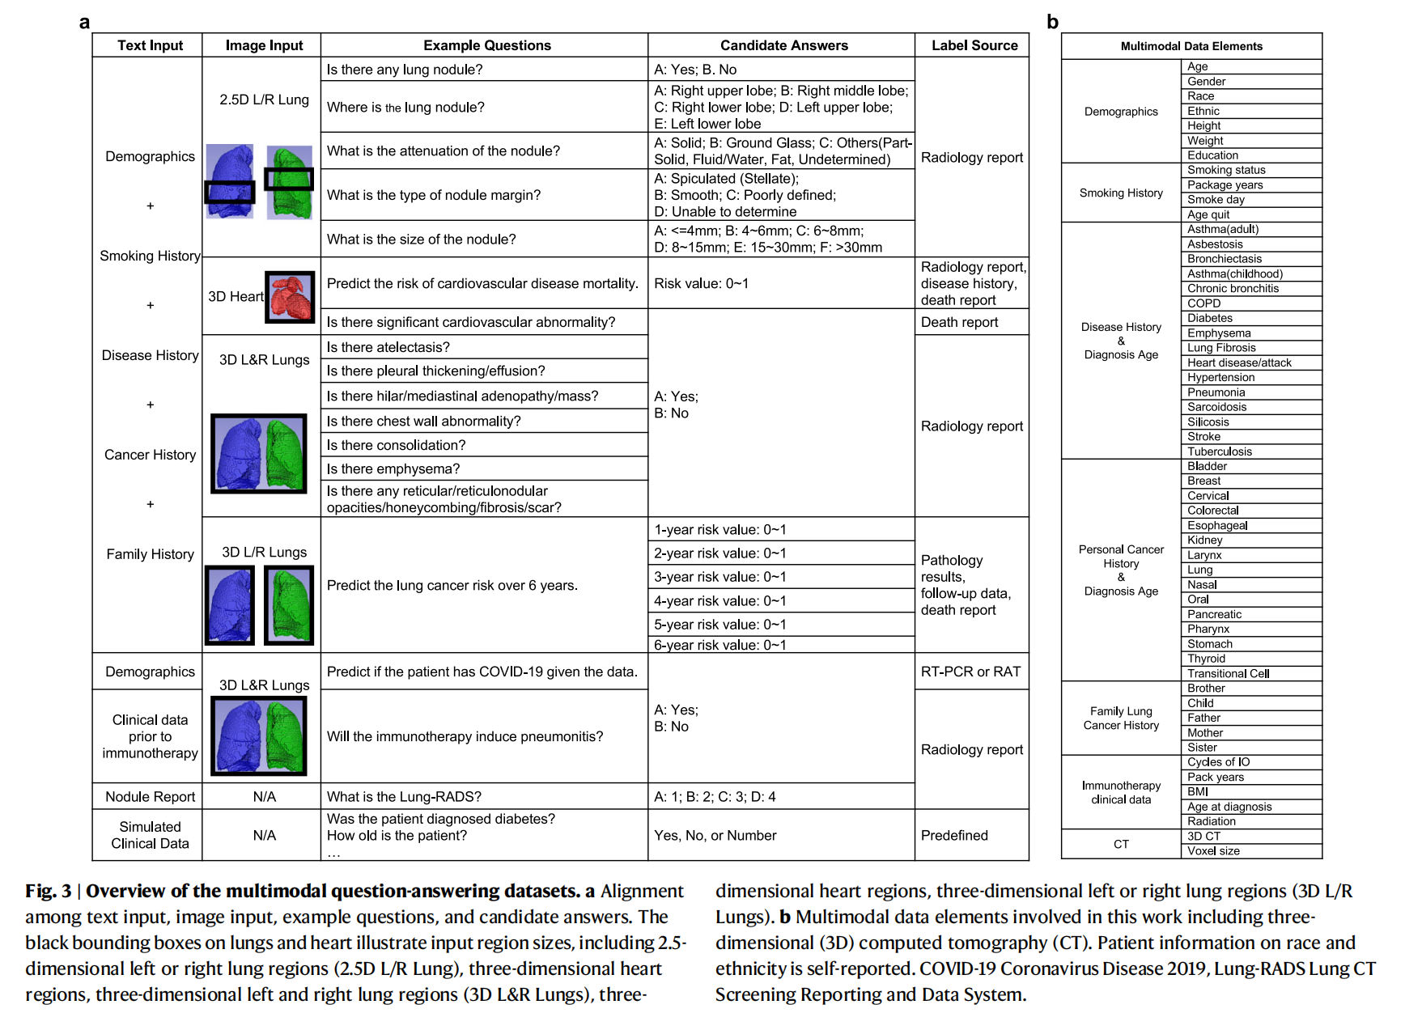

Slide 5
Model Design for M3FM
Encodes multimodal medical data including arbitary combinations of multi-scale 3D tomograhpic images and various other clinical data, and flexibly performs free-text prompting
To make M3FM scalable across multiple tasks, our distributed task-paralleltraining strategy assigns a single task to each device while allowing different devices to process different inputs/outputs for multitask parallel optimization.

