Slide 1
PROJECT TITLE
CAPSTONE PROJECT
Presented By:
Student Name- Irene Maria Thomas
College Name- ISBM College of Engineering, Pune.
Department – Artificial Intelligence & Data Science

Slide 2
OUTLINE
Problem Statement
Proposed System/Solution
IBM Cloud Services Used
End Users
Result
Conclusion
Git-hub Link
Future Scope

Slide 3
Problem Statement
Design and deploy an AI-powered Startup Blueprint Generator Agent using IBM watsonx.ai and Granite models. The agent uses Retrieval-Augmented Generation (RAG) to process uploaded startup policy documents and generate structured outputs—including business model canvas, funding schemes, go-to-market strategy, and investor suggestions—based on user-input startup ideas.

Slide 4
Proposed Solution
The proposed system aims to assist aspiring entrepreneurs in transforming raw startup ideas into complete, actionable business blueprints. This is achieved through a Retrieval-Augmented Generation (RAG)-based AI agent, built on IBM watsonx.ai and powered by IBM Granite foundation models.
Solution Components:
Document Ingestion & Vector Indexing: • Upload and process relevant government documents (e.g., Startup India Seed Fund Scheme PDF) into vector indexes. • Use IBM watsonx.ai’s built-in document handling to enable RAG-based querying from trusted sources.
Agent Design & Prompt Configuration: • Create an AI agent using LangGraph and ReAct architecture. • Configure system prompts to guide the agent as a startup advisor. • Select and apply IBM Granite models (e.g., granite-13b-chat) to generate structured responses.
User Input Handling: • Accept natural language input describing a startup idea. • Dynamically interpret intent and extract keywords for querying the document store.

Slide 5
Proposed Solution
Response Generation via RAG: • Retrieve relevant information from indexed documents (e.g., funding eligibility, legal norms). • Generate output that includes: – Business Model Canvas suggestions – Go-to-market strategy – Estimated budget and resource plan – Government scheme recommendations – Investor and incubator insights
Deployment: • Hosted within IBM’s Cloud Lite infrastructure via the watsonx.ai sandbox project. • No-code deployment allows seamless access via the UI or REST endpoints.
Evaluation & Testing: • Validate the agent’s responses using diverse startup scenarios. • Measure effectiveness based on relevance, completeness, and personalization of the generated blueprint.
Result: An intelligent, document-grounded AI assistant that reduces ambiguity and accelerates startup planning—empowering users to go from concept to execution with clarity and confidence.

Slide 6
IBM CLOUD SERVICES USED
Service | Purpose
IBM watsonx.ai | Core platform to build and deploy the AI agent using Granite models.
IBM Cloud Object Storage (COS) | Stores the uploaded documents (e.g., PDF policy files) used for RAG.
watsonx Vector Database | Indexes and embeds uploaded documents for retrieval-based querying.
IBM Granite Foundation Models | Used for generating responses (e.g., business plan, funding advice).
Agent Builder (watsonx.ai UI) | No-code interface to configure prompts, models, and document ingestion.

Slide 7
END USERS
Aspiring Entrepreneurs
Startup Incubators and Mentors
Students and Innovators
Government Startup Cell
Business Development Professionals

Slide 8
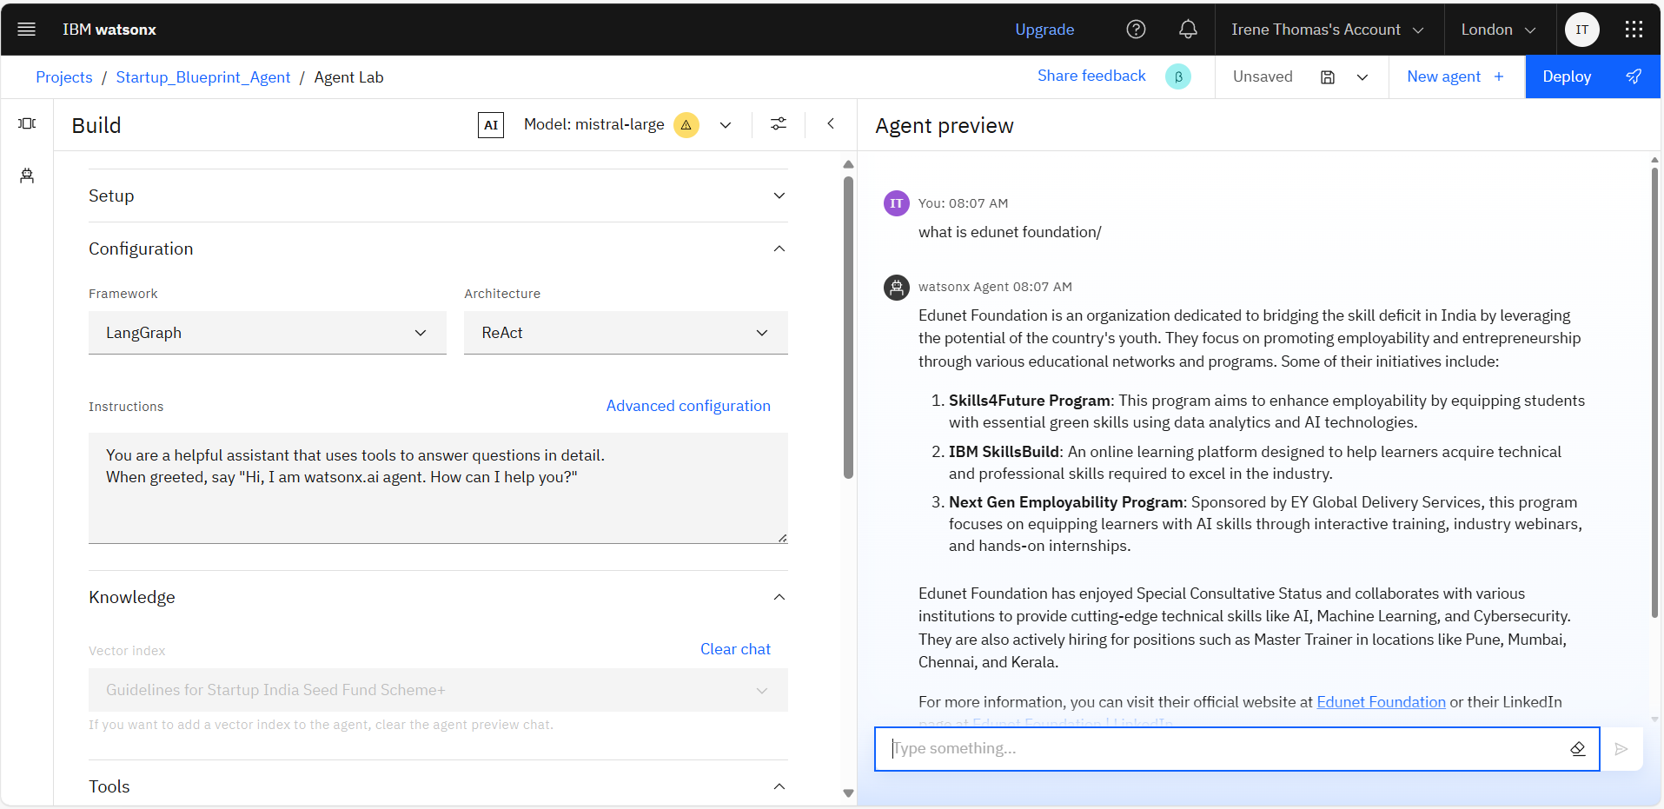
Result

Slide 9
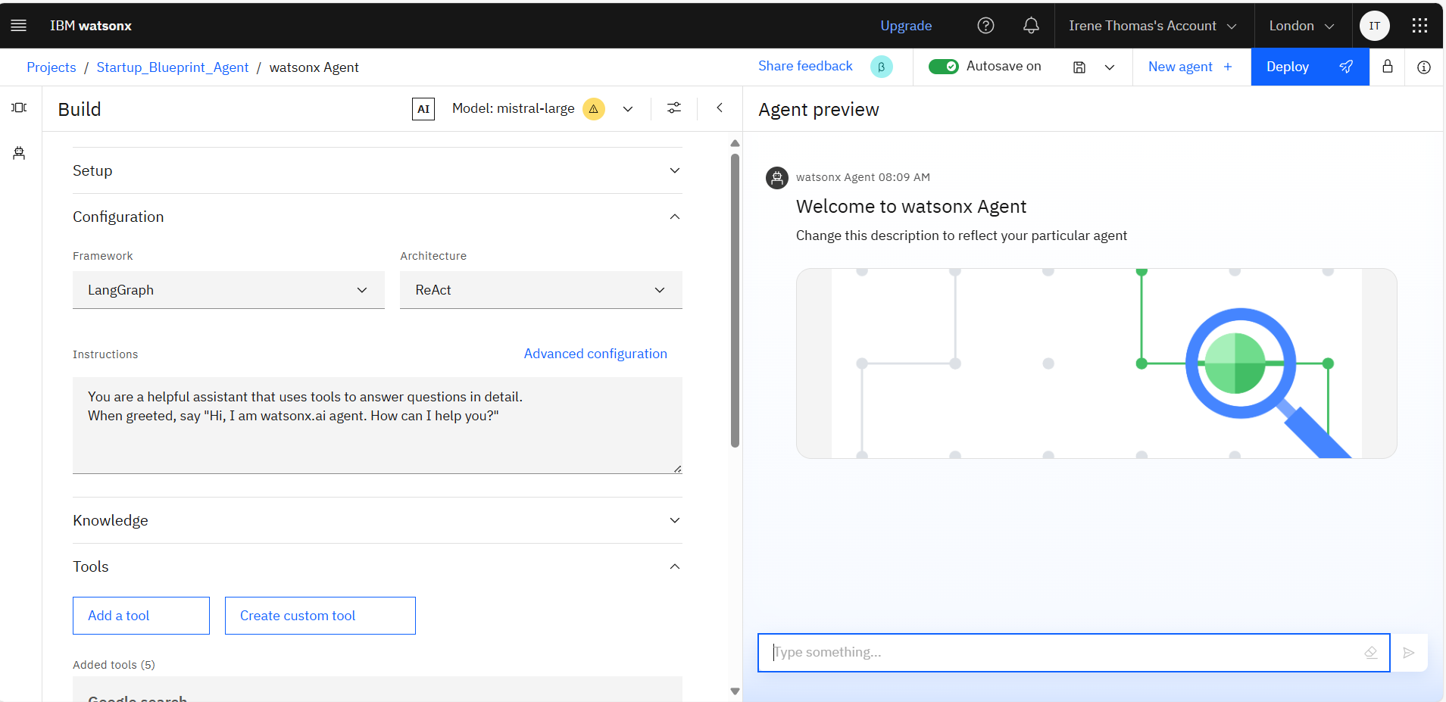
Result

Slide 10
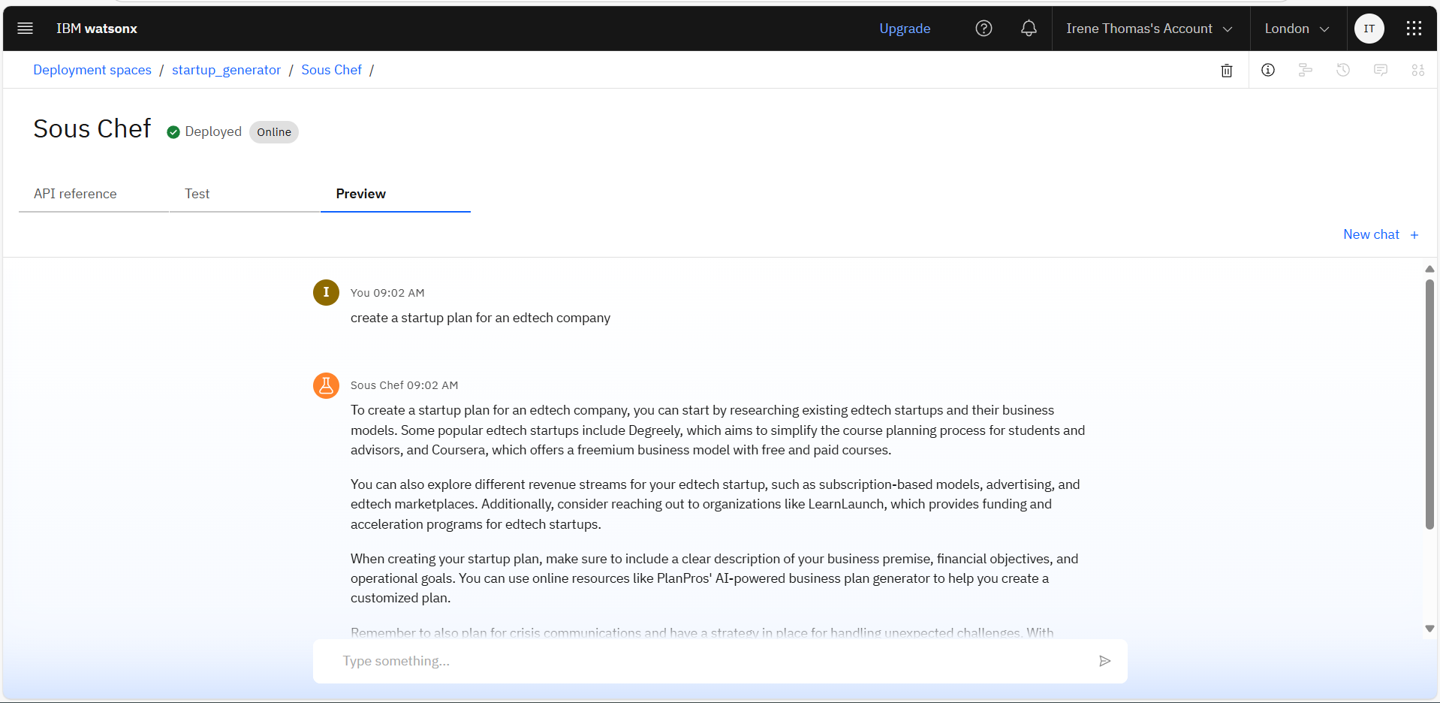
Result

Slide 11
Conclusion
The agent successfully transforms startup ideas into actionable business blueprints using IBM watsonx.ai and Granite models.
RAG with document ingestion enabled context-rich outputs based on real startup policy documents.
Challenges included configuring the vector index, managing document formatting, and working within the Lite plan limits.
The solution empowers aspiring entrepreneurs by simplifying planning, enhancing clarity, and accelerating idea-to-execution.

Slide 12
GIHUB LINK
https://github.com/Irene9756/IBM-Cloud-Startup-Blueprint

Slide 13
Future scope
Enhance Model Capabilities: Fine-tune Granite models or integrate advanced LLMs for more personalized and context-aware business blueprint generation.
Multi-region Support: Extend the system to handle region-specific startup policies, legal requirements, and funding schemes across multiple states or countries.
Adopt Emerging Technologies: Leverage edge computing for faster on-device inference and explore advanced ML techniques like reinforcement learning for adaptive blueprint suggestions.

Slide 14
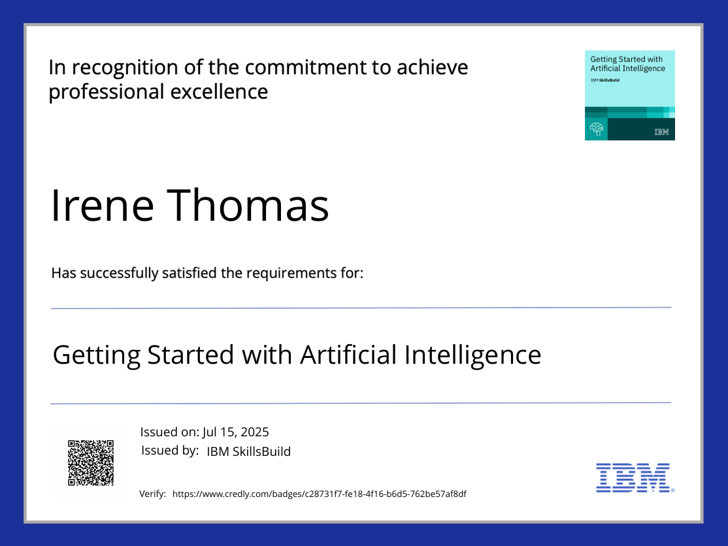
IBM Certifications

Slide 15
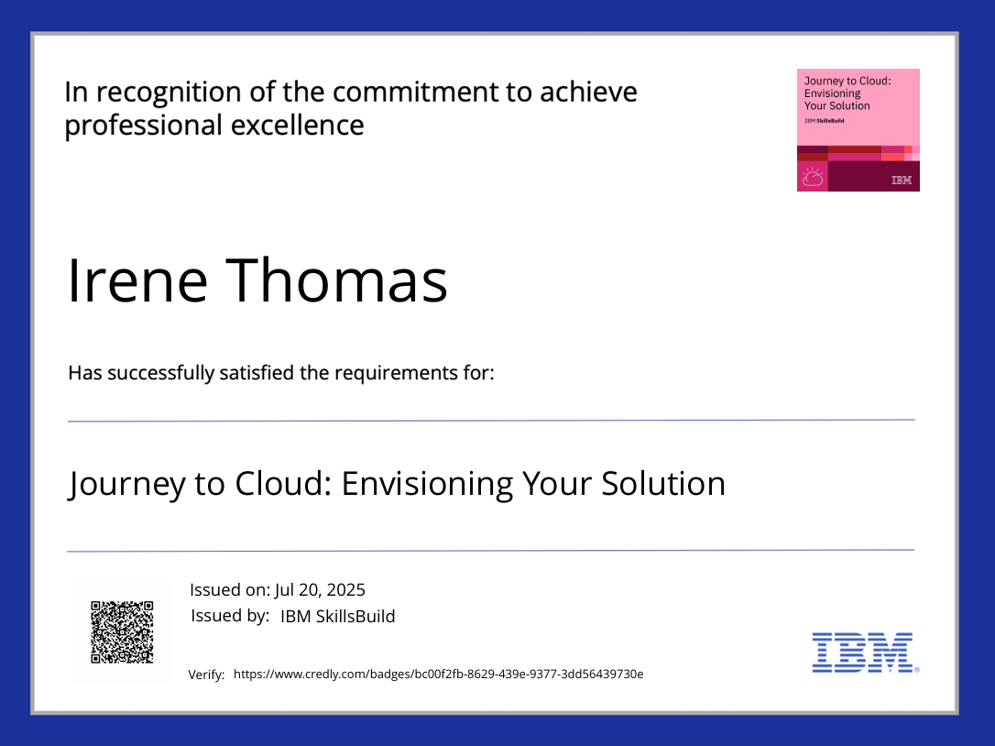
IBM Certifications

Slide 16
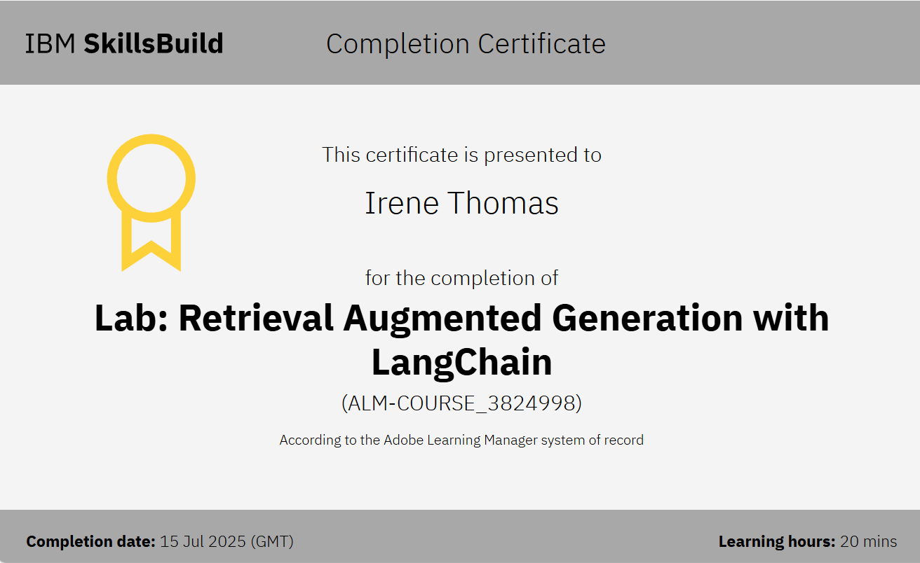
IBM Certifications

Slide 17
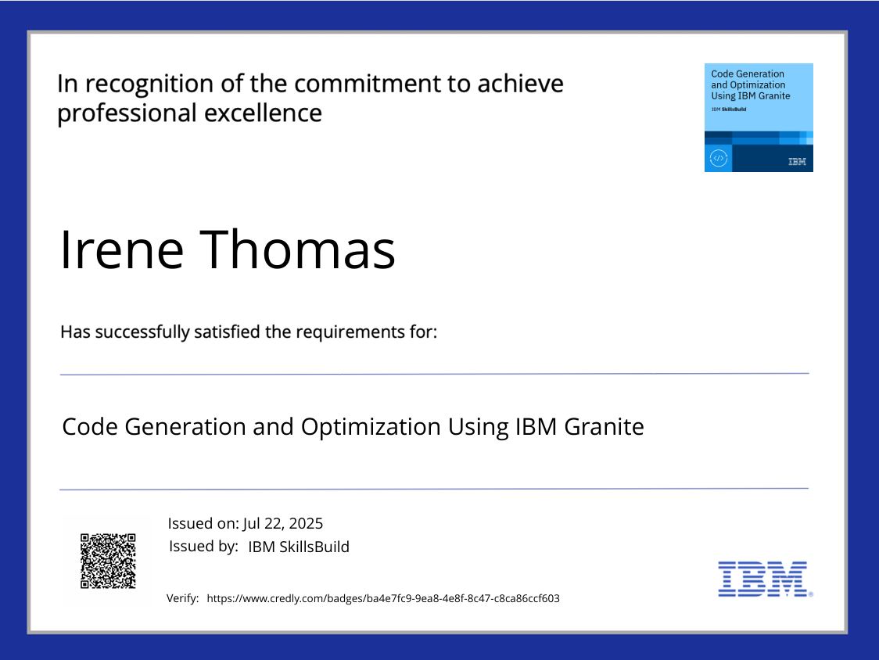
IBM Certifications

Slide 18
THANK YOU

