Slide 1
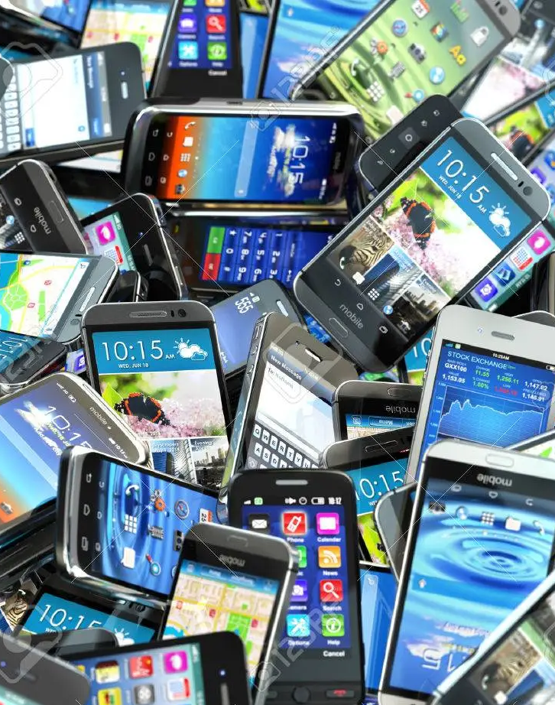
Mobile Phone Reviews
Business and Project Management
Project a.a. 2021-2022
Irene Cantini
Elisa De Filomeno

Slide 2
Contents overviews
Introduction
Sentiment Analysis
Keyword extraction
Conclusions

Slide 3
Introduction

Slide 4
Introduction
This project deals with the topic of online reviews that customers write about products on the internet.
Goal: analyze customer sentiments to give additional tools to companies
Two parts to answer two business-relevant questions
Techniques: Natural Language Processing (NLP)

Slide 5
Business Questions
Is Sentiment analysis useful to classify Online reviews and verify customer satisfaction with different products?
After the development of sentiment analysis, is it possible to identify strengths and weaknesses of brands using keyword extraction in order to make better future business decisions?

Slide 6
Dataset
Source by data.world: link
Data was extracted in December 2016 from the unlocked mobile category of amazon.com
Is composed by 413840 amazon mobile phone reviews and 6 attributes
Mobile cell phones are from different brands
Amazon Mobile Phone Reviews
Product Title
Brand
Price
Rating (from 1 to 5)
Reviews
Review vote

Slide 7
Sentiment Analysis
First question
“Is Sentiment analysis useful to classify Online reviews and verify customer satisfaction with different products?”

Slide 8
Steps
Dataset Preparation and Training Set
Text preprocessing, Building Vocabulary and Feature Extraction
Classifiers Evaluations
Model Selection

Slide 9
Dataset cleaning
Removed rows containing at least a null field
Dropped the useless price column
Removed useless characters
Removed not-English comments
Expanded English contractions
Tranformed all the texts in lower case

Slide 10
Training Set
Attribute selected:
Reviews -> containing the text of the comments
Rating -> score from 1 to 5, establishing a ground truth
15000 comments labelled:
Rating = 1 negative comment
Rating = 3 neutral comment
Rating = 5 positive comment
Balanced training set, 5000 instances for each class

Slide 11
Text Elaboration
“This phone is great!!!!!! Even my 15yr. old loved it”
Tokenization
<this><phone><is><great> <even><my><old><loved><it>
Stop-words filtering
<phone><great><loved>
Lemmatization
<phone><great><love>
Token filtering

Slide 12
Classification
5-fold cross validation for each classifier
Paired T-test between the two best classifiers

Slide 13
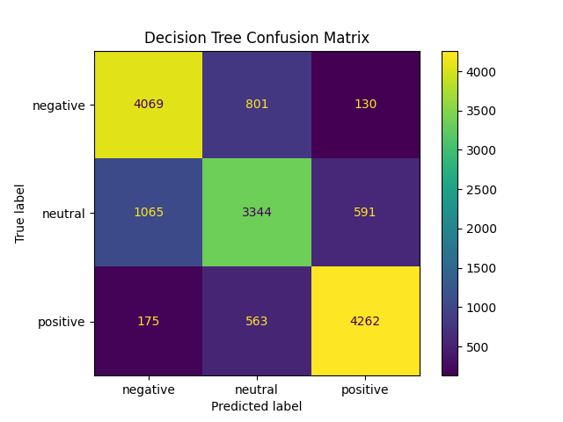
Results and Conclusions
LinearSVC is the best classifier with an accuracy of over 78%!
Is Sentiment analysis useful to classify Online reviews and verify customer satisfaction with different products?
YES

Slide 14
Keywords Exctraction
Second question
“After the development of sentiment analysis, is it possible to identify strengths and weaknesses of brands using keyword extraction in order to make better future business decisions?”

Slide 15
Steps
Classified all comments using the classifier built in the previous phase
Split the dataset: positive and negative
Extracted most frequent word pairs from both datasets
Goal: capture which aspects of different brands were the most and less appreciated
Considered 5 brands:
Brand | Number of comments
Samsung | 2633
BLU | 2570
Apple | 2441
LG | 929
Nokia | 732

Slide 16
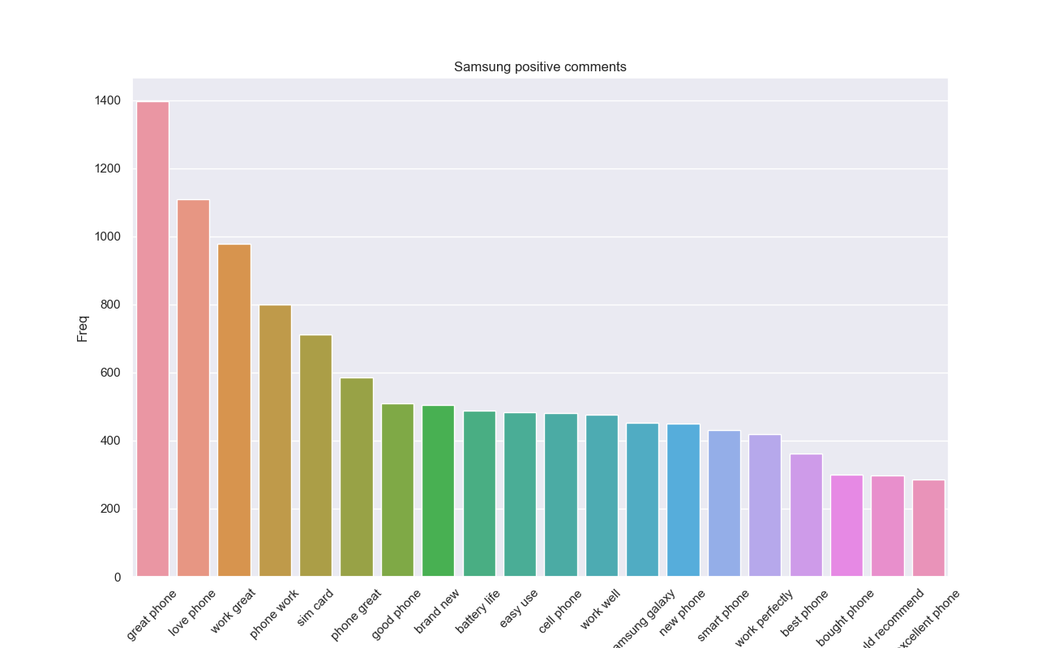
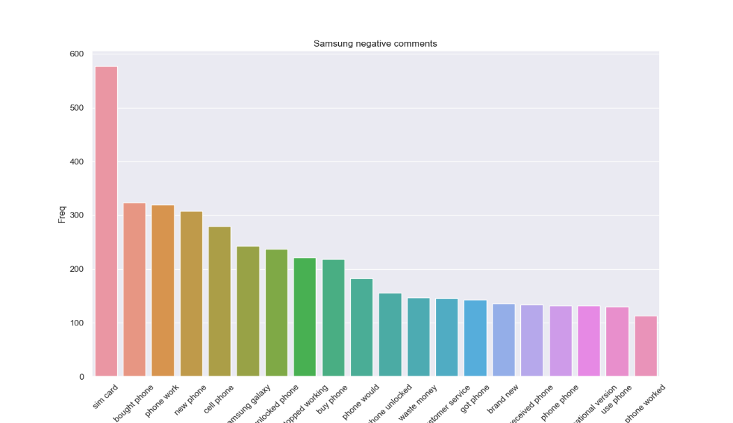
Samsung
Strenghts:
brand new
battery life
easy use
Weaknesses:
stopped working
customer service (?)

Slide 17
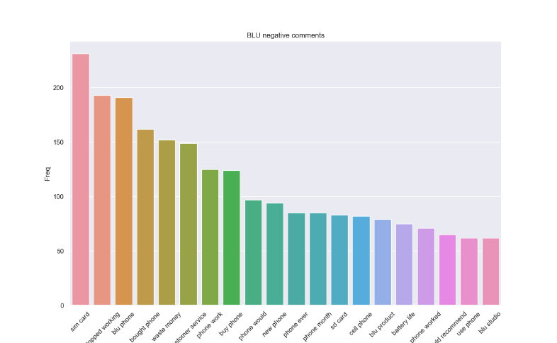
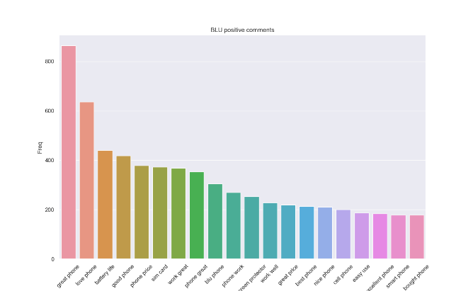
Blu
Strenghts:
phone price
battery life
easy use
Weaknesses:
Customer service
Battery life (less frequent than in positive plot)

Slide 18
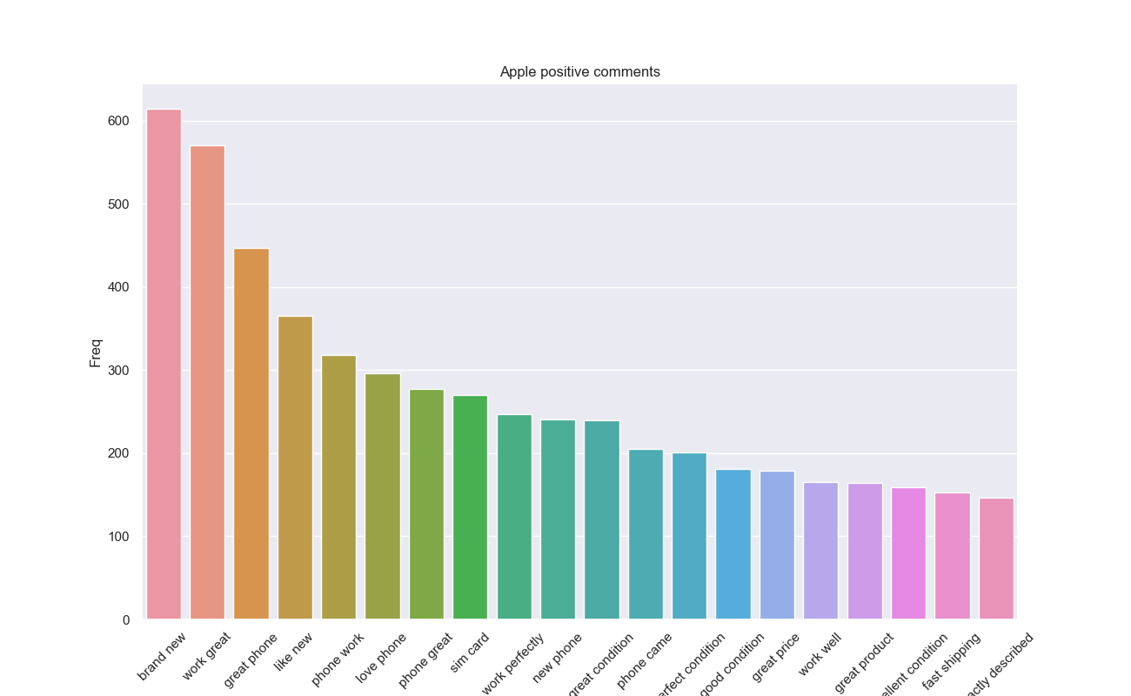
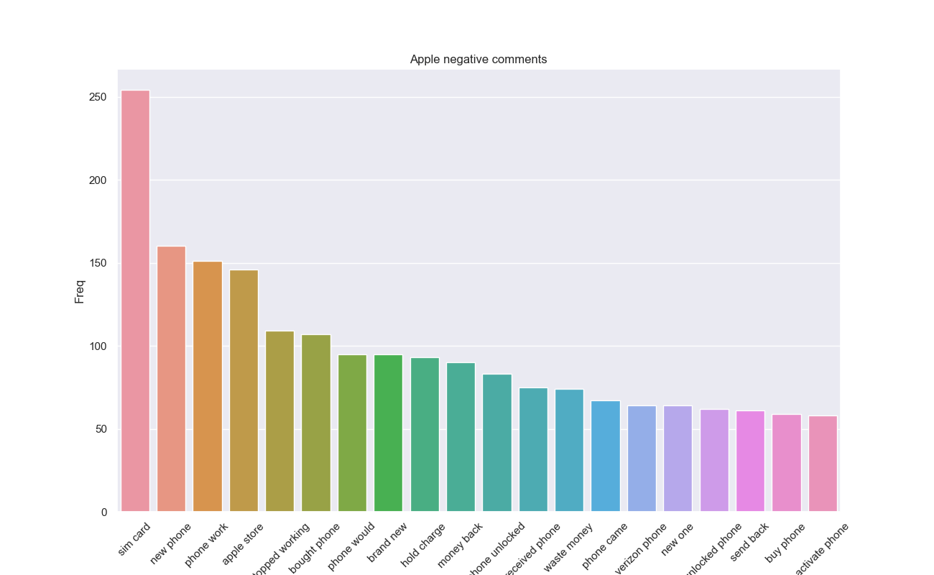
Apple
Strenghts:
brand new
work well
perfect condition
Weaknesses:
hold charge
stopped working
Apple store (?)

Slide 19
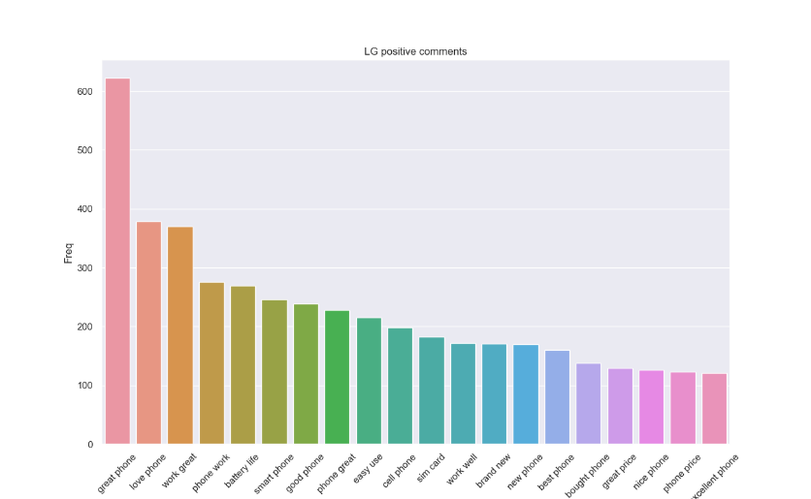
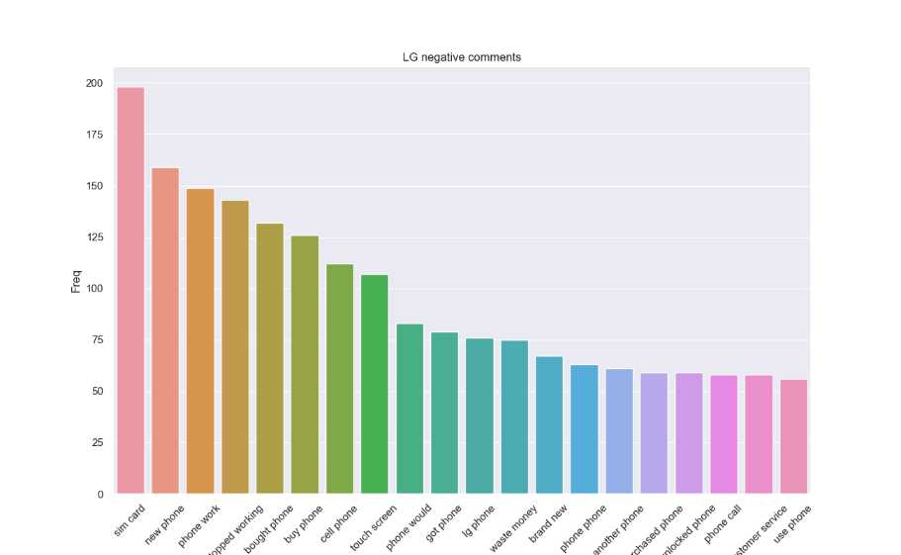
LG
Strenghts:
great price
battery life
easy use
Weaknesses:
touch screen
stopped working
customer service

Slide 20
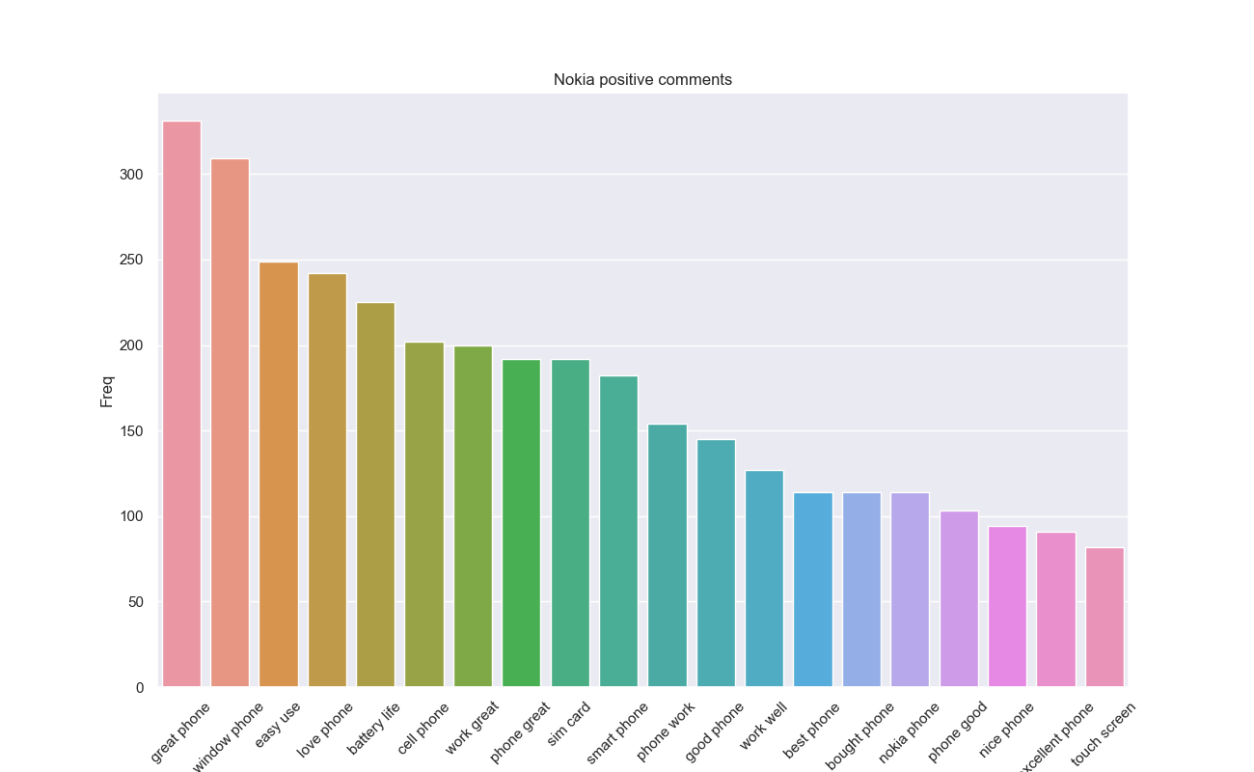
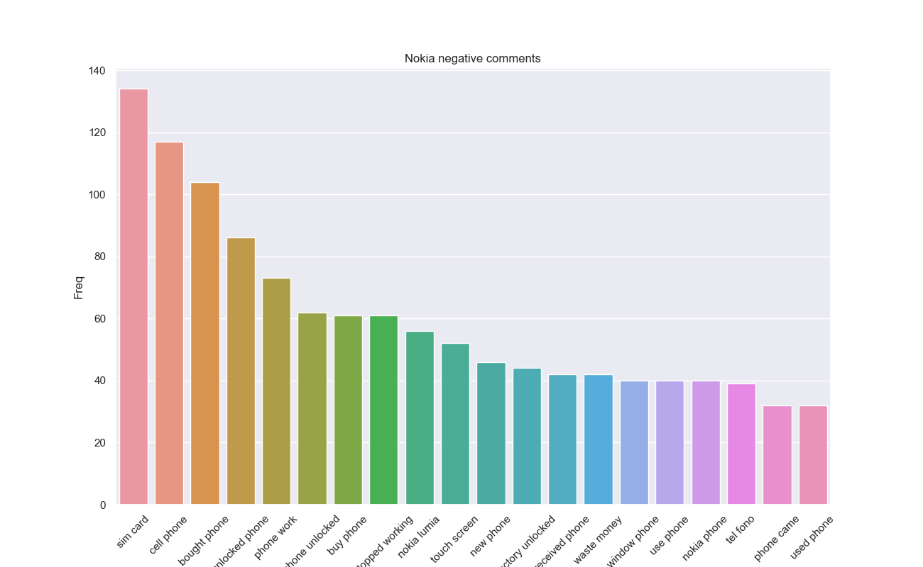
Nokia
Strenghts:
great price
easy use
window phone
battery life
Weaknesses:
touch screen
stopped working

Slide 21
Results
After the development of sentiment analysis, is it possible to identify strengths and weaknesses of brands using keyword extraction in order to make better future business decisions?
YES

Slide 22
Conclusion
This study can be used by:
customers to make more informed decisions
marketing to make more attractive the advertising campaigns
companies in defining business strategies
Recent research found out that 49% of consumers selected positive consumer reviews in their top 3 purchase influences
Customers reviews analysis
improve business strategies
improve customer satisfaction
Increase trust in the brand
Show that the company is an expert in the industry
Increase profits

Slide 23
THANKS FOR YOUR ATTENTION!
Irene Cantini
Elisa De Filomeno

