Slide 1

in documents / manuscript

Slide 2
Anatomy
Your first LaTeX document!
Structuring the document
Adding elements
Figures
Tables
Mathematics
Templates
in documents / manuscript

Slide 3
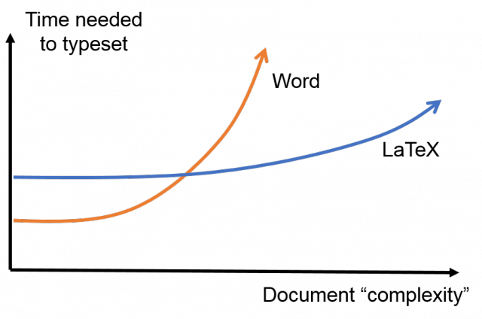

Slide 4
Anatomy of a LaTeX document
\documentclass[options]{class} Preamble commands, if needed \begin{document} Document text & commands here \begin{environment1} Environment 1 commands & text here \end{environment1} More document text & commands here \begin{environment2} Environment 2 commands \& text here \end{environment2} \end{document}

Slide 5
Anatomy of a LaTeX document
\documentclass[options]{class} Preamble commands, if needed \begin{document} Document text & commands here \begin{environment1} Environment 1 commands & text here \end{environment1} More document text & commands here \begin{environment2} Environment 2 commands \& text here \end{environment2} \end{document}
article, letter, report, slides, book, etc

Slide 6
Anatomy of a LaTeX document
\documentclass[options]{class} Preamble commands, if needed \begin{document} Document text & commands here \begin{environment1} Environment 1 commands & text here \end{environment1} More document text & commands here \begin{environment2} Environment 2 commands \& text here \end{environment2} \end{document}
10pt, 11pt, 12pt
letterpaper, legalpaper, a4paper, a5paper
onecolumn, twocolumn

Slide 7
Anatomy of a LaTeX document
\documentclass[options]{class} Preamble commands, if needed \begin{document} Document text & commands here \begin{environment1} Environment 1 commands & text here \end{environment1} More document text & commands here \begin{environment2} Environment 2 commands \& text here \end{environment2} \end{document}
Formatting, packages

Slide 8
Anatomy of a LaTeX document
\documentclass[options]{class} Preamble commands, if needed \begin{document} Document text & commands here \begin{environment1} Environment 1 commands & text here \end{environment1} More document text & commands here \begin{environment2} Environment 2 commands \& text here \end{environment2} \end{document}
Document contents

Slide 9
Anatomy of a LaTeX document
\documentclass[options]{class} Preamble commands, if needed \begin{document} Document text & commands here \begin{environment1} Environment 1 commands & text here \end{environment1} More document text & commands here \begin{environment2} Environment 2 commands \& text here \end{environment2} \end{document}
abstract, equation, eqnarray,
figure, table, tabular,
itemize, enumerate,
appendix, thebibliography

Slide 10
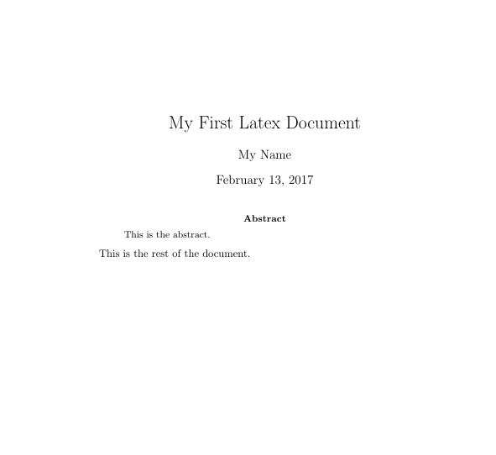
Your first LaTeX document!
\documentclass[10pt]{article}
\begin{document}
\title{My First Latex Document} \author{My Name} \maketitle
\begin{abstract}
This is the abstract.
\end{abstract}
This is the rest of the document. \end{document}
See example1.tex

Slide 11
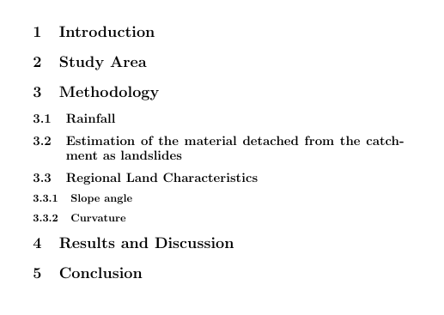
Structuring the document
.
.
.
\section{Section 1} \section{Section2}
\section{Section 3} \subsection{Subsection 1} \subsection{Subsection 2} \subsection{Subsection 3} \subsubsection{Subsubsection 1}
\subsubsection{Subsubsection 2}
\section{Section 4}
\section{Section 5}
.
.
.
See example2a.tex
See example2b.tex

Slide 12
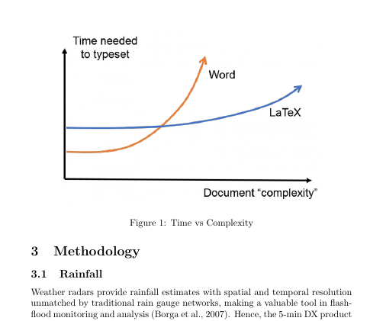
Adding elements to the document
Figures
\usepackage{graphicx}
.
.
. % document contents
\begin{figure}
\centering
\includegraphics[width=10cm]{myplot1}
\caption{Time vs Complexity}
\end{figure} .
.
.
See example3.tex

Slide 13
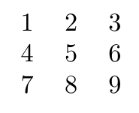
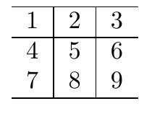
Adding elements to the document
.
.
. % document contents
\begin{tabular}{ l c r }
1 & 2 & 3 \\
4 & 5 & 6 \\
7 & 8 & 9 \\
\end{tabular}
\begin{tabular}{ l | c | r }
\hline
1 & 2 & 3 \\ \hline
4 & 5 & 6 \\
7 & 8 & 9 \\
\hline
\end{tabular} .
.
.
Table

Slide 14

Adding elements to the document
.
.
. % document contents
\begin{tabular}{ l c r }
1 & 2 & 3 \\
4 & 5 & 6 \\
7 & 8 & 9 \\
\end{tabular}
\begin{tabular}{ l | c | r }
\hline
1 & 2 & 3 \\ \hline
4 & 5 & 6 \\
7 & 8 & 9 \\
\hline
\end{tabular} .
.
.
Table
SO MUCH WORK!

Slide 15
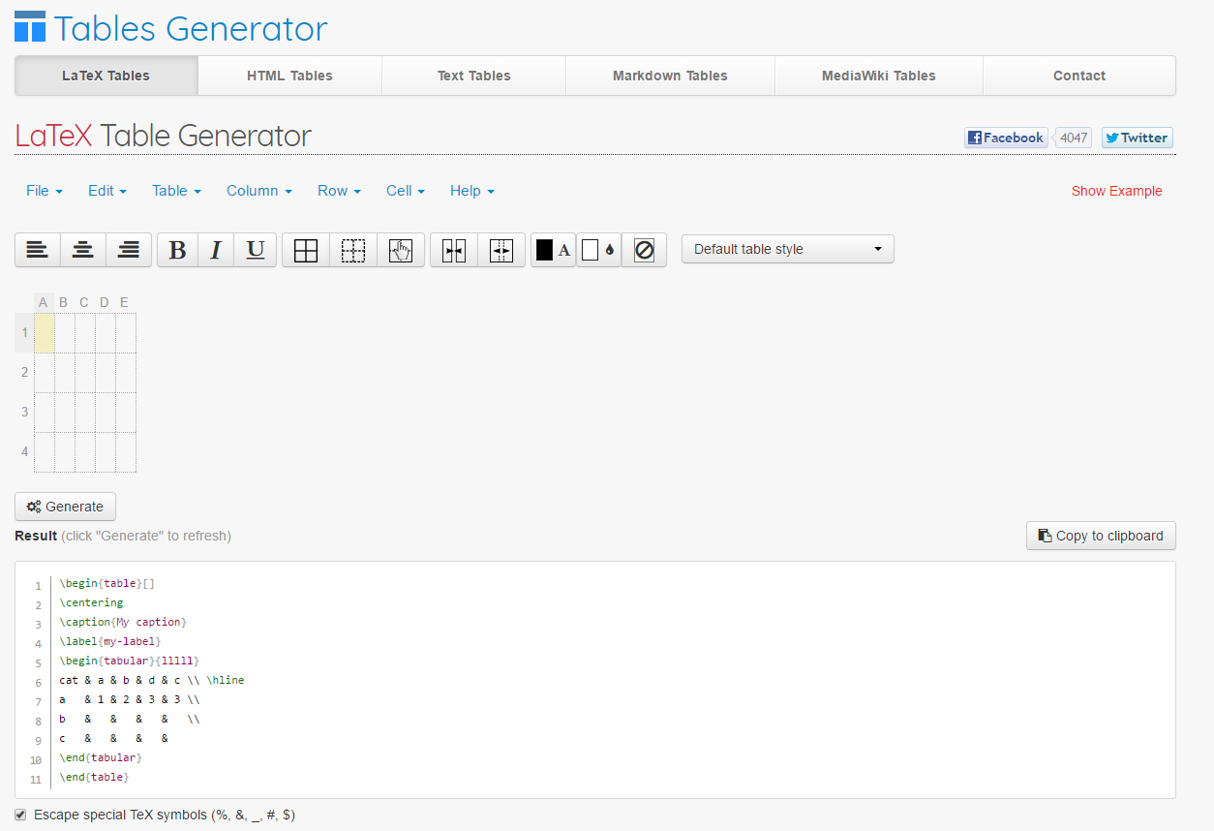
Adding elements to the document
http://www.tablesgenerator.com/
Table

Slide 16
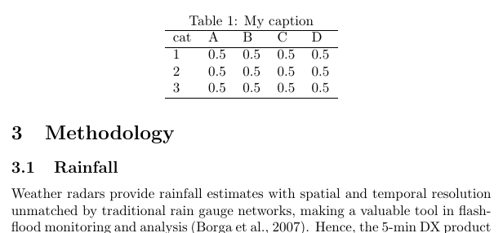
Adding elements to the document
Table
.
.
. % document contents
\begin{table}[]
\centering
\caption{My caption}
\label{my-label}
\begin{tabular}{lllll}
\hline
cat & A & B & C & D \\ \hline
1 & 0.5 & 0.5 & 0.5 & 0.5 \\
2 & 0.5 & 0.5 & 0.5 & 0.5 \\
3 & 0.5 & 0.5 & 0.5 & 0.5 \\ \hline
\end{tabular}
\end{table} .
.
.

Slide 17

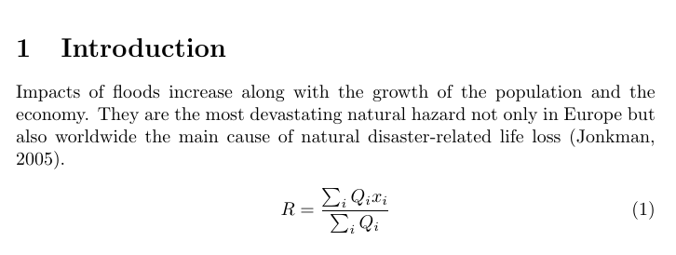
Adding elements to the document
Mathematics
Inline
Displayed

Slide 18

Adding elements to the document
Mathematics
Inline
.
.
. % document contents
Under the conditions that $\forall x \in X, \quad \exists y \leq \epsilon$ is satisfied. This is possible when $\lim_{x \to \infty} \exp(-x) = 0$. .
.
.

Slide 19
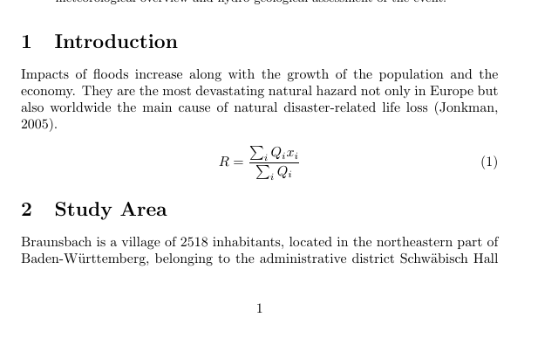
Adding elements to the document
Mathematics
Displayed
.
.
. % document contents
\begin{equation}
R=\frac{\sum_{i} Q_{i} x_i}{\sum_{i} Q_i}
\end{equation} .
.
.

Slide 20



Adding elements to the document
Mathematics
\frac{1}{2}
1 \times 2
\sqrt{\frac{a}{b}}
\frac{\partial }{\partial x}
\alpha, \beta, \gamma, \Gamma, \pi, \Pi, \phi, \mu, \Phi
\cos (2\theta) = \cos^2 \theta - \sin^2 \theta

Slide 21
Adding elements to the document
Mathematics
\frac{1}{2}
1 \times 2
\sqrt{\frac{a}{b}}
\frac{\partial }{\partial x}
\alpha, \beta, \gamma, \Gamma, \pi, \Pi, \phi, \mu, \Phi
\cos (2\theta) = \cos^2 \theta - \sin^2 \theta
Online LaTeX equation editors!
https://www.codecogs.com/latex/eqneditor.php

Slide 22
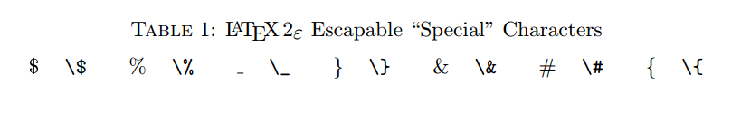
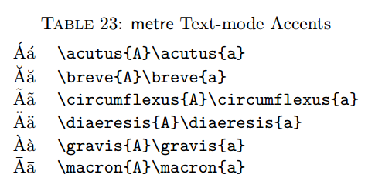
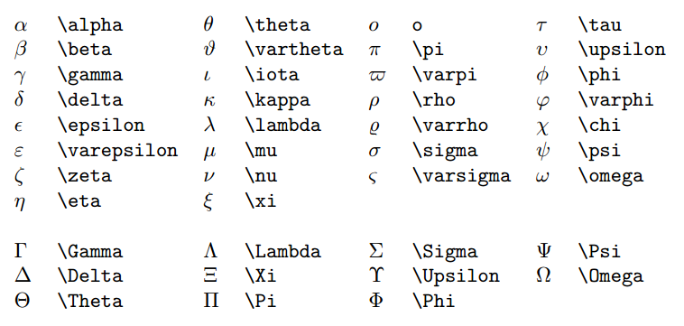
Special Characters

Slide 23
Special Characters
http://tug.ctan.org/info/symbols/comprehensive/symbols-a4.pdf
http://tex.stackexchange.com/

Slide 24


Templates
http://www.latextemplates.com/template/elseviers-elsarticle-document-class
http://www.hydrology-and-earth-system-sciences.net/for_authors/manuscript_preparation.html

