Slide 1
“How to Build a Regression Model”
Melinda K. Higgins, Ph.D.
14 November 2008

Slide 2
Outline
Basics
Assumptions
Linear Relationships
Understanding Correlation
3 Types of Linear Regression (theory development)
Diagnostics of Model Fit
Problems with Multicollinearity
Outliers
References

Slide 3
Basics
Dependent Variable
  Continuous
  Single
Independent Variables
  Continuous or Discrete (dummy coding)
  Single or Multiple
“Linear” Relationship – discussion following

Slide 4
Assumptions
The IVs (independent variables) have a relationship with the DV (dependent variable)
That relationship is linear (either directly or through transformations)
The independent variables are independent of one another (no multicollinearity) – although some “mild/minor” correlation may be tolerated.
Any case which has “missing” data on any of the IVs or DV will be eliminated from the analysis
The intercept and all coefficients for the IVs are “Fixed.” [“Random Coefficient Models” to be discussed later.]

Slide 5
Linear Relationships
Which are Linear?
Y = β₀ + β₁X₁ + ε
Y = β₀ + β₁X₁ + β₂X₂ + β₁₂X₁X₂ + ε
Y = β₀ + β₁X₁ + β₂X₁² + ε
lnY = β₀ + β₁X₁ + β₂(sqrt(X₂)) + ε
Y = β₀X₁^{β1}X₂^{β2}e^{ε}
[lnY = lnβ₀ + β₁lnX₁+ β₂lnX₂ + ε]
Y = β₀X₁^{β1}X₂^{β2} + ε




?
Take ln() natural log of both sides


Intrinsically nonlinear

Slide 6
Correlation (2 variables)
1-r²
r²
1-r²
Suppose r = 0.5, then r² = 0.25 and 1-r² = 0.75
Venn Diagram [“ballantine”] - where each circle represents the
variance of that variable
The overlap in circles represents the degree of correlation (or r²).
Just because we know r2 – MUST STILL MAKE PICTURES!!

Slide 7
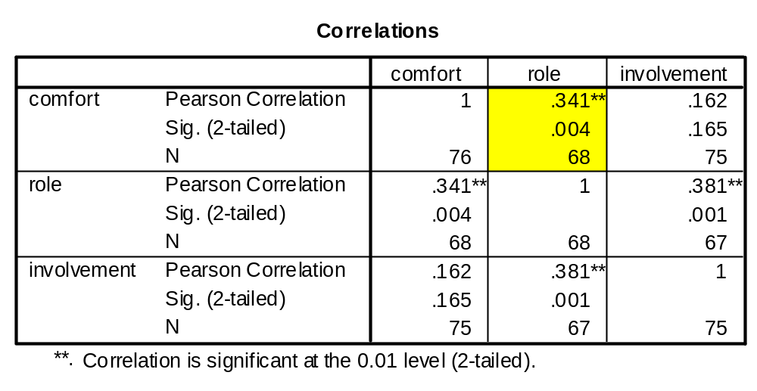
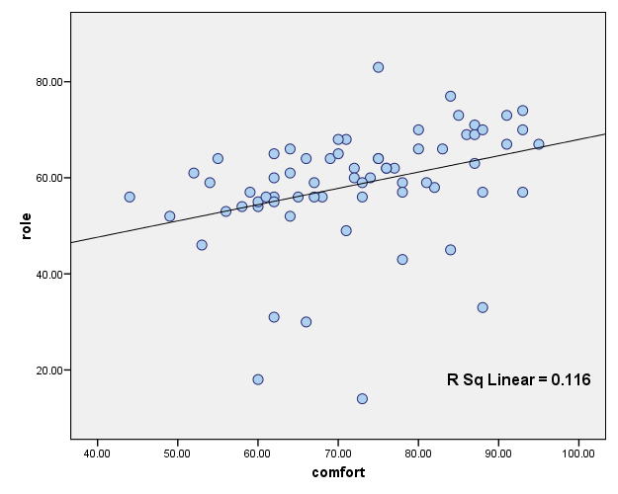
(0.341)² = .116

Slide 8
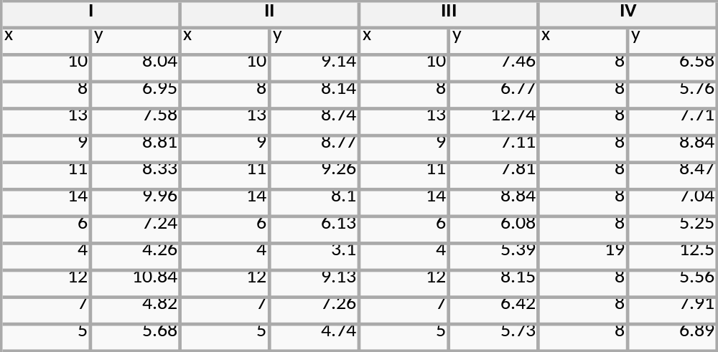
4 similar datasets – they have identical regression results – or do they?
For all four datasets:
Property Value
Mean of each x variable 9.0
Variance of each x variable 10.0
Mean of each y variable 7.5
Variance of each y variable 3.75
Correlation between each x and y variable 0.816
Linear regression line y = 3 + 0.5x
But what do they look like? →

Slide 9
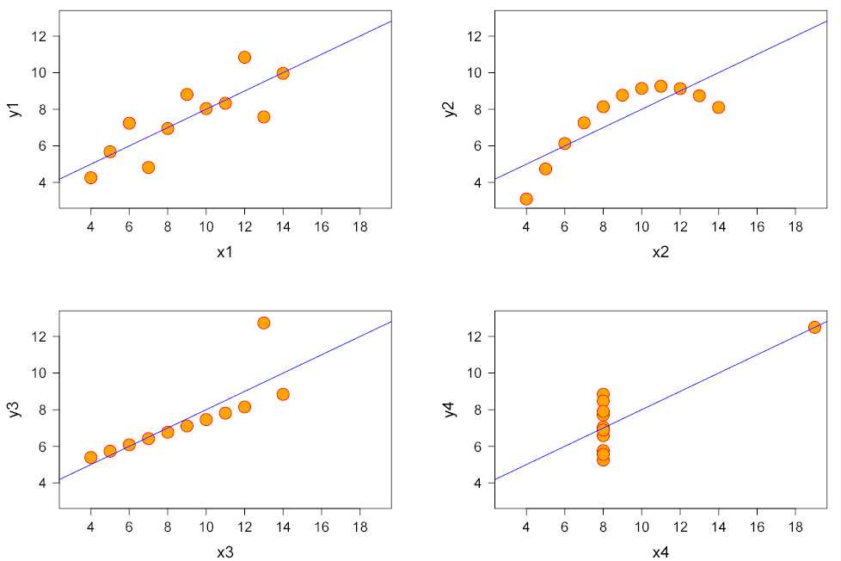
I
II
III
IV

Slide 10
See http://en.wikipedia.org/wiki/Anscombe%27s_quartet
F.J. Anscombe, "Graphs in Statistical Analysis," American Statistician, 27 (February 1973), 17-21.
Anscombe's quartet - From Wikipedia, the free encyclopedia
Anscombe's quartet comprises four datasets which have identical simple statistical properties, yet which are revealed to be very different when inspected graphically. Each dataset consists of eleven (x,y) points. They were constructed in 1973 by the statistician F.J. Anscombe to demonstrate the importance of graphing data before analyzing it, and of the effect of outliers on the statistical properties of a dataset.
The first one (top left) seems to be distributed normally, and corresponds to what one would expect when considering two variables correlated and following the assumption of normality.
The second one (top right) is not distributed normally; while an obvious relationship between the two variables can be observed, it is not linear, and the Pearson correlation coefficient is not relevant.
In the third case (bottom left), the linear relationship is perfect, except for one outlier which exerts enough influence to lower the correlation coefficient from 1 to 0.81.
Finally, the fourth example (bottom right) shows another example when one outlier is enough to produce a high correlation coefficient, even though the relationship between the two variables is not linear.

Slide 11
Correlation (among DV and IVs)
Y
NOTE:
a is always > 0
b is always > 0
but c can be + or -
d
a
b
c
X1
X2
Y with X₁ -- r²_{y1} = a+c
Y with X₂ -- r²_{y2} = b+c
Y with X₁ and X₂ -- r²_{y12} = a+b+c
[semi-partial, controlling for X₂]
a = sr²₁ = r²_{y12} – r²_{y2}
[semi-partial, controlling for X₁]
b = sr²₂ = r²_{y12} – r²_{y1}

Slide 12
Standard vs Sequential vs Stepwise
Standard – all variables enter at one time [“ENTER”]
Sequential (also sometimes called “Hierarchical Regression”) – variables enter in specific (sequential) order [“BLOCK1” “BLOCK2” etc]
Stepwise (also called “Statistical Regression”) – variables are allowed to “compete statistically” [“Forward, Backward”]

Slide 13
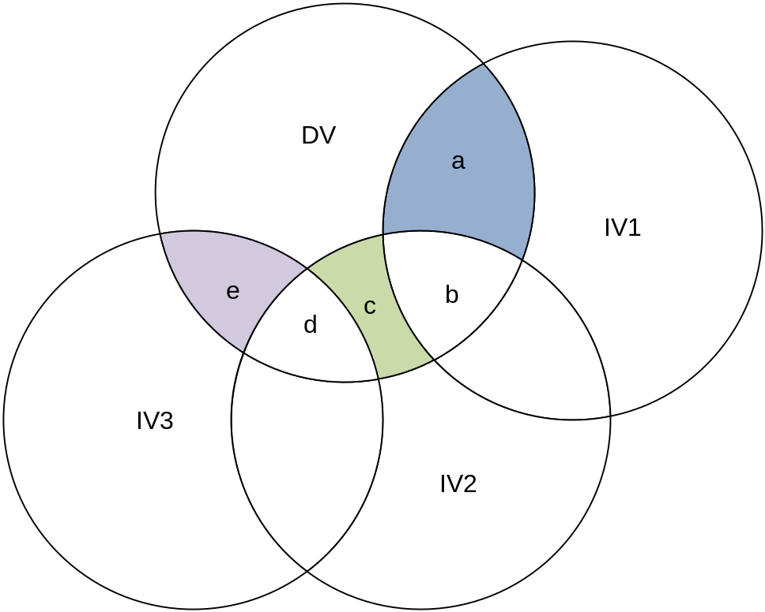
Standard – X₁ X₂ and X₃ all at once
R² = a+b+c+d+e
But who gets credit for each piece?
IV₁ gets credit for a
IV₂ gets credit for c
IV₃ gets credit for e
b and c do not get “assigned” to any of the 3 IVs

Slide 14
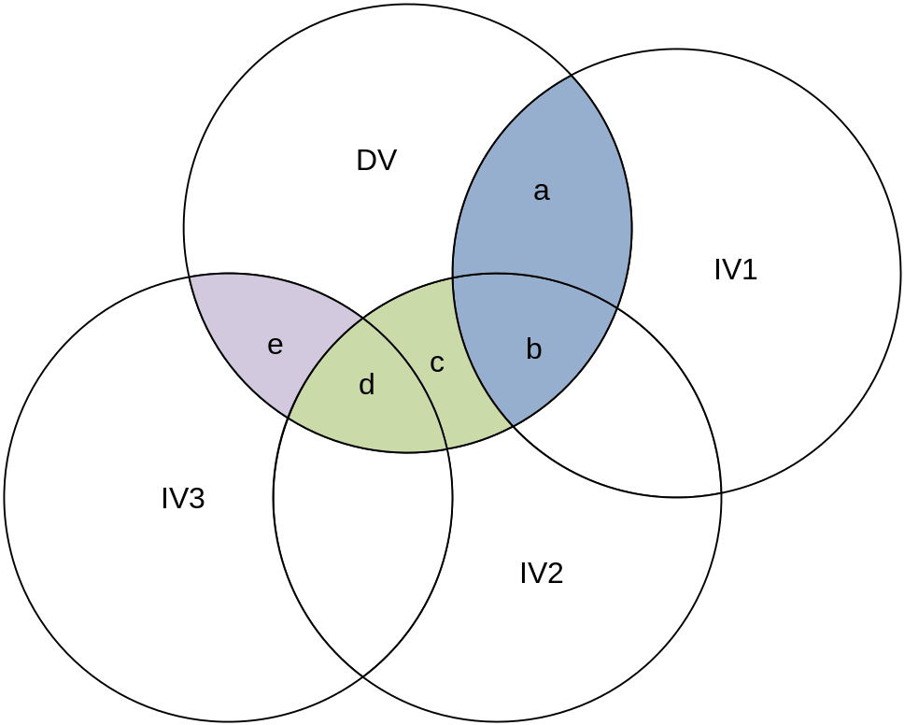
Sequential – X₁ then X₂ then X₃
R² = a+b+c+d+e
IV₁ gets credit for a + b
IV₂ gets credit for c + d
IV₃ gets credit for e

Slide 15
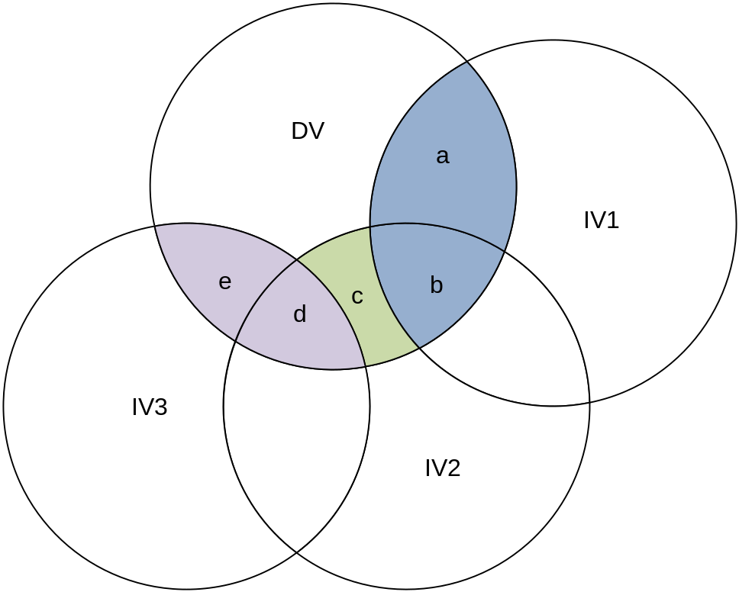
Stepwise (statistical) – X₁ X₂ and X₃ “compete”
R² = a+b+c+d+e
Assume the “amount of variance explained” is
highest for X1
followed by X3
followed by X2
IV₁ gets credit for a+b
IV₂ gets credit for c
IV₃ gets credit for e+d

Slide 16
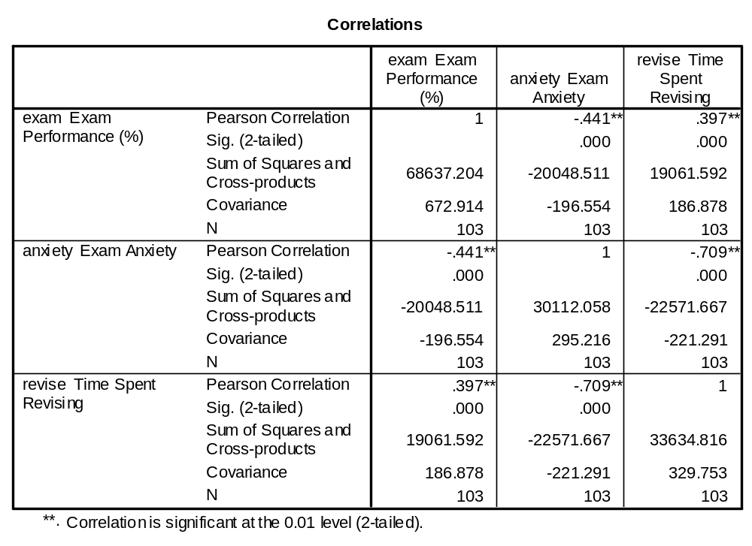
Exam Anxiety Example (A. Field Book)
Compare Exam Performance (DV=Y) against
Time Spent Revising Exam (IV1=X1) and Anxiety Level (IV2=X2)
[Correlation Matrix]

Slide 17
Assigning Variance
Exam-[Anxiety+Revision] R² = a+b+c
Exam-[Anxiety] r² = (-.441)² = .194
Exam-[Revision] r² = (.397)² = .157
Exam Performance
d
a
b
c
[Revision Time]
[Anxiety]

Slide 18
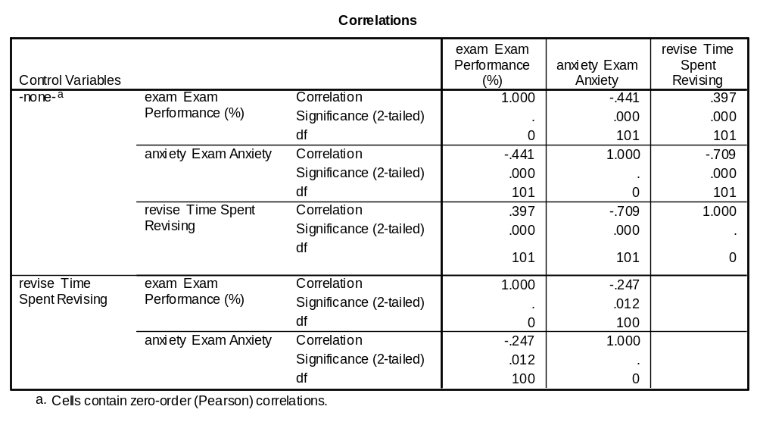
Partial Correlation
When Revision is controlled for, the squared correlation between Exam Performance and Anxiety is reduced from (-.441)² = .194 down to only
(-.247)² = .061.

Slide 19
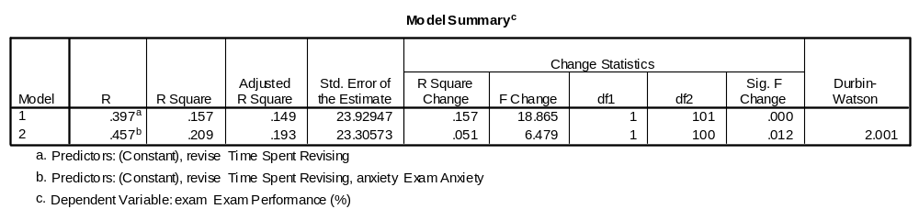
Semi-Partial Correlation
[obtained from Sequential Regression]
We knew this from the Initial Correlation Matrix Exam-[Revision] r² = (.397)² = .157
The amount of variance “left over” after “controlling for” Revision, for Anxiety is .051 (5.1%).

Slide 20
Back to the Venn Diagram
Exam-[Anxiety+Revision] R² = a+b+c
Exam-[Anxiety] r² = (-.441)² = .194
Exam-[Revision] r² = (.397)² = .157
And now we know the “semi-partial” correlation for Anxiety (controlling for Revision Time) = .051.
So, overall r²=.209=.157+.051
** Remember we don’t know c directly and we can’t get d directly**
Exam Performance
d
b=.051
a
b
a+c=.157
c
[Revision Time]
[Anxiety]

Slide 21
R² Breakdown (overall r²_{x1x2}=0.209)
Standard Regression (X1 and X2 together) | = or ≠ | Sequential Regression (X1 then X2)
r²_{X1} = (a+c)/(a+b+c+d) = 0.157 (revision) | = | r²_{X1} = (a+c)/(a+b+c+d) = 0.157
r²_{X2} = (b+c)/(a+b+c+d) = 0.194 (anxiety) | = | r²_{X2} = (b+c)/(a+b+c+d) = 0.194
sr²_{X1} = a/(a+b+c+d) = 0.014 (“Part” in SPSS) | ≠ | sr²_{X1} = (a+c)/(a+b+c+d) = 0.157 (r2 change)
sr²_{X2} = b/(a+b+c+d) = 0.051 | = | sr²_{X2} = b/(a+b+c+d) = 0.051
pr²_{X1} = a/(a+d) = 0.018 (“Partial” in SPSS) | ≠ | pr²_{X1} = (a+c)/(a+c+d) = 0.1576 (“Partial” in SPSS)
pr²_{X2} = b/(b+d) = 0.061 | = | pr²_{X2} = b/(b+d) = 0.061
From p.145 – Tabachnick – but notation based on previous Venn, where “c” represents the overlap of X1 and X2

Slide 22
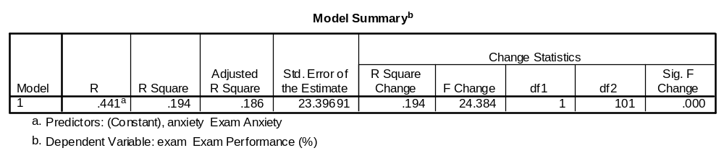
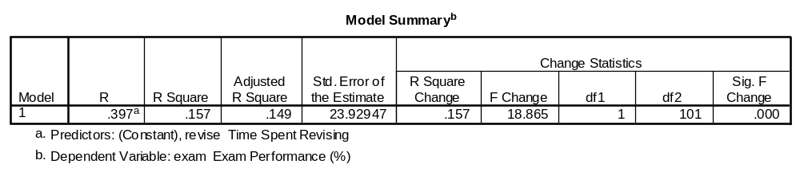
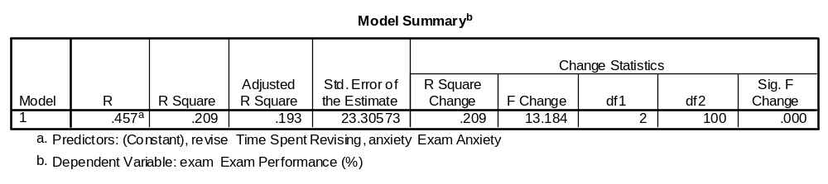
Separate Regressions

Slide 23
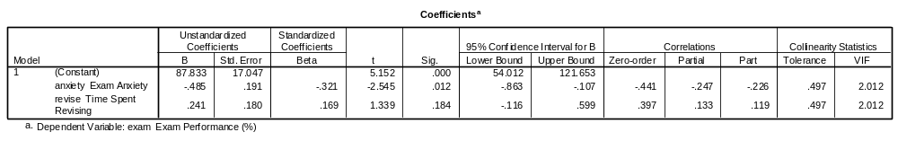
Standard Regressions – “correlations”
pr
sr
Take the squares of these to get pr² and sr² respectively.

Slide 24
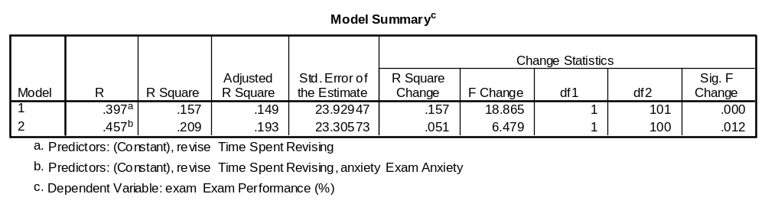
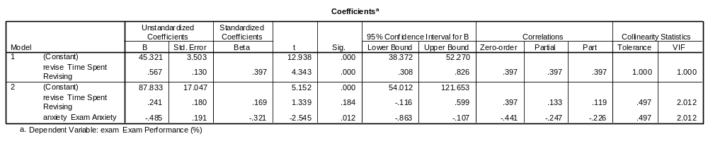
Sequential Regression – “correlations”
Revision Time goes in first
sr²
pr
sr
So (-0.226)² = 0.051 

Slide 25
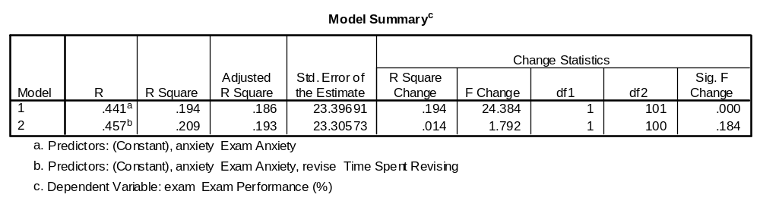
If Anxiety goes in first ….

Slide 26
R² Breakdown (overall r²_{x1x2}=0.209)
Standard Regression (X1 and X2 together) | = or ≠ | Sequential Regression (X1 then X2)
r²_{X1} = (a+c)/(a+b+c+d) = 0.157 (revision) | = | r²_{X1} = (a+c)/(a+b+c+d) = 0.157
r²_{X2} = (b+c)/(a+b+c+d) = 0.194 (anxiety) | = | r²_{X2} = (b+c)/(a+b+c+d) = 0.194
sr²_{X1} = a/(a+b+c+d) = 0.014 (“Part” in SPSS) | ≠ | sr²_{X1} = (a+c)/(a+b+c+d) = 0.157 (r2 change)
sr²_{X2} = b/(a+b+c+d) = 0.051 | = | sr²_{X2} = b/(a+b+c+d) = 0.051
pr²_{X1} = a/(a+d) = 0.018 (“Partial” in SPSS) | ≠ | pr²_{X1} = (a+c)/(a+c+d) = 0.1576 (“Partial” in SPSS)
pr²_{X2} = b/(b+d) = 0.061 | = | pr²_{X2} = b/(b+d) = 0.061
“Unique” contribution to variance from each IV – i.e. Anxiety contributes 5.1% of the variance (controlling for revision time) – OR Revision Time contributed 1.4% of the variance (controlling for Anxiety Level) – although this was not significant (p-val=0.184)**
** NOTE that sr²_{x1} is very small 0.014 – and if we run a sequential regression putting Anxiety in first, this r²change (0.014) for adding in Revision Time has a non-sig p-val (0.184).

Slide 27
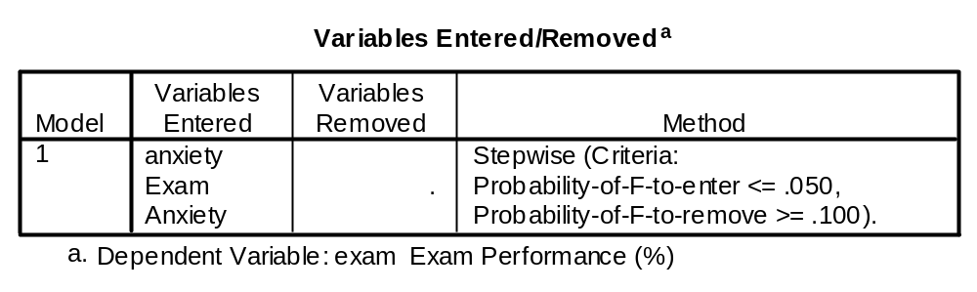
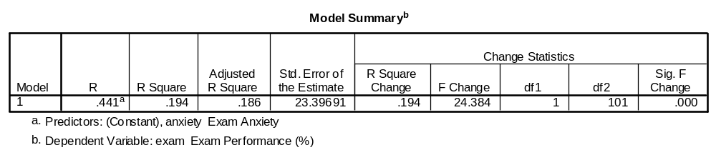
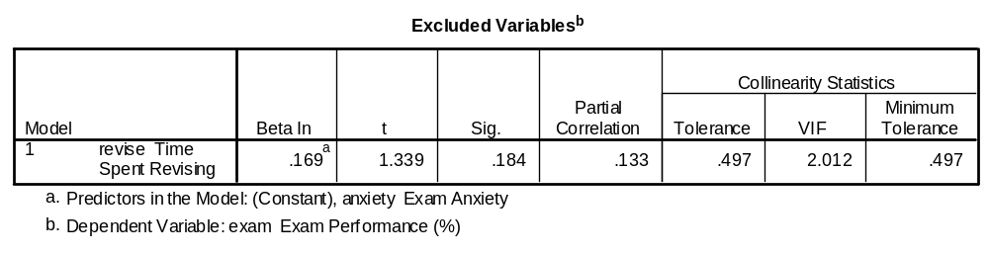
“Stepwise”/”Statistical” Regression

Slide 28
So what does this mean?
You need to know which variables to put into the model and when – ideally based on theory.
If you have no idea – try combinations – use “stepwise”/”statistical” regression to “see which ones fall out of the model”

Slide 29
Diagnostics
Look at your residuals (should look normal with a mean of 0 and even scatter) [observed vs predicted]
Look at normal probability plots
Look at plots of residuals versus the order in which the data were collected – should look random.
Look at residuals versus variables left out of the model – should look random, if not, you may want to consider including the variable in the model.

Slide 30
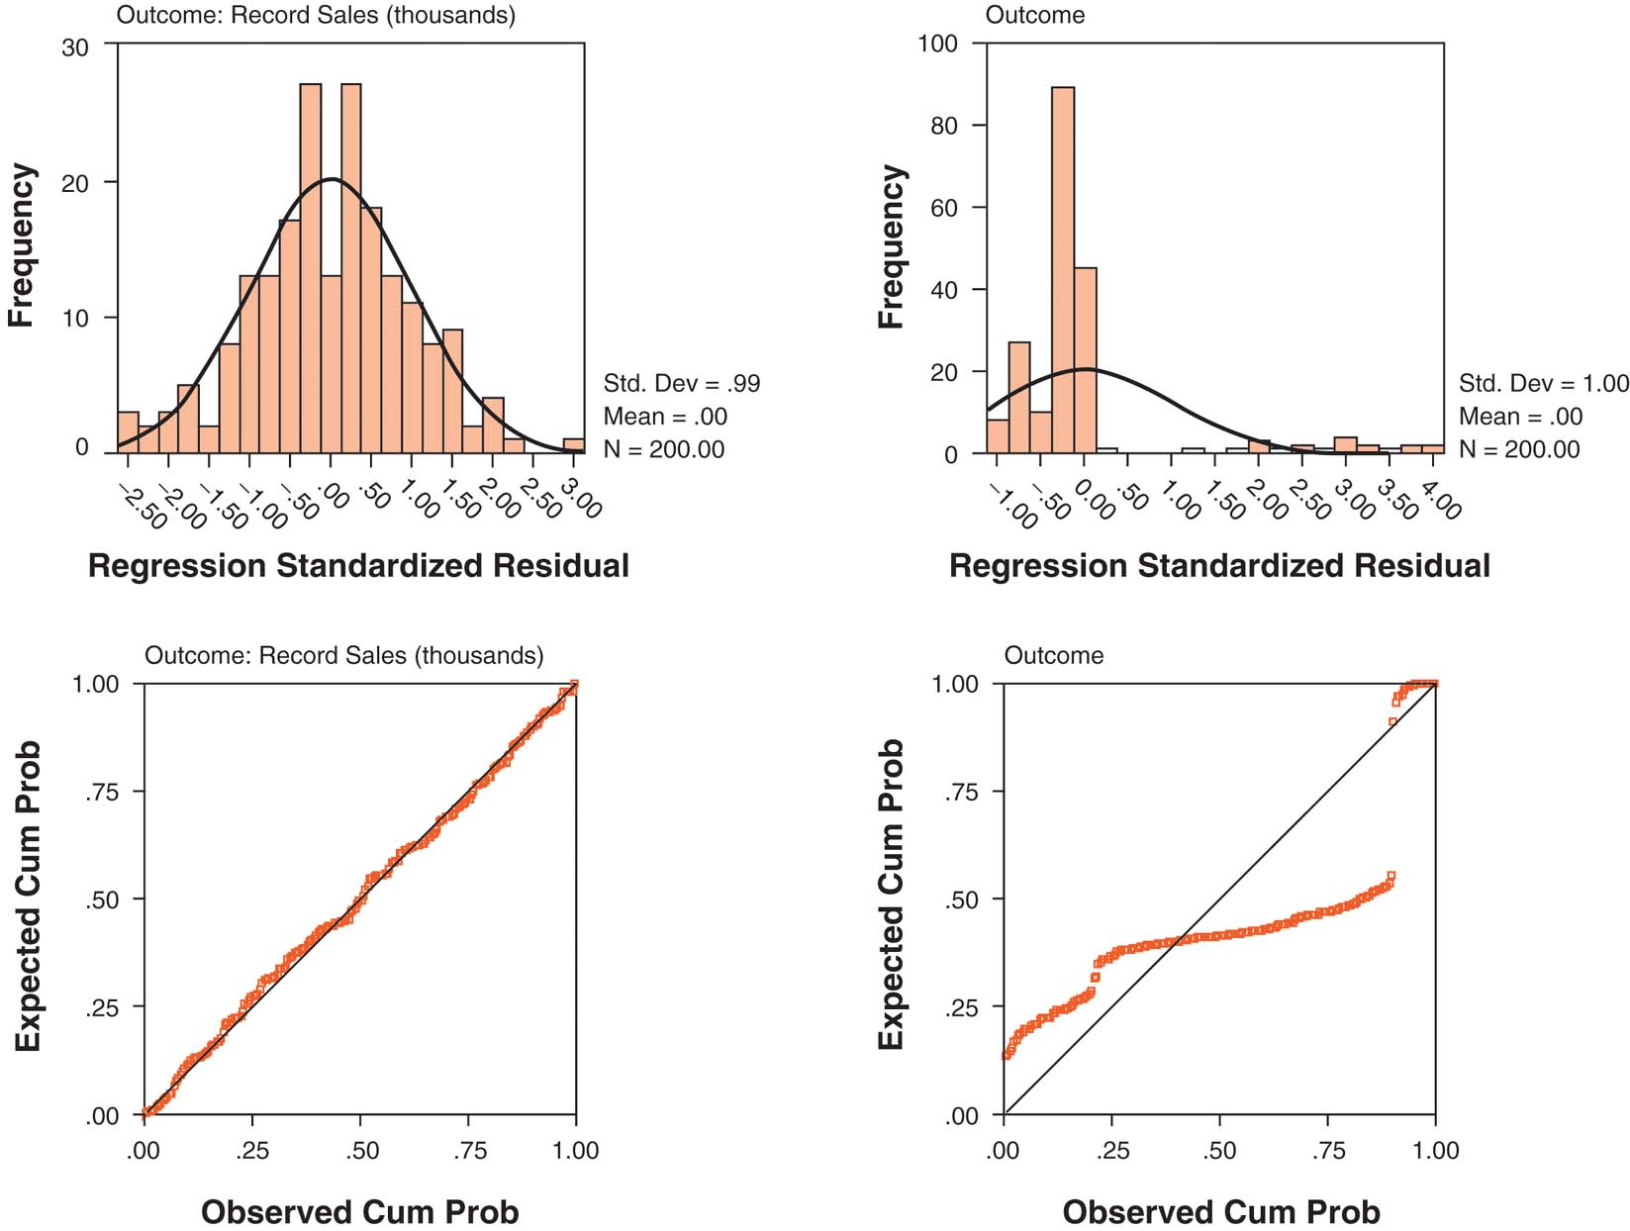
Figure 5.19 – A. Field Book - Slides

Slide 31
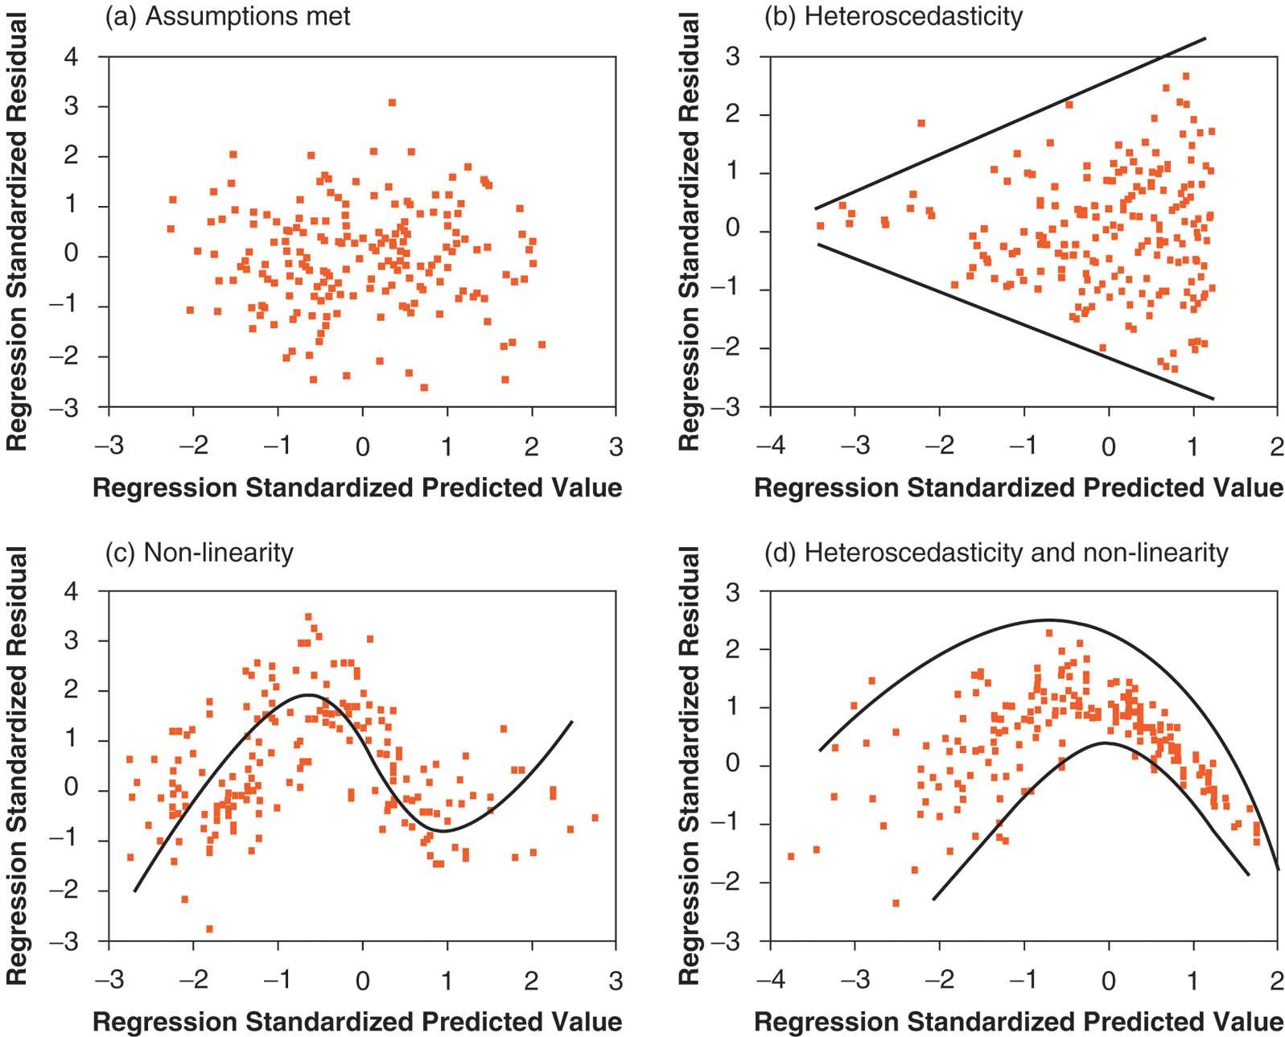
Figure 5.18 – A. Field Book - Slides

Slide 32
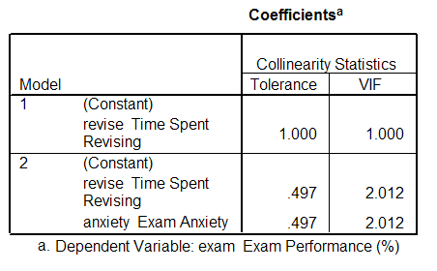
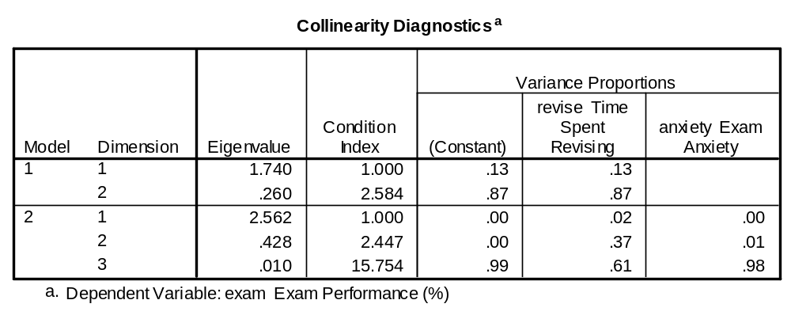
Multicollinearity – minor here
Ideally want VIF close to 1 and Tolerance close to 1.
Tolerances < 0.2 (<0.4) and VIF’s >10 (>2.5) or so are cause for concern.
Also review, Condition Index (>30 is a problem) and variance proportions (>0.5) for dimensions that correspond to higher condition indexes – if on same line.

Slide 33
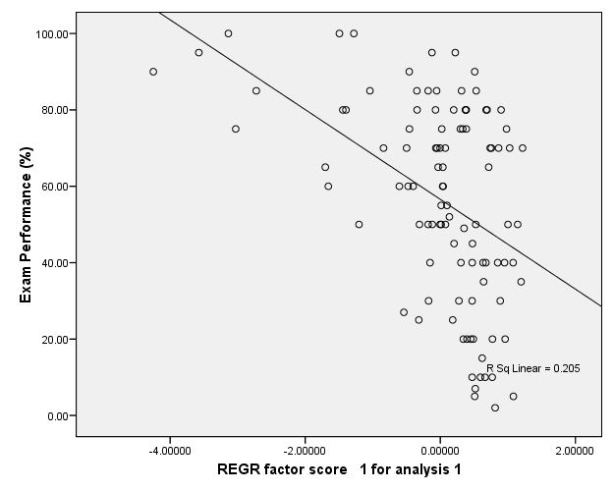
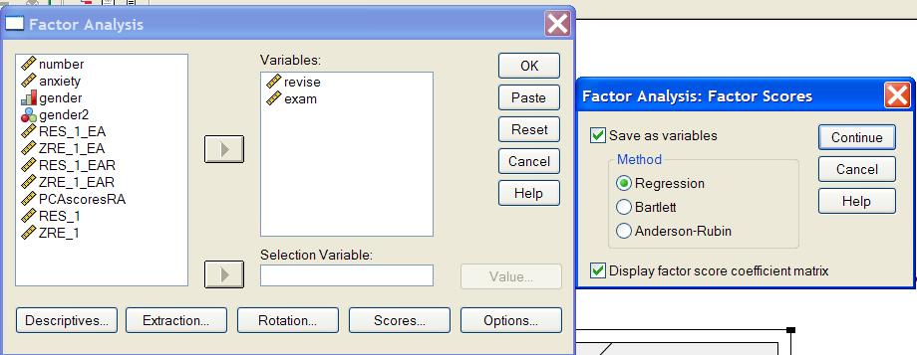
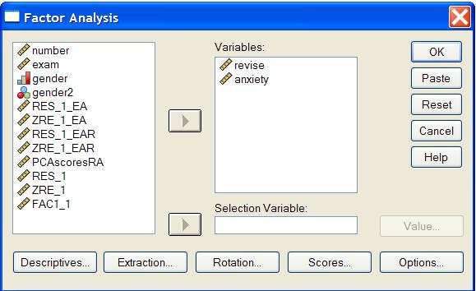
Could leave one out Or Could do PCA (principal components analysis)

Slide 34
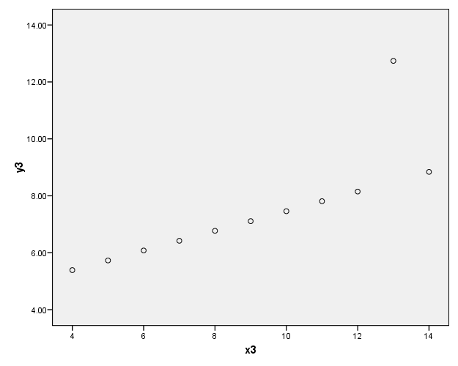
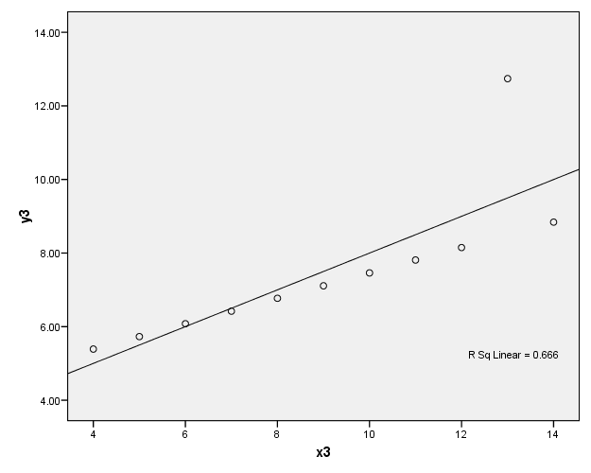
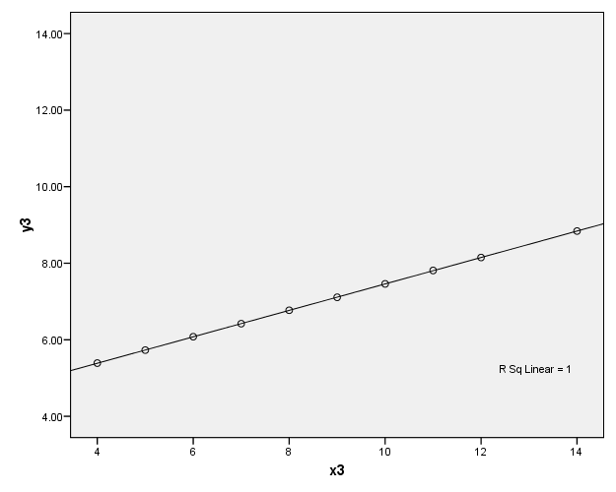
“Outliers?” - “Leverage”&“DFFit”&“DFBetas”

Slide 35
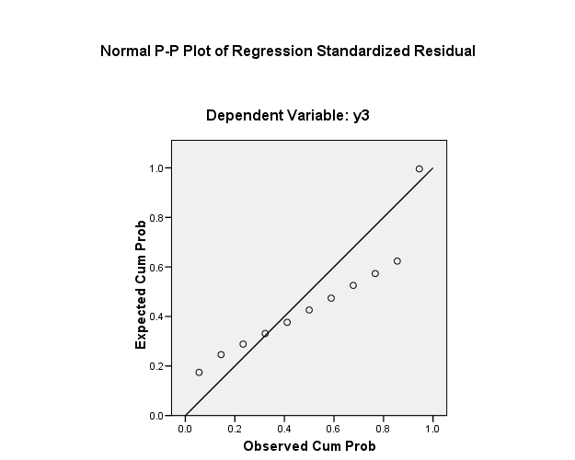
Residuals Plot – something’s off

Slide 36
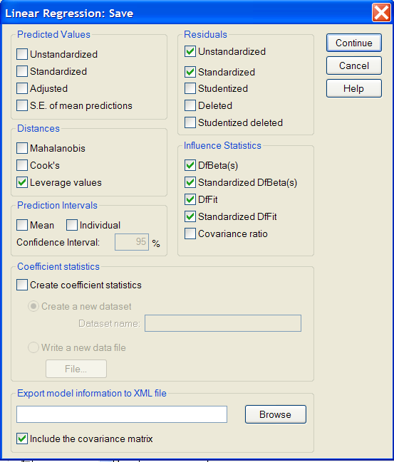
SPSS Linear Regression “Save” Menu

Slide 37
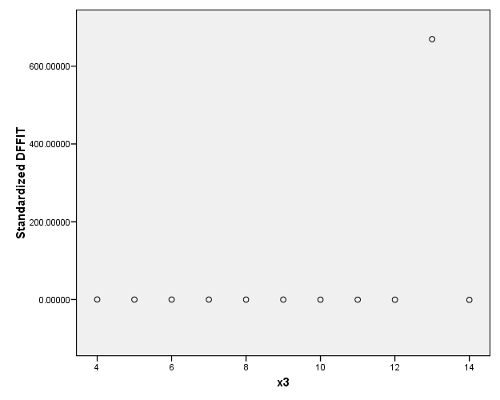
Plot x3 against Std DFfit

Slide 38
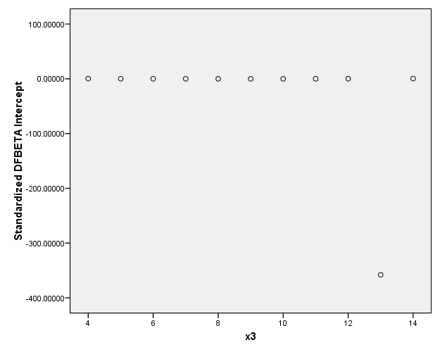

Plot x3 against Std DFBeta-intercept

Slide 39
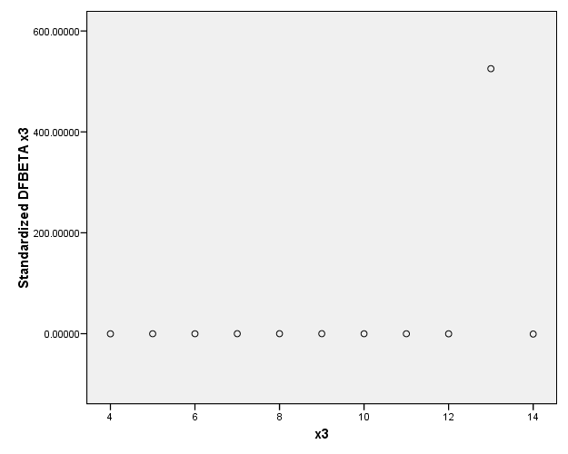
Plot x3 against DFBeta-x3

Slide 40
References
Field, Andy. “Discovering Statistics Using SPSS” 2nd edition, SAGE Publications, 2005.
Tabachnick, Barbara G.; Fidell, Linda S. “Using Multivariate Statistics” 5th edition, Pearson Eduation Inc., 2007.
Cohen, Jacob; Cohen, Patricia; West, Stephen; Aiken, Leona “Applied Multiple Regression/Correlation Analysis for the Behavioral Sciences” 3rd edition, Lawrence Erlbaum Associates Inc., 2003.

Slide 41

Parting Thoughts

Slide 42
VIII. Statistical Resources and Contact Info
SON S:\Shared\Statistics_MKHiggins\website2\index.htm
[updates in process]
  Working to include tip sheets (for SPSS, SAS, and other software), lectures (PPTs and handouts), datasets, other resources and references
  Statistics At Nursing Website: [website being updated] http://www.nursing.emory.edu/pulse/statistics/
  And Blackboard Site (in development) for “Organization: Statistics at School of Nursing”
Contact
    Dr. Melinda Higgins
    Melinda.higgins@emory.edu
    Office: 404-727-5180 / Mobile: 404-434-1785

