Slide 1
An Online Segmentation Method using Dynamic Time Warping

Slide 2
Outline
Motivation
Online segmentation algorithm
  Feature Search
  Template Match
Experiment results
Future Work

Slide 3
Motivation
Analysis of rehabilitation movements.
  Sensors data: assessment of current condition.
  Supervise: exercises of performance.
  Accurate tool: real-time feedback.
Identifying, segmenting and classifying human movements.
Difficulties in online segmentation:
  Variability in human movements.
  Capability for online processing.
Notes:
The online segm algo is for …
The data collected by sensors, which give the assessment of the patient's current condition after the injury or surgery.\
It needs someone to supervise on the performance of exercises to determine the recovery progress.

Slide 4
Online Segmentation Algorithm
  Breaking points are selected by a threshold.
  Set a moving sliding window to scan over.
  The window moves from a break point to the next one.
y
Templates
time
Compare
Breaking Points
Sliding Window

Slide 5
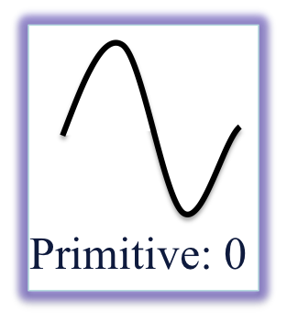

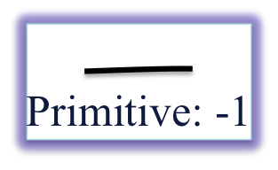
  3 Base Types of Templates:
Sum(Left) × Sum(Right) < 0
Sum(Left) × Sum(Right) > 0

Slide 6
Online Segmentation—Feature Searching
  When comparing the templates with the segments, only compare main features of both instead of every points.
  Sorting the values into descending order.
y
Global Average Height: H
Height: h
f = h/H
H
h
time
Points on a Segment
Breaking Points
[f₀, f₁, f₂, f₃,…] → Descending series

Slide 7
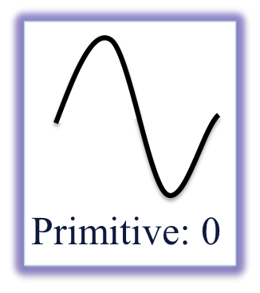

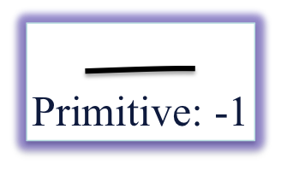
  Feature Extraction

Slide 8
Online Segmentation—Template Matching
Comparison algorithm on time series data: FastDTW
Template-based matching

Slide 9
Comparison algorithm:
Dynamic Time Warping
Aligns two time series by warping the time dimension. Compare how similar the two shapes are.
Time series: more intuitive similarity measure
i
i
i+2
time
time

Slide 10
Fast DTW
Time Series A
1
i_{s}
n
m
p_{k}
O(N) in
time and space Complexity
j_{s}
p_{s}
Time Series B
1
p₁

Slide 11
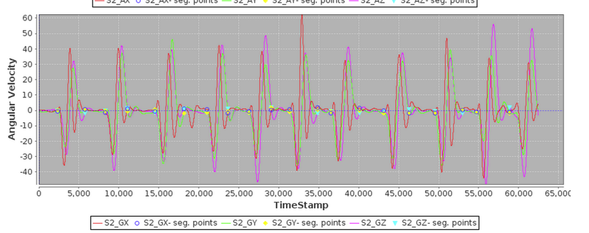
Experiment Results

Slide 12
Future Work
Future Work
  Feature selection: improving the accuracy.
  Templates: better templates models.
  Higher speed.

Slide 13
Thanks for Listening!
Q & A

