Slide 1
A Movement Recognition Method using Loopy Belief Propagation on Swift
Irene Li
UCD

Slide 2
Motivations
Graphic Models in Mobile
Inference Algorithm: A potential AI topic in mobile devices.
Powerful CPU: Strong computing ability.
Physical Sensors
Healthcare Data Collection: Possible for health analysis based on time series.

Slide 3
Proposed Approach (1) : Algorithm Introduction
1. Loopy Belief Propagation ^{[1]}
Loppy Belief Propagation ( sum-product algorithm) a dynamic programming approach to answering conditional probability queries in a graphical model.
A parallel message-passing algorithm, keep passing messages, until a stable belief state.

Slide 4
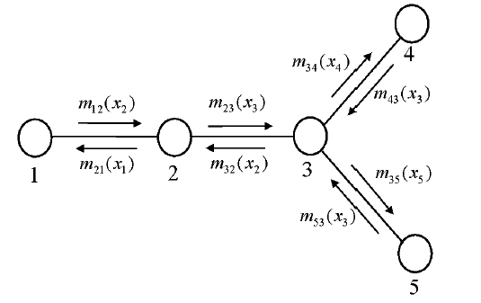
Proposed Approach (1) : Algorithm Introduction
1. Loopy Belief Propagation ^{[1]}
Peer-pressure: a final belief distribution by listening to neighbors. Exchange messages: adjacent nodes, update beliefs, based on conditional probabilities, etc.
Every node sends a probability density to its neighbors, the message to neighbor depends on messages received from all the other neighbors.

Slide 5
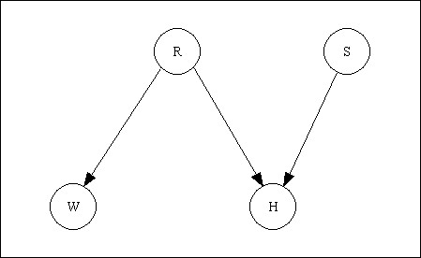
Proposed Approach (1) : Algorithm Introduction
2. L-BP on Bayesian Networks ^{[2]}.
We use L-BP on the inference of unknown nodes in a Bayesian Network.
An example ^{[3]} is shown in the graph: assume node R and S are known, and the relations of R and W, R and S, R and H.
Use L-BP to find out the state of W and H.
√
√
√
√
√
?
?
Bayesian Network: a direct graph.
Prior Probability of R,S
Boundary conditions P(W|R) and P(H|R,S)
Belief (Probability of each state) of W/H ?

Slide 6
Proposed Approach (2) : Model Building
Time-series Movement Data Plot.
Velocity
Time
Movement
Silence
Movement
Contains two types of movement and one type of silence.

Slide 7
Proposed Approach (2) : Model Building
Model Building.
In the series, the three states (silence and two types of movements) are always appear one by one, which means they have the relationship of transaction.
So we built the model in the right.
Node 0
Node -1
Node 1
Model Built

Slide 8
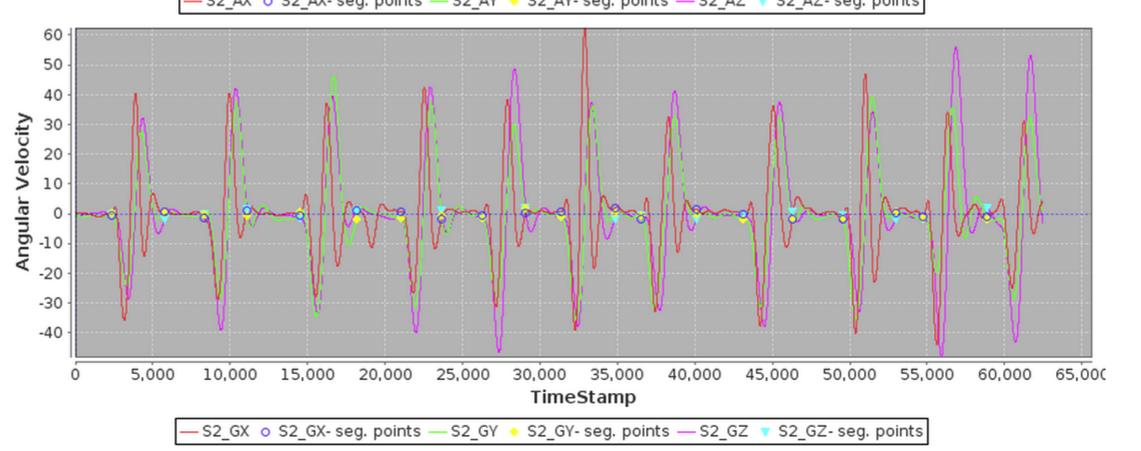
Evaluation (1) : Training Data
Training Data^{[3]}:
A number of healthy volunteers were selected to participate in the experiment. Sensor units have been used to this experiment of recognizing movements.
Training Data Plot (part)

Slide 9
Evaluation (2) : Plan
Data pre-processing.
Maximum Likelihood Estimation (still uncertain) : calculate prior probabilities and CPT of some nodes.
Loopy BP: calculate the Belief, make predictions, get the predicted movement recognition series.
Accuracy checking: manually check the recognition rate of human movements.

Slide 10
References
[1] Understanding Belief Propagation and its Generalizations, Jonathan S. Yedidia, William T. Freeman, and Yair Weiss TR2001-22 November 2001
[2] Loopy Belief Propagation for Approximate Inference: An Empirical Study, Kevin P. Murphy and Yair Weiss and Michael I. Jordan
[3] http://www.cse.unsw.edu.au/~cs9417ml/Bayes/Pages/PearlPropagation.html
[3] Evaluating Rehabilitation Exercise Performance Using a Single Inertial Measurement Unit, Oonagh Giggins, Daniel Kelly and Brian Cauleld in International Conference on Pervasive Computing Technologies for Healthcare and Workshops, 2013 7th

Slide 11
Thanks!
Q & A

