Slide 1
AI Clinic · Week 3
Improving clinical practice using clinical decision support systems
Kawamoto et al. 2005 · Which features make decision support work?
Kawamoto K et al. BMJ 2005;330:765. doi:10.1136/bmj.38398.500764.8F
Paper overview before the discussion
Notes:
Title, p.1: "Improving clinical practice using clinical decision support systems: a systematic review of trials to identify features critical to success". Week 2 showed one hospital doing it. This week asks which features predict success across many trials.

Slide 2
The paper in one sentence
• A systematic review of 70 randomised trials of clinical decision support systems (CDSS).
• It asks which features of a CDSS predict that it improves practice.
• Strongest predictor is support given automatically inside the clinician's workflow.
• Of 32 systems with all four key features, 30 (94%) worked.
Kawamoto K et al. BMJ 2005;330:765. doi:10.1136/bmj.38398.500764.8F
Notes:
Abstract, Results, p.1: "Multiple logistic regression analysis identified four features as independent predictors of improved clinical practice: automatic provision of decision support as part of clinician workflow (P < 0.00001), provision of recommendations rather than just assessments (P = 0.0187), provision of decision support at the time and location of decision making (P = 0.0263), and computer based decision support (P = 0.0294). Of 32 systems possessing all four features, 30 (94%) significantly improved clinical practice."

Slide 3
The problem and the aim
• Care often falls short of the evidence.
• One US audit found adults get only about half of recommended care.
• Decision support helps in 68% of trials, so why not in the rest?
• Aim is to find the features critical for improving practice.
Kawamoto K et al. BMJ 2005;330:765. doi:10.1136/bmj.38398.500764.8F
Notes:
Introduction, p.1: "A nationwide audit assessing 439 quality indicators found that US adults receive only about half of recommended care". Abstract, p.1: "Objective To identify features of clinical decision support systems critical for improving clinical practice." Abstract, Results, p.1: "Decision support systems significantly improved clinical practice in 68% of trials."

Slide 4
Methods
• Systematic review of randomised controlled trials up to 2003.
• Searched Medline, CINAHL and the Cochrane trials register.
• Both electronic and paper based systems were included.
• Each trial coded for 15 features suggested in the literature.
• Outcome was binary, significant improvement or not.
Kawamoto K et al. BMJ 2005;330:765. doi:10.1136/bmj.38398.500764.8F
Notes:
Abstract, p.1: "Design Systematic review of randomised controlled trials. Data sources Literature searches via Medline, CINAHL, and the Cochrane Controlled Trials Register up to 2003". Abstract, p.1: "...for the presence of 15 decision support system features whose importance had been repeatedly suggested in the literature." Methods, p.2: "We included both electronic and non-electronic systems because we felt the use of a computer represented only one of many potentially important factors." Discussion, p.6: "One limitation of this study is that we used a binary outcome measure rather than a continuous measure such as effect size."

Slide 5
The trials
• 10 688 articles screened.
• 88 papers describing 70 studies were included.
• About 6000 clinicians caring for about 130 000 patients.
Kawamoto K et al. BMJ 2005;330:765. doi:10.1136/bmj.38398.500764.8F
Notes:
Results, p.3: "Of 10 688 potentially relevant articles screened, 88 papers describing 70 studies met all our inclusion and exclusion criteria (figure)." "Between them, about 6000 clinicians acted as study subjects while caring for about 130 000 patients."

Slide 6
One feature stood out
• Support given automatically succeeded in 75% of interventions.
• When clinicians had to seek out the advice, none succeeded.
• Systems built into charting or order entry beat stand alone ones.
Kawamoto K et al. BMJ 2005;330:765. doi:10.1136/bmj.38398.500764.8F
Notes:
Results, Univariate analyses, p.3: "Most notably, 75% of interventions succeeded when the decision support was provided to clinicians automatically, whereas none succeeded when clinicians were required to seek out the advice of the decision support system (rate difference 75% (37% to 84%))." "Similarly, systems that were provided as an integrated component of charting or order entry systems were significantly more likely to succeed than stand alone systems (rate difference 37% (6% to 61%))"

Slide 7
The four features that predict success
• Automatic, as part of clinician workflow (P < 0.00001).
• At the time and place of the decision (P = 0.0263).
• A recommendation, not just an assessment (P = 0.0187).
• Generated by a computer (P = 0.0294).
• All four present, 30 of 32 worked. Any missing, 18 of 39.
Kawamoto K et al. BMJ 2005;330:765. doi:10.1136/bmj.38398.500764.8F
Notes:
Results, Meta-regression, p.4: "Most notably, this analysis confirmed the critical importance of automatically providing decision support as part of clinician workflow (P < 0.00001)." p.4 to p.5: "Among the 32 clinical decision support systems incorporating all four features, ... 30 (94% (80% to 99%)) significantly improved clinical practice. In contrast, clinical decision support systems lacking any of the four features improved clinical practice in only 18 out of 39 cases (46% (30% to 62%))."

Slide 8
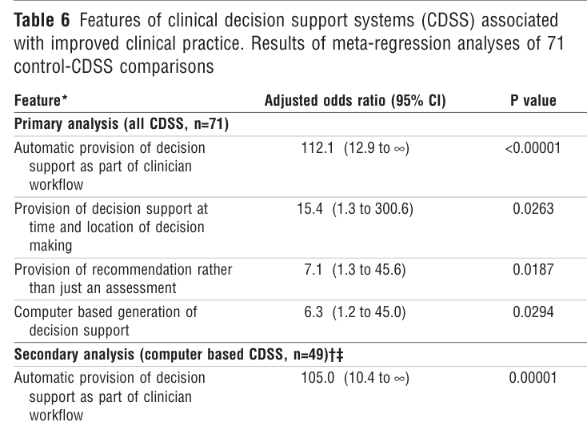
Table 6 · the regression result
• Primary analysis covers 71 comparisons.
• Automatic provision has an open ended upper limit.
• So quote the direction, not the size.
Kawamoto K et al. BMJ 2005;330:765. doi:10.1136/bmj.38398.500764.8F
Notes:
Table 6, p.5: "Table 6 Features of clinical decision support systems (CDSS) associated with improved clinical practice. Results of meta-regression analyses of 71 control-CDSS comparisons". Our own reading: the upper confidence limit for automatic provision is infinite, so the association is strong but its size is unknown.

Slide 9
Take-home points and caveats
• Make the system easy to use. That is the common thread.
• Build it into the workflow and do not make clinicians ask.
• Caveat. Binary outcome, so effect size is lost.
• Caveat. Rule based systems up to 2003, before modern AI.
• Our reading. The features still look right for AI tools.
Kawamoto K et al. BMJ 2005;330:765. doi:10.1136/bmj.38398.500764.8F
Notes:
Discussion, Implications, p.7: "A common theme among all four features is that they make it easier for clinicians to use a clinical decision support system." Discussion, p.6: "One limitation of this study is that we used a binary outcome measure rather than a continuous measure such as effect size." Our own reading, not the paper: these trials predate 2003 and none of the systems are machine learning, so the link to AI tools is an analogy to test.

Slide 10
Questions for our discussion
• Table 6 gives an odds ratio with no upper limit. How do we quote it?
• What does a binary "success or not" outcome hide?
• 71 comparisons and 18 variables. How far do we trust the four?
• Which of the four features still apply to AI tools today?
• Local user involvement did not predict success. Sendak relied on it.
• Does a fracture detection tool meet all four features?
Kawamoto K et al. BMJ 2005;330:765. doi:10.1136/bmj.38398.500764.8F
Notes:
Suggested answers (from the draft in the guided reading note, our own reading):
1. Zero successes without the feature, so the association is strong but its size is unknown.
2. Effect size. A tiny and a large improvement count the same.
3. A strong hypothesis. 15 features plus 3 environmental factors were candidates (Methods, p.3). Discussion, p.7: "our ratio of cases to explanatory variables was suboptimal" and "it is possible that one or more features were falsely included into the regression models because of over-fitting."
4. All four map well. Automatic and in-workflow is Sendak's design.
5. They measure different things, effect versus adoption.
6. Three of four. The recommendation is usually missing.

