Slide 1
AI Clinic · Week 2
Real-world integration of a sepsis deep learning technology into routine clinical care
Sendak et al. 2020 · Sepsis Watch at Duke Health
Sendak MP et al. JMIR Med Inform 2020;8(7):e15182. doi:10.2196/15182
Paper overview before the discussion
Notes:
Implementation study. Last week Hassan 2024 mapped barriers and facilitators.
This week we see one hospital actually do it.

Slide 2

Feedback from last weekn one sentence
Notes:
Folloing the feedback form last week we have deicied to intorduyce a more practical project to9ghetht
To see how people actually successfully inmpaofgememt ai in the reald cliacn workflow
How did they do it and why t=did they do right

Slide 3
Outline · how the paper is built
1 Abstract: A quality improvement report, not a trial
2 Introduction: Why ML rarely reaches the bedside
3 Introduction: Sepsis Watch and the 8-step framework
4 Methods: Steps 1 to 6, one subsection each
5 Results: Steps 7 and 8: go-live, governance, evaluation
6 Discussion: ~8000 hours of people time; steps overlap
7 Discussion: Limits: one centre, no outcome data yet
8 Conclusions: No playbook yet, lessons for others
Sendak MP et al. JMIR Med Inform 2020;8(7):e15182. doi:10.2196/15182
Notes:
Outline first. The paper follows its own 8 steps (Table 1): Methods hold steps 1 to 6, Results hold steps 7 and 8. Warn the group: the "Results" are about the rollout, not patient outcomes.

Slide 4
The paper in one sentence
Abstract
• Duke Health put a deep learning sepsis tool, Sepsis Watch, into routine emergency department care (go-live 5 November 2018).
• The hard part was not the model. It was people: workflow, trust, roles, training and governance.
• About 8000 hours of staff time, and over two years of work.
• The paper is a "how we did it" report in 8 steps, not a trial of patient outcomes.
Sendak MP et al. JMIR Med Inform 2020;8(7):e15182. doi:10.2196/15182
Notes:
Abstract, p.1: "Sepsis Watch was successfully integrated into routine clinical care and reshaped how local machine learning projects are executed." Discussion, p.11: "Personnel time was estimated for internal accounting purposes at about 8000 hours."
🗣️ ASK (Q1): Sendak calls this a quality improvement effort. Who has done a QIP? What was it for? How is that different from an audit?
📄 SHOW IN PAPER, p.1, Abstract, Objective, red highlight: "Objective: This study aims to report a quality improvement effort to integrate a deep learning sepsis detection and management platform, Sepsis Watch, into routine clinical care."
✅ ANSWER: An audit measures practice against a set standard. A QIP makes a change and re-measures, in PDSA cycles. Sepsis Watch had a standard (CMS SEP-1) but reports the change, so it is a QIP, at the scale of about 8000 hours.
🗣️ ASK (Q5): The paper sorts medical ML into predictive, prognostic and diagnostic. Is that how you would sort it, and which box is Sepsis Watch in?
📄 SHOW IN PAPER, p.2, Introduction, first sentence, red highlight: "Machine learning has been rapidly adopted in the biomedical sciences to enhance predictive, prognostic, and diagnostic methods."
✅ ANSWER: The three overlap. Other lenses: by task (Rajkomar 2019), by who it serves (Topol 2019), assistive vs autonomous. Sepsis Watch is early detection, between diagnosis and prediction, assistive. The box decides what evidence you need.
🗣️ ASK (Q10): Does everyone know what CDS is? Any examples from your hospital?
📄 SHOW IN PAPER, p.3, Methods, Problem assessment, red highlight: "Earlier attempts to implement CDS to improve timely detection and response to inpatient deterioration, including sepsis, caused significant alarm fatigue and did not improve clinical outcomes."
✅ ANSWER: CDS = clinical decision support, software in the EHR that prompts a clinician at the point of decision, e.g. drug-interaction pop-ups, early warning scores, sepsis alerts. Sepsis Watch is a CDS tool built with deep learning.

Slide 5
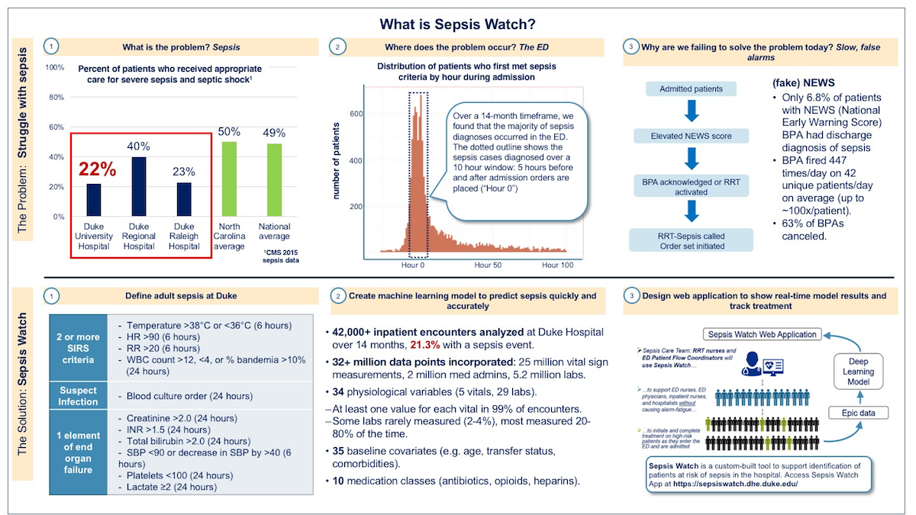
What is Sepsis Watch? (Figure 3)
Introduction
Sendak MP et al. JMIR Med Inform 2020;8(7):e15182. doi:10.2196/15182
Notes:
Introduce: this is the one-page overview Duke used to train staff (Figure 3, p.8).
Top row = the problem, bottom row = the solution.
(1) Only 22% of severe sepsis patients at Duke University Hospital got the full bundle, vs 49% nationally (CMS 2015).
(2) Most sepsis is diagnosed around hour 0 of admission, in the ED.
(3) The old NEWS alert: only 6.8% of alerted patients had sepsis, it fired 447 times a day on 42 patients, 63% cancelled = alarm fatigue.
Bottom:
(1) a computable sepsis definition (SIRS + suspected infection + organ failure); (2) the model, 42,000+ encounters, 32 million data points, 34 vitals and labs, 35 baseline covariates, 10 medication classes; (3) the web app, model on Epic data, used by RRT nurses and ED flow coordinators.
🗣️ ASK (Q12), while Figure 3 panel 1 is on screen: Does everyone know what "the sepsis bundle" is, and what counts as getting the full bundle?
📄 SHOW IN PAPER, p.3, Methods, Problem assessment, red highlight: "The Centers for Medicare and Medicaid Services (CMS) SEP-1 measure calculates compliance with 3-hour and 6-hour treatment bundles"
✅ ANSWER: A time-boxed checklist. Within 3 hours: lactate, blood cultures before antibiotics, broad-spectrum antibiotics, IV fluids if low blood pressure or high lactate. Within 6 hours: repeat lactate, vasopressors if pressure stays low, reassess volume. "Full bundle" = every item on time: 22% at Duke University Hospital in 2015 (Figure 3); 50.9% for the three core 3-hour items at baseline (Table 4).

Slide 6
The 8 steps they followed (Table 1)
Introduction
1 Problem assessment
2 Internal and external scans
3 Clinical workflow design
4 Model and infrastructure design
5 Workflow application development
6 Model and infrastructure development
7 Implementation, change management, governance
8 Evaluation plan and partnerships
Sendak MP et al. JMIR Med Inform 2020;8(7):e15182. doi:10.2196/15182
Notes:
Introduction, p.2: "In Table 1, we present the 8 steps required to integrate Sepsis Watch into routine care delivery successfully."
🗣️ ASK (Q8): Look down these 8 steps. Which have you been part of in your own hospital, how did it go, where did it get stuck?
📄 SHOW IN PAPER, p.3, Table 1, red highlight: "Table 1. Steps for integrating machine learning into clinical care."
✅ ANSWER: Go round the room, map each story onto a step. Most land on workflow design or change management, the steps Duke also found hardest. Close: which step is usually skipped at home?
🗣️ ASK (Q6): Which of the 8 steps matters most, and where could people like us help?
📄 SHOW IN PAPER, p.3, Table 1, red highlight: "Table 1. Steps for integrating machine learning into clinical care."
✅ ANSWER: Frontline staff were in every step and people time was the biggest cost (p.11). A strong pick is problem assessment: most sepsis presented in the ED (p.4). Clinicians help in problem assessment, workflow design, training and spotting drift.
🗣️ ASK (Q7): Step 2 says 'perform due diligence'. What does that mean, and what would you check before building something new?
📄 SHOW IN PAPER, p.3, Table 1, step 2, red highlight: "Perform due diligence on internal and external tools that attempt to address the problem."
✅ ANSWER: Due diligence = careful checking before you commit (a business term). Check existing vendor EHR alerts, the evidence they work, cost, and who maintains them.

Slide 7
Step 1 · The problem
Methods · step 1
• Performance on the national sepsis bundle measure (CMS SEP-1) was poor.
• Patients got the first bundle items, but the 3-hour and 6-hour follow-up items were often missed.
• 55% of sepsis occurred within 12 h and 68% within 24 h of arriving in the ED, so they started in the ED.
• An earlier alert system had caused alarm fatigue and did not improve outcomes.
Sendak MP et al. JMIR Med Inform 2020;8(7):e15182. doi:10.2196/15182
Notes:
Methods, Problem assessment, p.3 to p.4. "an analysis of DUH admissions data revealed that 55% and 68% of sepsis occurred within 12 hours and 24 hours, respectively, after presentation to the DUH emergency department (ED)." "Earlier attempts to implement CDS ... caused significant alarm fatigue and did not improve clinical outcomes."
🗣️ ASK (Q9): Duke had tried a deterioration alert before and it failed. Why, and have you seen the same?
📄 SHOW IN PAPER, p.3, Methods, Problem assessment, red highlight: "Earlier attempts to implement CDS to improve timely detection and response to inpatient deterioration, including sepsis, caused significant alarm fatigue and did not improve clinical outcomes."
✅ ANSWER: Alarm fatigue. Figure 3: only 6.8% of NEWS alerts were sepsis, 447 alerts a day on 42 patients, 63% cancelled; the alert had minimal impact (Bedoya 2019). Design answer: fewer alerts, to a triaging RRT nurse who calls the doctor.

Slide 8
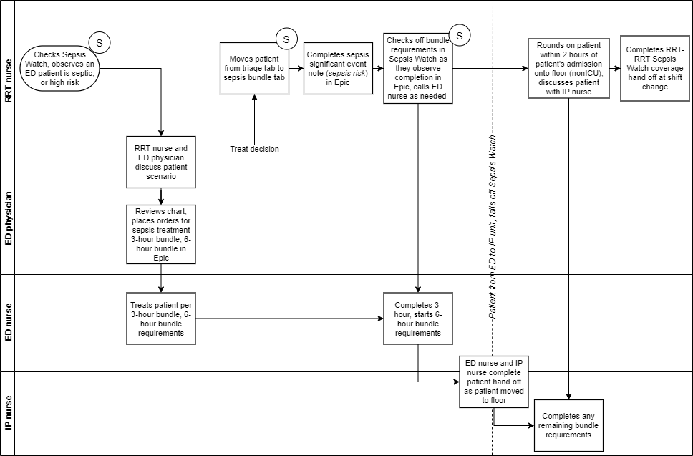
Step 3 · Who gets the alert?
Methods · step 3
• Alerts go to rapid response team (RRT) nurses, not ED staff.
• The nurse triages, phones the ED clinician and records a note.
• ED staff still carry out every diagnostic and treatment action.
• They avoided the term "code sepsis".
Sendak MP et al. JMIR Med Inform 2020;8(7):e15182. doi:10.2196/15182
Notes:
Methods, Clinical workflow design,
p.4: "The prior CDS implementation indicated that alert-fatigued frontline staff might not be the right personnel to receive alerts.
The clinical team agreed that the rapid response team (RRT) nurses within DUH were best suited to triage patient alerts to manage sepsis proactively." Figure 1 swimlane.

Slide 9
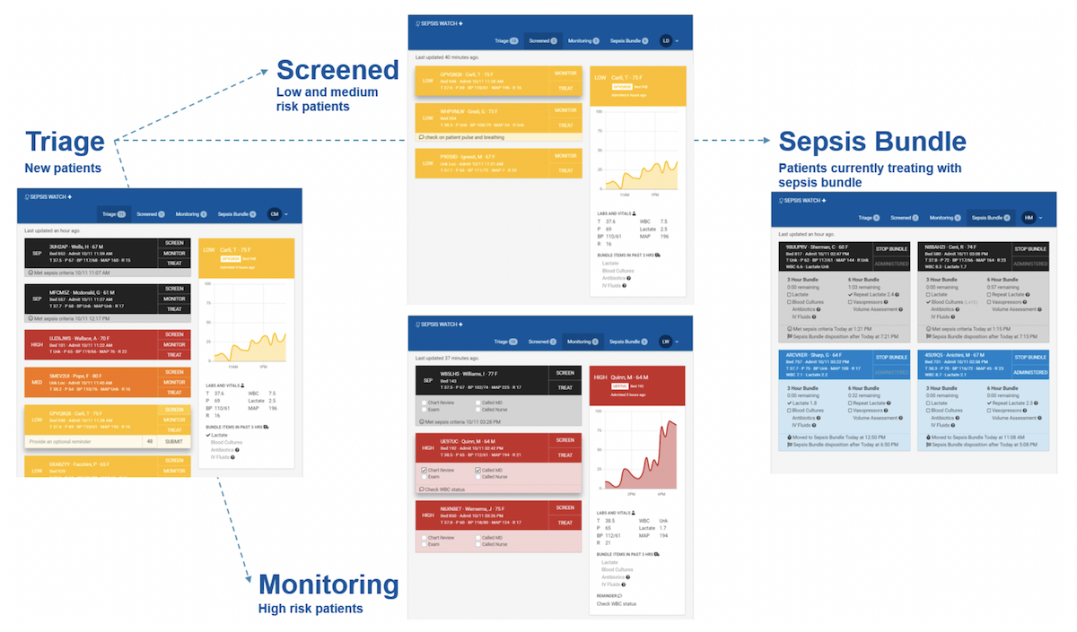
Step 4 · Model choices are workflow choices
Methods · step 4
• Clinical leaders cared most about positive predictive value.
• They traded interpretability for performance, because sepsis treatment is the same whatever the cause.
• Alert volume was capped at up to 4 high-risk alerts per hour per nurse.
• 3-month silent period on live data before launch.
Sendak MP et al. JMIR Med Inform 2020;8(7):e15182. doi:10.2196/15182
Notes:
Methods, Model and infrastructure design, p.6 to p.7: "Clinical leaders prioritized positive predictive value as a performance measure and were willing to trade-off model interpretability for performance gains." "Model interpretability was low priority because of the many causes of sepsis, and treatment protocols are largely agnostic to cause." "Up to 4 high-risk alerts per hour were agreed upon as ideal volume for a single RRT nurse user." "A 3-month silent period was implemented before launch."
🗣️ ASK (Q4): Models carry ongoing maintenance costs. What could quietly break a sepsis model a year after launch?
📄 SHOW IN PAPER, p.2, Introduction, second challenge, red highlight: "Second, even after a model is initially implemented, machine learning models can incur substantial ongoing maintenance costs."
✅ ANSWER: An EHR field changes and the model reads it wrong (Sculley 2014). The alert works, treatment comes earlier, the predicted outcome gets rarer, so the model drifts (Lenert 2019). And someone must own it after the project team leaves.
🗣️ ASK (Q11): This is what the RRT nurse saw on a tablet. What would you change before using it on your ward?
📄 SHOW IN PAPER, p.4, Methods, Clinical workflow design, and Figure 2, red highlight: "The Sepsis Watch user interface was carefully designed to accommodate tablet and mobile phone use."
✅ ANSWER: Four tabs: Triage, Screened, Monitoring, Sepsis Bundle, with colour-coded risk, a risk trend chart and bundle timers. Missing: any explanation of why a patient scored high, they traded interpretability for performance (p.6).

Slide 10
Steps 7 and 8 · Go-live, governance, evaluation
Results · steps 7, 8
• RRT nurses trained in person with a test version of the app.
• A governance committee: promote use, train, report bundle compliance weekly, plan sustainability.
• Evaluation set up with partners, including 2 social science research institutes, and a registered clinical trial.
• Trial primary outcome is bundle compliance, not mortality.
Sendak MP et al. JMIR Med Inform 2020;8(7):e15182. doi:10.2196/15182
Notes:
Results, p.8 to p.10: "The committee's 4 primary goals were to (1) promote usage of the Sepsis Watch app, (2) provide comprehensive training and communication on the application and workflow, (3) develop a reporting method to track patient volume and bundle compliance, and (4) plan for postpilot sustainability." "The primary outcome for this clinical trial is sepsis treatment bundle compliance."
🗣️ ASK (Q3): The abstract says Sepsis Watch was 'successfully integrated'. What did that take, and what does 'successful' mean?
📄 SHOW IN PAPER, p.1, Abstract, Results, red highlight: "Results: Sepsis Watch was successfully integrated into routine clinical care and reshaped how local machine learning projects are executed."
✅ ANSWER: 3-month silent period, RRT nurse to ED physician workflow, in-person training, soft launch 5 Nov 2018, weekly governance metrics (p.8). 'Successful' = adopted into daily care, not proven to improve outcomes.

Slide 11
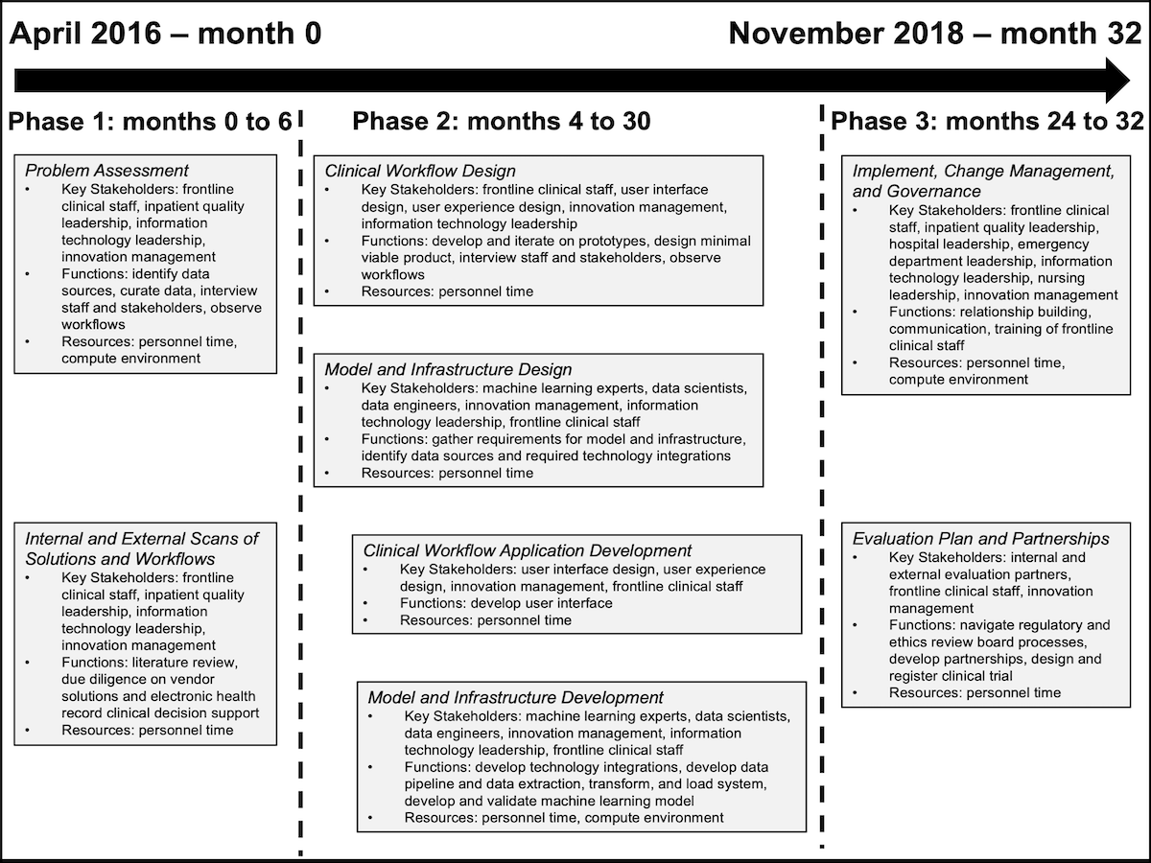
From problem to routine care (Figure 4)
Discussion
Sendak MP et al. JMIR Med Inform 2020;8(7):e15182. doi:10.2196/15182
Notes:
Figure 4. Timeline of steps involved in translation of Sepsis Watch from problem identification to integration into routine clinical care. Proposal October 2015, project launched April 2016, go-live 5 November 2018.

Slide 12
Three take-home points
Discussion · Conclusions
• Decide who acts on the alert before building the model.
• Trust is built with people: frontline co-design, training and a governance committee.
• Budget for the human work. Here it was about 8000 hours.
• Caution: one academic site with in-house experts, and no patient outcome data in this paper.
Sendak MP et al. JMIR Med Inform 2020;8(7):e15182. doi:10.2196/15182
Notes:
Limits to raise: single site, one academic hospital with in-house data science; this paper reports the implementation, not patient outcomes. Discussion, p.11: "Other institutions that do not have in-house capabilities across technical and clinical domains may face additional costs and barriers."
🗣️ ASK (Q2): The abstract promises 'learnings' for other hospitals. What would you take back to your own hospital?
📄 SHOW IN PAPER, p.2, Abstract, Conclusions, red highlight: "Although there is no playbook for integrating deep learning into clinical care, learnings from the Sepsis Watch integration can inform efforts to develop machine learning technologies at other health care delivery systems."
✅ ANSWER: About 8000 staff hours, not compute (p.11). The steps overlap and recur (p.11). Single academic centre with in-house teams, would a smaller hospital manage?

Slide 13
Questions for our discussion
Discussion
• Why send alerts to RRT nurses and not ED doctors?
• When is it fine to trade interpretability for performance?
• Who would pay for 8000 hours of staff time in an NHS trust?
• Is this a successful intervention, or a successful launch?
• What does this add to last week's barriers and facilitators?
• What would an orthopaedic version of Sepsis Watch look like?
Sendak MP et al. JMIR Med Inform 2020;8(7):e15182. doi:10.2196/15182
Notes:
Suggested answers (release after the session):
1. Earlier alert caused alarm fatigue; RRT nurses could triage and call the right doctor.
2. Acceptable when the action is the same whatever the cause and a clinician confirms before acting.
3. The paper treats it as investment that built reusable infrastructure. NHS budget line is our own suggestion.
4. A successful launch. Single site, no outcomes reported here.
5. Confirms workflow fit, trust via clinical champions, governance.
6. e.g. deterioration alert after hip fracture surgery to an orthogeriatric outreach nurse, capped per hour. A design idea only.

