Slide 1
15
Monopoly

Slide 2
While a competitive firm is a price taker, a monopoly firm is a price maker.

Slide 3
A firm is considered a monopoly if . . .
  it is the sole seller of its product.
  its product does not have close substitutes.

Slide 4
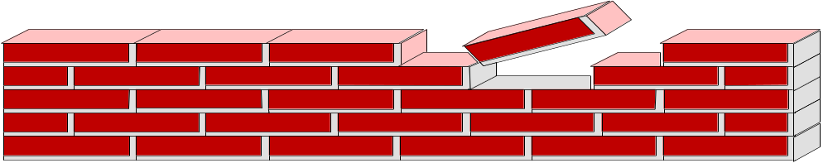
WHY MONOPOLIES ARISE
The fundamental cause of monopoly is barriers to entry.

Slide 5
WHY MONOPOLIES ARISE
Barriers to entry have three sources:
  Ownership of a key resource.
  The government gives a single firm the exclusive right to produce some good.
  Costs of production make a single producer more efficient than a large number of producers.

Slide 6
Monopoly Resources
Although exclusive ownership of a key resource is a potential source of monopoly, in practice monopolies rarely arise for this reason.

Slide 7
Government-Created Monopolies
Governments may restrict entry by giving a single firm the exclusive right to sell a particular good in certain markets.

Slide 8
Government-Created Monopolies
Patent and copyright laws are two important examples of how government creates a monopoly to serve the public interest.

Slide 9
Natural Monopolies
An industry is a natural monopoly when a single firm can supply a good or service to an entire market at a smaller cost than could two or more firms.
Notes:
Smaller cost: When a firm's average total cost curve continually declines

Slide 10
Natural Monopolies
A natural monopoly arises when there are economies of scale over the relevant range of output.

Slide 11

Figure 1 Economies of Scale as a Cause of Monopoly
Cost
Average
total
cost
0
Quantity of Output
Copyright © 2004 South-Western

Slide 12
HOW MONOPOLIES MAKE PRODUCTION AND PRICING DECISIONS
Monopoly versus Competition
  Monopoly
    Is the sole producer
    Faces a downward-sloping demand curve
    Is a price maker
    Reduces price to increase sales
  Competitive Firm
    Is one of many producers
    Faces a horizontal demand curve
    Is a price taker
    Sells as much or as little at same price

Slide 13
Figure 2 Demand Curves for Competitive and Monopoly Firms
(a) A Competitive Firm
’
s Demand Curve
(b) A Monopolist
’
s Demand Curve
Price
Price
Demand
Demand
0
Quantity of Output
0
Quantity of Output
Copyright © 2004 South-Western

Slide 14
A Monopoly’s Revenue
Total Revenue
P × Q = TR
Average Revenue
TR/Q = AR = P
Marginal Revenue
ΔTR/ΔQ = MR

Slide 15

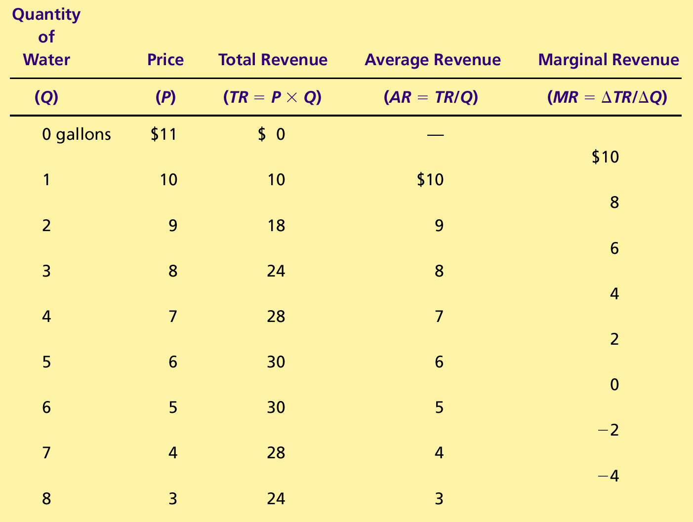
Table 1 A Monopoly’s Total, Average, and Marginal Revenue
Copyright©2004 South-Western

Slide 16
A Monopoly’s Revenue
A Monopoly’s Marginal Revenue
  A monopolist’s marginal revenue is always less than the price of its good.
    The demand curve is downward sloping.
    When a monopoly drops the price to sell one more unit, the revenue received from previously sold units also decreases.

Slide 17
A Monopoly’s Revenue
A Monopoly’s Marginal Revenue
  When a monopoly increases the amount it sells, it has two effects on total revenue (P × Q).
    The output effect—more output is sold, so Q is higher.
    The price effect—price falls, so P is lower.

Slide 18
Figure 3 Demand and Marginal-Revenue Curves for a Monopoly
Price
$11
10
9
8
7
6
5
4
3
Demand
2
Marginal
(average
1
revenue
revenue)
0
–1
1
2
3
4
5
6
7
8
Quantity of Water
–2
–3
–4
Copyright © 2004 South-Western

Slide 19
Profit Maximization
A monopoly maximizes profit by producing the quantity at which marginal revenue equals marginal cost.
It then uses the demand curve to find the price that will induce consumers to buy that quantity.

Slide 20
Figure 4 Profit Maximization for a Monopoly
Costs and
Revenue
2. . . . and then the demand
1. The intersection of the
curve shows the price
marginal-revenue curve
consistent with this quantity.
and the marginal-cost
curve determines the
B
profit-maximizing
Monopoly
quantity . . .
price
Average total cost
A
Marginal
Demand
cost
Marginal revenue
0
Q
Q_{MAX}
Q
Quantity
Copyright © 2004 South-Western

Slide 21
Profit Maximization
Comparing Monopoly and Competition
  For a competitive firm, price equals marginal cost.
  P = MR = MC
  For a monopoly firm, price exceeds marginal cost.
  P > MR = MC

Slide 22
A Monopoly’s Profit
Profit equals total revenue minus total costs.
  Profit = TR - TC
  Profit = (TR/Q - TC/Q) × Q
  Profit = (P - ATC) × Q

Slide 23
Figure 5 The Monopolist’s Profit
Costs and
Revenue
Marginal cost
Monopoly
E
B
price
Monopoly
Average total cost
profit
Average
total
D
C
cost
Demand
Marginal revenue
0
Q_{MAX}
Quantity
Copyright © 2004 South-Western

Slide 24
A Monopolist’s Profit
The monopolist will receive economic profits as long as price is greater than average total cost.

Slide 25
Figure 6 The Market for Drugs
Costs and
Revenue
Price
during
patent life
Price after
Marginal
patent
cost
expires
Marginal
Demand
revenue
0
Monopoly
Competitive
Quantity
quantity
quantity
Copyright © 2004 South-Western

Slide 26
THE WELFARE COST OF MONOPOLY
In contrast to a competitive firm, the monopoly charges a price above the marginal cost.
From the standpoint of consumers, this high price makes monopoly undesirable.
However, from the standpoint of the owners of the firm, the high price makes monopoly very desirable.

Slide 27
Figure 7 The Efficient Level of Output
Price
Marginal cost
Value
Cost
to
to
buyers
monopolist
Demand
Cost
Value
(value to buyers)
to
to
monopolist
buyers
0
Quantity
Value to buyers
Value to buyers
is greater than
is less than
cost to seller.
cost to seller.
Efficient
quantity
Copyright © 2004 South-Western

Slide 28
The Deadweight Loss
Because a monopoly sets its price above marginal cost, it places a wedge between the consumer’s willingness to pay and the producer’s cost.
  This wedge causes the quantity sold to fall short of the social optimum.

Slide 29
Figure 8 The Inefficiency of Monopoly
Price
Deadweight
Marginal cost
loss
Monopoly
price
Marginal
revenue
Demand
0
Monopoly
Efficient
Quantity
quantity
quantity
Copyright © 2004 South-Western

Slide 30
The Deadweight Loss
The Inefficiency of Monopoly
  The monopolist produces less than the socially efficient quantity of output.

Slide 31
The Deadweight Loss
The deadweight loss caused by a monopoly is similar to the deadweight loss caused by a tax.
The difference between the two cases is that the government gets the revenue from a tax, whereas a private firm gets the monopoly profit.

Slide 32
PUBLIC POLICY TOWARD MONOPOLIES
Government responds to the problem of monopoly in one of four ways.
  Making monopolized industries more competitive.
  Regulating the behavior of monopolies.
  Turning some private monopolies into public enterprises.
  Doing nothing at all.

Slide 33
Increasing Competition with Antitrust Laws
Antitrust laws are a collection of statutes aimed at curbing monopoly power.
Antitrust laws give government various ways to promote competition.
  They allow government to prevent mergers.
  They allow government to break up companies.
  They prevent companies from performing activities that make markets less competitive.

Slide 34
Increasing Competition with Antitrust Laws
Two Important Antitrust Laws
  Sherman Antitrust Act (1890)
    Reduced the market power of the large and powerful “trusts” of that time period.
  Clayton Act (1914)
    Strengthened the government’s powers and authorized private lawsuits.

Slide 35
Regulation
Government may regulate the prices that the monopoly charges.
  The allocation of resources will be efficient if price is set to equal marginal cost.

Slide 36
Figure 9 Marginal-Cost Pricing for a Natural Monopoly
Price
Average total
cost
Average total cost
Loss
Regulated
price
Marginal cost
Demand
0
Quantity
Copyright © 2004 South-Western

Slide 37
Regulation
In practice, regulators will allow monopolists to keep some of the benefits from lower costs in the form of higher profit, a practice that requires some departure from marginal-cost pricing.

Slide 38
Public Ownership
Rather than regulating a natural monopoly that is run by a private firm, the government can run the monopoly itself (e.g. in the United States, the government runs the Postal Service).

Slide 39
Doing Nothing
Government can do nothing at all if the market failure is deemed small compared to the imperfections of public policies.

Slide 40
PRICE DISCRIMINATION
Price discrimination is the business practice of selling the same good at different prices to different customers, even though the costs for producing for the two customers are the same.

Slide 41
PRICE DISCRIMINATION
Price discrimination is not possible when a good is sold in a competitive market since there are many firms all selling at the market price. In order to price discriminate, the firm must have some market power.
Perfect Price Discrimination
  Perfect price discrimination refers to the situation when the monopolist knows exactly the willingness to pay of each customer and can charge each customer a different price.

Slide 42
PRICE DISCRIMINATION
Two important effects of price discrimination:
  It can increase the monopolist’s profits.
  It can reduce deadweight loss.

Slide 43
Figure 10 Welfare with and without Price Discrimination
(a) Monopolist with Single Price
Price
Consumer
surplus
Monopoly
Deadweight
price
loss
Profit
Marginal cost
Marginal
Demand
revenue
0
Quantity sold
Quantity
Copyright © 2004 South-Western

Slide 44
Figure 10 Welfare with and without Price Discrimination
(b) Monopolist with Perfect Price Discrimination
Price
Profit
Marginal cost
Demand
0
Quantity sold
Quantity
Copyright © 2004 South-Western

Slide 45
PRICE DISCRIMINATION
Examples of Price Discrimination
  Movie tickets
  Airline prices
  Discount coupons
  Financial aid
  Quantity discounts

Slide 46
CONCLUSION: THE PREVALENCE OF MONOPOLY
How prevalent are the problems of monopolies?
  Monopolies are common.
  Most firms have some control over their prices because of differentiated products.
  Firms with substantial monopoly power are rare.
  Few goods are truly unique.

Slide 47
Summary
A monopoly is a firm that is the sole seller in its market.
It faces a downward-sloping demand curve for its product.
A monopoly’s marginal revenue is always below the price of its good.

Slide 48
Summary
Like a competitive firm, a monopoly maximizes profit by producing the quantity at which marginal cost and marginal revenue are equal.
Unlike a competitive firm, its price exceeds its marginal revenue, so its price exceeds marginal cost.

Slide 49
Summary
A monopolist’s profit-maximizing level of output is below the level that maximizes the sum of consumer and producer surplus.
A monopoly causes deadweight losses similar to the deadweight losses caused by taxes.

Slide 50
Summary
Policymakers can respond to the inefficiencies of monopoly behavior with antitrust laws, regulation of prices, or by turning the monopoly into a government-run enterprise.
If the market failure is deemed small, policymakers may decide to do nothing at all.

Slide 51
Summary
Monopolists can raise their profits by charging different prices to different buyers based on their willingness to pay.
Price discrimination can raise economic welfare and lessen deadweight losses.

