Slide 1
16
Oligopoly

Slide 2
BETWEEN MONOPOLY AND PERFECT COMPETITION
Imperfect competition refers to those market structures that fall between perfect competition and pure monopoly.

Slide 3
BETWEEN MONOPOLY AND PERFECT COMPETITION
Imperfect competition includes industries in which firms have competitors but do not face so much competition that they are price takers.

Slide 4
BETWEEN MONOPOLY AND PERFECT COMPETITION
Types of Imperfectly Competitive Markets
  Oligopoly
    Only a few sellers, each offering a similar or identical product to the others.
  Monopolistic Competition
    Many firms selling products that are similar but not identical.

Slide 5

Figure 1 The Four Types of Market Structure
Number of Firms?
Many
firms
Type of Products?
One
Few
Differentiated
Identical
firm
firms
products
products
Monopolistic
Perfect
Monopoly
Oligopoly
Competition
Competition
(Chapter 15)
(Chapter 16)
(Chapter 17)
(Chapter 14)
•
Tap water
•
Tennis balls
•
Novels
•
Wheat
•
Cable TV
•
Crude oil
•
Movies
•
Milk
Copyright © 2004 South-Western

Slide 6
MARKETS WITH ONLY A FEW SELLERS
Because of the few sellers, the key feature of oligopoly is the tension between cooperation and self-interest.

Slide 7
MARKETS WITH ONLY A FEW SELLERS
Characteristics of an Oligopoly Market
  Few sellers offering similar or identical products
  Interdependent firms
  Best off cooperating and acting like a monopolist by producing a small quantity of output and charging a price above marginal cost

Slide 8
A Duopoly Example
A duopoly is an oligopoly with only two members. It is the simplest type of oligopoly.

Slide 9
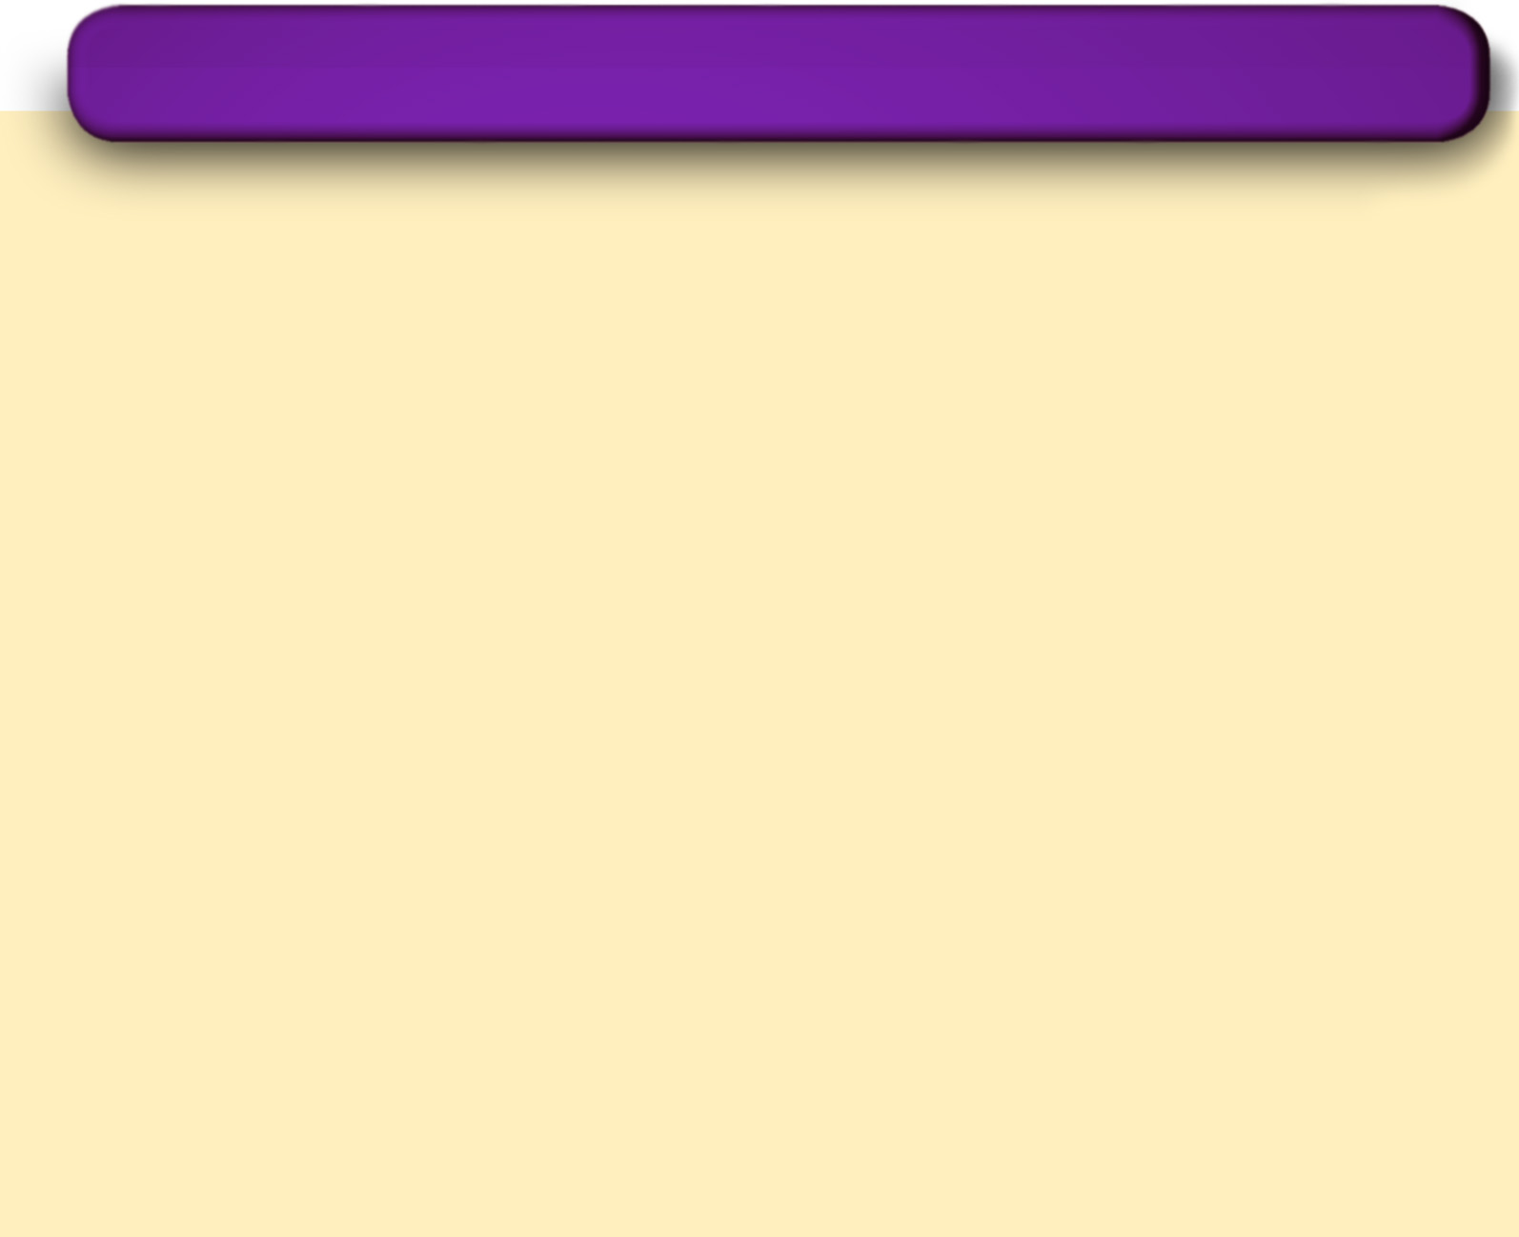
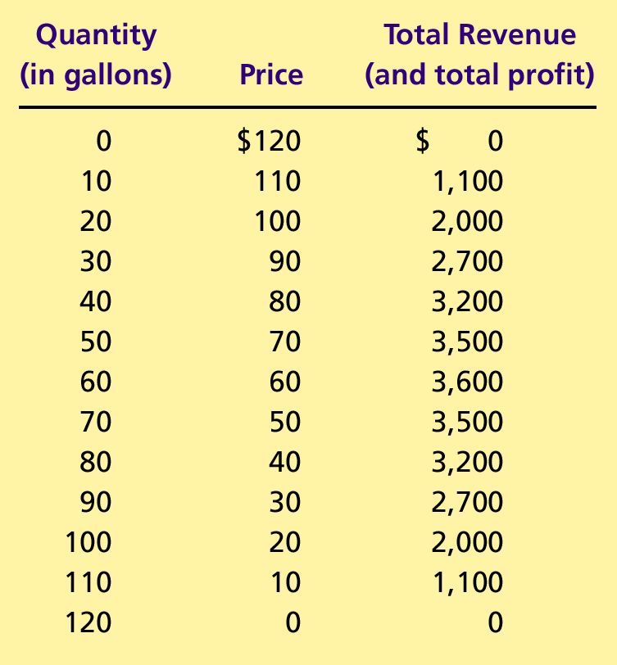
Table 1 The Demand Schedule for Water
Copyright © 2004 South-Western

Slide 10
A Duopoly Example
Price and Quantity Supplied
  The price of water in a perfectly competitive market would be driven to where the marginal cost is zero:
    P = MC = $0
    Q = 120 gallons
  The price and quantity in a monopoly market would be where total profit is maximized:
    P = $60
    Q = 60 gallons

Slide 11
A Duopoly Example
Price and Quantity Supplied
  The socially efficient quantity of water is 120 gallons, but a monopolist would produce only 60 gallons of water.
  So what outcome then could be expected from duopolists?

Slide 12
Competition, Monopolies, and Cartels
The duopolists may agree on a monopoly outcome.
  Collusion
    An agreement among firms in a market about quantities to produce or prices to charge.
  Cartel
    A group of firms acting in unison.

Slide 13
Competition, Monopolies, and Cartels
Although oligopolists would like to form cartels and earn monopoly profits, often that is not possible. Antitrust laws prohibit explicit agreements among oligopolists as a matter of public policy.

Slide 14
The Equilibrium for an Oligopoly
A Nash equilibrium is a situation in which economic actors interacting with one another each choose their best strategy given the strategies that all the others have chosen.

Slide 15
The Equilibrium for an Oligopoly
When firms in an oligopoly individually choose production to maximize profit, they produce quantity of output greater than the level produced by monopoly and less than the level produced by competition.

Slide 16
The Equilibrium for an Oligopoly
The oligopoly price is less than the monopoly price but greater than the competitive price (which equals marginal cost).

Slide 17
Equilibrium for an Oligopoly
Summary
  Possible outcome if oligopoly firms pursue their own self-interests:
    Joint output is greater than the monopoly quantity but less than the competitive industry quantity.
    Market prices are lower than monopoly price but greater than competitive price.
    Total profits are less than the monopoly profit.

Slide 18
Table 1 The Demand Schedule for Water
Copyright © 2004 South-Western

Slide 19
How the Size of an Oligopoly Affects the Market Outcome
How increasing the number of sellers affects the price and quantity:
  The output effect: Because price is above marginal cost, selling more at the going price raises profits.
  The price effect: Raising production will increase the amount sold, which will lower the price and the profit per unit on all units sold.

Slide 20
How the Size of an Oligopoly Affects the Market Outcome
As the number of sellers in an oligopoly grows larger, an oligopolistic market looks more and more like a competitive market.
The price approaches marginal cost, and the quantity produced approaches the socially efficient level.

Slide 21
GAME THEORY AND THE ECONOMICS OF COOPERATION
Game theory is the study of how people behave in strategic situations.
Strategic decisions are those in which each person, in deciding what actions to take, must consider how others might respond to that action.

Slide 22
GAME THEORY AND THE ECONOMICS OF COOPERATION
Because the number of firms in an oligopolistic market is small, each firm must act strategically.
Each firm knows that its profit depends not only on how much it produces but also on how much the other firms produce.

Slide 23
The Prisoners’ Dilemma
The prisoners’ dilemma provides insight into the difficulty in maintaining cooperation.
Often people (firms) fail to cooperate with one another even when cooperation would make them better off.

Slide 24
The Prisoners’ Dilemma
The prisoners’ dilemma is a particular “game” between two captured prisoners that illustrates why cooperation is difficult to maintain even when it is mutually beneficial.

Slide 25
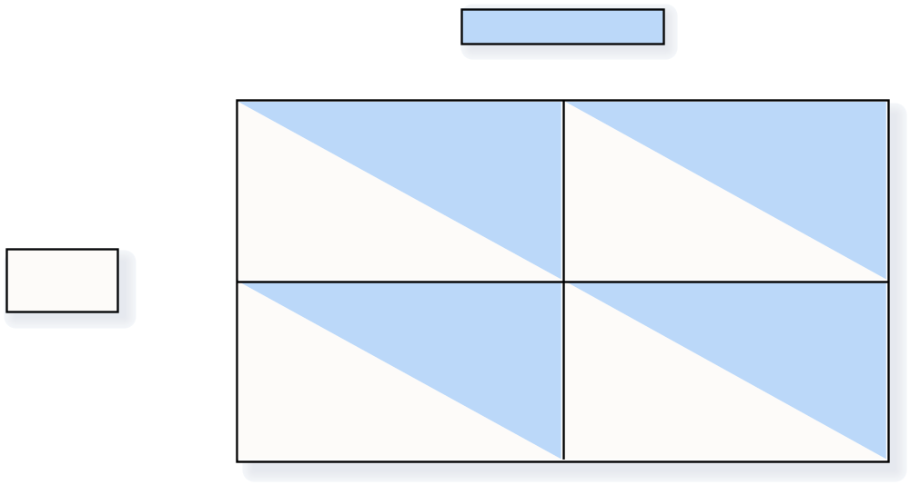
Figure 2 The Prisoners’ Dilemma
Bonnie’ s Decision
Confess
Remain Silent
Bonnie gets 8 years
Bonnie gets 20 years
Confess
Clyde’s
Clyde gets 8 years
Clyde goes free
Decision
Bonnie goes free
Bonnie
gets 1 year
Remain
Silent
Clyde gets 20 years
Clyde gets 1 year
Copyright©2003 Southwestern/Thomson Learning

Slide 26
The Prisoners’ Dilemma
The dominant strategy is the best strategy for a player to follow regardless of the strategies chosen by the other players.

Slide 27
The Prisoners’ Dilemma
Cooperation is difficult to maintain, because cooperation is not in the best interest of the individual player.

Slide 28

Figure 3 An Oligopoly Game
Iraq
’
s Decision
High Production
Low Production
Iraq gets $40 billion
Iraq gets $30 billion
High
Production
Iran
’
s
Iran gets $40 billion
Iran gets $60 billion
Decision
Iraq gets $60 billion
Iraq gets $50 billion
Low
Production
Iran gets $30 billion
Iran gets $50 billion
Copyright©2003 Southwestern/Thomson Learning

Slide 29
Oligopolies as a Prisoners’ Dilemma
Self-interest makes it difficult for the oligopoly to maintain a cooperative outcome with low production, high prices, and monopoly profits.

Slide 30
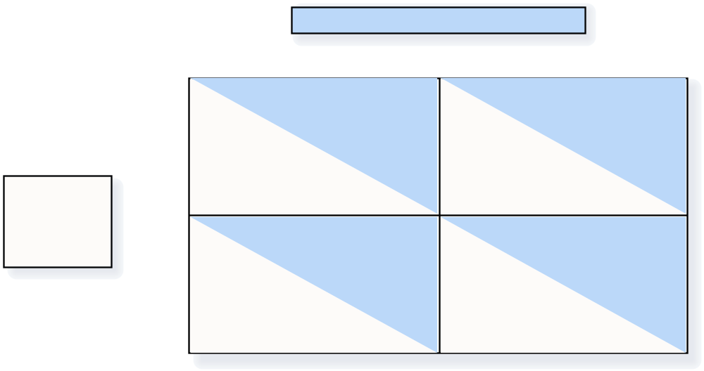
Figure 4 An Arms-Race Game
Decision of the United States (U.S.)
Arm
Disarm
U.S. at risk
U.S. at risk and weak
Arm
Decision
USSR at risk
USSR safe and powerful
of the
Soviet Union
U.S. safe and powerful
U.S. safe
(USSR)
Disarm
USSR at risk and weak
USSR safe
Copyright©2003 Southwestern/Thomson Learning

Slide 31
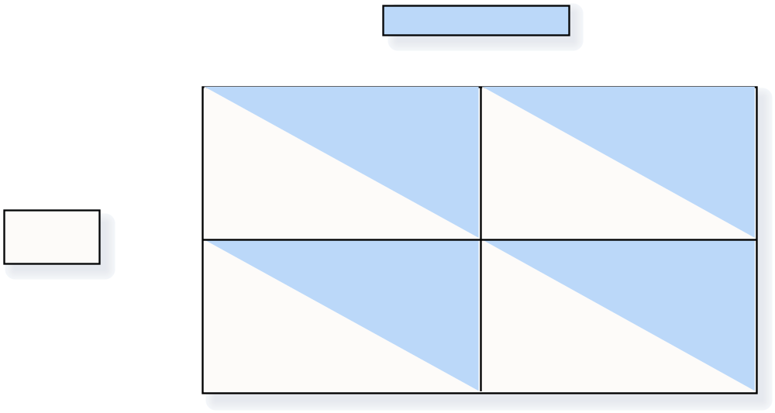
Figure 5 An Advertising Game
Marlboro’ s Decision
Advertise
Don
’
t Advertise
Marlboro gets $3
Marlboro gets $2
billion profit
billion profit
Advertise
Camel gets $3
Camel gets $5
Camel’s
billion profit
billion profit
Decision
Marlboro gets $5
Marlboro gets $4
billion profit
billion profit
Don
’
t
Advertise
Camel gets $2
Camel gets $4
billion profit
billion profit
Copyright©2003 Southwestern/Thomson Learning

Slide 32
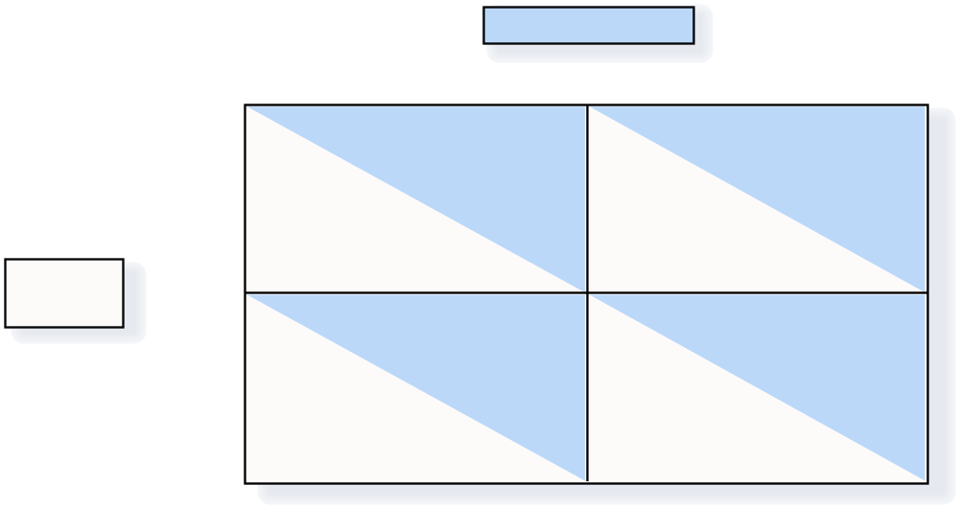
Figure 6 A Common-Resource Game
Exxon
’
s Decision
Drill Two Wells
Drill One Well
Exxon gets $4
Exxon gets $3
million profit
million profit
Drill Two
Wells
Texaco gets $4
Texaco gets $6
Texaco’s
million profit
million profit
Decision
Exxon gets $6
Exxon gets $5
million profit
million profit
Drill One
Well
Texaco gets $3
Texaco gets $5
million profit
million profit
Copyright©2003 Southwestern/Thomson Learning

Slide 33
Why People Sometimes Cooperate
Firms that care about future profits will cooperate in repeated games rather than cheating in a single game to achieve a one-time gain.

Slide 34

Figure 7 Jack and Jill Oligopoly Game
Jack’s Decision
Sell 40 Gallons
Sell 30 Gallons
Jack gets
Jack gets
$1,600 profit
$1,500 profit
Sell 40
Gallons
Jill gets
Jill gets
Jill’s
$1,600 profit
$2,000 profit
Decision
Jack gets
Jack gets
$2,000 profit
$1,800 profit
Sell 30
Gallons
Jill gets
Jill gets
$1,500 profit
$1,800 profit
Copyright©2003 Southwestern/Thomson Learning

Slide 35
PUBLIC POLICY TOWARD OLIGOPOLIES
Cooperation among oligopolists is undesirable from the standpoint of society as a whole because it leads to production that is too low and prices that are too high.

Slide 36
Restraint of Trade and the Antitrust Laws
Antitrust laws make it illegal to restrain trade or attempt to monopolize a market.
  Sherman Antitrust Act of 1890
  Clayton Act of 1914

Slide 37
Controversies over Antitrust Policy
Antitrust policies sometimes may not allow business practices that have potentially positive effects:
  Resale price maintenance
  Predatory pricing
  Tying

Slide 38
Controversies over Antitrust Policy
Resale Price Maintenance (or fair trade)
  occurs when suppliers (like wholesalers) require retailers to charge a specific amount
Predatory Pricing
  occurs when a large firm begins to cut the price of its product(s) with the intent of driving its competitor(s) out of the market
Tying
  when a firm offers two (or more) of its products together at a single price, rather than separately

Slide 39
Summary
Oligopolists maximize their total profits by forming a cartel and acting like a monopolist.
If oligopolists make decisions about production levels individually, the result is a greater quantity and a lower price than under the monopoly outcome.

Slide 40
Summary
The prisoners’ dilemma shows that self-interest can prevent people from maintaining cooperation, even when cooperation is in their mutual self-interest.
The logic of the prisoners’ dilemma applies in many situations, including oligopolies.

Slide 41
Summary
Policymakers use the antitrust laws to prevent oligopolies from engaging in behavior that reduces competition.

