Slide 1

Optimization of Bonus Allocation
Irfan H
2024

Slide 2
Team Members
Prabhu D Mahabalashetti
www.linkedin.com/in/prabhu-shetti-9828502b4

Slide 3

Contents
Business objective
Business Constraints
Project Architecture
Data collection and details
Exploratory Data Analysis
Visualization
Modeling
Evaluation
Deployment
Notes:
Change

Slide 4
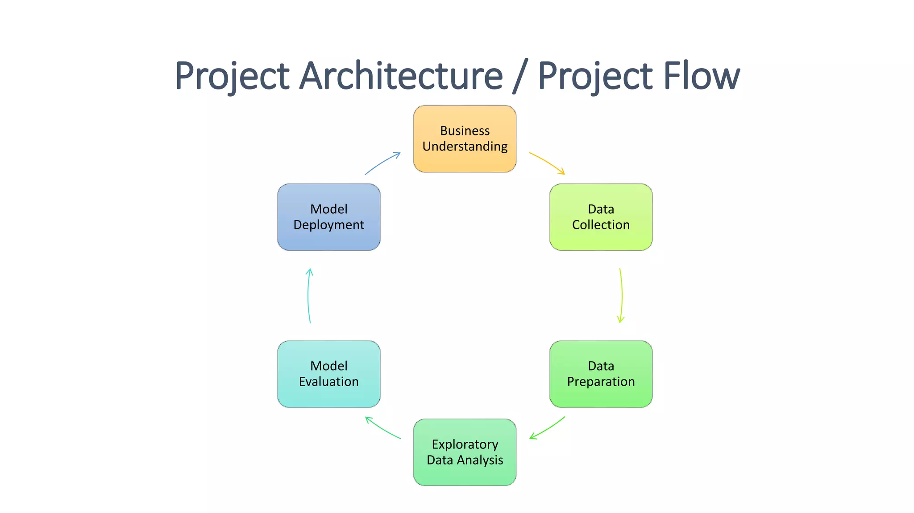
Project Overview and Scope

Slide 5
Business Problem
The company's bonus allocation process misaligns with KPIs and objectives, causing resource wastage, customer dissatisfaction, higher costs, and decreased motivation.
Optimizing the system is crucial for effective bonus distribution, enhancing customer performance and satisfaction efficiently.

Slide 6
Business Objective
CRISP-ML(Q) Methodology:
1. Business and Data Understanding
2. Data Preparation
3. Model Building
4. Model Evaluation
5. Model Deployment
6. Monitoring and Maintenance
Constraints
Maximize the Fairness in the bonus allocation.
Maximize Customer Satisfaction.
Minimize the Variance in bonus allocation.

Slide 7
CRISP-ML(Q) Methodology
There are six stages of CRISP-ML(Q) Methodology
1.Business and data understanding
2.Data preparation
3.model building
4.Model evaluation
5.Model deployment
6.Monitoring and maintenance

Slide 8
Technical Stacks
Data was collected from an online betting platform, including customer demographics, betting patterns, and bonus-related activities. The dataset consists of both categorical and numerical features, which were preprocessed for model training.
Data Collection:
Collect a comprehensive and inclusive dataset of online betting and bonus allocation that adequately reflects a broad range of perspectives and experiences.
Data Preprocessing:
Clean and preprocess the collected data. This may involve Type casting, Null values, Duplicate values, Outliers detection etc.
Labeling:
Annotate the dataset with suitable for machine learninga lgorithms.
Model Selection:
Four interpretable, complex classification algorithms—Logistic Regression, Random Forest, Gradient Boosting, and Support Vector Machine (SVM)—were chosen to assess their predictive performance on the target variable.
Training:
The Dataset was split into training(70%), testing(30%) to ensure unbiased model evaluation.

Slide 9
Technical Stacks
Key findings from EDA:
- Most frequent bonus recipients are customers with high betting activity.
- Strong correlation between income level and bonus allocation.
- Outliers detected in 'Average Bet Amount' and handled accordingly.

Slide 10
Data Collection and Understanding
Data Collection:
Data Collection involved aggregating customer information, transactional data, and behavioural metrics from online betting platform. The dataset was curated to include variables, such as demographic details, betting pattern, and bonus-related activities, providing a comprehensive foundation for predictive analysis.

Slide 11
Data Information
Dataset Characteristics:
Understand the nature of the collected dataset, the dataset comprises mix of categorical and numerical features.
Assess the diversity of the dataset, considering variations between patterns.
Evaluate the representativeness of the dataset across different online betting dataset.
Dataset Preprocessing Details:
Data preprocessing steps performed on the dataset, involved encoding categorical variables, standardizing numerical features
Any specific techniques or algorithms applied during preprocessing to enhance the model performance and ensuring consistent input data or ML learning algorithms.
Labeling Information:
Details about how the dataset is annotated, such as the use of label encodes to standardize dataset.
Information on the accuracy and consistency of labeling across different features.
Data Splitting:
Information about how the dataset is split into training, and test sets.
Considerations for maintaining a diverse representation of images in each set.

Slide 12
Data set
The final model was deployed using Streamlit, allowing real-time predictions on customer bonus eligibility. Key challenges included handling a large dataset and ensuring quick model inference.

Slide 13
System Requirements
Hardware Requirements:
Training Hardware:
High-performance GPUs (Graphics Processing Units) for faster model training. The specific GPU model depends on the complexity of the chosen deep learning architecture.
Sufficient RAM to handle large datasets and model parameters during training.
Inference Hardware:
GPUs for real-time or batch processing during model inference. The GPU requirements for inference may be different from those used during training, and optimized inference engines can be employed.
Storage:
Adequate storage for storing the dataset, trained models, and any intermediate files generated during training.
Fast storage access to minimize data loading times.
Networking:
High-speed internet connection for data download, model updates, and potential cloud-based solutions.

Slide 14
Exploratory Data Analysis [EDA]
Data Loading and Inspection:
Load a subset of the dataset into your preferred data analysis environment (e.g., Python with Pandas).
Inspect the structure of the dataset, including file paths, annotations, and class labels.
2. Class Distribution:
Examine the distribution of different online betting classes in the dataset.
Check for imbalances that may affect the model's ability to generalize across classes.
3. Data Visualization:
Visualize sample images with annotated classification to understand the quality of annotations.
Plot histograms to represent class distributions.
4. Statistics:
Calculate and analyze basic statistics, such as dimensions, mean values, and standard deviations.
Ensure consistency dataset.
Notes:
EDA is used for seeing what the data can tell us before the modeling task.
Change

Slide 15
Data Preprocessing
1. Data Cleaning:
Check for and handle any missing or corrupted data in the dataset.
Remove duplicate rows or annotations if applicable.
2. Normalization:
Normalize pixel values to a common scale (e.g., [0, 1] or [-1, 1]).
This helps in preventing numerical instability during training.
3. Splitting the Dataset:
Split the dataset into training, validation, and test sets.
Common splits include 70% for training, 20% for validation, and 10% for testing.
Notes:
Keep observations

Slide 16
Data Preprocessing
1.Exploratory Data Analysis
2.Outliers Detection.
3.Outliers Treatment.
4.Splitting the Dataset (Optional):
If you have a labeled dataset, split it into training, and test sets.

Slide 17
Model Building
Model Selection:
Logistic Regression: A simple and interpretable model often used for binary classification tasks. It was selected for its efficiency and ease of interpretation.
1.1.Data Preparation:
Clean and preprocess the dataset.
Labeling:
Annotate the dataset with label encoder.
Training:
Split dataset into training and validation sets.
Evaluation:
Assess model accuracy,.
Fine-tune the model based on evaluation results.
Notes:
classification is the task of predicting a discrete class label. Regression is the task of predicting a continuous quantity.
What is classification techniques in machine learning?
The Classification algorithm is a Supervised Learning technique that is used to identify the category of new observations on the basis of training data. In Classification, a program learns from the given dataset or observations and then classifies new observation into several classes or groups.
What is regression techniques in machine learning?
Regression is a technique for investigating the relationship between independent variables or features and a dependent variable or outcome. It's used as a method for predictive modeling in machine learning, in which an algorithm is used to predict continuous outcomes.

Slide 18
Model Building
7.Deployment:
Integrate the trained model into the application/system.
8.Monitoring and Maintenance:
Implement mechanisms for continuous monitoring.

Slide 19
Model Accuracy Comparison
Select Evaluation Metrics:
Choose appropriate evaluation metrics based on the nature of the problem. In addition to accuracy, consider precision.
Prepare a Common Test Dataset:
Ensure that all models are evaluated on the same test dataset to maintain consistency in the comparison.
Evaluate Each Model:
Use the selected metrics to evaluate each model's performance on the test dataset.
Calculate accuracy,score for each model.
4.Statistical Significance Testing (Optional):
If the dataset is large enough, consider statistical significance testing to determine if observed differences in performance metrics are statistically significant.
6.Visualize Results:
Create visualizations, such as confusion matrices or precision-recall curves, to better understand the strengths and weaknesses of each model.

Slide 20
Best Model –
Logistic Regression: A simple and interpretable model often used for binary classification tasks. It was selected for its efficiency and ease of interpretation.
Notes:
Why Random Forest Regression is good?
A Random Forest Regression model is powerful and accurate. It usually performs great on many problems, including features with non-linear relationships
How is XGBoost different from random forest?
One of the most important differences between XG Boost and Random forest is that the XGBoost always gives more importance to functional space when reducing the cost of a model while Random Forest tries to give more preferences to hyperparameters to optimize the model..
n_estimators — the number of decision trees you will be running in the model

Slide 21
Model Deployment - Strategy
1.Streamlit:
created a Streamlit web application with a select the input customer details.
The main function (predict_customer to receive bonus or not)

Slide 22
Challenges
Data Quality :
Challenge: Ensuring representative dataset that covers various customer details .
Solution: Rigorous data collection and augmentation techniques to enhance dataset diversity.
Class Imbalances:
Challenge: Imbalances in the number of similar customer deatials consists same value for different games .It can affect model performance.
Solution: Address techniques like data resampling during training.
Model Complexity and Resource Requirements:
Solution: Optimize model architecture and consider distributed training or cloud-based solutions to handle resource constraints.

Slide 23

Queries ?

Slide 24


