Slide 1
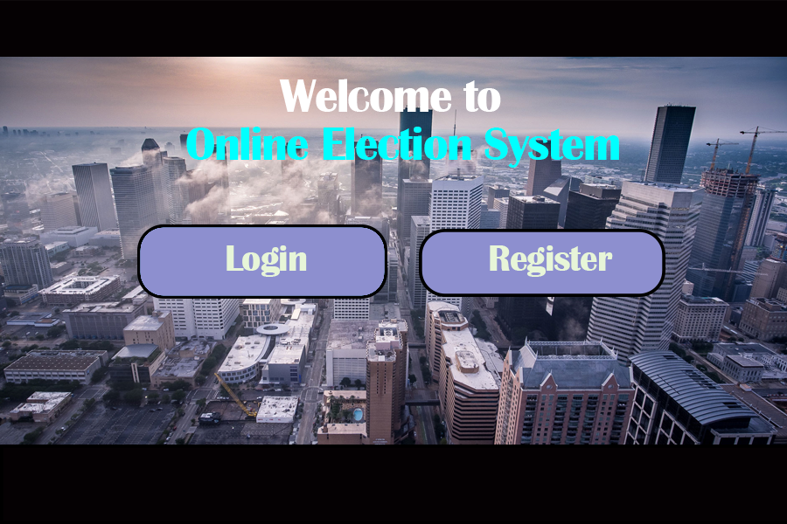

Slide 2
LOGIN AS
VOTER
ADMIN

Slide 3
LOGIN AS
VOTER
USERNAME
CANDITATE
PASSWORD

Slide 4
REGISTER AS
VOTER
CANDITATE

Slide 5
Radio Button (RB)
REGISTER AS
Full Name
Username
Sex (RB)
VOTER
Age (RB)
CANDITATE
Address
Password
Expecting Position (RB)
IMAGE

Slide 6
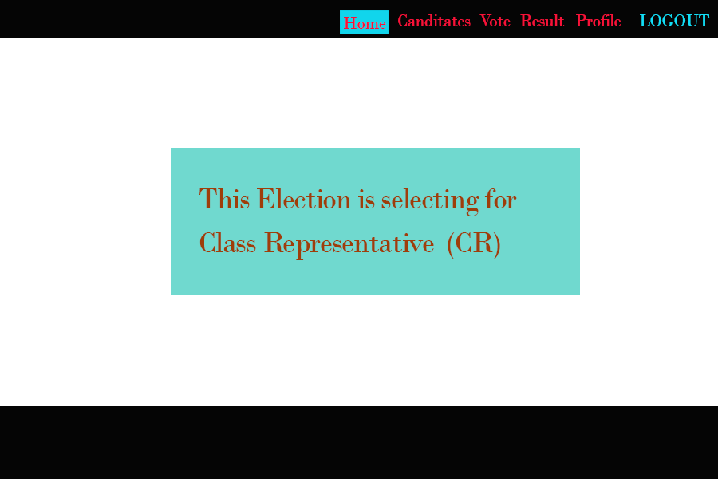

Slide 7
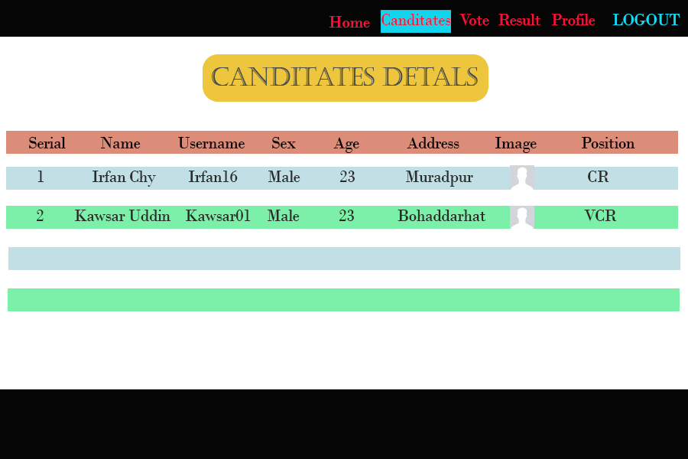

Slide 8
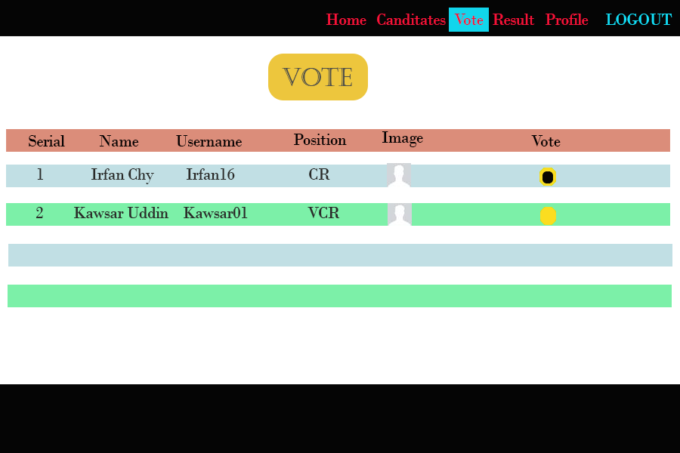

Slide 9
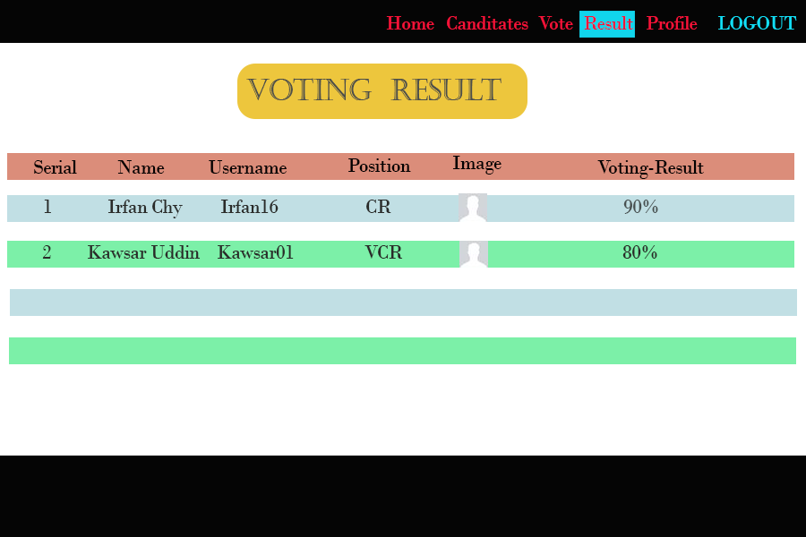

Slide 10
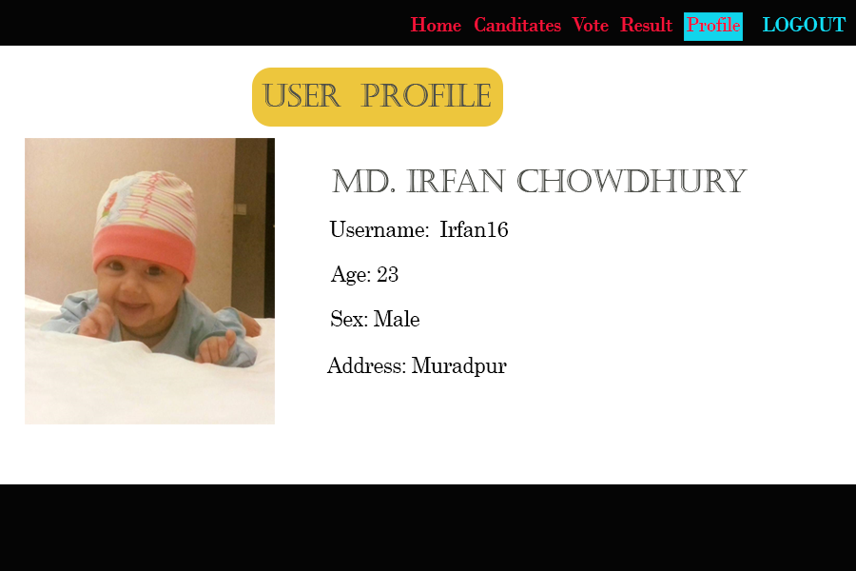

Slide 11
Add New Voter
Add New Canditate
Remove voter/canditate
Admin Control
Update voter/canditate info
Only Admin can do this
Publish Result
Other control

