Slide 1
Slide 14 Heaps and Priority Queues
CSE225: Data Structures and Algorithms

Slide 2
Priority Queues
Items can be added and deleted (like queues)
Not necessarily maintains the First In First Out order

Slide 3
Priority Queues
Items can be added and deleted (like queues)
Not necessarily maintains the First In First Out order
Items can be added in any order
Always, the item with the highest priority is deleted

Slide 4
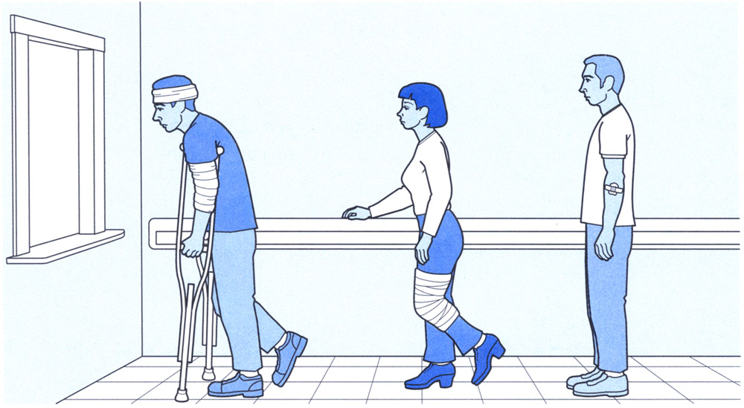
Priority Queues
Items can be added and deleted (like queues)
Not necessarily maintains the First In First Out order
Items can be added in any order
Always, the item with the highest priority is deleted

Slide 5
Priority Queue Specification
Structure: | The priority queue is arranged to support access to the highest-priority item.
Operations:
MakeEmpty
Function | Initializes the queue to an empty state.
Postcondition | Queue is empty.
Boolean IsEmpty
Function | Tests whether the queue is empty.
Postcondition | Returns true if queue is empty and false otherwise.
Boolean IsFull
Function | Tests whether the queue is full.
Postcondition | Returns true if queue is full and false otherwise.

Slide 6
Priority Queue Specification
Enqueue(ItemType newItem)
Function | Adds newItem to the queue.
Postcondition | If (the priority queue is full), exception FullPQ is thrown; else newItem is in the queue.
Dequeue(ItemType& item)
Function | Removes element with highest priority and returns it in item.
Postcondition | If (the priority queue is empty), exception EmptyPQ is thrown; else highest priority element has been removed from queue. item is a copy of removed element.

Slide 7
Heaps
A complete binary tree
Each of the elements contains a value that is less than or equal to the value of each of its children (Min-heap)
Each of the elements contains a value that is greater than or equal to the value of each of its children (Max-heap)

Slide 8
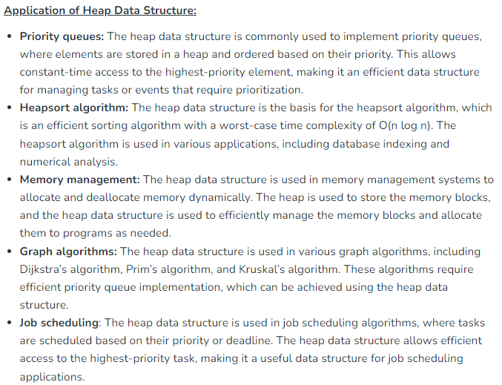

Slide 9
Heaps
A complete binary tree
Each of the elements contains a value that is less than or equal to the value of each of its children (Min-heap)
Each of the elements contains a value that is greater than or equal to the value of each of its children (Max-heap)
1
11
2
5
9
4
3
4
8
7
7
8
3
1
11
6
9
2
5
6
Min-heap
Max-heap

Slide 10
Heaps
A complete binary tree
Each of the elements contains a value that is less than or equal to the value of each of its children (Min-heap)
Each of the elements contains a value that is greater than or equal to the value of each of its children (Max-heap)
Shape property
1
11
2
5
9
4
3
4
8
7
7
8
3
1
11
6
9
2
5
6
Min-heap
Max-heap
The shape of all heaps with a given number of elements is the same.

Slide 11
Heaps
A complete binary tree
Each of the elements contains a value that is less than or equal to the value of each of its children (Min-heap)
Each of the elements contains a value that is greater than or equal to the value of each of its children (Max-heap)
Shape property
1
Order property
11
2
5
9
4
3
4
8
7
7
8
3
1
11
6
9
2
5
6
Min-heap
Max-heap
The shape of all heaps with a given number of elements is the same.
The root node always contains the largest value in the heap (in addition, the subtrees are heaps as well).

Slide 12
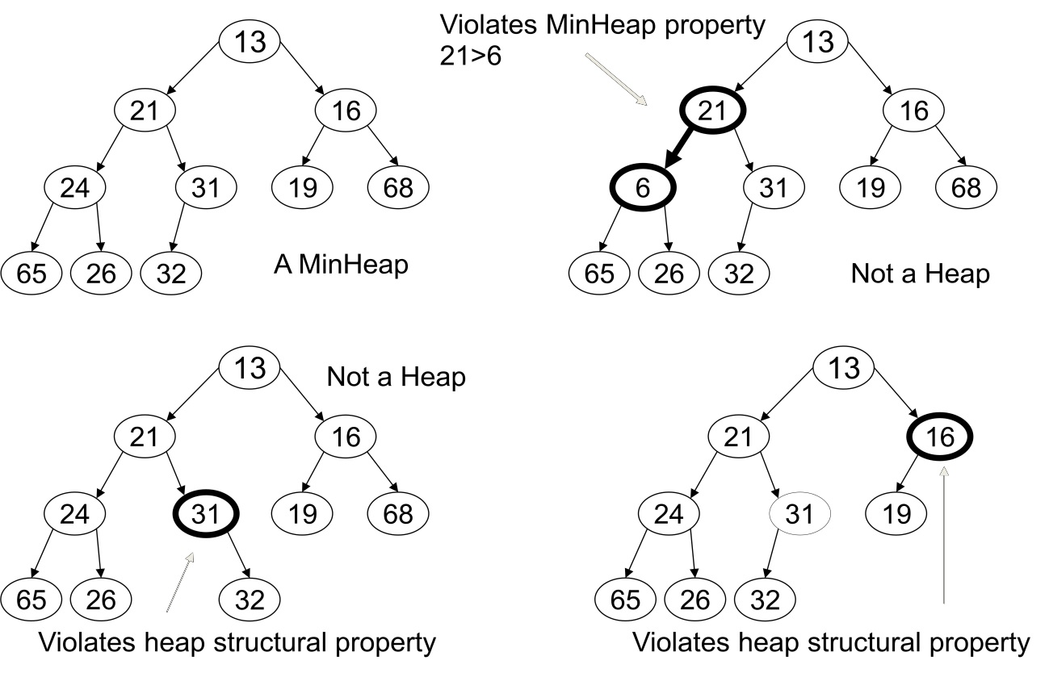
Example

Slide 13
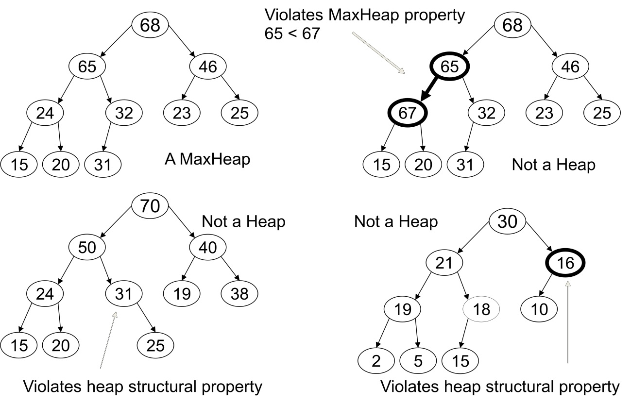
Max-Heap:
The largest Element is always in the root node.
Each node must have a key that is greater or equal to the key of each of its children.

Slide 14
Heaps
Root
A heap is a certain kind of complete binary tree.
When a complete
binary tree is built,
its first node must be
the root.
Notes:
The first node of a complete binary tree is always the root...

Slide 15
Heaps
Complete binary tree.
Left child
of the
root
The second node is
always the left child
of the root.
Notes:
...the second node is always the left child of the root...

Slide 16
Heaps
Complete binary tree.
Right child
of the
root
The third node is
always the right child
of the root.
Notes:
...then the right child of the root...

Slide 17
Heaps
Complete binary tree.
The next nodes
always fill the next
level from left-to-right.
Notes:
...and so on. The nodes always fill each level from left-to-right...

Slide 18
Heaps
Complete binary tree.
The next nodes
always fill the next
level from left-to-right.
Notes:
...from left-to-right...

Slide 19
Heaps
Complete binary tree.
The next nodes
always fill the next
level from left-to-right.
Notes:
...from left-to-right...

Slide 20
Heaps
Complete binary tree.
The next nodes
always fill the next
level from left-to-right.
Notes:
...from left-to-right...

Slide 21
Heaps
Complete binary tree.
Notes:
...and when a level is filled you start the next level at the left.

Slide 22
Heaps
A heap is a certain kind of complete binary tree.
45
35
23
27
21
22
4
19
Each node in a heap
contains a key that
can be compared to
other nodes' keys.
Notes:
So, a heap is a complete binary tree. Each node in a heap contains a key, and these keys must be organized in a particular manner. Notice that this is not a binary search tree, but the keys do follow some semblance of order.
Can you see what rule is being enforced here?

Slide 23
Heaps
A heap is a certain kind of complete binary tree.
45
35
23
27
21
22
4
19
The "heap property"
requires that each
node's key is >= the
keys of its children
Notes:
The heap property requires that each node's key is >= to the keys of its children.
This is a handy property because the biggest node is always at the top. Because of this, a heap can easily implement a priority queue (where we need quick access to the highest priority item).

Slide 24
Heaps (Implementation Issue)
We do not need linked structures to store a heap (since the tree is complete, there are not any “holes” in the tree)
11
9
4
7
8
3
1
2
5
6

Slide 25
Heaps (Implementation Issue)
We do not need linked structures to store a heap (since the tree is complete, there are not any “holes” in the tree)
11
Index | Value
0 | 11
1 | 9
2 | 4
3 | 7
4 | 8
5 | 3
6 | 1
7 | 2
8 | 5
9 | 6
9
4
7
8
3
1
2
5
6
We can arrays in order to store heaps.
Root at index 0.
For any value at index i,
Left child at index 2i+1
Right child at index 2i+2
For any value at index i
Parent is at index (i-1)/2

Slide 26
Implementing a Heap
42
We will store the data from the nodes in a partially-filled array.
35
23
27
21
An array of data
Notes:
This slide shows the typical way that a heap is implemented. For the most part, there is nothing new here, because you already know how to implement a complete binary tree using a partially-filled array. That is what we are doing with the heap.

Slide 27
Implementing a Heap
42
Data from the root goes in the first location of the array.
35
23
27
21
42
An array of data
Notes:
Following the usual technique for implementing a complete binary tree, the data from the root is stored in the first entry of the array.

Slide 28
Implementing a Heap
42
Data from the next row goes in the next two array locations.
35
23
27
21
42
35
23
An array of data
Notes:
The next two nodes go in the next two locations of the array.

Slide 29
Implementing a Heap
42
Data from the next row goes in the next two array locations.
35
23
27
21
42
35
23
27
21
An array of data
Notes:
and so on.

Slide 30
Implementing a Heap
42
Data from the next row goes in the next two array locations.
35
23
27
21
42
35
23
27
21
An array of data
We don't care what's in
this part of the array.
Notes:
As with any partially-filled array, we are only concerned with the front part of the array. If the tree has five nodes, then we are only concerned with the entries in the first five components of the array.

Slide 31
Important Points about the Implementation
42
The links between the tree's nodes are not actually stored as pointers, or in any other way.
The only way we "know" that "the array is a tree" is from the way we manipulate the data.
35
23
27
21
42
35
23
27
21
An array of data
Notes:
With this implementation of a heap, there are no pointers. The only way that we know that the array is a heap is the manner in which we manipulate it.

Slide 32
Important Points about the Implementation
42
If you know the index of a node, then it is easy to figure out the indexes of that node's parent and children. Formulas are given in the book.
35
23
27
21
42
35
23
27
21
[1] [2] [3] [4] [5]
Notes:
The manipulations are the same manipulations that you've used for a complete binary tree, making it easy to compute the index where various nodes are stored.

Slide 33
Adding a Node to a Heap
Put the new node in the next available spot.
Push the new node upward, swapping with its parent until the new node reaches an acceptable location.
45
35
23
27
21
22
4
19
42
Notes:
We can add new elements to a heap whenever we like. Because the heap is a complete binary search tree, we must add the new element at the next available location, filling in the levels from left-to-right.
In this example, I have just added the new element with a key of 42.
Of course, we now have a problem: The heap property is no longer valid. The 42 is bigger than its parent 27.
To fix the problem, we will push the new node upwards until it reaches an acceptable location.

Slide 34
Adding a Node to a Heap
Put the new node in the next available spot.
Push the new node upward, swapping with its parent until the new node reaches an acceptable location.
45
35
23
42
21
22
4
19
27
Notes:
Here we have pushed the 42 upward one level, swapping it with its smaller parent 27.
We can't stop here though, because the parent 35 is still smaller than the new node 42.

Slide 35
Adding a Node to a Heap
Put the new node in the next available spot.
Push the new node upward, swapping with its parent until the new node reaches an acceptable location.
45
42
23
35
21
22
4
19
27
Notes:
Can we stop now? Yes, because the 42 is less than or equal to its parent.

Slide 36
Adding a Node to a Heap
The parent has a key that is >= new node, or
The node reaches the root.
The process of pushing the new node upward is called reheapup.
45
42
23
35
21
22
4
19
27
Notes:
In general, there are two conditions that can stop the pushing upward:
1. We reach a spot where the parent is >= the new node, or
2. We reach the root.
This process is called reheapification upward (I didn't just make up that name, really).

Slide 37
Removing the Top of a Heap
45
Move the last node onto the root.
42
23
35
21
22
4
19
27
Notes:
We can also remove the top node from a heap. The first step of the removal is to move the last node of the tree onto the root. In this example we move the 27 onto the root.

Slide 38
Removing the Top of a Heap
27
Move the last node onto the root.
42
23
35
21
22
4
19
Notes:
Now the 27 is on top of the heap, and the original root (45) is no longer around. But the heap property is once again violated.

Slide 39
Removing the Top of a Heap
Move the last node onto the root.
Push the out-of-place node downward, swapping with its larger child until the new node reaches an acceptable location.
27
42
23
35
21
22
4
19
Notes:
We'll fix the problem by pushing the out-of-place node downward. Perhaps you can guess what the downward pushing is called....reheapification downward.

Slide 40
Removing the Top of a Heap
Move the last node onto the root.
Push the out-of-place node downward, swapping with its larger child until the new node reaches an acceptable location.
42
27
23
35
21
22
4
19
Notes:
When we push a node downward it is important to swap it with its largest child. (Otherwise we are creating extra problems by placing the smaller child on top of the larger child.) This is what the tree looks like after one swap.
Should I continue with the reheapification downward?

Slide 41
Removing the Top of a Heap
Move the last node onto the root.
Push the out-of-place node downward, swapping with its larger child until the new node reaches an acceptable location.
42
35
23
27
21
22
4
19
Notes:
Yes, I swap again, and now the 27 is in an acceptable location.

Slide 42
Removing the Top of a Heap
The children all have keys <= the out-of-place node, or
The node reaches the leaf.
The process of pushing the new node downward is called reheapdown.
42
35
23
27
21
22
4
19
Notes:
Reheapification downward can stop under two circumstances:
1. The children all have keys that are <= the out-of-place node.
2. The out-of-place node reaches a leaf.

Slide 43
The Enqueue operation
11
9
4
3
1
Enqueue 15
7
8
2
5
6
Index | 0 | 1 | 2 | 3 | 4 | 5 | 6 | 7 | 8 | 9 | 10
value | 11 | 9 | 4 | 7 | 8 | 3 | 1 | 2 | 5 | 6 | ?
Length = 10

Slide 44
The Enqueue operation
Increment length
11
9
4
3
1
Enqueue 15
7
8
2
5
6
Index | 0 | 1 | 2 | 3 | 4 | 5 | 6 | 7 | 8 | 9 | 10
value | 11 | 9 | 4 | 7 | 8 | 3 | 1 | 2 | 5 | 6 | ?
Length = 10

Slide 45
The Enqueue operation
Increment length
11
9
4
3
1
Enqueue 15
7
8
2
5
6
Index | 0 | 1 | 2 | 3 | 4 | 5 | 6 | 7 | 8 | 9 | 10
value | 11 | 9 | 4 | 7 | 8 | 3 | 1 | 2 | 5 | 6 | ?
Length = 11

Slide 46
The Enqueue operation
Increment length
Add the item to be enqueued as the last leaf node (at index length-1)
11
9
4
3
1
Enqueue 15
7
8
2
5
6
Index | 0 | 1 | 2 | 3 | 4 | 5 | 6 | 7 | 8 | 9 | 10
value | 11 | 9 | 4 | 7 | 8 | 3 | 1 | 2 | 5 | 6 | ?
Length = 11

Slide 47
The Enqueue operation
Increment length
Add the item to be enqueued as the last leaf node (at index length-1)
11
9
4
3
1
Enqueue 15
7
8
2
5
6
15
Index | 0 | 1 | 2 | 3 | 4 | 5 | 6 | 7 | 8 | 9 | 10
value | 11 | 9 | 4 | 7 | 8 | 3 | 1 | 2 | 5 | 6 | 15
Length = 11

Slide 48
The Enqueue operation
Increment length
Add the item to be enqueued as the last leaf node (at index length-1)
Perform ReheapUp operation
11
9
4
3
1
Enqueue 15
7
8
2
5
6
15
Index | 0 | 1 | 2 | 3 | 4 | 5 | 6 | 7 | 8 | 9 | 10
value | 11 | 9 | 4 | 7 | 8 | 3 | 1 | 2 | 5 | 6 | 15
Length = 11

Slide 49
The Enqueue operation
Increment length
Add the item to be enqueued as the last leaf node (at index length-1)
Perform ReheapUp operation
11
9
4
3
1
Enqueue 15
7
8
2
5
6
15
Index | 0 | 1 | 2 | 3 | 4 | 5 | 6 | 7 | 8 | 9 | 10
value | 11 | 9 | 4 | 7 | 8 | 3 | 1 | 2 | 5 | 6 | 15
Length = 11

Slide 50
The Enqueue operation
Increment length
Add the item to be enqueued as the last leaf node (at index length-1)
Perform ReheapUp operation
11
9
4
3
1
Enqueue 15
7
15
2
5
6
8
Index | 0 | 1 | 2 | 3 | 4 | 5 | 6 | 7 | 8 | 9 | 10
value | 11 | 9 | 4 | 7 | 15 | 3 | 1 | 2 | 5 | 6 | 8
Length = 11

Slide 51
The Enqueue operation
Increment length
Add the item to be enqueued as the last leaf node (at index length-1)
Perform ReheapUp operation
11
9
4
3
1
Enqueue 15
7
15
2
5
6
8
Index | 0 | 1 | 2 | 3 | 4 | 5 | 6 | 7 | 8 | 9 | 10
value | 11 | 9 | 4 | 7 | 15 | 3 | 1 | 2 | 5 | 6 | 8
Length = 11

Slide 52
The Enqueue operation
Increment length
Add the item to be enqueued as the last leaf node (at index length-1)
Perform ReheapUp operation
11
15
4
3
1
Enqueue 15
7
9
2
5
6
8
Index | 0 | 1 | 2 | 3 | 4 | 5 | 6 | 7 | 8 | 9 | 10
value | 11 | 15 | 4 | 7 | 9 | 3 | 1 | 2 | 5 | 6 | 8
Length = 11

Slide 53
The Enqueue operation
Increment length
Add the item to be enqueued as the last leaf node (at index length-1)
Perform ReheapUp operation
11
15
4
3
1
Enqueue 15
7
9
2
5
6
8
Index | 0 | 1 | 2 | 3 | 4 | 5 | 6 | 7 | 8 | 9 | 10
value | 11 | 15 | 4 | 7 | 9 | 3 | 1 | 2 | 5 | 6 | 8
Length = 11

Slide 54
The Enqueue operation
Increment length
Add the item to be enqueued as the last leaf node (at index length-1)
Perform ReheapUp operation
15
11
4
3
1
Enqueue 15
7
9
2
5
6
8
Index | 0 | 1 | 2 | 3 | 4 | 5 | 6 | 7 | 8 | 9 | 10
value | 15 | 11 | 4 | 7 | 9 | 3 | 1 | 2 | 5 | 6 | 8
Length = 11

Slide 55
The Enqueue operation
Increment length
Add the item to be enqueued as the last leaf node (at index length-1)
Perform ReheapUp operation
15
11
4
3
1
Enqueue 15
7
9
2
5
6
8
Index | 0 | 1 | 2 | 3 | 4 | 5 | 6 | 7 | 8 | 9 | 10
value | 15 | 11 | 4 | 7 | 9 | 3 | 1 | 2 | 5 | 6 | 8
Length = 11

Slide 56
The Dequeue operation
11
9
4
7
8
3
1
2
5
6
Index | 0 | 1 | 2 | 3 | 4 | 5 | 6 | 7 | 8 | 9
value | 11 | 9 | 4 | 7 | 8 | 3 | 1 | 2 | 5 | 6
Length = 10

Slide 57
The Dequeue operation
Replace the root with the last leaf node
11
9
4
7
8
3
1
2
5
6
Index | 0 | 1 | 2 | 3 | 4 | 5 | 6 | 7 | 8 | 9
value | 11 | 9 | 4 | 7 | 8 | 3 | 1 | 2 | 5 | 6
Length = 10

Slide 58
The Dequeue operation
Replace the root with the last leaf node
6
9
4
7
8
3
1
2
5
11
Index | 0 | 1 | 2 | 3 | 4 | 5 | 6 | 7 | 8 | 9
value | 6 | 9 | 4 | 7 | 8 | 3 | 1 | 2 | 5 | 11
Length = 10

Slide 59
The Dequeue operation
Replace the root with the last leaf node
6
9
4
7
8
3
1
2
5
11
Index | 0 | 1 | 2 | 3 | 4 | 5 | 6 | 7 | 8 | 9
value | 6 | 9 | 4 | 7 | 8 | 3 | 1 | 2 | 5 | 11
Length = 10

Slide 60
The Dequeue operation
Replace the root with the last leaf node
Decrement length (the last leaf node is out of the tree now)
6
9
4
7
8
3
1
2
5
11
Index | 0 | 1 | 2 | 3 | 4 | 5 | 6 | 7 | 8 | 9
value | 6 | 9 | 4 | 7 | 8 | 3 | 1 | 2 | 5 | 11
Length = 10

Slide 61
The Dequeue operation
Replace the root with the last leaf node
Decrement length (the last leaf node is out of the tree now)
6
9
4
7
8
3
1
2
5
Index | 0 | 1 | 2 | 3 | 4 | 5 | 6 | 7 | 8 | 9
value | 6 | 9 | 4 | 7 | 8 | 3 | 1 | 2 | 5 | 11
Length = 9

Slide 62
The Dequeue operation
Replace the root with the last leaf node
Decrement length (the last leaf node is out of the tree now)
Perform ReheapDown operation
6
9
4
7
8
3
1
2
5
Index | 0 | 1 | 2 | 3 | 4 | 5 | 6 | 7 | 8 | 9
value | 6 | 9 | 4 | 7 | 8 | 3 | 1 | 2 | 5 | 11
Length = 9

Slide 63
The Dequeue operation
Replace the root with the last leaf node
Decrement length (the last leaf node is out of the tree now)
Perform ReheapDown operation
6
9
4
7
8
3
1
2
5
Index | 0 | 1 | 2 | 3 | 4 | 5 | 6 | 7 | 8 | 9
value | 6 | 9 | 4 | 7 | 8 | 3 | 1 | 2 | 5 | 11
Length = 9

Slide 64
The Dequeue operation
Replace the root with the last leaf node
Decrement length (the last leaf node is out of the tree now)
Perform ReheapDown operation
9
6
4
7
8
3
1
2
5
Index | 0 | 1 | 2 | 3 | 4 | 5 | 6 | 7 | 8 | 9
value | 9 | 6 | 4 | 7 | 8 | 3 | 1 | 2 | 5 | 11
Length = 9

Slide 65
The Dequeue operation
Replace the root with the last leaf node
Decrement length (the last leaf node is out of the tree now)
Perform ReheapDown operation
9
6
4
7
8
3
1
2
5
Index | 0 | 1 | 2 | 3 | 4 | 5 | 6 | 7 | 8 | 9
value | 9 | 6 | 4 | 7 | 8 | 3 | 1 | 2 | 5 | 11
Length = 9

Slide 66
The Dequeue operation
Replace the root with the last leaf node
Decrement length (the last leaf node is out of the tree now)
Perform ReheapDown operation
9
8
4
7
6
3
1
2
5
Index | 0 | 1 | 2 | 3 | 4 | 5 | 6 | 7 | 8 | 9
value | 9 | 8 | 4 | 7 | 6 | 3 | 1 | 2 | 5 | 11
Length = 9

