Slide 1
CSE225: Data Structure using C++

Slide 2
Outline
Fundamentals of C++
Class & inheritance
Overloading & overriding

Slide 3
The New C++ Headers
The new-style headers do not specify file-extension.
They simply specify standard identifiers that might be mapped to files by the compiler.
<iostream>
<vector>
<string>, not related with <string.h>
<cmath>, C++ version of <math.h>
<cstring>, C++ version of <string.h>
Programmer defined header files should end in “.h”.

Slide 4
Namespaces
A namespace is a declarative region.
It localizes the names of identifiers to avoid name collisions.
The contents of new-style headers are placed in the std namespace.
Example: namespace.cpp

Slide 5
C++ Console I/O (Output)
cout ???
Shift right operator ???
How does a shift right operator produce output to the screen?
cout << “Hello World!”;
printf(“Hello World!”);
cout << iCount; /* int iCount */
printf(“%d”, iCount);
cout << 100.99;
printf(“%f”, 100.99);
cout << “\n”, or cout << ‘\n’, or cout << endl
printf(“\n”)
In general, cout << expression;
polymorphism here

Slide 6
C++ Console I/O (Input)
cin >> strName; /* char strName[16] */
scanf(“%s”, strName);
cin >> iCount; /* int iCount */
scanf(“%d”, &iCount);
cin >> fValue; /* float fValue */
scanf(“%f”, &fValue);
In general, cin >> variable;

Slide 7
Classes: A First Look
General syntax -
class class-name { // private functions and variables public:
// public functions and variables };

Slide 8
How to write a class in C++:
A class is an expanded concept of a data structure:
instead of holding only data, it can hold both data and functions.
An object is an instantiation of a class.
In terms of variables, a class would be the type, and an object would be the variable.
Classes are generally declared using the keyword class, with the following format:
class class_name {
access_specifier_1:
member1;
access_specifier_2:
member2;
...
} object_names;
Example-: Crectangle.cpp

Slide 9
A PIE Model of OOP
Abstraction
Polymorphism
Inheritance
Encapsulation

Slide 10
A PIE Model of OOP
Abstraction: Abstraction of Data or Hiding of Information is called Abstraction
Polymorphism: It is the ability to redefine methods for derived classes. or we can say that object can behave in different forms is call Polymorphism.
Inheritance: Inheritance enables new objects to take on the properties of existing objects. There are different ways in which Inheritance can be done.
Single Inheritance
Multi-level Inheritance
Multiple Inheritance
Hierarchical Inheritance
Encapsulation: Binding of Data and Functions (that manipulate the data) together and keep both safe from outside interference and misuse is called Encapsulation.

Slide 11
Classes: A First Look (cont.)
A class declaration is a logical abstraction that defines a new type.
It determines what an object of that type will look like.
An object declaration creates a physical entity of that type.
That is, an object occupies memory space, but a type definition does not.
Example: box.cpp

Slide 12
Classes: A First Look (cont.)
Each object of a class has its own copy of every variable declared within the class (except static variables which will be introduced later), but they all share the same copy of member functions.
class box
{
double dLength, dWidth, dHeight;
double dVolume;
public:
double vol(){return dLength * dWidth * dHeight;}
}
Box b;

Slide 13
Public vs. private
Public functions and variables are accessible from anywhere the object is visible
Private functions and variable are only accessible from the members of the same class and “friend”
Protected

Slide 14
Constructors
A special member function with the same name of the class
No return type (not void)
Executed when an instance of the class is the created
Destructors:
A special member function with no parameters
Executed when the class is destroyed
//Employee.cpp [for constructor and destructor]

Slide 15
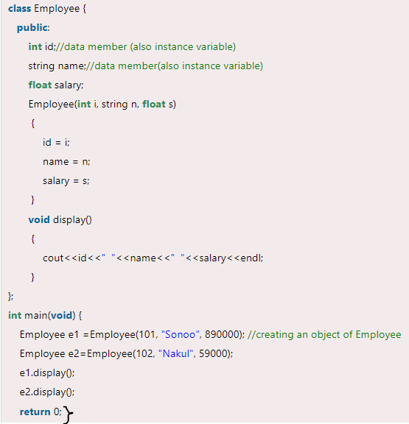

Slide 16
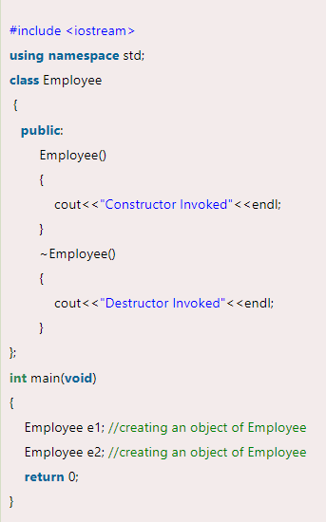

Slide 17
Empty constructor & Copy constructor
Empty constructor
The default constructor with no parameters when an object is created
Do nothing: e.g. Examp::Examp(){}
Copy constructor
Copy an object (shallow copy)
The default constructor when an object is copied (call by value, return an object, initialized to be the copy of another object)

Slide 18
Creating and Using a Copy Constructor
By default when a assign an object to another object or initialize a new object by an existing object, a bitwise copy is performed.
This cause problems when the objects contain pointer to dynamically allocated memory and destructors are used to free that memory.
It causes the same memory to be released multiple times that causes the program to crash.

Slide 19
Copy constructors are used to solve this problem while we perform object initialization with another object of the same class.
MyClass ob1;
MyClass ob2 = ob1; // uses copy constructor
Copy constructors do not affect assignment operations.
MyClass ob1, ob2;
ob2 = ob1; // does not use copy constructor

Slide 20
Creating and Using a Copy Constructor (contd.)
If we do not write our own copy constructor, then the compiler supplies a copy constructor that simply performs bitwise copy.
We can write our own copy constructor to dictate precisely how members of two objects should be copied.
The most common form of copy constructor is
classname (const classname &obj) {
// body of constructor
}

Slide 21
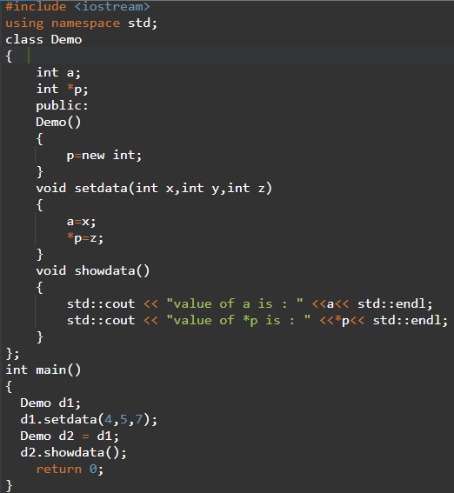
Shallow Copy

Slide 22
Deep Copy
Demo(Demo &d)
{
a = d.a;
p = new int;
*p = *(d.p);
}

Slide 23
Inheritance
Base class
Derived class
class derived-class-name : access base-class-name { … };
Here access is one of three keywords
public
private
protected
Use of access is optional
It is private by default if the derived class is a class
It is public by default if the derived class is a struct

Slide 24
Multiple Inheritance (contd.)
b1
b1
b2
b3
d2
d3
d1
b1d2d1
Option - 1
Option - 2

Slide 25
Inheritance
base
derived
Public inheritance
public
public
protected
protected
private
N/A
Private inheritance
public
private
protected
private
private
N/A
Protected
inheritance
public
protected
protected
protected
private
N/A

Slide 26
Static members in class
Static variables
Shared by all objects
Static functions
Have access to static members only
Static members can be accessed by the class name
Friend functions / Friend Class
Have access to the private members of a class.
Must be declared as friend in that class.
Why friend functions?
Efficiency
A class can be declared as the friend of another class.

Slide 27
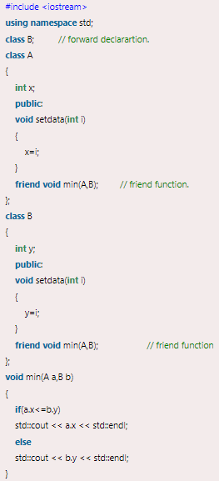

Slide 28
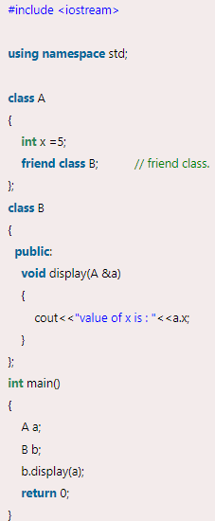
Friend Class

Slide 29
Function overloading
Define several functions of the same name, differ by parameters.
void Show()
void Show(char *str)
Void Show(int x)

Slide 30
Function overloading
Must have different parameters
int func1(int a, int b);
double func1(int a, int b);
void func(int value);
void func(int &value);
Static binding
The compilers determine which function is called.
(Often used for the multiple constructors)

Slide 31
Overloading summary
Same name
Different parameters
Static binding (compile time)
Anywhere

Slide 32
Important Point on Inheritance
In C++, only public inheritance supports the perfect IS-A relationship.
In case of private and protected inheritance, we cannot treat a derived class object in the same way as a base class object
If we use private or protected inheritance, we cannot assign the address of a derived class object to a base class pointer directly.
This is one of the reason for which Java only supports public inheritance.

Slide 33
Overloading & overriding
Polymorphism
Static and dynamic
Compile time and running time
Parameters
Anywhere / between the base and derived class

Slide 34
Operator Overloading
Redefine or overload most of the built-in operators available in C++
Overloaded operators are functions with special names
keyword "operator" followed by the symbol operator
an overloaded operator has a return type and a parameter list.

Slide 35
Operator Overloading Syntax
Box Box::operator+(const Box&);
return type
Scope of
Box class
‘+’ operator
overloaded
Reference of the object passed
But can not altered inside the function
declares the addition operator for the Box class that can be used to add two Box objects and returns final Box object.

Slide 36
Example
double Box::getVolume(void) {
return length * breadth * height;
}
void Box::setLength( double len ) {
length = len;
}
void Box:: setBreadth( double bre ) {
breadth = bre;
}
void Box:: setHeight( double hei ) {
height = hei;
}
Box Box:: operator+(const Box& b) {
Box box;
box.length = this->length + b.length;
box.breadth = this->breadth + b.breadth;
box.height = this->height + b.height;
return box;
}
class Box {
public:
double getVolume(void);
void setLength( double );
void setBreadth( double );
void setHeight( double );
Box operator+(const Box& );
private:
double length;
double breadth;
double height;
};

Slide 37
Example
int main() {
Box Box1;
Box Box2;
Box Box3;
double volume = 0.0;
Box1.setLength(6.0);
Box1.setBreadth(7.0);
Box1.setHeight(5.0);
Box2.setLength(12.0);
Box2.setBreadth(13.0);
Box2.setHeight(10.0);
volume = Box1.getVolume();
cout << "Volume of Box1 : " << volume <<endl;
volume = Box2.getVolume();
cout << "Volume of Box2 : " << volume <<endl;
Box3 = Box1 + Box2;
volume = Box3.getVolume();
cout << "Volume of Box3 : " << volume <<endl;
return 0;
}
Output
Volume of Box1 : 210
Volume of Box2 : 1560
Volume of Box3 : 5400

