Slide 1
Lecture 05 Analysis of Algorithms
CSE225: Data Structures and Algorithms

Slide 2
Analysis of Algorithms
An algorithm is a finite set of precise instructions for performing a computation or for solving a problem.
It must produce the correct result
It must finish in some finite time
You can represent an algorithm using pseudocode, flowchart, or even actual code

Slide 3
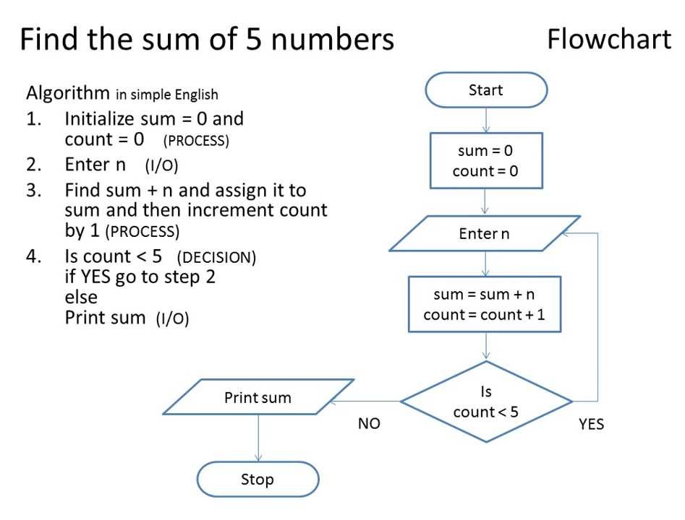
Analysis of Algorithms

Slide 4
Analysis of Algorithms
What does it mean to analyze an algorithm?
To have an estimate about how much time an algorithm may take to finish, or in other words, to analyze its running time
Sometimes, instead of running time, we are interested in how much memory the algorithm may consume while it runs
It enables us to compare between two algorithms
What do we mean by running time analysis?
Also referred to as time-complexity analysis
To determine how running time increases as the size of the problem increases.

Slide 5
Analysis of Algorithms
Size of the problem can be a range of things, including
size of an array
polynomial degree of an equation
number of elements in a matrix
number of bits in the binary representation of the input
.
.
and so on…

Slide 6
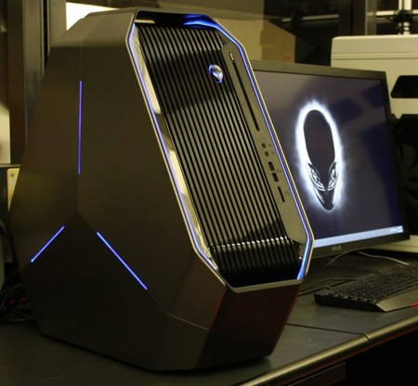
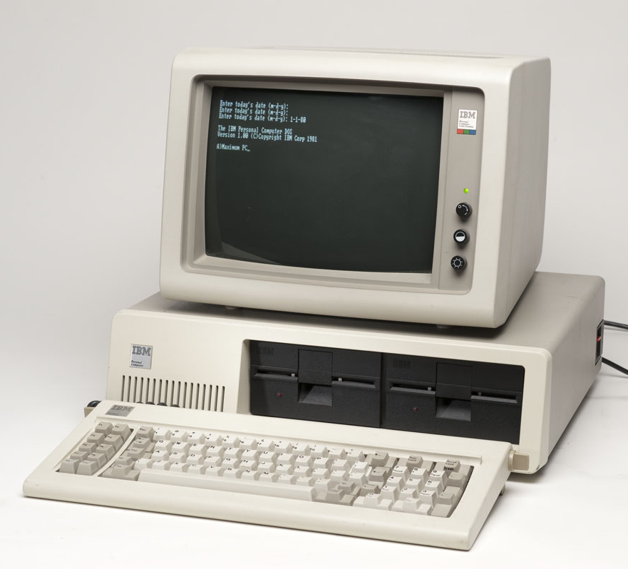
How Do We Analyze Running Time?
We need to define an objective measure.
(1) Compare execution times?
Not good: times are specific to a particular computer !!

Slide 7
How Do We Analyze Running Time?
We need to define an objective measure.
(2) Count the number of statements executed?
Associate a "cost" with each statement.
Find the "total cost“ by finding the total number of times each statement is executed.
Not good: number of statements vary with the programming language as well as the style of the individual programmer.
Algorithm 1
Time
arr[0] = 0; c₁
arr[1] = 0; c₁
arr[2] = 0; c₁
...
arr[N-1] = 0; c₁
----------------------c₁+c₁+...+c₁ = c₁N
Algorithm 2
Time
for(i=0; i<N; i++) c₁+c₂(N+1)+ c₃N
arr[i] = 0; c₁N
-----------------------------
c₁+c₂(N+1)+c₃N+c₁N = (c₁+c₂+c₃)N+(c₁+c₂)
c₁
c₂
c₃

Slide 8
Ideal Solution
Express running time as a function of the input size n (i.e., f(n)).
Compare different functions of running times in an asymptotic manner.
Such an analysis is independent of machine type, programming style, etc.

Slide 9
Visualizing Orders of Growth
On a graph, as you go to the right, a faster growing function eventually becomes larger.
f_{A}(n)=30n+8
Running time→
f_{B}(n)=n²+1
Increasing n →

Slide 10
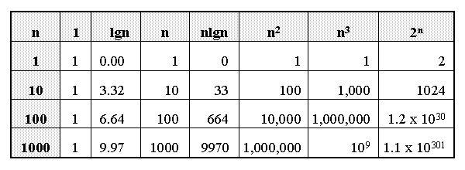
Growth of Functions

Slide 11
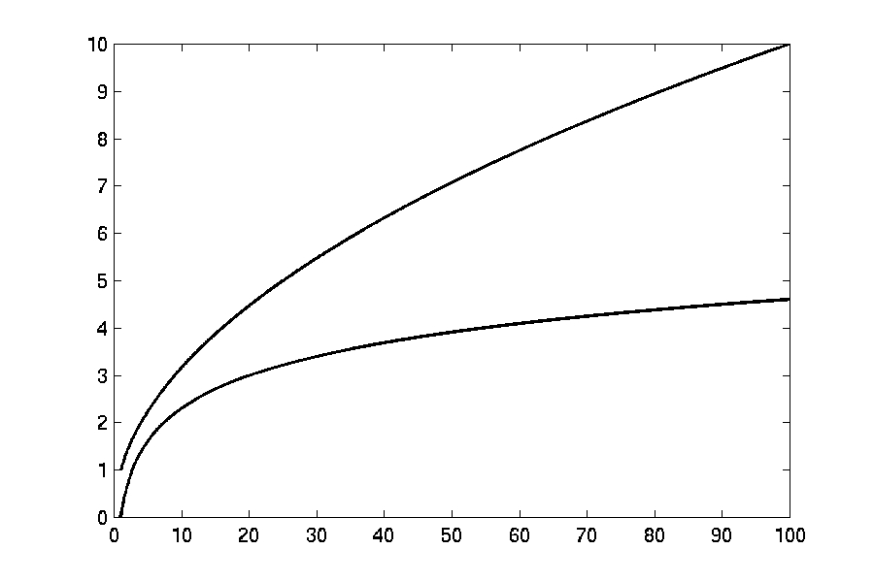
Complexity Graphs
log(n)

Slide 12
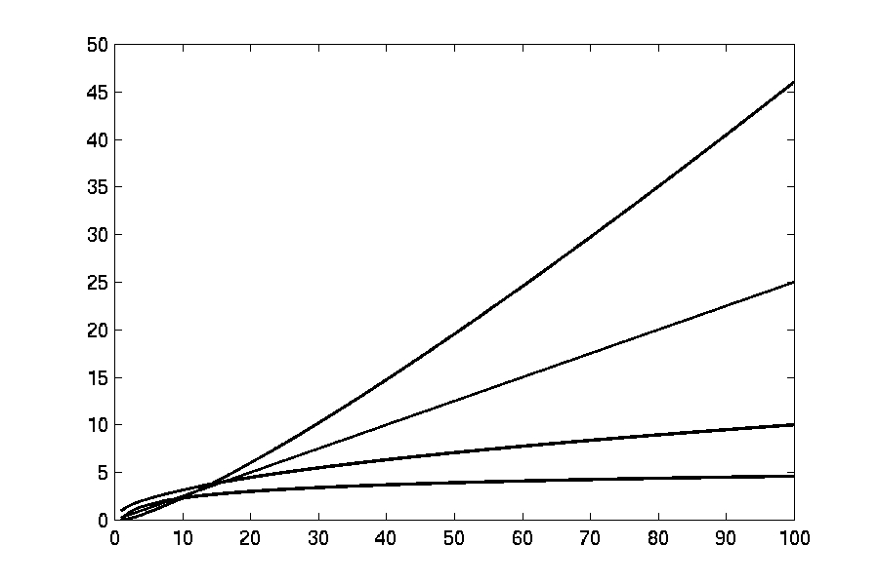
Complexity Graphs
n log(n)
n
log(n)

Slide 13
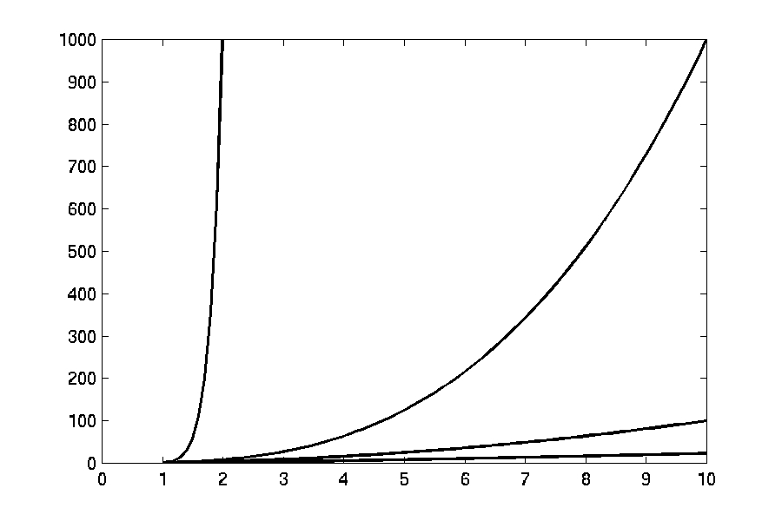
Complexity Graphs
n¹⁰
n³
n²
n log(n)

Slide 14
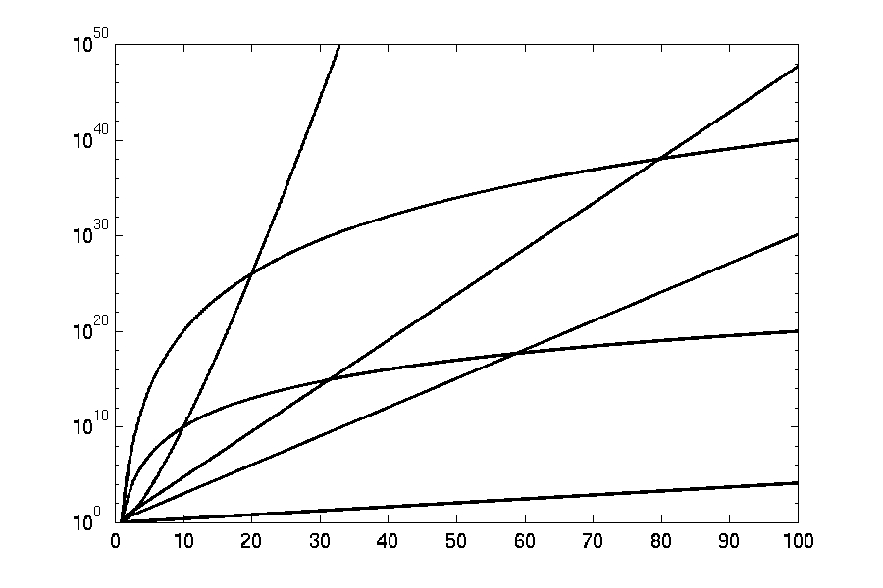
Complexity Graphs (log scale)
3^{n}
n^{n}
n²⁰
2^{n}
n¹⁰
1.1^{n}

Slide 15

Types of Analysis
Is input size everything that matters?
int find_a(char *str)
{
int i;
for (i = 0; str[i]; i++)
{
if (str[i] == ’a’)
return i;
}
return -1;
}
Time complexity: $O(n)$
Consider two inputs: “alibi” and “never”

Slide 16
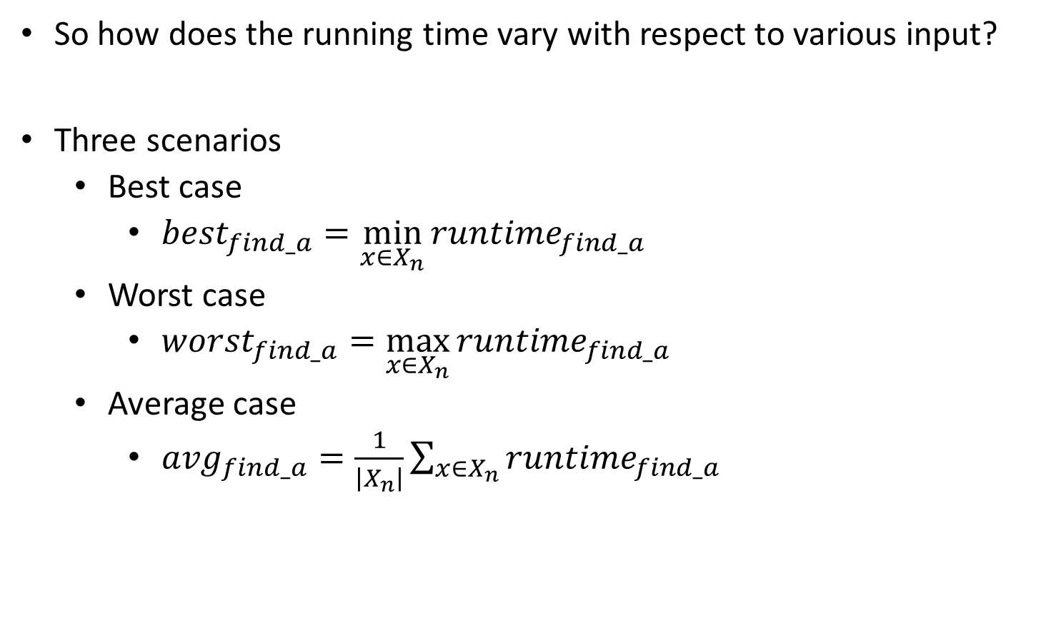
Types of Analysis
So how does the running time vary with respect to various input?
Three scenarios
Best case
${best}_{find_a}=\min_{x∈X_{n}}{{runtime}_{find_a}}$
Worst case
${worst}_{find_a}=\max_{x∈X_{n}}{{runtime}_{find_a}}$
Average case
${avg}_{find_a}=\frac{1}{\left|X_{n}\right|}{\sum_{x∈X_{n}}{{runtime}_{find_a}}}$

Slide 17
Types of Analysis
Worst-case: (usually done)
upper bound on running time
maximum running time of algorithm on any input of size n
Average-case: (sometimes done)
we take all possible inputs and calculate computing time for all of the inputs
sum all the calculated values and divide the sum by total number of inputs
we must know (or predict) distribution of cases
Best-case: (bogus)
lower bound on running time of an algorithm
minimum running time of algorithm on any input of size n

Slide 18
Asymptotic Upper Bound
Asymptotically bounds the growth of a running time for large values of n to within constant factors above, or in other words, “the running time grows at most this much, but it could grow more slowly”
A means to compare two algorithms with running times f(n) and g(n), we can establish a rough measure that characterizes how fast each function grows.
Compare functions in the limit, that is, asymptotically!

Slide 19
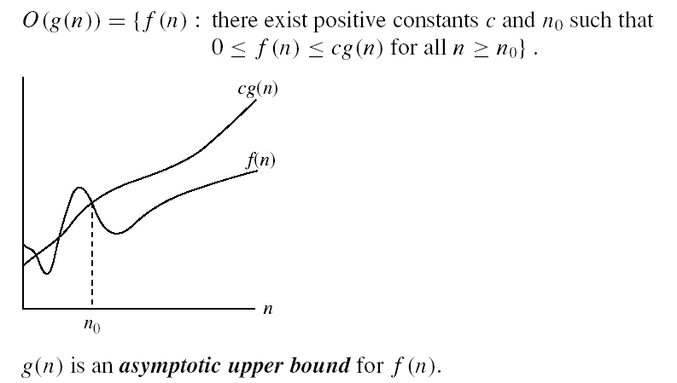
Asymptotic Upper Bound
O-notation
O(g(n)) is the set of functions with smaller or same order of growth as g(n)

Slide 20
Asymptotic Upper Bound
Example:
Show that f(x) = x² + 2x + 1 is O(x²).
For x > 1 we have:
x² + 2x + 1 ≤ x² + 2x² + x²
⇒ x² + 2x + 1 ≤ 4x²
Therefore, for C = 4 and k = 1:
f(x) ≤ Cx² whenever x > k.
⇒ f(x) is O(x²).

Slide 21
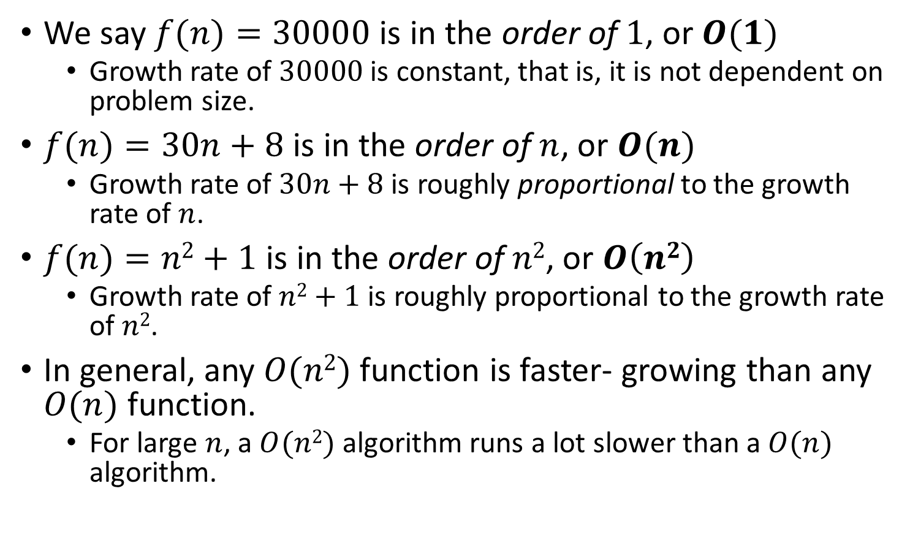
Asymptotic Upper Bound
We say $f(n)=30000$ is in the order of $1$, or $O(1)$
Growth rate of $30000$ is constant, that is, it is not dependent on problem size.
$f(n)=30n+8$ is in the order of $n$, or $O(n)$
Growth rate of $30n+8$ is roughly proportional to the growth rate of $n$.
$f(n)=n2+1$ is in the order of $n2$, or $O\left(n2\right)$
Growth rate of $n2+1$ is roughly proportional to the growth rate of $n2$.
In general, any $O(n2)$ function is faster- growing than any $O(n)$ function.
For large $n$, a $O(n2)$ algorithm runs a lot slower than a $O(n)$ algorithm.

Slide 22
Asymptotic Upper Bound
Consider the example of buying elephants and goldfish:
Cost: cost_of_elephants + cost_of_goldfish
Cost ~ cost_of_elephants (approximation)
Easier way: Discard the low order terms, as well as constants in a function since they are relatively insignificant for large n
6n + 4 ~ n
n⁴ + 100n² + 10n + 50 ~ n⁴
i.e., we say that n⁴ + 100n² + 10n + 50 and n⁴ have the same rate of growth

Slide 23
Some Examples
Determine the time complexity for the following algorithm.
count = 0;
for(i=0; i<10000; i++)
count++;

Slide 24

Some Examples
Determine the time complexity for the following algorithm.
count = 0;
for(i=0; i<10000; i++)
count++;
$$O(1)$$

Slide 25
Some Examples
Determine the time complexity for the following algorithm.
count = 0;
for(i=0; i<N; i++)
count++;

Slide 26

Some Examples
Determine the time complexity for the following algorithm.
count = 0;
for(i=0; i<N; i++)
count++;
$$O(n)$$

Slide 27
Some Examples
Determine the time complexity for the following algorithm.
sum = 0;
for(i=0; i<N; i++)
for(j=0; j<N; j++)
sum += arr[i][j];

Slide 28

Some Examples
Determine the time complexity for the following algorithm.
sum = 0;
for(i=0; i<N; i++)
for(j=0; j<N; j++)
sum += arr[i][j];
$$O(n2)$$

Slide 29
Some Examples
Determine the time complexity for the following algorithm.
count = 0;
for(i=1; i<N; i=i*2)
count++;

Slide 30

Some Examples
Determine the time complexity for the following algorithm.
count = 0;
for(i=1; i<N; i=i*2)
count++;
$$O(\log{n})$$

Slide 31
Some Examples
Determine the time complexity for the following algorithm.
char someString[10];
gets(someString);
for(i=0; i<strlen(someString); i++)
someString[i] -= 32;

Slide 32
Some Examples
Determine the time complexity for the following algorithm.
char someString[10];
gets(someString);
for(i=0; i<strlen(someString); i++)
someString[i] -= 32;
$$O(n2)$$

