Slide 1
Circular Array

Slide 2
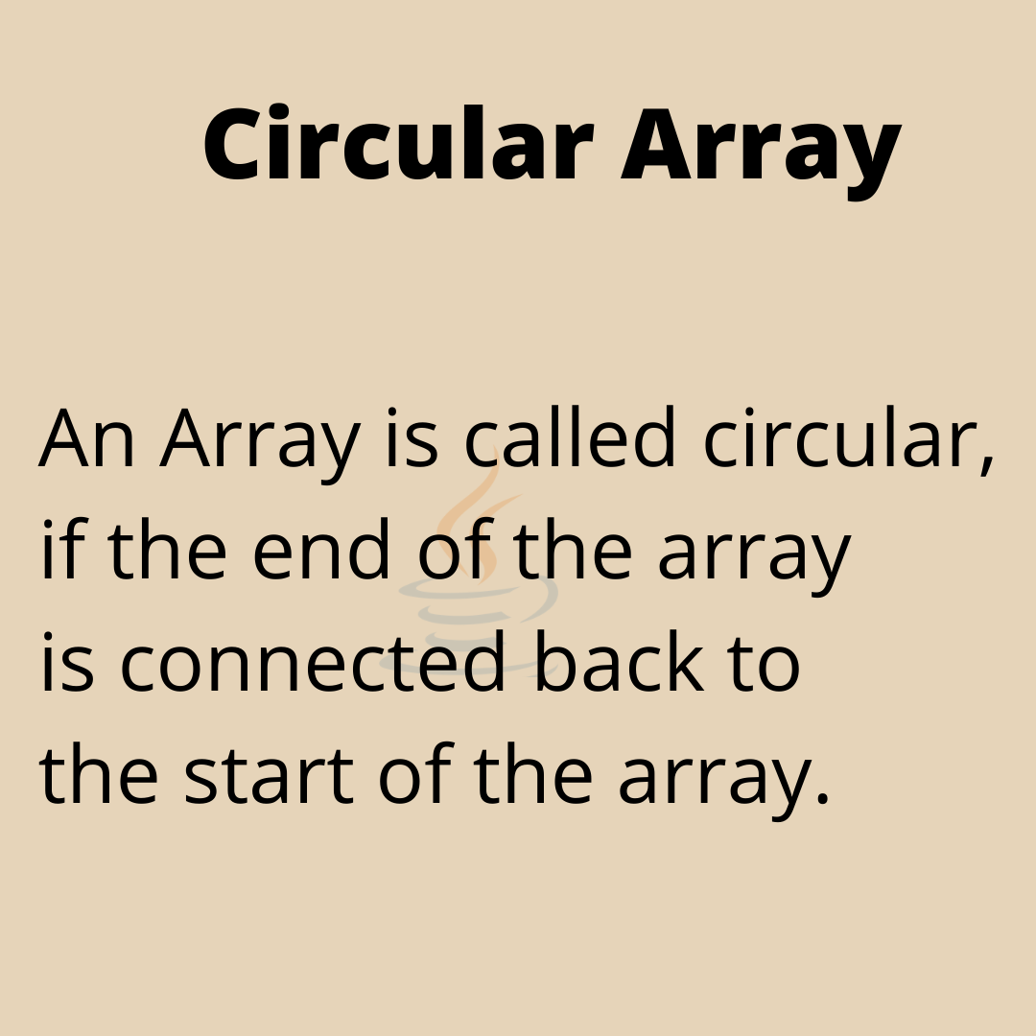

Slide 3
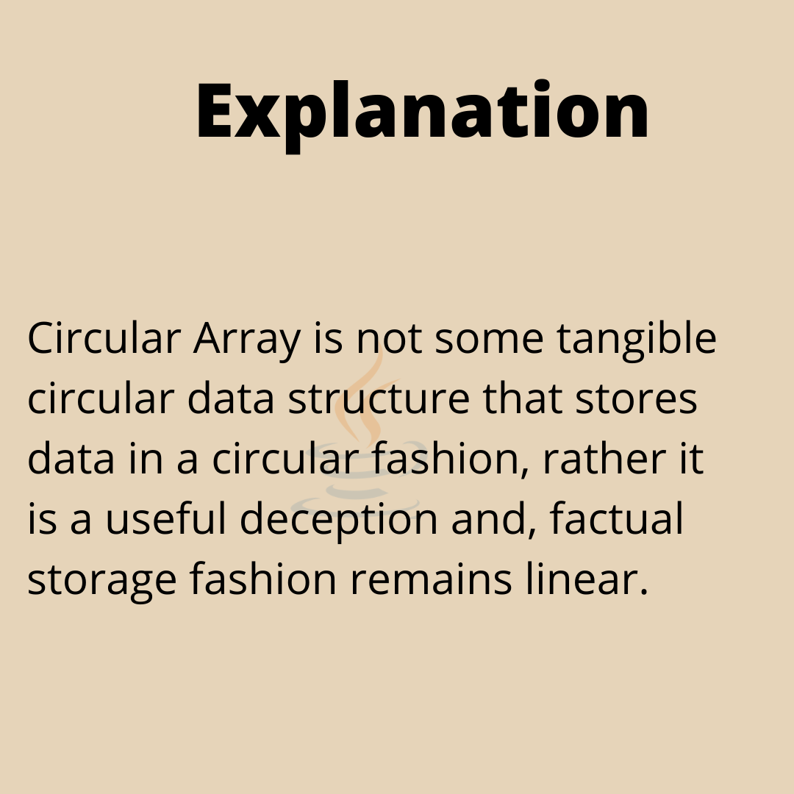

Slide 4
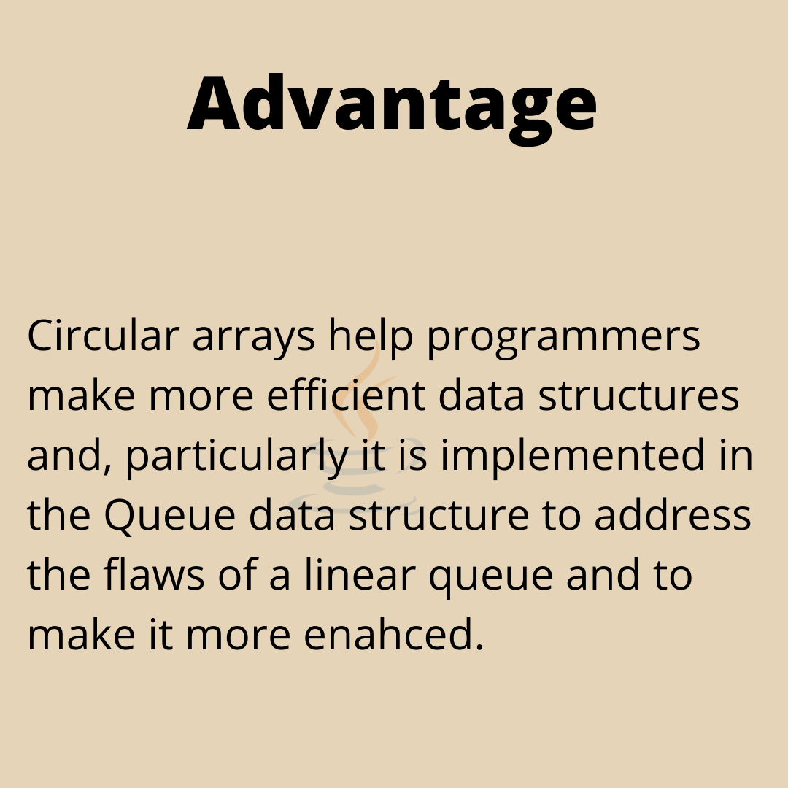

Slide 5
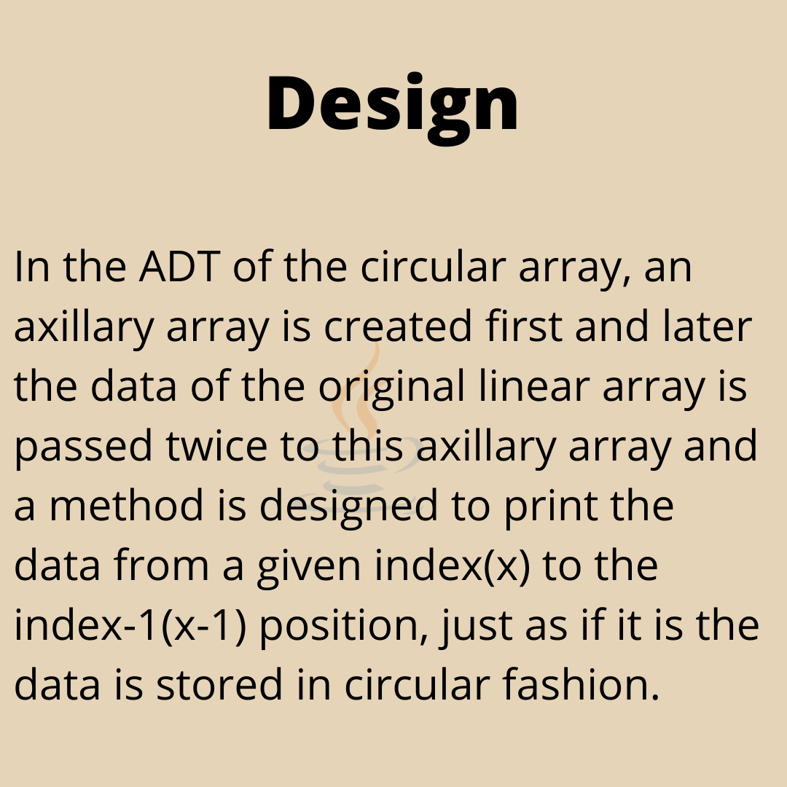

Slide 6
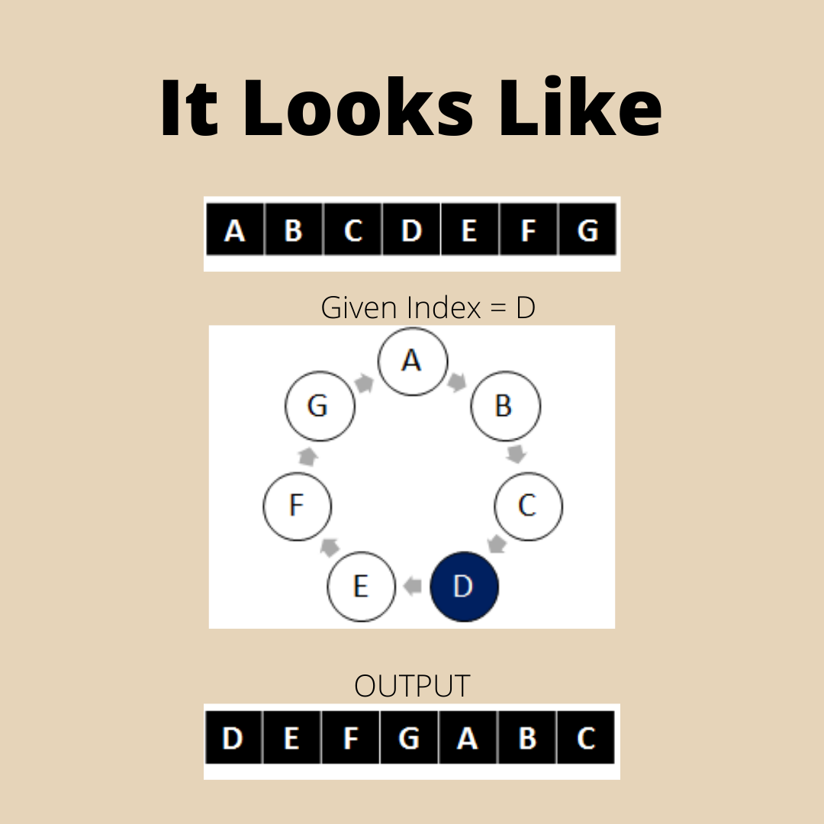

Slide 7
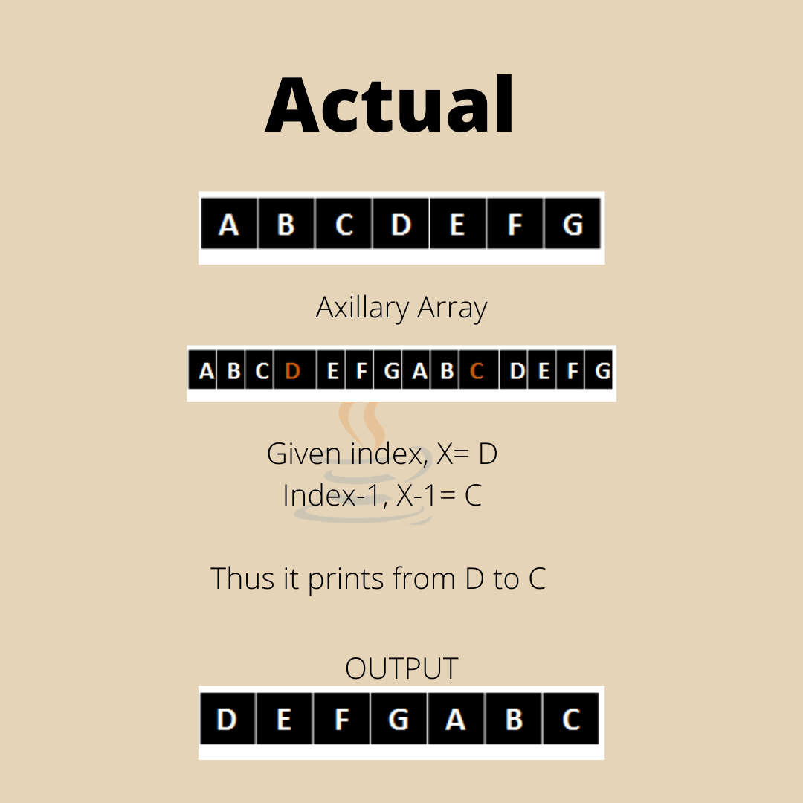

Slide 8
Codes (Non Circular Implementation)
#include <bits/stdc++.h>
using namespace std;
void print(char a[], int n, int ind)
{
// Create an auxiliary array of twice size.
char b[(2 * n)];
// Copy a[] to b[] two times
for (int i = 0; i < n; i++)
b[i] = b[n + i] = a[i];
// print from ind-th index to (n+i)th index.
for (int i = ind; i < n + ind; i++)
cout << b[i] << " ";
}
// Driver code
int main()
{
char a[] = { 'A', 'B', 'C', 'D', 'E', ‘F’, ‘G’ };
int n = sizeof(a) / sizeof(a[0]);
print(a, n, 3);
return 0;
}

Slide 9
Codes (Circular Implementation)
#include <bits/stdc++.h>
using namespace std;
// function to print circular list starting
// from given index ind.
void print(char a[], int n, int ind)
{
// print from ind-th index to (n+i)th index.
for (int i = ind; i < n + ind; i++)
cout << a[(i % n)] << " ";
}
// Driver code
int main()
{
char a[] = { 'A', 'B', 'C', 'D', 'E', ‘F’, ‘G’ };
int n = sizeof(a) / sizeof(a[0]);
print(a, n, 3);
return 0;
}

