Slide 1
CSE225: Data Structure and Algorithms
Lec: QUEUE

Slide 2
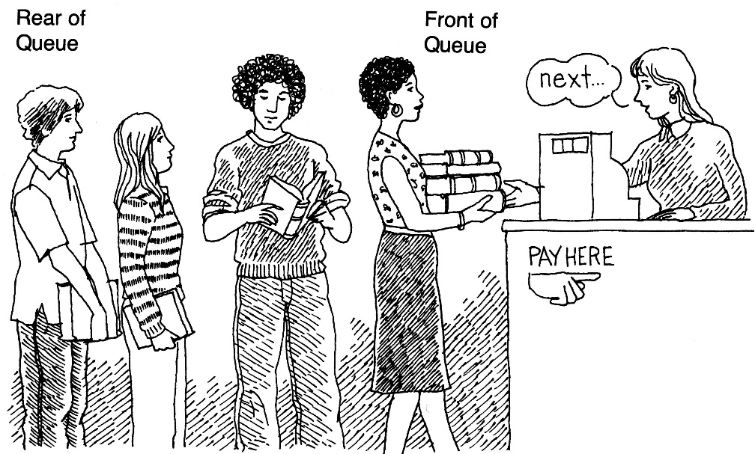
What is a queue?
It is an ordered group of homogeneous items of elements.
Queues have two ends:
Elements are added at one end.
Elements are removed from the other end.
The element added first is also removed first (FIFO: First In, First Out).

Slide 3
Specification of QueueType
Structure: | Elements are added to the rear and removed from the front of the queue.
Definitions (provided by user):
MAX_ITEMS | Maximum number of items that might be on the queue.
ItemType | Data type of the items on the queue.
Operations (provided by the ADT):
MakeEmpty
Function | Sets queueto an empty state.
Postcondition | queueis empty.
Boolean IsEmpty
Function | Determines whether the queue is empty.
Precondition | queuehas been initialized.
Postcondition | Returns true if queueis empty and false otherwise.
Boolean IsFull
Function | Determines whether the queue is full.
Precondition | Queue has been initialized.
Postcondition | Returns true if queue is full and false otherwise.

Slide 4
Specification of QueueType
Enqueue(ItemType newItem)
Function | Adds newItem to the rear of the queue.
Precondition | Queue has been initialized.
Postcondition | If (queue is full), FullQueue exception is thrown, else newItem is at rear of queue.
Dequeue(ItemType& item)
Function | Removes front item from the queue and returns it in item.
Precondition | Queue has been initialized.
Postcondition | If (queue is empty), EmptyQueue exception is thrown and item is undefined, else front element has been removed from queue and item is a copy of removed element.

Slide 5
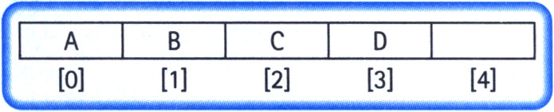
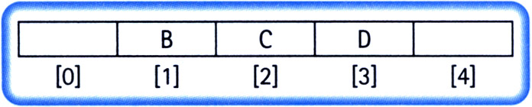
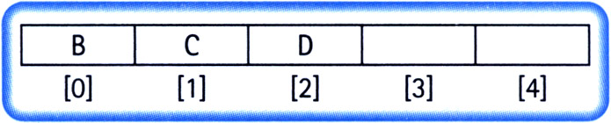
Implementation Issues
Always insert elements at the back of the array.
Complexity of deletion: O(N)

Slide 6
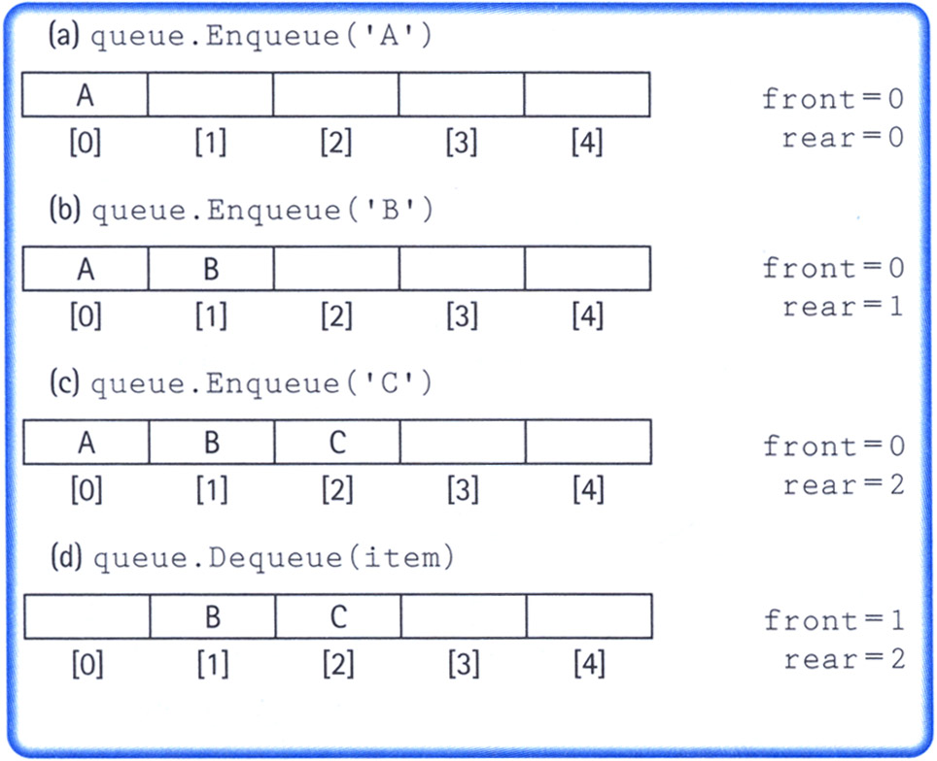
Implementation Issues
Maintain two indices: front and rear
Increment the indices as additions and deletions are performed (rear++ for addition and front++ for deletion)
Dead space

Slide 7
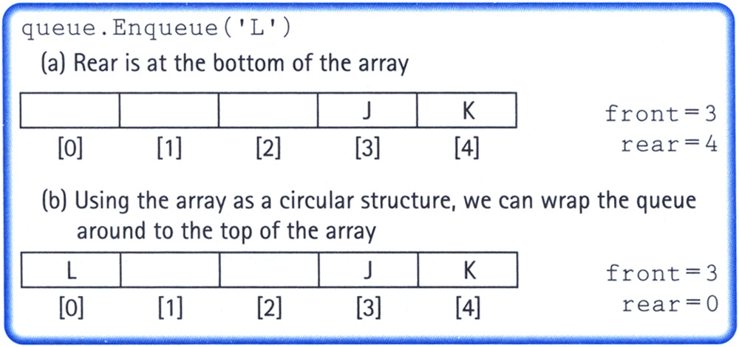
Implementation Issues
Maintain two indices: front and rear
Make the indices “wrap around” when they reach the end of the array
rear = (rear + 1) % maxQue; //maxQue=size of array
front = (front + 1) % maxQue;

Slide 8
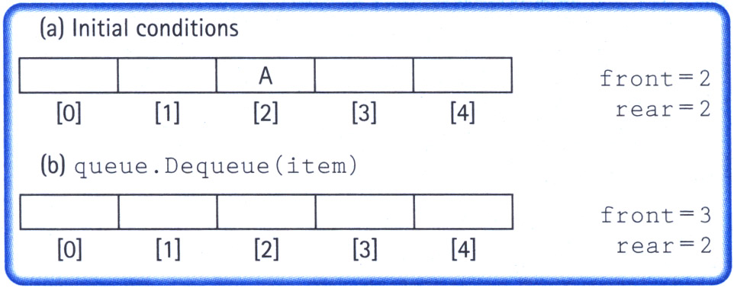
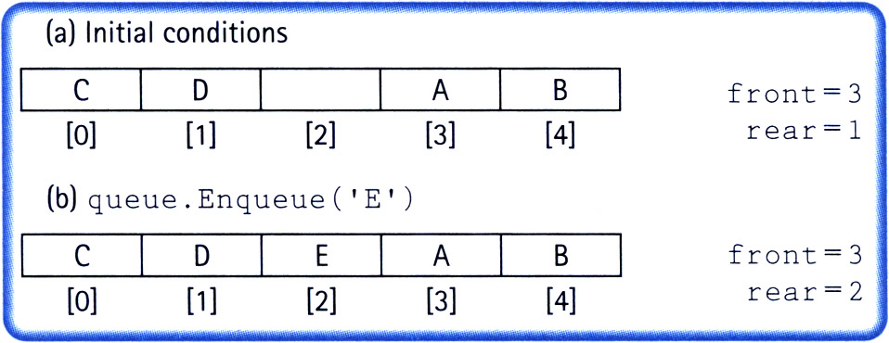
Implementation Issues
How do we differentiate between the empty state and the full state?

Slide 9
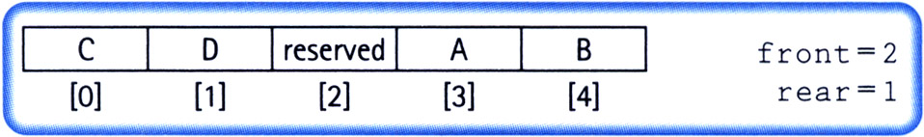
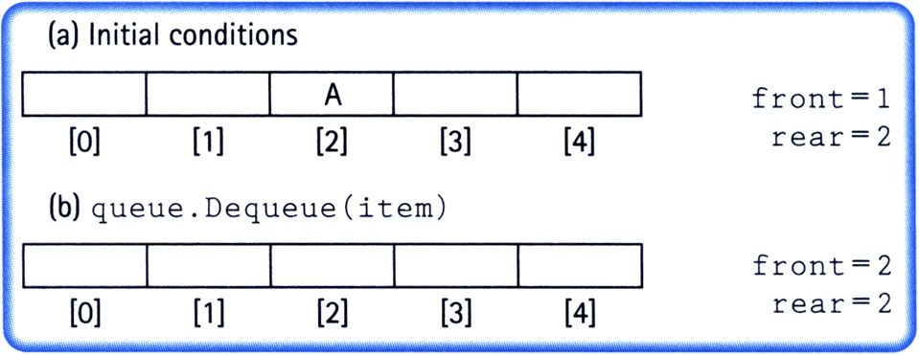
Implementation Issues
Let front indicate the index of the array slot preceding the front element.
The array slot preceding the front element is reserved and items are not assigned in that slot.

Slide 10
Implementation Issues
Full queue when (rear + 1) % maxQue == front
Empty queue when front == rear

Slide 11
Queue Implementation
template<class ItemType>
class QueueType {
public:
QueueType(int);
QueueType();
~QueueType();
void MakeEmpty();
bool IsEmpty() const;
bool IsFull() const;
void Enqueue(ItemType);
void Dequeue(ItemType&);
private:
int front;
int rear;
ItemType* items;
int maxQue;
};

Slide 12
Queue Implementation (cont.)
template<class ItemType>
QueueType<ItemType>::QueueType(int max)
{
maxQue = max + 1;
front = maxQue - 1;
rear = maxQue - 1;
items = new ItemType[maxQue];
}

Slide 13
Queue Implementation (cont.)
template<class ItemType>
QueueType<ItemType>::~QueueType()
{
delete [] items;
}

Slide 14
Queue Implementation (cont.)
template<class ItemType>
void QueueType<ItemType>:: MakeEmpty()
{
front = maxQue - 1;
rear = maxQue - 1;
}

Slide 15
Queue Implementation (cont.)
template<class ItemType>
bool QueueType<ItemType>::IsEmpty() const
{
return (rear == front);
}
template<class ItemType>
bool QueueType<ItemType>::IsFull() const
{
return ( (rear + 1) % maxQue == front);
}

Slide 16
Queue Implementation (cont.)
template<class ItemType>
void QueueType<ItemType>::Enqueue (ItemType newItem)
{
rear = (rear + 1) % maxQue;
items[rear] = newItem;
}

Slide 17
Queue Implementation (cont.)
template<class ItemType>
void QueueType<ItemType>::Dequeue (ItemType& item)
{
front = (front + 1) % maxQue;
item = items[front];
}

Slide 18
Queue overflow
The condition resulting from trying to add an element onto a full queue.
if(!q.IsFull())
q.Enqueue(item);

Slide 19
Queue underflow
The condition resulting from trying to remove an element from an empty queue.
if(!q.IsEmpty())
q.Dequeue(item);

Slide 20
Applications of Queue Data Structure
Queue is used when things don’t have to be processed immediately, but have to be processed in First In First Out order like Breadth First Search. This property of Queue makes it also useful in following kind of scenarios.
When a resource is shared among multiple consumers. Examples include CPU scheduling, Disk Scheduling.
When data is transferred asynchronously (data not necessarily received at same rate as sent) between two processes. Examples include IO Buffers, pipes, file IO, etc.)

Slide 21
Dynamic ADT QUEUE
A queue can be implemented for
Abstract data type (using template)
Dynamic sizing (using pointers)
the slides next present the implementation code

Slide 22
Queue ADT Operations
MakeEmpty -- Sets queue to an empty state.
IsEmpty -- Determines whether the queue is currently empty.
IsFull -- Determines whether the queue is currently full.
Enqueue (ItemType newItem) -- Adds newItem to the rear of the queue.
Dequeue (ItemType& item) -- Removes the item at the front of the queue and returns it in item.
22

Slide 23
ADT Queue Operations
Transformers
MakeEmpty
Enqueue
Dequeue
Observers
IsEmpty
IsFull
change state
observe state
23

Slide 24
DYNAMIC ARRAY IMPLEMENTATION
class QueType
QueType
Private Data:
front 1
rear 4
maxQue 5
items
~QueType
Enqueue
RESERVED
‘C’ ‘X’ ‘J’
Dequeue
.
.
.
items [0] [1] [2] [3] [4]

Slide 25
//--------------------------------------------------------
// CLASS TEMPLATE DEFINITION FOR CIRCULAR QUEUE
#include "ItemType.h" // for ItemType
template<class ItemType>
class QueType {
public:
QueType( );
QueType( int max ); // PARAMETERIZED CONSTRUCTOR
~QueType( ) ; // DESTRUCTOR
. . .
bool IsFull( ) const;
void Enqueue( ItemType item );
void Dequeue( ItemType& item );
private:
int front;
int rear;
int maxQue;
ItemType* items; // DYNAMIC ARRAY IMPLEMENTATION
};
25

Slide 26
//--------------------------------------------------------
// CLASS TEMPLATE DEFINITION FOR CIRCULAR QUEUE cont’d
//--------------------------------------------------------
template<class ItemType>
QueType<ItemType>::QueType( int max ) // PARAMETERIZED
{
maxQue = max + 1;
front = maxQue - 1;
rear = maxQue - 1;
items = new ItemType[maxQue]; // dynamically allocates
}
template<class ItemType>
bool QueType<ItemType>::IsEmpty( )
{
return ( rear == front )
}
26

Slide 27
//--------------------------------------------------------
// CLASS TEMPLATE DEFINITION FOR CIRCULAR QUEUE cont’d
//--------------------------------------------------------
template<class ItemType>
QueType<ItemType>::~QueType( )
{
delete [ ] items; // deallocates array
}
.
.
.
template<class ItemType>
bool QueType<ItemType>::IsFull( )
{ // WRAP AROUND
return ( (rear + 1) % maxQue == front )
}
27

Slide 28
Example: recognizing palindromes
A palindrome is a string that reads the same forward and backward.
Able was I ere I saw Elba
We will read the line of text into both a stack and a queue.
Compare the contents of the stack and the queue character-by-character to see if they would produce the same string of characters.

Slide 29
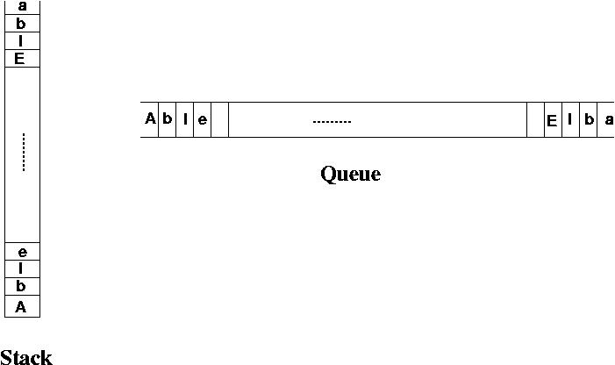
Example: recognizing palindromes

Slide 30
Example: recognizing palindromes
#include <iostream.h>
#include <ctype.h>
#include "stack.h"
#include "queue.h“
int main()
{
StackType<char> s;
QueType<char> q;
char ch;
char sItem, qItem;
int mismatches = 0;
cout << "Enter string: " << endl;
while(cin.peek() != '\\n') {
cin >> ch;
if(isalpha(ch)) {
if(!s.IsFull())
s.Push(toupper(ch));
if(!q.IsFull())
q.Enqueue(toupper(ch));
}
}

Slide 31
Example: recognizing palindromes
while( (!q.IsEmpty()) && (!s.IsEmpty()) ) {
s.Pop(sItem);
q.Dequeue(qItem);
if(sItem != qItem)
++mismatches;
}
if (mismatches == 0)
cout << "That is a palindrome" << endl;
else
cout << That is not a palindrome" << endl;
return 0;
}

