Slide 1
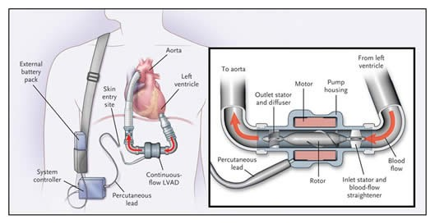
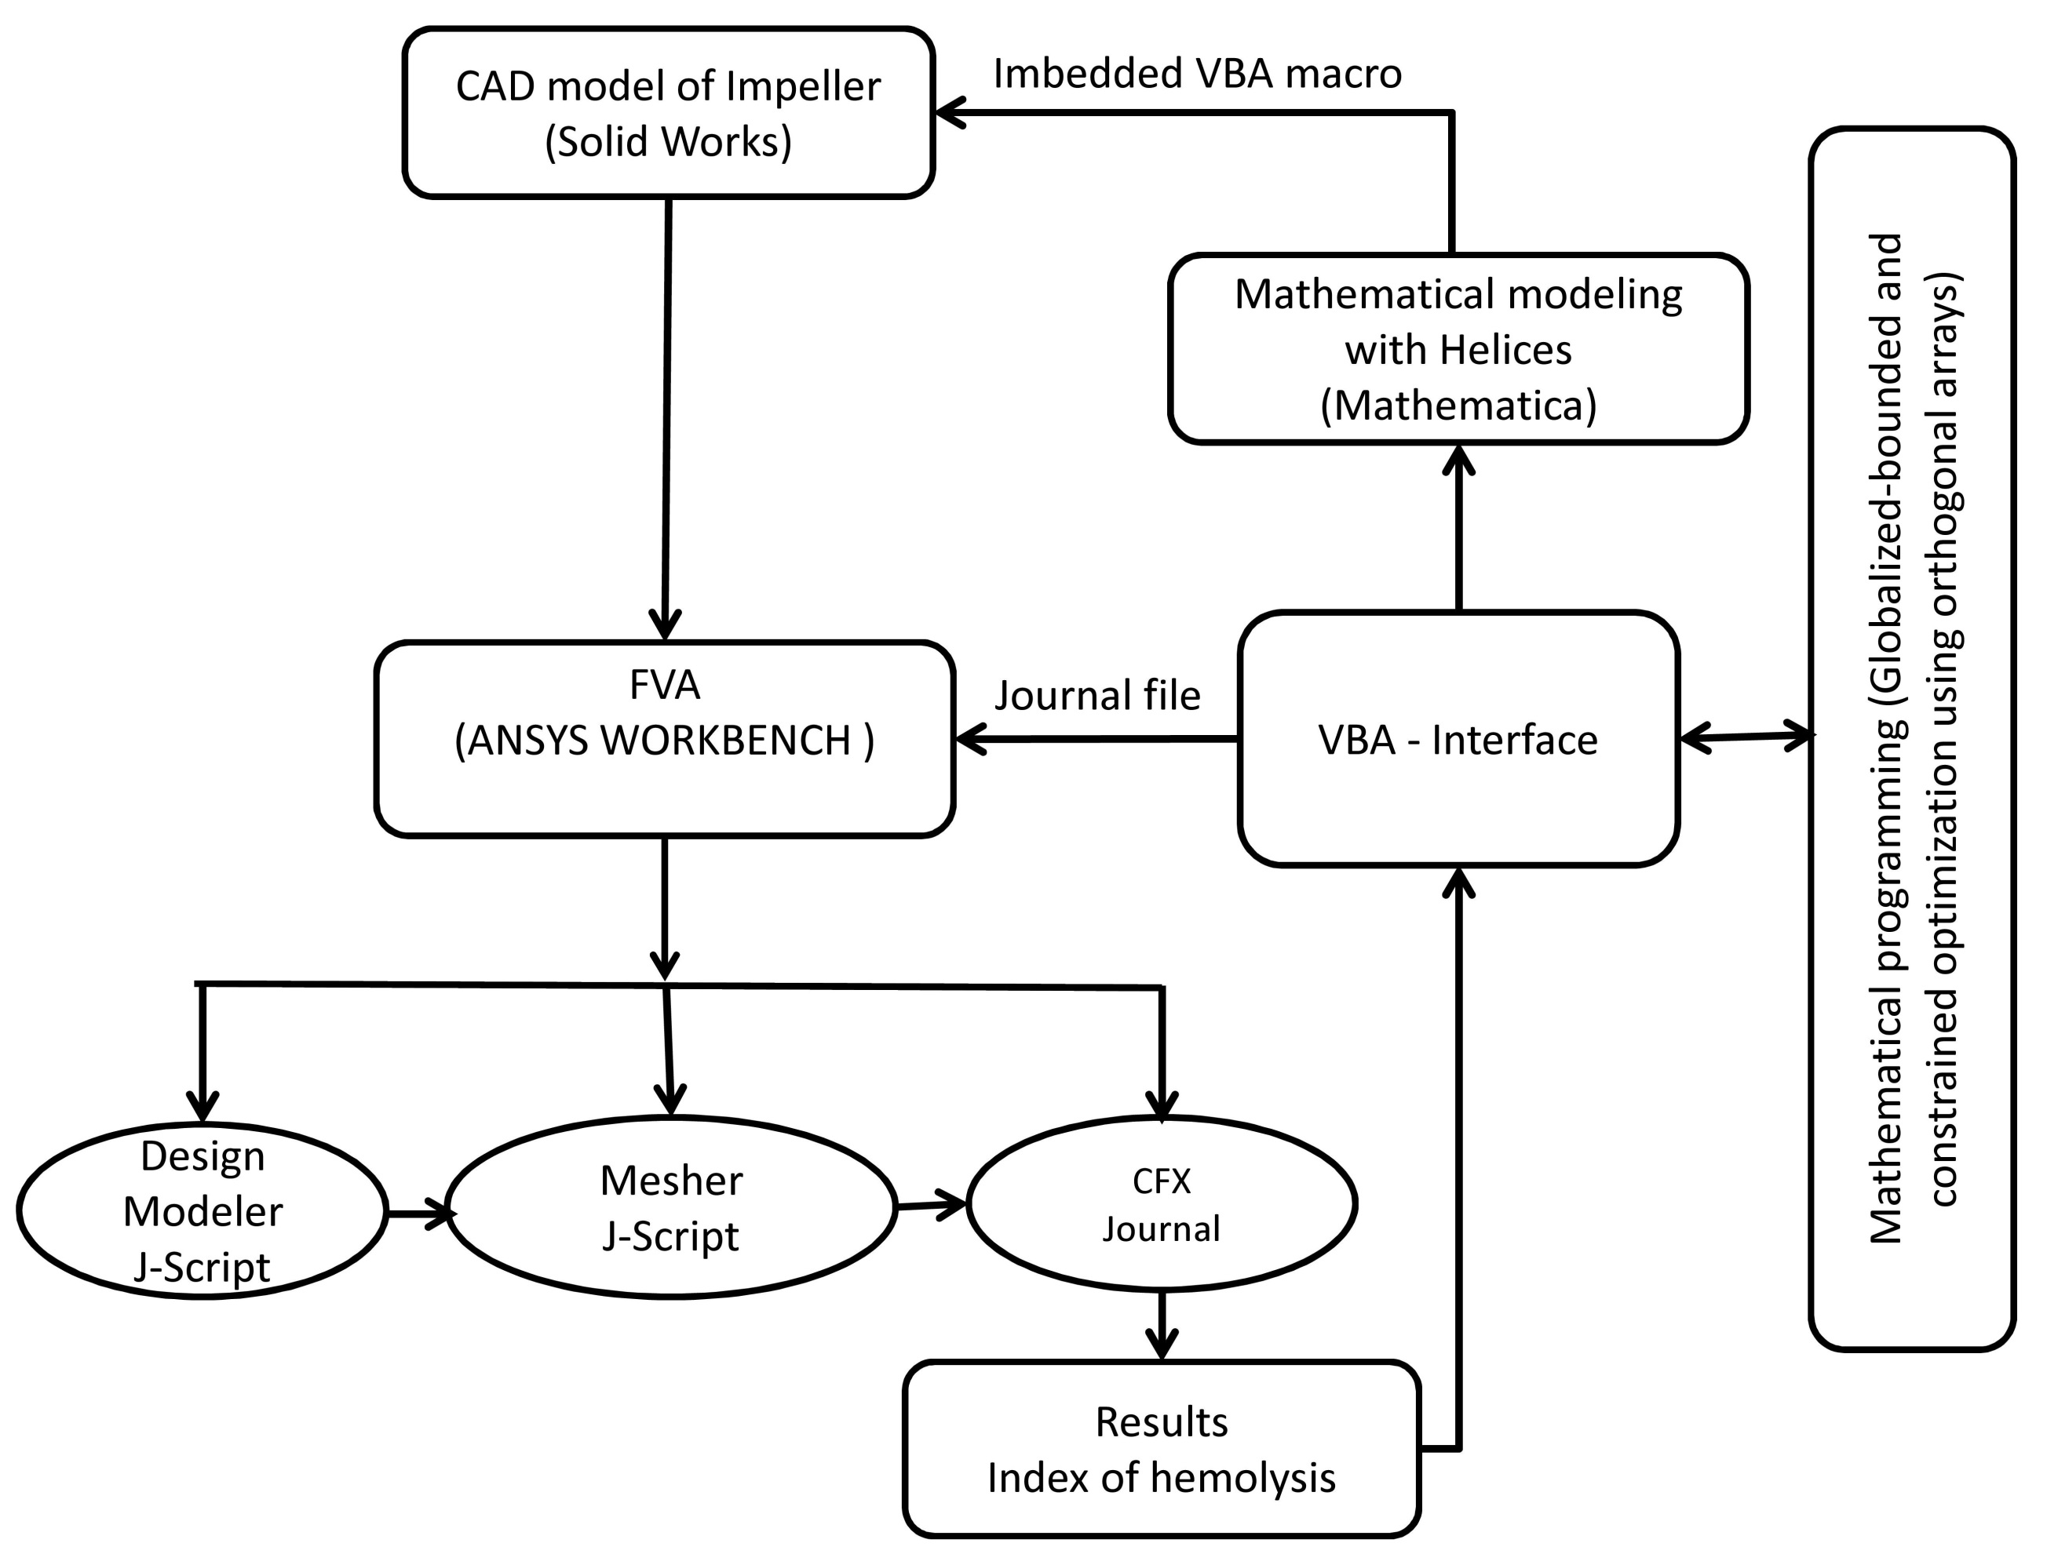
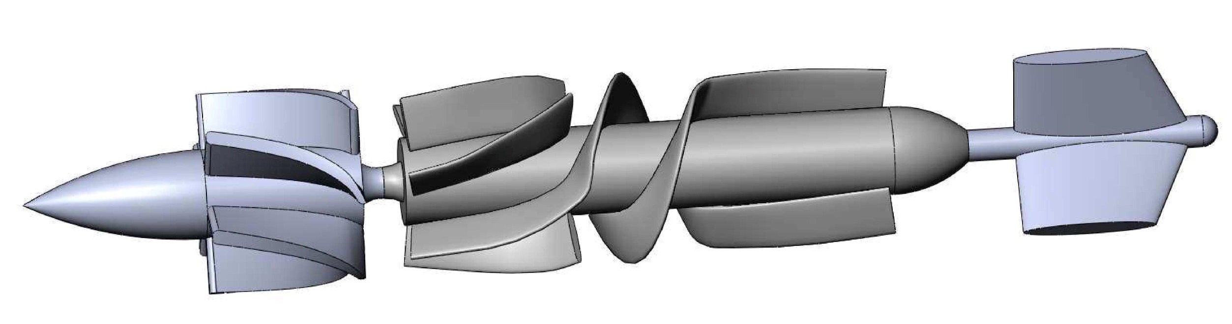
Minimizing Hemolysis in Ventricular Assist Device
Mohamat Eirban Ali Bin Kaja Najumudeen and Abdellah Ait Moussa Department of Engineering and Physics, University of Central Oklahoma, 100 North University Drive, Edmond, OK 73034
Tel: (405) 974-5293 Fax: (405) 974-3812 Email: aaitmoussa@uco.edu
Summary
Objectives
Modeling and optimization of the VAD
Heart failure (HF) affects more than 6 million patients in the US alone and in 2006, HF contributed to almost 300,000 deaths. The fatality rate for HF is high, with one in five people dying within 1 year and fewer than 60% surviving 5 years. The estimated direct and indirect cost of HF in the United States for 2010 was $39.2 billion, and by 2030 this number is estimated to reach $97 billion. For many patients with cardiovascular disease, mechanical circulatory support devices such as ventricular assist devices (VADs) are one of the very few available surviving tools, however there are still a number of associated challenges to overcome, in particular excessive Hemolysis owing to the exposure of blood cells to high shear stress rates that cause the tearing of red blood cell membranes.
Shear stress is an unavoidable property of viscous fluid flow, but can be reduced with careful pump designs that minimize the levels of shear stress and time of exposure of blood cells to high-stress regions.
The main objective of this research is to identify the important design parameters (.i.e. Geometrical features of the pump) that further advance pump efficiency and reduce hemolysis of the blood.
The impeller blades were designed to consist of three different splines; the first and last spline is of helices with variable pitch while the middle spline is a helix with constant pitch.
The first and last spline were made to have variable spline so that we are able to control the curvature of the blade forming the inlet and the outlet; it is more desirable for the entrance and exit part of the VAD to be straighter as to facilitate easier transition of blood flow.
The final product of the spline is then copied and rotated by 180 degree as to form the second impeller blade on the VAD.
The impeller blades were then assembled together with the cylinder that forms the main body of the VAD rotor; this will then be sent to the ANSYS for meshing and analysis.
Research Plan
To achieve the objectives of this research we devised a series of individualized tasks as depicted in the diagram of Fig.2
Figure 3: A sample VAD rotor generated by Solidworks
Figure 1: Battery operated Left Ventricular Assist Device (LVAD)
Figure 3 shows the 3D model of the VAD rotor generated from Solidworks using VBA coding in Microsoft Excel. Even though the macro was created in Solidworks but now the macro is being run from Microsoft Excel and the parameters defining the shape and dimension of the VAD rotor is controlled in a spreadsheet in Microsoft Excel. The various combination of possible parameters will give rise for the need to optimization process that will be able to select the parameters for the best performance. The parameters can be modified to suit any other outside factor if the need arises.
Introduction
Ventricular Assist Devices (VADs) are rotary pumps designed to augment or replace the function of one or more chambers of a failing heart, they have been developed as a bridge to transplant, a bridge to recovery, and as an end stage treatment. They can be implanted to support the left ventricle (LVAD) or the right ventricle (RVAD) or two devices are used to support both left and right ventricles (Bi-VAD). In addition to adult patients with end stage heart failure (HF), pediatric patients with ventricular dysfunction (congenital or acquired) constitute another group requiring circulatory support.
VADs have benefitted many patients already; however, there are still a number of significant challenges to overcome. The most pronounced of these challenges is the damage to the blood components, in particular thrombosis (clotting), which consists of a complex series of chemical and mechanical reactions that leads to the formation of a blood clot. Patients with implanted VADs are prescribed anti-coagulation medication to prevent clotting; this one however, can lead to excessive bleeding. Hemolysis is another drawback with VADs; it is associated with the exposure of blood to high shear rates that cause the tearing of red blood cell membranes.
Figure 2: Methodology schematics
We begin with the numerical analysis (aim.1) and proceed with the parametric modeling and design of the pump components including the rotor, the inlet stator and blood flow straightener and the outlet stator and diffuser. A steady state finite Element Analysis (FEA) will follow and the calculated values of the shear stress and time displacement will be evaluated along the flow streamlines. Optimal designs following the numerical analysis will be statistically to identify the important design parameters as well as the levels of their interactions and value range for future successful designs. The benchmarking and verification of the numerical technique is executed by correlating numerical results and flow measurement using particle image velocimetry on a blood mimicking fluid (BMF) composed of water, glycerol sodium iodide with corresponding dynamic viscosity within the average cited range of healthy human blood (4.4±0.5 cP) at room temperature
Future Work
Fully developed automation process that will involve multiple software interaction through one platform; the design and the simulation process are able to be run simultaneously as to minimize optimization process.
Actual model to be built based on the simulation result; the actual scaled up model is then used to run experiment with blood mimics to see the validity of the simulation.
Implementation in a real application under strict supervision of medical research facility.
Acknowledgements
We would like to express our gratitude to the Office of High-Impact Practices at the University of Central Oklahoma (UCO) for the financial support during this research.

