Slide 1




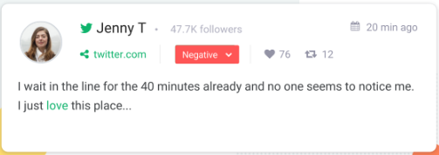
G.Khano
After Strong #earthquake in #Batagrame team are still working to reach people who under debris

