Slide 1

Lecture 4 – Informed Search
FALL 2016
M. Shahid Iqbal

Slide 2

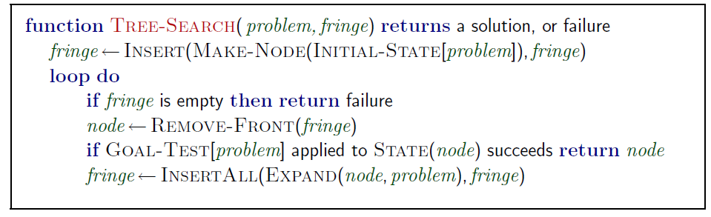
A strategy is defined by picking the order of node expansion

Slide 3

Idea: use an evaluation function for each node
  Estimate of desirability
Expand most desirable unexpanded node
Implementation:
  fringe is a queue sorted in ascending order of f-values.
Special cases:
  Greedy (best-first) search
  A* search

Slide 4
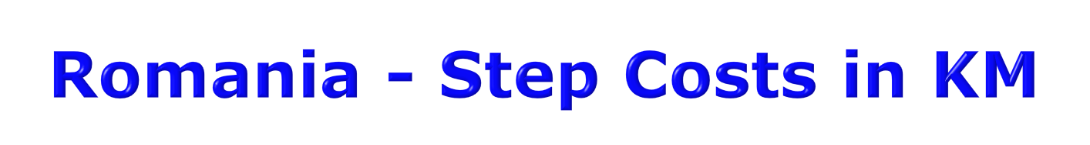

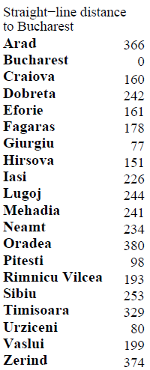

Slide 5

Evaluation function h(n) (heuristic)
  Estimated cost of the cheapest path from node n to a goal node
E.g., h_{SLD}(n) = straight-line distance from n to Bucharest
Greedy search expands the node that appears to be closest to goal.

Slide 6



Slide 7


Slide 8


Slide 9

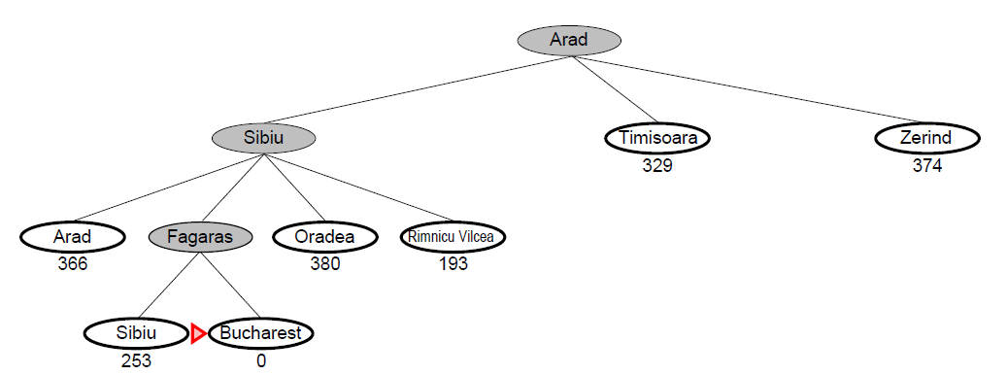

Slide 10

Complete? No – can get stuck in loops, e.g., with Oradea as goal and start from Iasi:
  Iasi → Neamt → Iasi → Neamt →
Time? O(b^{m}), but a good heuristic can give dramatic improvement
Space? O(b^{m}) -- keeps all nodes in memory
Optimal? No.
  Complete in finite space with repeated state checking

Slide 11

Idea: Avoid expanding paths that are already expensive
Evaluation function f(n) = g(n) + h(n)
  g(n) = exact cost so far to reach n
  h(n) = estimated cost to goal from n
  f(n) = estimated total cost of cheapest path through n to goal
A* search uses an admissible heuristic:
  h(n) ≤ h*(n) where h*(n) is the true cost from n
  Also h(n) ≥ 0, and h(G)=0 for any goal G
  E.g., h_{SLD}(n) is an admissible heuristic because it doesn’t overestimate the actual road distance.

Slide 12
If we are trying to find the cheapest solution, a reasonable thing to try first is the node with the lowest value of g(n) + h(n)
This strategy is more than just reasonable
  Provided that h(n) satisfies certain conditions, A* using TREE search is both complete and optimal.

Slide 13

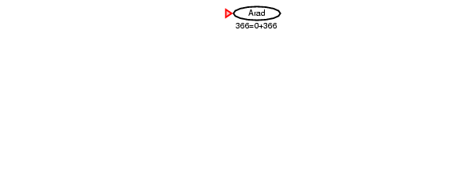

Slide 14


Slide 15


Slide 16


Slide 17


Slide 18


Slide 19


Failure to detect repeated states can turn a linear problem into an exponential one!
  We don’t want to expand a node that has already been expanded

Slide 20


Maintain a closed-list containing those nodes that have already been expanded. Then, if a node is encountered that is already in closed-list, it is simply ignored
This guarantees that no loops are generated, and essentially converts the graph into a tree

Slide 21

Its very well to prune the search space by ignoring repeated states
But the problem is that Graph-search can end up discovering sub-optimal solutions
  Basically, a loop means that there might be more then one path to a node
  Once we discover a path to a node, then any other paths to the same node are ignored by graph-search
  However, it is not necessary that the first path is the optimal one
  Hence, sub-optimal solutions can be returned.

Slide 22
Solution?
  We can adopt a uniform-cost approach, in which we keep track of all the paths that have been currently generated
  Then, we select only that path which has the least-cost.

Slide 23

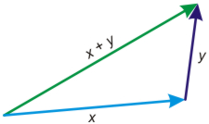
This proof can break down with Graph-search
A* can return sub-optimal solutions, if we don’t apply the uniform-cost approach
However, this is really messy and expensive
A much better solution is to ensure that the heuristic that you have selected is consistent
Triangle inequality

Slide 24


A heuristic is consistent if for every node n, every successor n' of n generated by any action a,
h(n) ≤ c(n,a,n') + h(n')
If h is consistent, we have
f(n') = g(n') + h(n')
= g(n) + c(n,a,n') + h(n')
≥ g(n) + h(n)
≥ f(n)
i.e., f(n) is non-decreasing along any path.
Theorem: If h(n) is consistent, A* using GRAPH-SEARCH is optimal

Slide 25

Complete? Yes (unless there are infinitely many nodes with f ≤ F* )
Time? Exponential
Space? Keeps all nodes in memory
Optimal? Yes

