Slide 1
Introduction to PHP

Slide 2
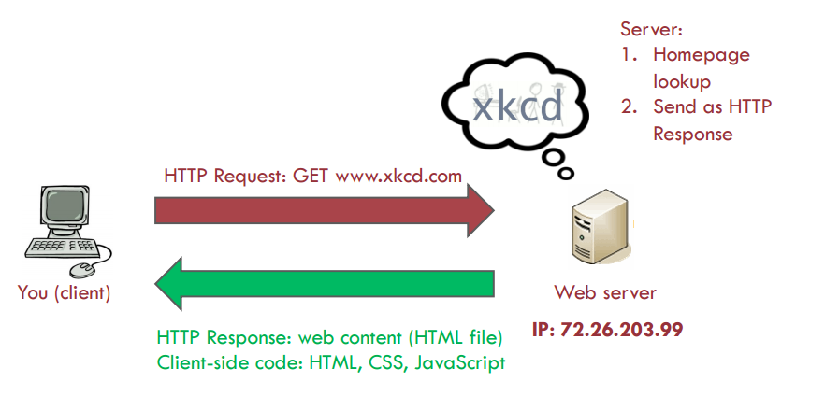
Request to Static Website

Slide 3
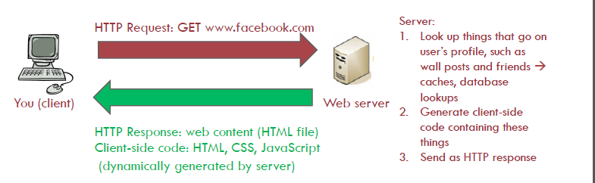
Request to a Dynamic Site
The server must respond dynamically if it needs to provide
different client-side code depending on the situation
Date and time
Specifics of the user’s request
Database contents – forms and authentication

Slide 4
Why Dynamic?
Dynamic content needed for:
Sophisticated user interaction (e.g. search engines, shopping carts)
Content changes often (e.g. weather forecast, news headlines)
Web gateways to database-based applications (e.g. prices of products, online ticket reservations)

Slide 5
Server Side Scripting
Server-side scripting is used to provide a customized interface for the user.
Scripts can be written in any of a number of server-side scripting languages.
Scripts on a web server produce a response which is customized for each user's request to the website.
These scripts use the client characteristics for customizing the response based on those characteristics, the user's requirements, access rights, etc.
Server-side scripting also enables the website owner to hide the source code that generates the interface

Slide 6
Server Side Scripting Languages & Framworks
PHP
Laravel, CakePHP, Zend etc.
.NET Framework (ASP.NET & C#)
Perl
Python
Ruby on Rails Framework
Node Js

Slide 7
PHP
PHP: PHP Hypertext Pre-processor
Programming language that is interpreted and executed on the server
Execution is done before delivering content to the client
Contains a vast library of functionality that programmers can harness
Executes entirely on the server, requiring no specific features from the client

Slide 8
Introduction
Static resources such as regular HTML are simply output to the client from the server
Dynamic resources such as PHP scripts are processed on the server prior to being output to the client
PHP has the capability of connecting to many database systems making the entire process transparent to the client
Web Page Request
Load PHP File
PHP Engine –
Run Script
HTML Response
PHP Results

Slide 9
PHP
widely-used Open Source general-purpose scripting language
especially suited for Web development
can be embedded into HTML.
<html>
<head>
<title>Example</title>
</head>
<body>
<?php echo "Hi, I'm a PHP script!"; ?>
</body>
</html>
For PHP guide http://Php.net

Slide 10
Installation for PHP
Assume that a server has support for PHP activated and that all files ending in .php are handled by PHP
Create .php files and put them in web directory and the server will magically parse them for you
No need to compile anything
Develop locally
install a web server, such as Apache
install PHP
install a database as well, such as MySQL.

Slide 11
First PHP-enabled page
Create a file named hello.php
Put it in your web servers directory (xampp/htdocs)
<html>
<head>
<title>PHP Test</title>
</head>
<body>
<?php echo "<p>Hello World</p>"; ?>
</body>
</html>
Use browser to access the file

Slide 12
Side-by-side
PHP File:
<html>
<head>
<title> PHP Introduction </title>
</head>
<body>
This is HTML! <br />
<?php
echo 'This is PHP! <br />';
?>
</body>
</html>
Output: resulting HTML
<html>
<head>
<title> PHP Introduction </title>
</head>
<body>
This is HTML! <br />
This is PHP! <br /></body>
</html>

Slide 13
Details
<html>
<head>
<title> PHP Introduction </title>
</head>
<body>
This is HTML! <br />
<?php
echo 'This is PHP! <br />'; // prints to screen
/*
Here's a longer
comment
that spans multiple
lines.
*/
?>
</body>
</html>
PHP tags: <?php and ?>
The echo command
Single line comment ( // )
Multiple line comment (/* and */)

Slide 14
Variables
Variables represented by a dollar sign followed by the name of the variable
name is case-sensitive.
name starts with a letter or underscore, followed by any number of letters, numbers, or underscores
type is assigned by value
<?php
$name= "Bob";
$Name= "Joe";
echo “$name, $Name"; // outputs "Bob, Joe"
$x = 1;
$x = ‘abc’; // type can change if value changes
$4site = 'not yet'; // invalid; starts with a number $_4site = 'not yet'; // valid; starts with an underscore
?>

Slide 15
Arrays
created by the array() language-construct
takes a certain number of comma-separated key => value pairs
Three types of arrays
Indexed, Associative, multidimentional
<?php
$arr = array("foo" => "bar", 12 => true);
echo "Value of foo <br />";
echo $arr["foo"]; // bar
echo " <br /> Value of 12 <br />";
echo $arr[12]; // 1
echo " <br /> Print Array <br />";
print_r($arr);// print_r() displays information about a variable in a way that's readable by humans
?>

Slide 16
Arrays
Output
Value of foo bar Value of 12 1 Print Array Array ( [foo] => bar [12] => 1 )

Slide 17
Arrays (cont.)
<?php // Create a simple array.
$array = array(1, 2, 3, 4, 5);
print_r($array);
// Now delete every item, but leave the array
// itself unchanged:
foreach ($array as $i => $value) { unset($array[$i]);
}
print_r($array);
// Append an item (note that the new key is 5,
// instead of 0 as you might expect).
$array[] = 6;
print_r($array);
// Re-index:
$array = array_values($array);
$array[] = 7;
print_r($array); //prints array with index value information
var_dump($array);// prints array for complete information about data structure
?>
array_values() returns all the values from the array
and indexes the array numerically.

Slide 18
Dealing with forms
HTML Forms (GET and POST)
Form is submitted to a PHP script
information from that form is automatically made available to the script
Both GET and POST create an array.
This array holds key/value pairs, where keys are the names of the form controls and values are the input data from the user
forms.php
<form action="foo.php" method="POST">
Name: <input type="text" name="username"><br> Email: <input type="text" name="email"><br> <input type="submit" name="submit" value="Submit me!">
</form>

Slide 19
Forms – foo.php
<?php
print $_POST['username'];
print $_REQUEST['username'];
?>
Check the Get Method

Slide 20
Another forms example
info_form.php
<form action=“show_answers.php” method="POST">
Your name: <input type="text" name="name" />
Your age: <input type="text" name="age" />
<input type="submit">
</form>
show_answers.php
Hi
<?php echo $_POST["name"]; ?>.
You are <?php echo $_POST["age"]; ?> years old.

Slide 21
PhP Superglobals
$GLOBALS
$_SERVER
$_SERVER['PHP_SELF'], $_SERVER [SERVER_NAME],
$_SERVER [REQUEST_METHOD]
$_REQUEST
$_POST
$_GET
$_FILES
$_ENV // Environment variables
$_COOKIE
$_SESSION //session variables available to the current scrip
Returns the request method
used to access the page
(such as POST)
An associative array of items
uploaded to the current script
via the HTTP POST method

Slide 22
Something useful
check what sort of browser the person viewing the page is using
check the user agent string that the browser sends as part of its HTTP request
stored in a variable
always start with a dollar-sign in PHP
$_SERVER["HTTP_USER_AGENT"].
$_SERVER is a special reserved PHP variable that contains all web server information
<html>
<head>
<title>PHP Test</title>
</head>
<body>
<?php echo $_SERVER["HTTP_USER_AGENT"]; ?>
</body>
</html>

