Slide 1
PHP Cookies & Sessions

Slide 2
Cookies
Cookies are a mechanism for storing data in the remote browser and thus tracking or identifying the users
Cookies are like variable
Stores single piece of data under a unique name
Browser dependent
  stores cookies on user’s browser
Moves page to page
Avoids the problem to log in every time
Always stored as text
E.g. No of visits for particular website can be counted

Slide 3
Cookies
Cookies are part of the HTTP header, so setcookie() must be called before any output is sent to the browser
<?php
$cookie_name = "Ali";
$cookie_value = "Shopping Cart";
setcookie($cookie_name, $cookie_value, time() + (86400 * 30), "/"); // 86400 = 1 day
if(!isset($_COOKIE[$cookie_name])) {
echo "Cookie named '" . $cookie_name . "' is not set!";
} else {
echo "Cookie '" . $cookie_name . "' is set!<br>";
echo "Value is: " . $_COOKIE[$cookie_name];
} ?>

Slide 4
Cookies
Set cookie
  setcookie() stores data in cookies
  Syntax: setcookie(“cookie name”,”value”);
  Accepts an optional third argument
    Sets the expiration date of the cookie
  E.g: setcookie(‘username’, ‘aacssh’, time()+(60 * 60));
    Sets expiration date 1 hour (60sec * 60min) from the current time
Retrieve cookie
    using super global using $_COOKIE
    E.g: $_COOKIE[‘cookie name’];

Slide 5
Cookies
  Delete cookie
    Set expiration date to time in the past
    Syntax:
      setcookie(‘username’,’aacssh’, time()-3600);
        Set time in the past
      *Cookies are stored at client’s computer

Slide 6
Sessions
HTTP is a stateless protocol, which means that the protocol has no built-in way of maintaining state between two transactions.
When a user requests one page, followed by another, HTTP does not provide a way for you to tell that both requests came from the same user.
The idea of session control is to be able to track a user during a single session on a website.
If you can do this, you can easily support logging in a user and showing content according to his/her authorization level or personal preferences.

Slide 7
Sessions
Sessions in PHP are driven by a unique session ID, a cryptographically random number.
This session ID is generated by PHP and stored on the client side for the lifetime of a session. This identifier can be transmitted either GET (PHPSESSID added to the end of the URL) or POST Cookie (cookie on client) as the server configuration.
It can be either stored on a user’s computer in a cookie or passed along through URLs.
A session ID acts as a key that allows you to register particular variables as so-called session variables.
The contents of these variables are stored at the server.
The session ID is the only information visible at the client side.

Slide 8
Sessions
Session variables are set with the PHP global variable: $_SESSION.
<?php
// Start the session
session_start();
?>
<!DOCTYPE html>
<html>
<body>
<?php
// Set session variables
$_SESSION[“userName"] = “Ali";
$_SESSION[“regNo"] = “FA16/10/ATK";
$_SESSION[“SlectedSubj"] = “CSC336";
echo "Session variables are set.";
// Print all session variables
print_r($_SESSION);
?>

Slide 9
Sessions
Before you can use session functionality, you need to actually begin a session.
The simplest way of starting a session is to begin a script with a call to the session_start() function.
This function checks to see whether there is already a current session. If not, it will essentially create one, providing access to the superglobal $_SESSION array.
If a session already exists, session_start() loads the registered session variables so that you can use them.
It is a good idea to call session_start() at the start of all your scripts that use sessions.

Slide 10
Remove Session
// remove all session variables
session_unset();
// destroy the session
session_destroy();
Check output for following
  print_r($_SESSION);
  Var_dump($_SESSION);

Slide 11
PHP MYSQL
Create Table
<?php
$sql = "CREATE TABLE MyStudent( “.
"student_id INT NOT NULL AUTO_INCREMENT, ".
"student_name VARCHAR(100) NOT NULL, ".
"student_email VARCHAR(40) NOT NULL, ".
"PRIMARY KEY ( student_id )); ";
if ($con->query($sql) === TRUE) {
echo "Table MyStudent created successfully";
}
else {
echo "Error creating table: " . $con->error;
}
?>
//PHP Connection with MYSQL
<?php
$servername = "localhost";
$username = "root";
$password = ‘’;
$dbname = "data";
$con = mysqli_connect($servername, $username, $password, $dbname)
or die ('Could not connect to the database server' . mysqli_connect_error());
$con->close();
?>

Slide 12
Login & Session
<? Php
$username = $_POST[“username”];
$password= $_POST[“password”];
//Select values from table
$sql = "SELECT username, password FROM users WHERE username =‘$username’ && password=‘$password’;";
$result = $con->query($sql);
if ($result->num_rows > 0) {
// output data of each row
while($row = $result->fetch_assoc()) {
$_SESSION[“Username”]“ = $username;
}
} else {
echo “Username or password is incorrect";
}
?>
Table Name
For successful Select statement this will return mysqli_result object. For other statements e.g. update, create it will return True

Slide 13


jQuery

Slide 14




Who's Using jQuery?

Slide 15
Introduction
jQuery is a fast, small, and feature-rich JavaScript library.
It makes things like HTML document traversal and manipulation, event handling, animation, and Ajax much simpler with an easy-to-use API that works across a multitude of browsers.
With a combination of versatility and extensibility, jQuery has changed the way that millions of people write JavaScript.

Slide 16
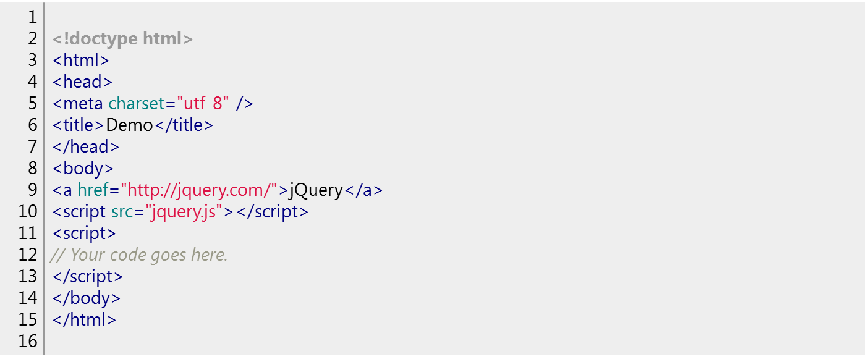
How jQuery works
The src attribute in the <script> element must point to a copy of jQuery. Download a copy of jQuery from https://jquery.com and store t jquery.js file in the same directory as your HTML file.

Slide 17
How jQuery works
A page can't be manipulated safely until the document is "ready." jQuery detects this state of readiness.
Code included inside $( document ).ready() will only run once the page Document Object Model (DOM) is ready for JavaScript code to execute
$( document ).ready(function() {
// Your code here.
});
For example, inside the ready event, add a click handler to the link:
$( document ).ready(function() {
$( "a" ).click(function( event ) {
alert( "Thanks for visiting!" );
});
});

Slide 18
Find Something
"Select" elements in the document

Slide 19
jQuery Selectors
HTML element(s) can be selected and manipulated through jQuery selectors.
jQuery selectors are used to "find" (or select) HTML elements based on their name, id, classes, types, attributes, values of attributes and much more.
It's based on the existing CSS Selectors, and in addition, it has some own custom selectors.
All selectors in jQuery start with the dollar sign and parentheses: $()

Slide 20
jQuery Selectors
$("*") | Selects all elements
$(this) | Selects the current HTML element
$("p.intro") | Selects all <p> elements with class="intro"
$("p:first") | Selects the first <p> element
$("ul li:first") | Selects the first <li> element of the first <ul>

Slide 21
Adding and Removing a Class
Important: Place the remaining jQuery examples inside the ready event so that your code executes when the document is ready to be worked on.
Another common task is adding or removing a class.
First, add some style information into the <head> of the document, like this:
1 2 3 4 5 | <style> a.test { font-weight: bold; } </style>
Next, add the .addClass() call to the script:
1 | $( "a" ).addClass( "test" );
All <a> elements are now bold.
To remove an existing class, use .removeClass():
1 | $( "a" ).removeClass( "test" );

