Slide 1


jQuery

Slide 2
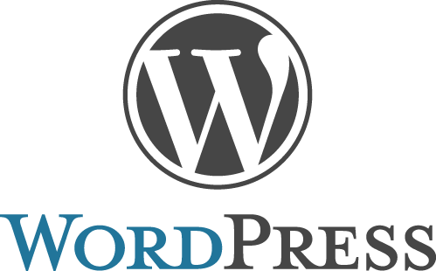



Who's Using jQuery?

Slide 3
Introduction
jQuery is a fast, small, and feature-rich JavaScript library.
It makes things like HTML document traversal and manipulation, event handling, animation, and Ajax much simpler with an easy-to-use API that works across a multitude of browsers.
With a combination of versatility and extensibility, jQuery has changed the way that millions of people write JavaScript.

Slide 4
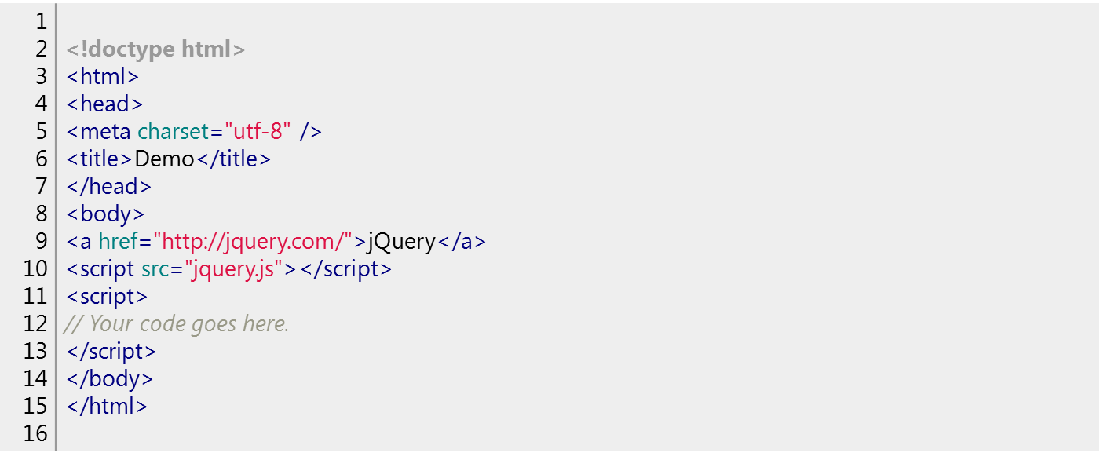
How jQuery works
The src attribute in the <script> element must point to a copy of jQuery. Download a copy of jQuery from https://jquery.com and store t jquery.js file in the same directory as your HTML file.

Slide 5
How jQuery works
A page can't be manipulated safely until the document is "ready." jQuery detects this state of readiness.
Code included inside $( document ).ready() will only run once the page Document Object Model (DOM) is ready for JavaScript code to execute
$( document ).ready(function() {
// Your code here.
});
For example, inside the ready event, add a click handler to the link:
$( document ).ready(function() {
$( "a" ).click(function( event ) {
alert( "Thanks for visiting!" );
});
});

Slide 6
Find Something
"Select" elements in the document

Slide 7
jQuery Selectors
HTML element(s) can be selected and manipulated through jQuery selectors.
jQuery selectors are used to "find" (or select) HTML elements based on their name, id, classes, types, attributes, values of attributes and much more.
It's based on the existing CSS Selectors, and in addition, it has some own custom selectors.
All selectors in jQuery start with the dollar sign and parentheses: $()

Slide 8
jQuery Selectors
$("*") | Selects all elements
$(this) | Selects the current HTML element
$("p.intro") | Selects all <p> elements with class="intro"
$("p:first") | Selects the first <p> element
$("ul li:first") | Selects the first <li> element of the first <ul>

Slide 9
Adding and Removing a Class
Important: Place the remaining jQuery examples inside the ready event so that your code executes when the document is ready to be worked on.
Another common task is adding or removing a class.
First, add some style information into the <head> of the document, like this:
1 2 3 4 5 | <style> a.test { font-weight: bold; } </style>
Next, add the .addClass() call to the script:
1 | $( "a" ).addClass( "test" );
All <a> elements are now bold.
To remove an existing class, use .removeClass():
1 | $( "a" ).removeClass( "test" );

Slide 10
Example
<html>
<head>
…….
</head>
<body>
<span class="test">This is text example for Span with class test!</span><br>
<span >This is text example for Span without class test!</span>
<script>
$().ready(function() {
$("span").wrap(function(){
return $(this).is(".test") ? "<strong>" : "<em>";
});
});
</script>
</body>
</html>
<style>
.test{ color:blue; }
</style>
Output
This is text example for Span with class test!
This is text example for Span without class test!

Slide 11
jQuery Events
An event is a mechanism that allows you to run a piece of code when something happens on the page (like a user clicking a button).
The code that gets run is a function, and functions allow you to make your jQuery more efficient and reusable
jQuery gives a very easy ways to add event listeners to any element on the page, so users are no longer just clicking on links and buttons

Slide 12
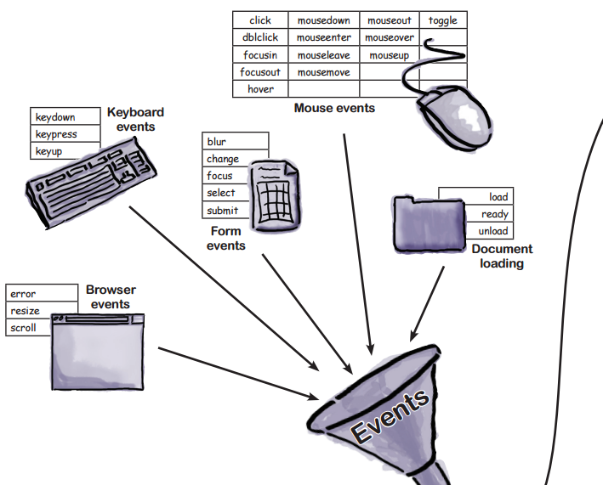
jQuery Events
Events can be triggered by a wide variety of things on any given page. In fact, your entire browser is eventful, and pretty much any part of it can trigger events!
Event Handler: A function
to execute each time the
event is triggered

Slide 13
Remove events
//Add a focus event listener to the element with an ID of myElement
$("#myElement").bind ('focus', function()
{
alert("I've got focus");
});
//Add a click event listener to the element with an ID of myElement
$("#myElement").click(function()
{
alert('You clicked me.');
});
//Remove event (All events will be removed)
$("#myElement").unbind();

Slide 14
Example (Mouse Events)
<html><head>
<script src="https://ajax.googleapis.com/ajax/libs/jquery/3.1.1/jquery.min.js"></script>
<script>
$(document).ready(function(){
$("input").hover(function(){
$(this).css("background-color", "#CFF");
});
$("input").mouseleave(function(){
$(this).css("background-color", "#ffffff");
});
</script> </head>
<body>
Name: <input type="text" name="fullname"><br>
Email: <input type="text" name="email">
</body></html>

Slide 15
Many events and handlers
Suppose that you want different event handlers for when the mouse enters and leaves an element. For example, if you want to show and hide a tooltip on hover, you would use this.
.on() accepts an object containing multiple events and handlers.
  $( "div" ).on({
  mouseenter: function() {
  console.log( "hovered over a div" );
  },
  mouseleave: function() {
  console.log( "mouse left a div" );
  },
  click: function() {
  console.log( "clicked on a div" );
  }
  });

Slide 16
Callback
JavaScript statements are executed line by line. However, with effects, the next line of code can be run even though the effect is not finished. This can create errors.
To prevent this, a callback function is used.
A callback is a function that is passed as an argument to another function and is executed after its parent function has completed.
Callbacks are special because they patiently wait to execute until their parent finishes. Meanwhile, the browser can be executing other functions or doing all sorts of other work.

Slide 17
Callback: Example
//alert box will be displayed before the hide effect is completed (Replace following code in example to see the effect )
$("button").click(function(){
$("p").hide(1000);
alert("The paragraph is now hidden");
});
$(document).ready(function(){
$("button").click(function(){
$("p").hide("slow", function(){
alert("The paragraph is now hidden");
});
});
});
Code with problem
Parent function hide executes first

Slide 18

jQuery Chaining
in jQuery, most of the methods returns a jQuery object that can be used to call another method.
This allows you to do command chaining, where you can perform multiple methods on the same set of elements, which is really neat because it saves you and the browser from having to find the same elements more than once
  $(document).ready(function(){
  $("button").click(function(){
  $("#p1").css("color", "red").slideUp(2000).slideDown(2000);
  });
  });

Slide 19
AJAX

Slide 20
AJAX: Introduction
AJAX = Asynchronous JavaScript And XML.
AJAX is not a programming language.
AJAX just uses a combination of:
  A browser built-in XMLHttpRequest object (to request data from a web server)
  JavaScript and HTML DOM (to display or use the data)

Slide 21
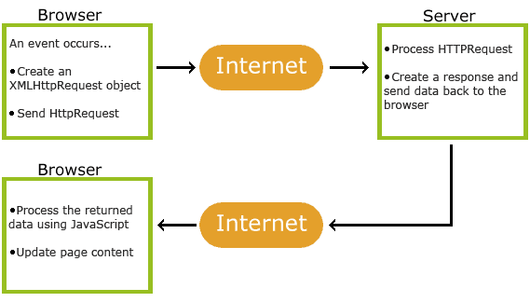
How it works

Slide 22
XMLHttpRequest
XMLHttpRequest is an API in the form of an object whose methods transfer data between a web browser and a web server
It has built in XML parser.
readyState-> The XMLHttpRequest.readyState property returns the state of XMLHttpRequest client
For Reference
https://developer.mozilla.org/en-US/docs/Web/API/XMLHttpRequest/readyState
Value | State | Description
0 | UNSENT | Client has been created. open() not called yet.
1 | OPENED | open() has been called.
2 | HEADERS_RECEIVED | send() has been called, and headers and status are available.
3 | LOADING | Downloading; responseText holds partial data.
4 | DONE | The operation is complete.

Slide 23
HTTP 200 OK success status
The HTTP 200 OK success status response code indicates that the request has succeeded. A 200 response is cacheable by default.
The meaning of a success depends on the HTTP request method:
  GET: The resource has been fetched and is transmitted in the message body.
  POST: The resource describing the result of the action is transmitted in the message body.

Slide 24
AJAX: Introduction
AJAX allows web pages to be updated asynchronously by exchanging data with a web server behind the scenes.
Through this way it is possible to update parts of a web page, without reloading the whole page.
XMLHttpRequest.status
  Returns the numerical status code of the response of the XMLHttpRequest. (unsigned short)
  The status codes returned are the standard HTTP status codes.
  For example, status 200 denotes a successful request
  Before the request is complete, the value of status will be 0

Slide 25
readyStateChanged
The XMLHttpRequest.onreadystatechange property contains the event handler to be called when the readystatechange event is fired
The readystatechange event is fired when the readyState
attribute of a document has changed

Slide 26
Examples of AJAX
Google Maps
  A user can drag an entire map by using the mouse, rather than clicking on a button.
Google Suggest
  As you type, Google will offer suggestions. Use the arrow keys to navigate the results.
Gmail
  How?

Slide 27
AJAX and PHP
<html>
<head>
<script>
function showHint(str) {
if (str.length == 0) {
document.getElementById("txtHint").innerHTML = "";
return;
} else {
var xmlhttp = new XMLHttpRequest();
xmlhttp.onreadystatechange = function() {
if (this.readyState == 4 && this.status == 200) {
document.getElementById("txtHint").innerHTML = this.responseText;
} };
xmlhttp.open("GET", “suggestions.php?q=" + str, true);
xmlhttp.send();
} }
</script>
</head>
<body>
<p><b>Start typing a name in the input field below:</b></p>
<form>
First name: <input type="text" onkeyup="showHint(this.value)">
</form>
<p>Suggestions: <span id="txtHint">
</span></p>
</body>
</html>
Callback: a function executed
when readystate is changed
Status of XMLHttpRequest
Perform operation asynchronously:
Script will run without waiting for response
The HTTP and HTTPS requests of the XMLHttpRequest
object must be initialized through the open method.

Slide 28
AJAX and PHP
//suggestions.php
<?php
// Array with names
$a[] = "Anna"; $a[] = "Brittany";
$a[] = "Cinderella"; $a[] = "Diana";
$a[] = "Eva"; $a[] = "Fiona";
$a[] = "Gunda"; $a[] = "Hege";
$a[] = "Inga"; $a[] = "Johanna";
$a[] = "Kitty"; $a[] = "Linda";
$a[] = "Nina"; $a[] = "Ophelia";
$a[] = "Petunia"; $a[] = "Amanda";
$a[] = "Raquel"; $a[] = "Cindy";
$a[] = "Doris"; $a[] = "Eve";
$a[] = "Evita"; $a[] = "Sunniva";
$a[] = "Tove"; $a[] = "Unni";
$a[] = "Violet"; $a[] = "Liza";
$a[] = "Elizabeth"; $a[] = "Ellen";
$a[] = "Wenche"; $a[] = "Vicky";
// get the q parameter from URL
$data = $_REQUEST["q"];
$hint = "";
// lookup all hints from array if $q is different from ""
if ($data !== "") {
$data = strtolower($data);
$len=strlen($data);
foreach($a as $name) {
if (stristr($data, substr($name, 0, $len))) {
if ($hint === "") {
$hint = $name;
} else {$hint .= ", $name"; } }
} }
// Output "no suggestion" if no hint was found or output correct values
echo $hint === "" ? "no suggestion" : $hint;
?>

Slide 29
PHP - AJAX and MySQL
function showUser(str) {
if (str == "") {
document.getElementById("txtHint").innerHTML = "";
return;
} else {
if (window.XMLHttpRequest) {
// code for IE7+, Firefox, Chrome, Opera, Safari
xmlhttp = new XMLHttpRequest();
} else {
// code for IE6, IE5
xmlhttp = new ActiveXObject("Microsoft.XMLHTTP");
}
xmlhttp.onreadystatechange = function() {
if (this.readyState == 4 && this.status == 200)
{ document.getElementById("txtHint").innerHTML = this.responseText;
}
};
xmlhttp.open("GET","getuser.php?q="+str,true);
xmlhttp.send();
} }
</script>
</head>
<body>
<form>
<select name="users" onchange="showUser(this.value)">
<option value="">Select a person:</option>
<option value="1">Peter Griffin</option>
<option value="2">Lois Griffin</option>
<option value="3">Joseph Swanson</option>
<option value="4">Glenn Quagmire</option>
</select>
</form>
<br>
<div id="txtHint"><b>Person info will be listed here...</b></div>
</body>
</html>

Slide 30
PHP - AJAX and MySQL
<html>
<head>
<style>
table { width: 100%; border-collapse: collapse;}
table, td, th {border: 1px solid black; padding: 5px;}
th {text-align: left;}
</style></head><body>
<?php
$q = intval($_GET['q']);
$con = mysqli_connect('localhost','peter','abc123','my_db');
if (!$con) {
die('Could not connect: ' . mysqli_error($con));
}
mysqli_select_db($con,"ajax_demo");
$sql="SELECT * FROM user WHERE id = '".$q."'";
$result = mysqli_query($con,$sql);
echo "<table>
<tr><th>Firstname</th>
<th>Lastname</th>
<th>Age</th>
<th>Hometown</th>
<th>Job</th></tr>";
while($row = mysqli_fetch_array($result)) {
echo "<tr>";
echo "<td>" . $row['FirstName'] . "</td>";
echo "<td>" . $row['LastName'] . "</td>";
echo "<td>" . $row['Age'] . "</td>";
echo "<td>" . $row['Hometown'] . "</td>";
echo "<td>" . $row['Job'] . "</td>";
echo "</tr>";
}
echo "</table>";
mysqli_close($con);
?></body></html>

Slide 31
jQuery and AJAX
jQuery provides several methods for AJAX functionality
The jQuery load() method is a simple, but powerful AJAX method.
The load() method loads data from a server and puts the returned data into the selected element.
  $(selector).load(URL,data,callback);

