Slide 1



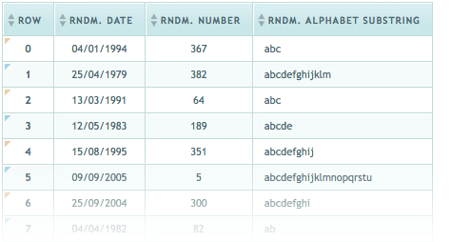

HTML

Slide 2
HTML Structure
HTML is comprised of “elements” and “tags”
Begins with <html> and ends with </html>
When writing XHTML, must define a namespace
Elements (tags) are nested one inside another:
Tags have attributes:
HTML describes structure using two main sections: <head> and <body>
<html xmlns="http://www.w3.org/1999/xhtml">
<html> <head></head> <body></body> </html>
<img src="logo.jpg" alt="logo" />

Slide 3
HTML Code Formatting
The HTML source code should be formatted to increase readability and facilitate debugging.
Every block element should start on a new line.
Every nested (block) element should be indented.
Browsers ignore multiple whitespaces in the page source, so formatting is harmless.

Slide 4
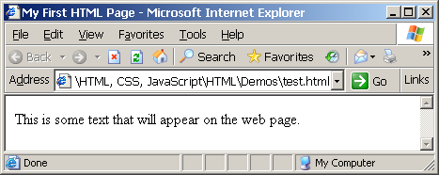
First HTML Page
test.html
<!DOCTYPE HTML>
<html>
<head>
<title>My First HTML Page</title>
</head>
<body>
<p id=“text” style=“”>This is some text...</p>
</body>
</html>

Slide 5
First HTML Page: Tags
<!DOCTYPE HTML>
<html>
<head>
<title>My First HTML Page</title>
</head>
<body>
<p>This is some text...</p>
</body>
</html>
Opening tag
Closing tag
An HTML element consists of an opening tag, a closing tag and the content inside.

Slide 6
Some Simple Tags
Hyperlink Tags
Image Tags
Text formatting tags
<a href="http://www.telerik.com/"
title="Telerik">Link to Telerik Web site</a>
<img src="logo.gif" alt="logo" />
This text is <em>emphasized.</em>
<br />new line<br />
This one is <strong>more emphasized.</strong>

Slide 7
Some Simple Tags – Example
some-tags.html
<!DOCTYPE HTML>
<html>
<head>
<title>Simple Tags Demo</title>
</head>
<body>
<a href="http://www.telerik.com/" title=
"Telerik site">This is a link.</a>
<br />
<img src="logo.gif" alt="logo" />
<br />
<strong>Bold</strong> and <em>italic</em> text.
</body>
</html>

Slide 8
Tag Attributes
Tags can have attributes
Attributes specify properties and behavior
Example:
Few attributes can apply to every element:
id, style, class, title
The id is unique in the document
Content of title attribute is displayed as hint when the element is hovered with the mouse
Some elements have obligatory attributes
Attribute alt with value "logo"
<img src="logo.gif" alt="logo" />

Slide 9
Headings and Paragraphs
Heading Tags (h1 – h6)
Paragraph Tags
Sections: div and span
<h1>Heading 1</h1>
<h2>Sub heading 2</h2>
<h3>Sub heading 3</h3>
<p>This is my first paragraph</p>
<p>This is my second paragraph</p>
<div style="background: skyblue;">
This is a div</div>

Slide 10
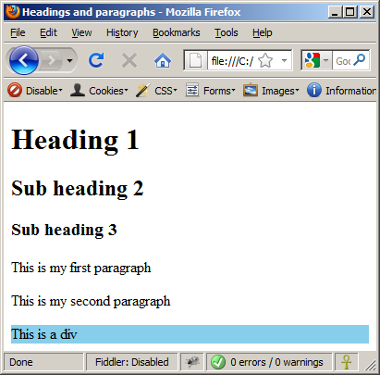
Headings and Paragraphs – Example (2)
headings.html
<!DOCTYPE HTML>
<html>
<head><title>Headings and paragraphs</title></head>
<body>
<h1>Heading 1</h1>
<h2>Sub heading 2</h2>
<h3>Sub heading 3</h3>
<p>This is my first paragraph</p>
<p>This is my second paragraph</p>
<div style="background:skyblue">
This is a div</div>
</body>
</html>

Slide 11
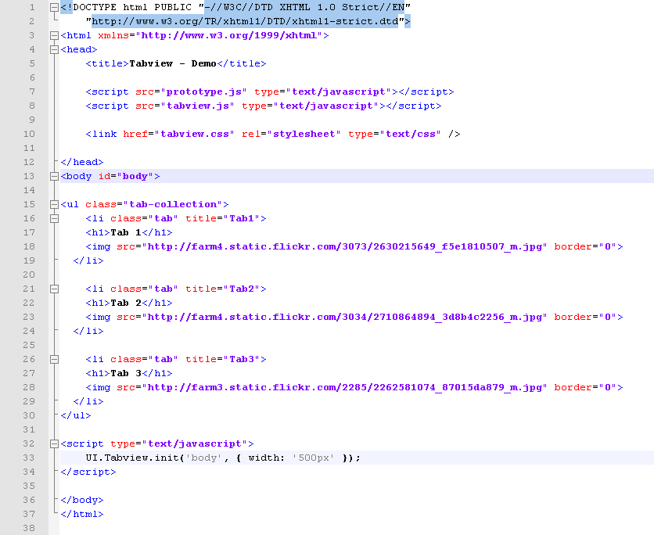
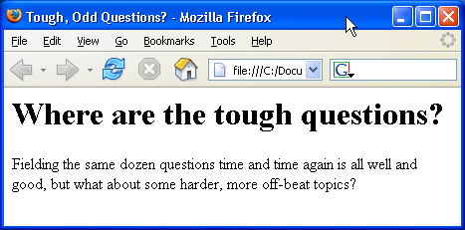
HTML Document Structure in Depth

Slide 12
Preface
It is important to have the correct vision and attitude towards HTML
HTML is only about structure, not appearance
Browsers tolerate invalid HTML code and parse errors – you should not
Always think about semantics

Slide 13
The <!DOCTYPE> Declaration
HTML documents must start with a document type definition (DTD)
It tells web browsers what type is the served code
Possible versions: HTML 4.01, XHTML 1.0 (Transitional or Strict), XHTML 1.1, HTML 5
Example:
See http://w3.org/QA/2002/04/valid-dtd-list.html for a list of possible doctypes
<!DOCTYPE html PUBLIC "-//W3C//DTD XHTML 1.0 Transitional//EN" "http://www.w3.org/TR/xhtml1/DTD/xhtml1-transitional.dtd">

Slide 14
The <head> Section
Contains information that doesn’t show directly on the viewable page
Starts after the <!doctype> declaration
Begins with <head> and ends with </head>
Contains mandatory single <title> tag
Can contain some other tags, e.g.
<meta>
<script>
<style>
<!–- comments -->

Slide 15
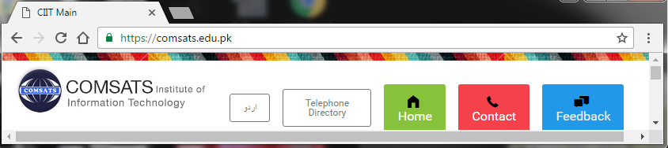
<head> Section: <title> tag
Title should be placed between <head> and </head> tags
Used to specify a title in the window titlebar
Search engines and people rely on titles
<title>CIIT Main</title>

Slide 16
<head> Section: <meta>
Meta tags additionally describe the content contained within the page
<meta name="description" content="HTML tutorial" />
<meta name="keywords" content="html, web design, styles" />
<meta name="author" content="Chris Brewer" />
<meta http-equiv="refresh" content="5; url=http://www.telerik.com" />
<meta name="viewport" content="width=device-width, initial-scale=1.0">

Slide 17
<head> Section: <script>
The <script> element is used to embed scripts into an HTML document
Script are executed in the client's Web browser
Scripts can live in the <head> and in the <body> sections
Supported client-side scripting languages:
JavaScript (it is not Java!)
VBScript
JScript

Slide 18
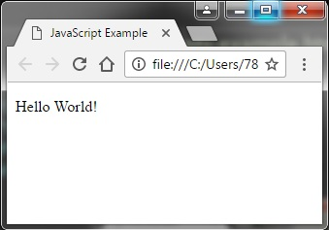
The <script> Tag – Example
scripts-example.html
<!DOCTYPE HTML>
<html>
<head>
<title>JavaScript Example</title>
<script type="text/javascript">
function sayHello() {
document.write("<p>Hello World!<\/p>");
}
</script>
</head>
<body>
<script type=
"text/javascript">
sayHello();
</script>
</body>
</html>

Slide 19
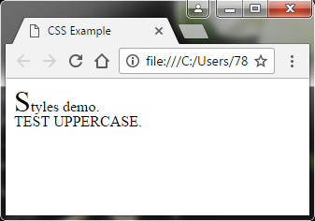
<head> Section: <style>
The <style> element embeds formatting information (CSS styles) into an HTML page
style-example.html
<html>
<head>
<title>CSS Example</title>
<style type="text/css">
p { font-size: 12pt; line-height: 12pt; }
p:first-letter { font-size: 200%; }
span { text-transform: uppercase; }
</style>
</head>
<body>
<p>Styles demo.<br />
<span>Test uppercase</span>.
</p>
</body>
</html>

Slide 20
<body> Section: Introduction
The <body> section describes the viewable portion of the page
Starts after the <head> </head> section
Begins with <body> and ends with </body>
<html>
<head><title>Test page</title></head>
<body>
<!-- This is the Web page body -->
</body>
</html>

Slide 21
Text Formatting
Text formatting tags modify the text between the opening tag and the closing tag
Ex. <b>Hello</b> makes “Hello” bold
<b></b> | bold
<i></i> | italicized
<u></u> | underlined
<sup></sup> | Sample^{superscript}
<sub></sub> | Sample_{subscript}
<strong></strong> | strong
<em></em> | emphasized
<pre></pre> | Preformatted text
<blockquote></blockquote> | Quoted text block
<del></del> | Deleted text – strike through
21

Slide 22
Hyperlinks: <a> Tag
Link to a document called form.html on the same server in the same directory:
Link to a document called parent.html on the same server in the parent directory:
Link to a document called cat.html on the same server in the subdirectory stuff:
<a href="form.html">Fill Our Form</a>
<a href="../parent.html">Parent</a>
<a href="stuff/cat.html">Catalog</a>

Slide 23
Hyperlinks: <a> Tag (2)
Link to an external Web site:
Always use a full URL, including "http://", not just "www.somesite.com"
Using the target="_blank" attribute opens the link in a new window
Link to an e-mail address:
<a href="http://www.devbg.org" target="_blank">BASD</a>
<a href="mailto:bugs@example.com?subject=Bug+Report">
Please report bugs here (by e-mail only)</a>

Slide 24
Hyperlinks and Sections
Link to another location in the same document:
Link to a specific location in another document:
<a href="#section1">Go to Introduction</a>
...
<h2 id="section1">Introduction</h2>
<a href="chapter3.html#section3.1.1">Go to Section 3.1.1</a>
<!–- In chapter3.html -->
...
<div id="section3.1.1">
<h3>3.1.1. Technical Background</h3>
</div>

Slide 25
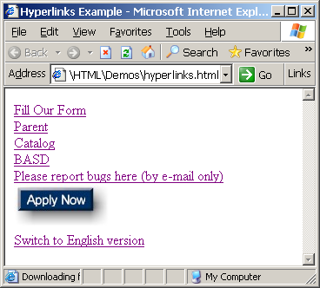
Hyperlinks – Example (2)
hyperlinks.html
<a href="form.html">Fill Our Form</a> <br />
<a href="../parent.html">Parent</a> <br />
<a href="stuff/cat.html">Catalog</a> <br />
<a href="http://www.devbg.org" target="_blank">BASD</a> <br />
<a href="mailto:bugs@example.com?subject=Bug Report">Please report bugs here (by e-mail only)</a>
<br />
<a href="apply-now.html"><img src="apply-now-button.jpg” /></a> <br />
<a href="../english/index.html">Switch to English version</a> <br />

Slide 26
Images: <img> tag
Inserting an image with <img> tag:
Image attributes:
Example:
<img src="/img/basd-logo.png">
src | Location of image file (relative or absolute)
alt | Substitute text for display (e.g. in text mode)
height | Number of pixels of the height
width | Number of pixels of the width
border | Size of border, 0 for no border
<img src="./php.png" alt="PHP Logo" />
26

Slide 27
Miscellaneous Tags
<hr />: Draws a horizontal rule (line):
<center></center>: Deprecated!
<font></font>: Deprecated!
<hr size="5" width="70%" />
<center>Hello World!</center>
<font size="3" color="blue">Font3</font>
<font size="+4" color="blue">Font+4</font>

Slide 28
Categories of Elemenets
All the HTML elements can be categorized into two categories: Block Level Elements and Inline Elements
Block Elements
Block elements appear on the screen as if they have a line break before and after them. For example the <p>, <h1>, <h2>, <h3>, <h4>, <h5>, <h6>, <ul>, <ol>, <dl>, <pre>, <hr />, <blockquote>, and <address> elements are all block level elements. They all start on their own new line, and anything that follows them appears on its own new line.
Inline Elements
Inline elements, on the other hand, can appear within sentences and do not have to appear on a new line of their own. The <b>, <i>, <u>, <em>, <strong>, <sup>, <sub>, <big>, <small>, <li> elements are all inline elements.

Slide 29

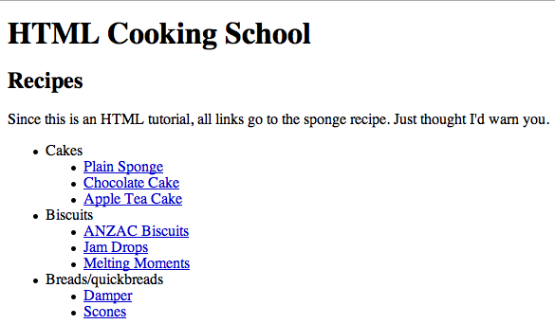

Creating Lists

Slide 30
Ordered Lists: <ol> Tag
Create an Ordered List using <ol></ol>:
Attribute values for type are 1, A, a, I, or i
<ol type="1">
<li>Apple</li>
<li>Orange</li>
<li>Grapefruit</li>
</ol>
Apple
Orange
Grapefruit
Apple
Orange
Grapefruit
Apple
Orange
Grapefruit
Apple
Orange
Grapefruit
Apple
Orange
Grapefruit

Slide 31
Unordered Lists: <ul> Tag
Create an Unordered List using <ul></ul>:
Attribute values for type are:
disc, circle or square
<ul type="disk">
<li>Apple</li>
<li>Orange</li>
<li>Grapefruit</li>
</ul>
Apple
Orange
Pear
Apple
Orange
Pear
Apple
Orange
Pear

Slide 32
Definition lists: <dl> tag
Create definition lists using <dl>
Pairs of text and associated definition; text is in <dt> tag, definition in <dd> tag
Renders without bullets
Definition is indented
<dl>
<dt>HTML</dt>
<dd>A markup language …</dd>
<dt>CSS</dt>
<dd>Language used to …</dd>
</dl>

Slide 33
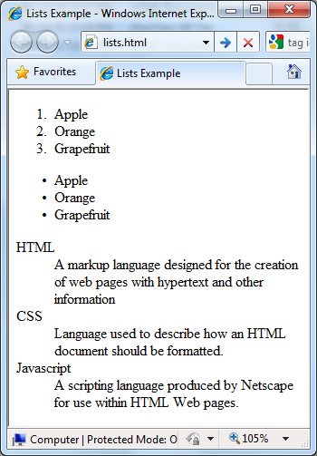
Lists – Example
lists.html
<ol type="1">
<li>Apple</li>
<li>Orange</li>
<li>Grapefruit</li>
</ol>
<ul type="disc">
<li>Apple</li>
<li>Orange</li>
<li>Grapefruit</li>
</ul>
<dl>
<dt>HTML</dt>
<dd>A markup lang…</dd>
</dl>

Slide 34
HTML Special Characters
Symbol Name
HTML Entity
Symbol
Copyright Sign
&copy;
©
Registered Trademark Sign
&reg;
®
Trademark Sign
&trade;
™
Less Than
&lt;
<
Greater Than
&gt;
>
Ampersand
&amp;
&
Non-breaking Space
&nbsp;
Em Dash
&mdash;
—
Quotation Mark
&quot;
"
Euro
&#8364;
€
British Pound
&pound;
£
Japanese Yen
&yen;
¥
34

Slide 35
Special Characters – Example
special-chars.html
<p>[&gt;&gt;&nbsp;&nbsp;Welcome
&nbsp;&nbsp;&lt;&lt;]</p>
<p>&#9658;I have following cards:
A&#9827;, K&#9830; and 9&#9829;.</p>
<p>&#9658;I prefer hard rock &#9835;
music &#9835;</p>
<p>&copy; 2006 by Svetlin Nakov &amp; his team</p>
<p>Telerik Academy™</p>

Slide 36
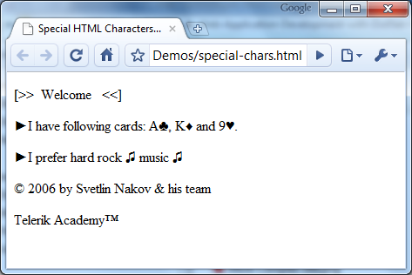
Special Chars – Example (2)
special-chars.html
<p>[&gt;&gt;&nbsp;&nbsp;Welcome
&nbsp;&nbsp;&lt;&lt;]</p>
<p>&#9658;I have following cards:
A&#9827;, K&#9830; and 9&#9829;.</p>
<p>&#9658;I prefer hard rock &#9835;
music &#9835;</p>
<p>&copy; 2006 by Svetlin Nakov &amp; his team</p>
<p>Telerik Academy™</p>

Slide 37
HTML Table
The <table> tag defines an HTML table.
An HTML table consists of the <table> element and one or more <tr>, <th>, and <td> elements.
The <tr> element defines a table row, the <th> element defines a table header, and the <td> element defines a table cell.
A more complex HTML table may also include <caption>, <col>, <colgroup>, <thead>, <tfoot>, and <tbody> elements.

Slide 38
HTML 4.0 Table Vs HTML5 Table
Differences Between HTML 4.01 and HTML5
The "align", "bgcolor", "border", "cellpadding", "cellspacing", "frame", "rules", "summary", and "width" attributes are not supported in HTML5.

Slide 39
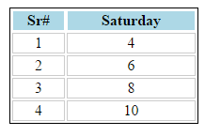
HTML Table- Example
<body>
<table>
<tr> <th>Sr#</th> <th>Saturday</th> </tr>
<tr> <td>1</td> <td>4</td> </tr>
<tr> <td>2</td> <td>6</td> </tr>
<tr> <td>3</td> <td>8</td></tr>
<tr> <td>4</td> <td>10</td></tr>
</table>

Slide 40
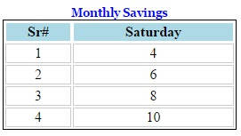
HTML Table- Example: Caption
<table>
<caption>Monthly Savings</caption>
<tr> <th>Sr#</th> <td>1</th> </tr>
<tr> <th>Saturday</td> <td>4</td> </tr>
<tr> <td>2</td> <td>6</td> </tr>
<tr> <td>3</td> <td>8</td></tr>
<tr> <td>4</td> <td>10</td></tr>
</table>

Slide 41
HTML Table- Example: colgroup, thead, tbody, tfoot
<html>
<head>
<title>HTML Table</title>
<style>
Table { width: 20%;}
table, th, td { border: 1px solid #06C; }
td, th { border: 1px solid #ccc; text-align: center; }
th {background: lightblue; border-color: white; }
caption { font-family: Georgia, "Times New Roman", Times, serif; color: blue; font-weight: bold; font-size:small; }
tfoot { background-color:#999; color:#003;
font-weight: bold;font-size:small;}
.heading {font-weight: bold;font-size:small;}
body { padding: 1rem; }
</style>
</head>
<table>
<caption class="heading">Monthly Savings</caption>
<tr> <th>Sr#</th> <th>Saturday</th> </tr>
<colgroup>
<col style="background-color:#CCC">
<col style="background-color:#9CF">
</colgroup>
<thead class="heading">
<tr> <th>Sr#</th> <th>Saturday</th> </tr>
</thead>
<tfoot class="heading">
<tr> <td>Total</td> <td></td> </tr>
</tfoot>
<tbody>
<tr> <td>1</td> <td>4</td> </tr>
<tr> <td>2</td> <td>6</td> </tr>
<tr> <td>3</td> <td>8</td></tr>
<tr> <td>4</td> <td>10</td></tr>
</tbody>
</table>
</body>
</html>

Slide 42
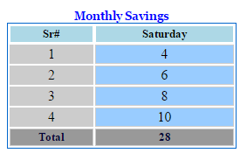
HTML Table- Example: colgroup, thead, tbody, tfoot

Slide 43
HTML Table: thead, tfoot, tbody
The HTML <colgroup> tag is used for specifying properties for a group of columns within a table.
The <thead> tag is used to group header content in an HTML table.
The <thead> element is used in conjunction with the <tbody> and <tfoot> elements to specify each part of a table (header, body, footer).
The <thead> tag must be used in the following context: As a child of a <table> element, after any <caption>, and <colgroup> elements, and before any <tbody>, <tfoot>, and <tr> elements.
The <tfoot> tag must be used in the following context: As a child of a <table> element, after any <caption>, <colgroup>, and <thead> elements and before any <tbody> and <tr> elements.
The <tbody> element must have one or more <tr> tags inside.

Slide 44
HTML Table: thead, tfoot, tbody Cont..
Browsers can use these elements to enable scrolling of the table body independently of the header and footer.
Also, when printing a large table that spans multiple pages, these elements can enable the table header and footer to be printed at the top and bottom of each page.
These elements can help in formatting by applying css on targeted group

Slide 45
The <div> & <Span>
<Div> tag
This is the very important block level tag which plays a big role in grouping various other HTML tags and applying CSS on group of elements.
This tag does not provide any visual change on the block but this has more meaning when it is used with CSS.
<Span> tag
The HTML <span> is an inline element and it can be used to group inline-elements in an HTML document. This tag also does not provide any visual change on the block but has more meaning when it is used with CSS.

Slide 46
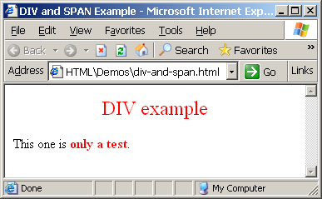
The <div> Tag
<div> creates logical divisions within a page
Block style element
Used with CSS
Example:
div.html
<div style="font-size:24px; color:red">DIV example</div>
<p>This one is <span style="color:red; font-weight:bold">only a test</span>.</p>

Slide 47
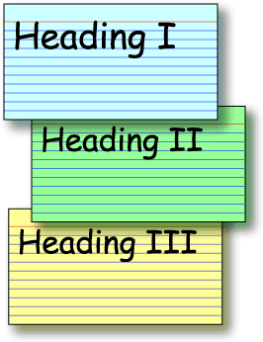
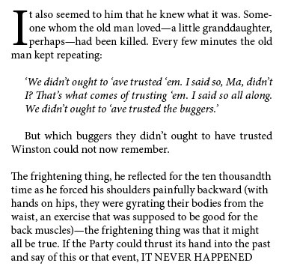
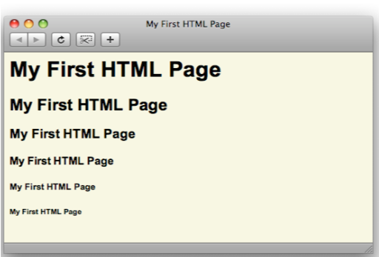
HTML Events

Slide 48
HTML Events
HTML 4 added the ability to let events trigger actions in a browser, like starting a JavaScript when a user clicks on an element.
An HTML event can be something the browser does, or something a user does.
Examples of HTML events:
An HTML web page has finished loading
An HTML input field was changed
An HTML button was clicked
When events happen, a developer may want to perform some task e.g. change background color of button when clicked.
JavaScript lets you execute code when events are detected.

Slide 49
Type of Events
Window Events
Events triggered for the window object (applies to the <body> tag)
onload
Form Events
onsubmit, onselect, onsearch, onchange
Keyboard Events
onkeyup, onkeydown , onkeypress
Mouse Events
onclick, onmouseover, onmouseout

Slide 50
Common HTML Events
Event | Description
onchange | An HTML element has been changed
onclick | The user clicks an HTML element
onmouseover | The user moves the mouse over an HTML element
onmouseout | The user moves the mouse away from an HTML element
onkeydown | The user pushes a keyboard key
onload | The browser has finished loading the page

