Slide 1
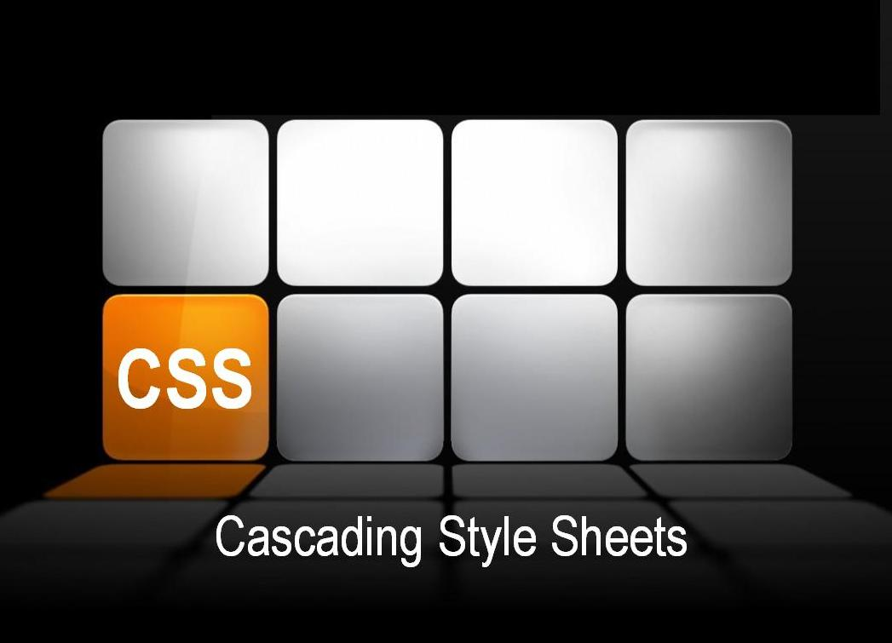
Lecture#6
Lecture#6

Slide 2
Overview
Introduction
Style Rules
Types of Style Sheets
Selector
Pseudo-class
Pseudo-Element

Slide 3

Cascading Style Sheets
CSS stands for Cascading Style Sheets
Styles define how to display HTML elements
CSS is a set of instructions that tells the browser how the website looks so it is all about styling.
The difference between HTML and CSS is HTML is all about contents of website and CSS is about styling of website

Slide 4
Introduction
CSS has various levels and profiles. Each level of CSS builds upon the last, typically adding new features and typically denoted as CSS1, CSS2, and CSS3.
The first CSS specification to become an official W3C Recommendation is CSS level 1, published in December 1996
CSS level 2 was developed by the W3C and published as a Recommendation in May 1998. A superset of CSS1, CSS2 includes a number of new capabilities like absolute, relative, and fixed positioning of elements and z-index, the concept of media types etc.
CSS 3 CSS level 3 is currently under development. The W3C maintains a CSS3 progress report.

Slide 5
Introduction
HTML markup can be used to represent
Semantics: h1 means that an element is a top-level heading
Presentation: h1 elements look a certain way
It’s advisable to separate semantics from presentation because:
It’s easier to present documents on multiple platforms (browser, cell phone, spoken, …)
It’s easier to generate documents with consistent look
Semantic and presentation changes can be made independently of one another (division of labor)
User control of presentation is facilitated

Slide 6
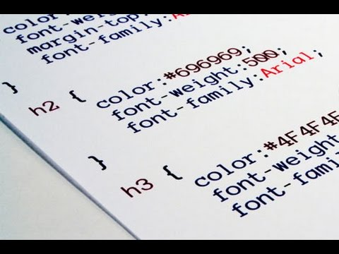
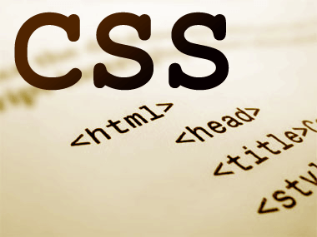
STYLE RULES

Slide 7
Understanding Style Rules
Declaration
Selector
A Style Rule is composed of two parts: a selector and a declaration.
TH {color: red;}.
The Selector indicates the element to which the rule is applied.
The Declaration determines the property values of a selector.
Notes:
7
The header cell of a table

Slide 8
Understanding Style Rules
Property
Value
The Property specifies a characteristic, such as color, font-family, position, and is followed by a colon (:).
The Value expresses specification of a property, such as red for color, arial for font family, 12 pt for font-size, and is followed by a semicolon (;).
P {color: red;}

Slide 9
Understanding Style Rules
CSS declarations always ends with a semicolon, and declaration groups are surrounded by curly brackets
To make the CSS more readable, you can put one declaration on each line, like this:
p {color:red;text-align:center;}
p { color:red; text-align:center; }

Slide 10
Comments
CSS Comments
A CSS comment begins with "/*", and ends with "*/", like this:
/*This is a comment*/
p { text-align:center; /*This is another comment*/ color:black; font-family:arial; }

Slide 11

STYLE SHEETS

Slide 12
Ways to Insert CSS
Inline style
Style rules can also be added directly to any HTML element.
Internal style sheet
Style rules can be embedded directly into any HTML page
External style sheet
most common method of attaching CSS rules to an HTML document

Slide 13
Inline style
A style parameter is added to the element via HTML ‘style’ attribute and style rules are entered as the value
An inline style loses many of the advantages of style sheets by mixing content with presentation
<h2 style="color:red;background:black;">This is a red heading with a black background</h2>

Slide 14
Internal Style Sheet
An internal style sheet should be used when a single document has a unique style.
Define internal styles in the head section of an HTML page.
<!DOCTYPE HTML>
<html>
<head> <style> hr {color:red;} p {margin-left:20px;} body {background-image:url("images/back40.gif");} </style> </head>
<body>
<p> This is a paragraph</p>
</body></html>`

Slide 15
External Style Sheet
An external style sheet is ideal when the style is applied to many pages.
With an external style sheets, you can change the look of an entire Web site by changing the style sheets.
Each page must link to the style sheet using the <link> tag. The <link> tag goes inside the head section:
<head> <link rel="stylesheet" type="text/css" href="mystyle.css" /> </head>

Slide 16
External Style Sheet:<Link> Attributes
The <link> tag defines a link between a document and an external resource (defined in head tag)
rel="stylesheet"
Describes the relationship between the current document and the destination URL.
Href
Specifies the URL of the resource document.

Slide 17
External Style Sheet
An external style sheet can be written in any text editor. The file should not contain any html tags.
Style sheet should be saved with a .css extension.
*{
margin:0px;
padding:0px}
hr {color:red;} p {margin-left:20px;} body {background-image:url("images/back40.gif");}

Slide 18
Multiple Stylesheets
If some properties have been set for the same selector in different style sheets, the values will be inherited from the more specific style sheet.
For example, an external style sheet has these properties for the h3 selector:
And an internal style sheet has these properties for the h3 selector:
If the page with the internal style sheet also links to the external style sheet the properties for h3 will be:
The color is inherited from the external style sheet and the text-alignment and the font-size is replaced by the internal style sheet.
H3 { color:red; text-align:left;font-size:8pt; }
H3 {text-align:right; font-size:20pt;}
color:red;text-align:right;font-size:20pt;

Slide 19
Inheritance
A descendant is an element that is enclosed (nested) in another, its ancestor. (If it is an immediate descendant, it is a child of the enclosing element, its parent. Elements having the same parent are siblings.)
All descendants of an element inherit its style properties, unless these are overridden by their own style rules.
If two styles could apply to the same element, the one defined by the more specific rule will be used. For instance, an explicit rule is always more specific than an inherited rule.

Slide 20

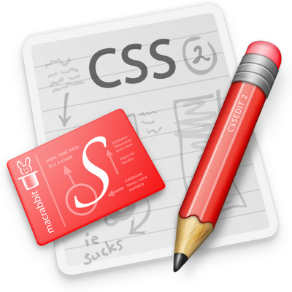
SELECTORS

Slide 21
Selectors
Universal Selector
Type Selector
Descendent Selectors
Child Selectors
Adjacent Selectors
Attribute selectors
ID Selector
Class Selector

Slide 22
Universal Selector
The universal selector matches any element type
This rule set will be applied to every element in a document:
* {
margin: 0;
padding: 0;
}

Slide 23
Type Selector
A type selector matches the name of a document language element type. A type selector matches every instance of the element type in the document tree.
The following rule matches all H1 elements in the document tree:
h1 { font-family: sans-serif }
img {margin:0px;
width:20%;
height: 20%}

Slide 24
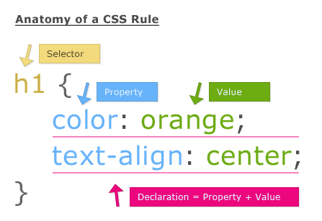
Type Selector

Slide 25
ID Selector
The following ID selector matches the ID attribute that has the value " firstname":
#firstname {color:Blue; font-weight:bold}

Slide 26
ID Selector
ID attribute can be used to uniquely identify its element.
In HTML all ID attributes are named "id.
CSS ID selectors match an element instance based on its identifier.
A CSS ID selector contains a "#" immediately followed by the ID value, which must be an identifier.

Slide 27
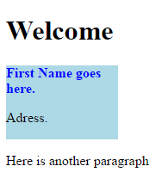
ID Selector
<head>
<style>
#firstname {color:Blue; font-weight:bold}
#intro {
background-color: lightblue;
width:20%; height:20%
}
</style></head>
<body>
<h1>Welcome</h1>
<div id="intro">
<p id="firstname">First Name goes here.</p>
<p id="hometown">Adress.</p>
</div>
<p>Here is another paragraph</p>
</body>

Slide 28
Class Selector
The class selector allows you to match a rule with an element (or elements) carrying a class attribute whose value matches the one specified in the class selector.
For example, a < p > element with a class attribute whose value was BackgroundNote
< p class=”BackgroundNote” > This paragraph contains an aside.
< /p >

Slide 29
Class Selector
One way is to simply assign a rule that applies to any element that has a class attribute whose value is BackgroundNote
Or you can create a selector that selects only the < p > elements that carry a class attribute with a value of BackgroundNote (not other elements) like so:
.BackgroundNote {}
p.BackgroundNote {}

Slide 30
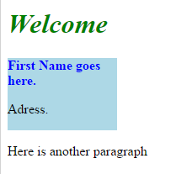
Class Selector: Example
<head>
<style>
.welcome{font-style:italic; color:Green}
.firstname {color:Blue; font-weight:bold}
.intro {
background-color: lightblue;
width:20%; height:20%
}
</style></head>
<body>
<h1 class="welcome">Welcome</h1>
<div class="intro">
<p class="firstname">First Name goes here.</p>
<p id="hometown">Adress.</p>
</div>
<p>Here is another paragraph</p>
</body>

Slide 31
Descendent Selector
At times, authors may want selectors to match an element that is the descendant of another element in the document tree
e.g., "Match those EM elements that are contained by a div element“
Descendant selectors express such a relationship in a pattern. A descendant selector is made up of two or more selectors separated by white space.
A descendant selector of the form "A B" matches when an element B is an arbitrary descendant of some ancestor element A.

Slide 32
Descendent Selector
Selectors can be defined so that a style rule applies to an element only when it is a descendant of a certain other type of element. Examples:
ul ul { list-style-type : square }
This specifies that all unordered lists that are descendents of another unordered list will be bulleted by squares.
h1 em em { color : red }
This specifies that emphasized text inside emphasized text in an <h1> header will appear in red.

Slide 33
Descendent Selector
For example, consider the following example for heading which emphasizes some text
For example, consider the following rules
Consider a rule that sets the text color to blue whenever an EM occurs anywhere within an H1
The third rule will match the EM inside the H1
<H1>This headline is <EM>very</EM> important</H1>
h1 { color: red }
em { color: red}
h1 { color: red }
em { color: red }
h1 em { color: blue }

Slide 34
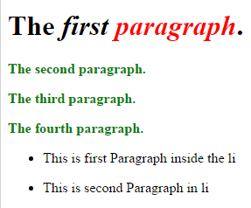
Example
<!DOCTYPE html>
<html>
<head>
<style>
body>p { color: green; font-weight:bold }
p em em{color: red; font-weight:bold}
</style>
</head>
<body>
<p>The <em>first <em>paragraph</em></em>.
</p>
<p>The second paragraph.</p>
<p>The third paragraph.</p>
<p>The fourth paragraph.</p>
<ul>
<li><p>This is first <em>Paragraph</em> inside the li</p></<li>
<li><p>This is second Paragraph inside the li</p></<li>
</ul>
</body>
</html>

Slide 35
HTML Tree
html
head
body
p
p
p
p
ul
li
li
p
p

Slide 36
Child Selector
A child selector matches when an element is a direct child of another. A child selector is made up of two or more selectors separated by ">".
In this case it matches any < b > elements that are direct children of < td >
body > P { line-height: 1.3 }
td > b {font-size: small}

Slide 37
Child Selector
The following example combines descendant selectors and child selectors:
It matches a P element that is a descendant of an li; the li element must be the child of an UL element; the UL element must be a descendant of a DIV. Notice that the optional white space around the ">" combinator has been left out.
div ul>li p

Slide 38
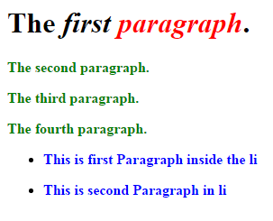
Example
<!DOCTYPE html>
<html>
<head>
<style>
body>p { color: green; font-weight:bold }
h1 em em {color: red; font-weight:bold}
div ul>li p { color: blue; font-weight:bold}
</style></head>
<body>
<p> <h1>The <em>first <em>paragraph</em></em>.</h1></p>
<p>The second paragraph.</p>
<p>The third paragraph.</p>
<p>The fourth paragraph.</p>
<div>
<ul>
<li><p>This is first Paragraph inside the li</p></<li>
<li><p>This is second Paragraph in li</p></<li>
</ul>
</div></body>
</html>

Slide 39
Adjacent Selector
An adjacent sibling selector matches an element type that is the next sibling of another.
For example, if you want to make the first paragraph after any level 1 heading a different style from other < p > elements you can use the adjacent sibling selector like so to specify rules for just the first < p > element to come after any < h1 > element:
h1+p {}

Slide 40
Adjacent Selector
Adjacent sibling selectors have the following syntax: E1 + E2, where E2 is the subject of the selector.
The selector matches if E1 and E2 share the same parent in the document tree and E1 immediately precedes E2, ignoring non-element nodes (such as text nodes and comments).
Thus, the following rule states that when a P element immediately follows a p element, it should not be indented
The next example reduces the vertical space separating an H1 and an H2 that immediately follows it:
h1 + p { text-indent: 0 }
h1 + h2 { margin-top: -5mm }

Slide 41
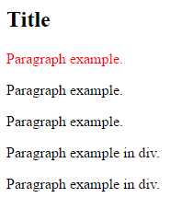
Adjacent Selector: Example
<head>
<style>
.box {color:blue}
h2+p {
color:red;
}
H2~p{color: green}
</style>
</head>
<body>
<h2>Title</h2>
<p>Paragraph example.</p>
<p>Paragraph example.</p>
<p>Paragraph example.</p>
<div class="box">
<p>Paragraph example in div.</p>
<p>Paragraph example in div.</p>
</div>
</body>
</html>

Slide 42
General Sibling Selector
The General Sibling Selector The general sibling selector matches an element type that is a sibling of another, although it does not have to be the directly preceding element.
If there are two < p > elements that are siblings of an < h1 > element, they would both use the rules of this selector.
h1~p {}

Slide 43
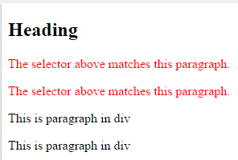
Sibling Selector: Example
<head>
<style>
h2~div p{color:red}
</style></head>
<body>
<h2>Heading</h2>
<p>The selector above matches this paragraph.</p>
<p>The selector above matches this paragraph.</p>
<div>
<p>This is paragraph in div</p>
<p>This is paragraph in div</p>
</div>
</body>

Slide 44
Attribute Selector
Allows authors to specify rules that match elements which have certain attributes defined in the source document.
[attribute^=value] Represents an element with the attribute whose value begins with the prefix value.
[attribute$=value] Represents an element with the attribute whose value ends with the prefix value.
[attribute*=value] Represents an element with the attribute whose value contains the prefix value.

Slide 45
Attribute Selector Example
CSS
<html>
<head>
<style>
.menu{}
.meniuItems{}
.menubar{}
Div[class*=menu]{
Margin:5px}
input[type=text] {
width: 200px;
background-color: yellow;
}
input[type=submit] {
width: 120px;
border-radius: 5px}
</style>
</head>
HTML
<body>
<div class =“menu”>
<div class=“menubar”></div>
</div>
<div class =“abc”></div>
<h2>Attribute Selector Exmple</h2>
<form action="" method="get">
Firstname:<input type="text" name=“FirstName">
Lastname:<input type="text" name=“LastName"
<input type=“submit" value=“Submit">
</form>
</body>
</html>

Slide 46
Vendor Prefixes
Some CSS rules won’t work without the vendor prefix.
To use a brand new CSS style property, the standard CSS property is taken and the prefix is added for each browser.
Browser prefixes, are a way for browser makers to add support for new CSS features before those features are fully supported in all browsers.
Android: -webkit
Chrome: -webkit
Firefox: -moz
Internet Explorer: -ms
iOS: -webkit
Opera: -o
Safari: -webkit-
Browser manufacturer is
determining exactly how
these new CSS features
will be implemented.

Slide 47
Vendor Prefixes
Few years back
-moz-border-radius: 10px 5px;
-webkit-border-top-left-radius: 10px;
-webkit-border-top-right-radius: 5px;
-webkit-border-bottom-right-radius: 10px;
-webkit-border-bottom-left-radius: 5px;
Now Standard version is
border-radius: 10px 5px;

Slide 48
CSS Units
Absolute Units
The absolute length units are fixed.
Length expressed in terms of any of these will be displayed according to exactly that size.
cm, mm, in, px, pt, pc
Relative Units
Relative length units describe the length relative to another length property.
relative to the current element's font-size or viewport size:
Relative length units are considered to scale better amongst different rendering mediums (screens).
em, rem, vw, vh, vmin, vmax, %

Slide 49
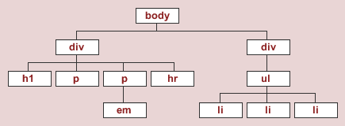
Pseudo-Class & Pseudo Element
Style is normally attached to an element based on its position in the document tree
Neither pseudo-elements nor pseudo-classes appear in the document source or document tree.

Slide 50
Pseudo-Element & Pseudo-Class
CSS introduces the concepts of pseudo-elements and pseudo-classes to permit formatting based on information that lies outside the document tree.
Pseudo-classes, together with pseudo-elements, let you apply a style to an element not only in relation to the content of the document tree, but also in relation to external factors like the history of the navigator (:visited, for example), the status of its content (like :checked on some form elements), or the position of the mouse (like :hover which lets you know if the mouse is over an element or not).

Slide 51
Pseudo-Class
A pseudo-class is used to define a special state of an element
A CSS pseudo-class is a keyword added to selectors that specifies a special state of the element to be selected.
For example :hover will apply a style when the user hovers over the element specified by the selector.
A CSS pseudo-class can be used to
Style an element on mouse over it
Style visited and unvisited links differently
Style an element when it gets focus
selector:pseudo-class { property: value; }

Slide 52
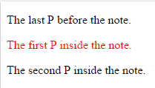
Pseudo-Class: Types
:first-child pseudo-Class
The :first-child pseudo-class matches an element that is the first child element of some other element.
This selector would match the P inside the DIV of the following fragment
div > p:first-child { text-indent: 0; color:red;}
<p> The last P before the note.</p>
<div class="note">
<p>The first P inside the note.</p>
<p>The second P inside the note. </p>
</div>

Slide 53
Pseudo-Class: Types Cont..
The link pseudo-classes: :link and :visited
CSS provides the pseudo-classes ':link' and ':visited' to distinguish visited and unvisited links
The :link pseudo-class applies to the links that have not yet been visited.
The :visited pseudo-class applies once the link has been visited by the user.
<a class="external" href=“www.google.com">external link</a>

Slide 54
Pseudo-Class: Types Cont..
CSS provides three pseudo-classes for common cases:
The :hover pseudo-class applies while the cursor (mouse pointer) hovers over a box generated by the element. User agents not supporting interactive media do not have to support this pseudo-class. Some conforming user agents supporting interactive media may not be able to support this pseudo-class (e.g., a pen device).
The :active pseudo-class applies while an element is being activated by the user. For example, between the times the user presses the mouse button and releases it.
The :focus pseudo-class applies while an element has the focus (accepts keyboard events or other forms of text input).
An element may match several pseudo-classes at the same time.

Slide 55
Pseudo-Class
a:link { color: blue;} /* visited link */ a:visited { color: red; }
/* mouse over link */
a:hover { color: pink; }
/* selected link */
a:active { */ when clicked*/
color: green;
}
p:nth-child(2)
/*Selects every p element that is second child of its parent*/
{
color: blue;
}
pseudo-classes

Slide 56
Pseudo Element
A CSS pseudo-element is used to style specified parts of an element.
For example, pseudo-element can be used to:
Style the first letter, or line, of an element
Insert content before, or after, the content of an element
The :first-line pseudo-element can only be attached to a block container element.

Slide 57
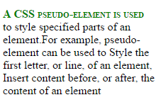
Pseudo Element
<!DOCTYPE html>
<html>
<head>
<style>
p:first-line {
color: green;
font-weight:bold;
font-variant: small-caps;}
</style></head>
<body>
<p>A CSS pseudo-element is used to style specified parts of an element. For example, pseudo-element can be used to Style the first letter, or line, of an element, Insert content before, or after, the content of an element
</p>
</body></html>

Slide 58
Pseudo-Element: Types
::first-letter
::Selection
::before
::after
::first-line
Apply the style to first line of Block-level Element e.g. <P>
:first-line introduced in CSS2
::first-line introduced in CSS3
Small subset of CSS properties can be used with ::first-line e.g. color, font and background related properties

Slide 59
Grouping
When several selectors share the same declarations, they may be grouped into a comma-separated list.
In this example, three rules with identical declarations can be combined into one. Thus,
h1 { font-family: sans-serif }
h2 { font-family: sans-serif }
h3 { font-family: sans-serif } is equivalent to:
h1, h2, h3 { font-family: sans-serif }

Slide 60
Pattern Matching
Pattern | Meaning
* | Matches any element.
E | Matches any E element (i.e., an element of type E).
E F | Matches any F element that is a descendant of an E element.
E > F | Matches any F element that is a child of an element E
E:first-child | Matches element E when E is the first child of its parent.
E:link E:visited | Matches element E if E is the source anchor of a hyperlink of which the target is not yet visited (:link) or already visited (:visited).

Slide 61
Pattern Matching
Pattern | Meaning
E:active E:hover E:focus | Matches E during certain user actions.
E:lang(c) | Matches element of type E if it is in (human) language c (the document language specifies how language is determined).
E + F | Matches any F element immediately preceded by a sibling element E
E[foo] | Matches any E element with the "foo" attribute set (whatever the value).
.warning | Language specific. (In HTML, the same as DIV[class~="warning"].)
#myid | Matches any E element with ID equal to "myid".

Slide 62
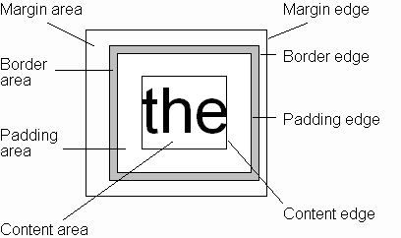
CSS Box Model
Every rendered element occupies a box:
(or outer edge)
(or inner edge)

Slide 63
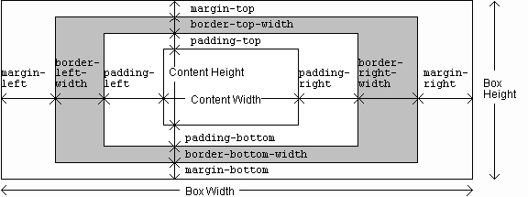
CSS Box Model

Slide 64
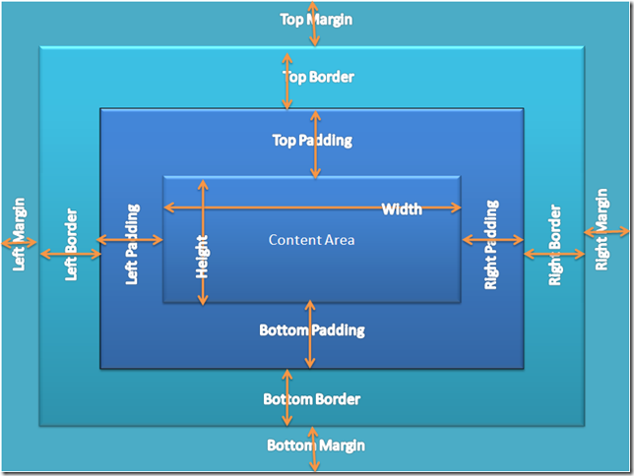
CSS Box Model

Slide 65
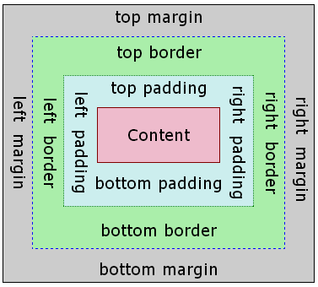
CSS Box Model

Slide 66
Flow Layout
Block
elements
only

Slide 67
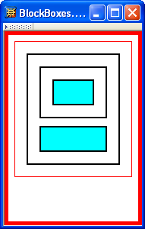
Flow Layout
html
body
div d1
div d2
div d3
div d4
Top edges of
block boxes are
in document order

Slide 68
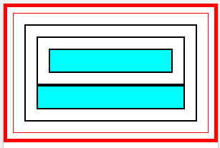
Flow Layout
Eliminate Top Margin class from d4

