Slide 1
Pemesanan Tiket Kereta Online
Kelompok 2:
-
-
-
-

Slide 2
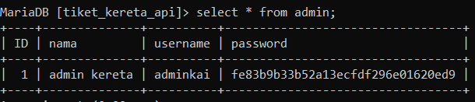
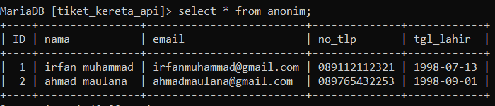
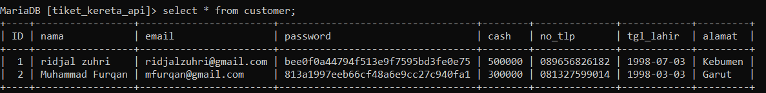
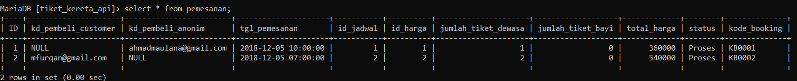
Integritas Entitas (Entity Integrity) Integritas Data Antar Tabel (Redundant Data Integrity) Integritas Aturan Nyata (Bussiness Rule Integrity)

Slide 3
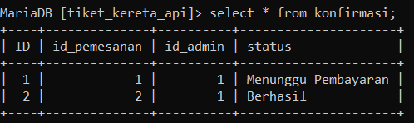
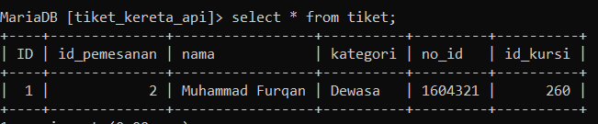
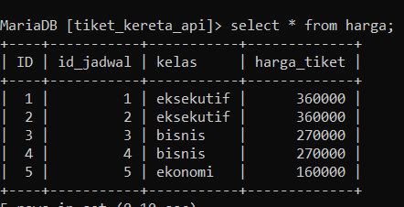
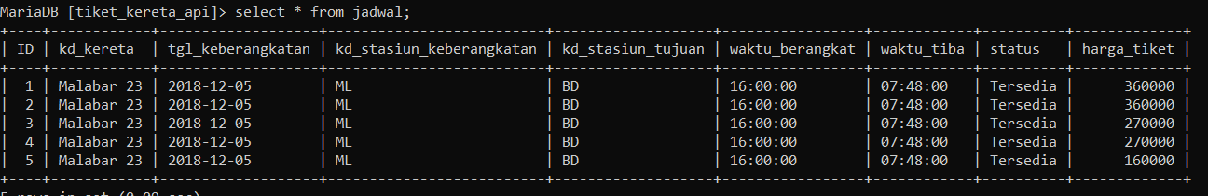
Integritas Entitas (Entity Integrity) Integritas Data Antar Tabel (Redundant Data Integrity) Integritas Aturan Nyata (Bussiness Rule Integrity)

Slide 4
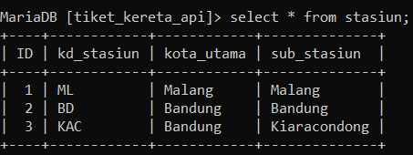
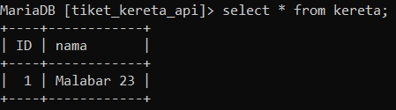
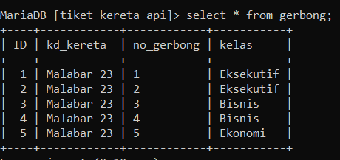
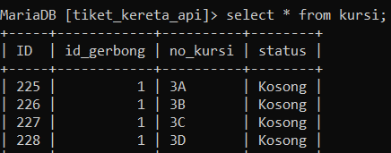
Integritas Entitas (Entity Integrity) Integritas Data Antar Tabel (Redundant Data Integrity) Integritas Aturan Nyata (Bussiness Rule Integrity)

Slide 5
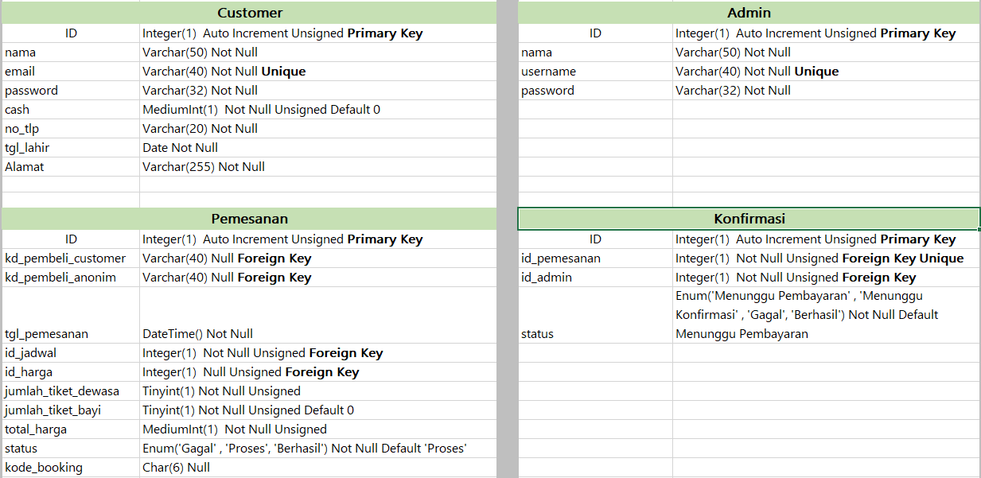
Integritas Jangkauan (Domain Integrity)

Slide 6
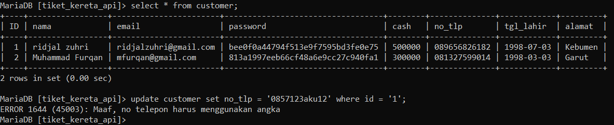
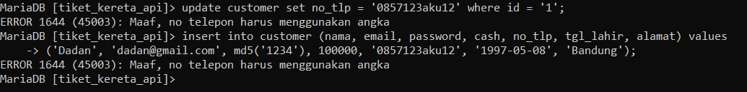
Integritas Jangkauan (Domain Integrity)

Slide 7
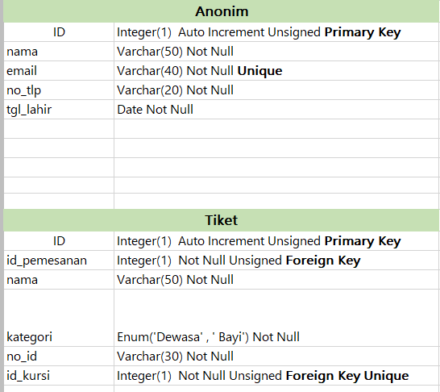
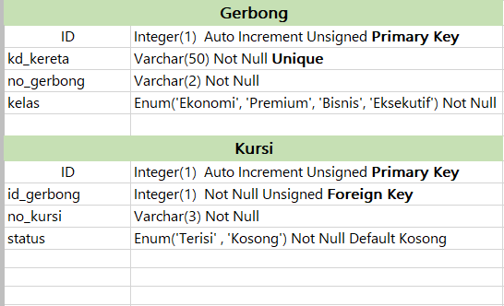
Integritas Jangkauan (Domain Integrity)

Slide 8
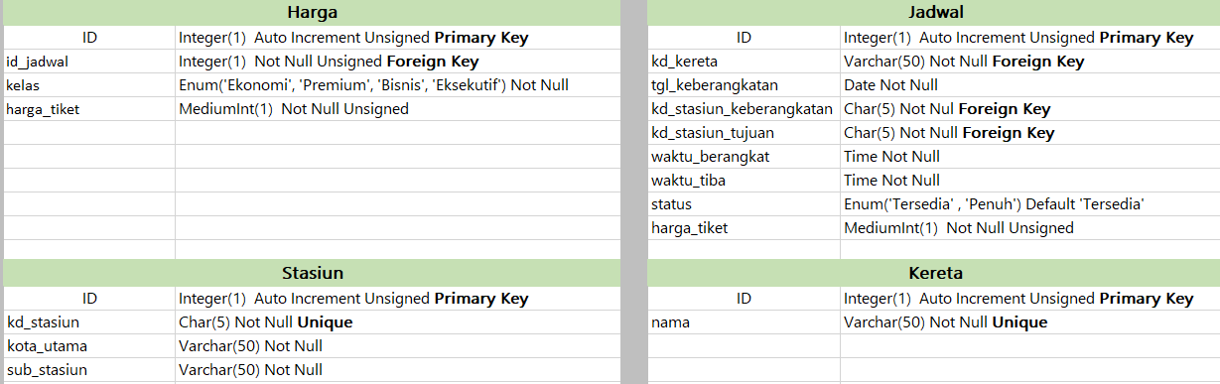
Integritas Jangkauan (Domain Integrity)

Slide 9
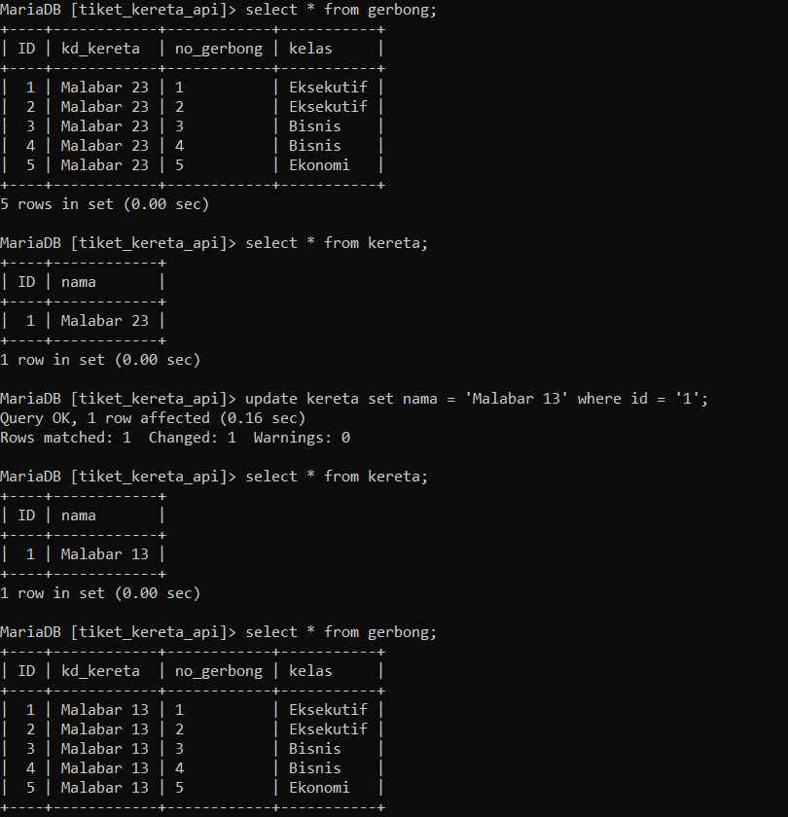
Integritas Acuan (Referential Integrity)

