Slide 1
AriseScholar AI-Driven Notes & Quiz Generator
Here is where your presentation begins

Slide 2
Problem Statement
Students spend hours reading and making notes from textbooks, PYQs, and PDFs.
Manual quiz and flashcard creation is time-consuming.
Lack of personalized, automated learning tools.

Slide 3
Our Solution
AriseScholar: AI-powered web app for students to upload study material and get:
Automatically generated quizzes (MCQs, True/False)
Flashcards for quick revision
Summarized notes from documentsPersonalized, efficient, and interactive learning.

Slide 4
Key Features
01.
02.
03.
04.
05.
06.
Document Upload: Upload PDFs, DOCX, and PYQs.
AI-Generated Notes: Summaries and answers for repeated questions
Quiz Generation: MCQs, True/False questions dynamically created.
Dashboard: Stats like total documents, quizzes, flashcards, average scores, etc.
Flashcards: Question-answer style flashcards for revision.
Adaptive Learning Recommendations: Personalized suggestions based on performance

Slide 5
Technology Stack
Backend: Django, Django REST Framework
Frontend: React / Next.js (if applicable)
AI Services: Groq API (for quiz/note generation)
Database: SQLite / MongoDB
Deployment: Render
Tools: Python, Node.js

Slide 6
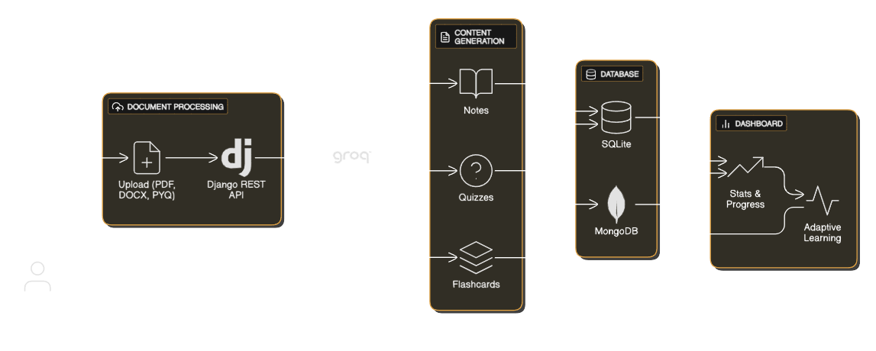
System Architecture

Slide 7
Demo

Slide 8
Future Enhancements
Multi-language support (Marathi, Hindi) for PYQs
Real-time quiz performance analytics
Mobile app versionBlockchain integration for verified study content
Personalized AI tutor recommendations

Slide 9
Conclusion
Content:Show upload → notes/quiz generation → dashboard workflow.
Emphasize time-saving and adaptive learning.
Encourage judges to try the platform for quick learning.

Slide 10
Thank you!
Do you have any questions?
sandeshpol268@gmail.com
+91 9067248106

