Slide 1



Green University of Bangladesh
Dept. of CSE
Presentation on
GreenU SpeakUp
Presented By
Toufiq Zahan Tushar
ID - 231002020
Irfan Ferdous Siam
ID - 231002025
Presented to
Mahbubur Rahman
Lecturer
Dept. of CSE
Green University of Bangladesh.

Slide 2

01
TABLE OF CONTENTS
Introduction
Key Features
Project Goals
Technology used
Challenges Faced
Limitations
Future Improvements
Conclusion

Slide 3
02
INTRODUCTION
Green U SpeakUp is a web-based platform designed to provide students and teachers with an easy way to share complaints and suggestions related to university issues. The project aims to facilitate transparent and effective communication between the university community and management, allowing problems to be addressed quickly and efficiently.

Slide 4
03
KEY FEATURES
Secure user registration and login system
Ability to post complaints and suggestions
Comment section for discussion on posts
Dedicated page for solved problems with proof images
Dark mode for better accessibility and user experience

Slide 5
05
PROJECT GOALS
Simplify the complaint and suggestion process.
Encourage more student-teacher engagement.
Maintain a record of issues raised and solved.
Enable posting, commenting, and interaction like a mini social platform.

Slide 6
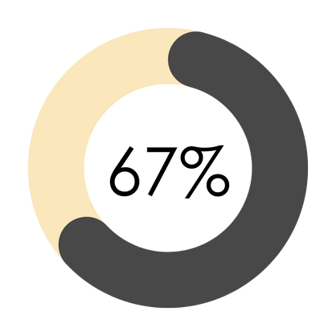
06
TECHNOLOGY STACK
HTML
CSS
JAVA SCRIPT
Firebase
GitHub Pages

Slide 7
07
CHALLENGES FACED
Developing real-time updates was tricky but important for a smooth user experience. Learning Firebase integration and handling user authentication without a traditional backend also took time. Designing a clean, responsive interface that works well on different devices was another challenge

Slide 8
08
LIMITATIONS
No admin panel yet.
No email verification or password reset.
No notification system or attachments.
Only supports text-based posts

Slide 9
09
FUTURE IMPROVEMENTS
Add admin dashboard for post moderation.
Enable image uploads and categories.
Email/password recovery.
Real-time notifications for updates.

Slide 10
10
CONCLUSION
GreenU SpeakUp successfully creates a space for open communication in the university community. Although there are some limitations, the platform’s core functions work well, and the use of Firebase made development easier and faster. With future enhancements, this project can become a vital tool for campus engagement.

Slide 11
11
THANK YOU
Visit the site

