Slide 1
FYP-1 Mid Evaluation
Words In Action

Slide 2
Team members
Hamza Tariq (I16-0134)
Shan Akber (I16-0149)
Irfan ULLAH (I16-0533)
Supervisor (Dr. Omer Baig)

Slide 3
Words In Action
Basic Idea

Slide 4
Modifications
A development project
Redefined Scope

Slide 5
Constraints
Story length
Animation length
Desktop application

Slide 6
First Iteration
Studying NLP strategies and Unity 3D

Slide 7
Implementation of NLP techniques
NLTK(Natural Language ToolKit)
SpaCy

Slide 8
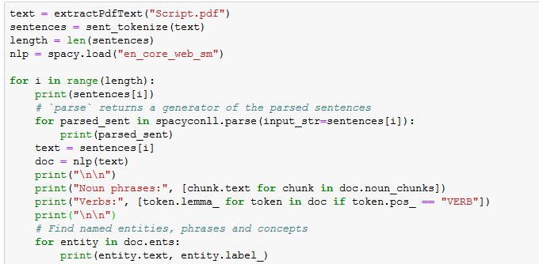
Code

Slide 9
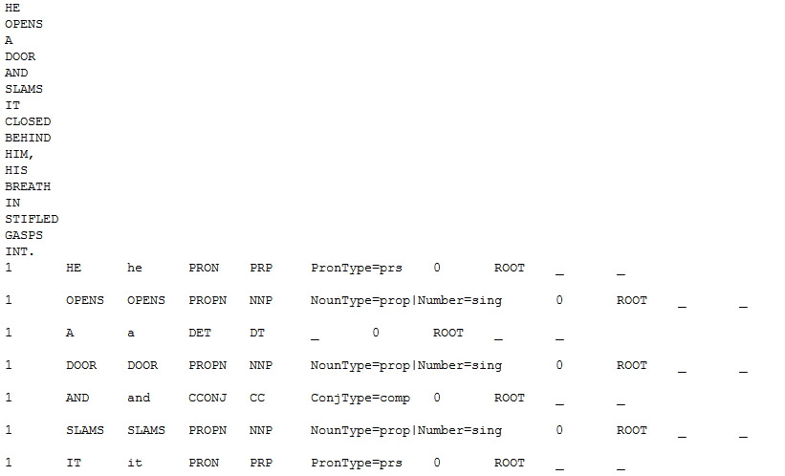
Results

Slide 10
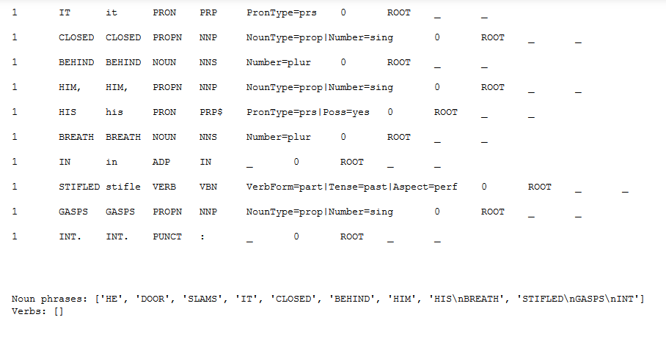
Results(cont)

Slide 11
Demo
Pipeline of text to animation

Slide 12
Unity 3D work
Pipeline
Control Chararter

Slide 13
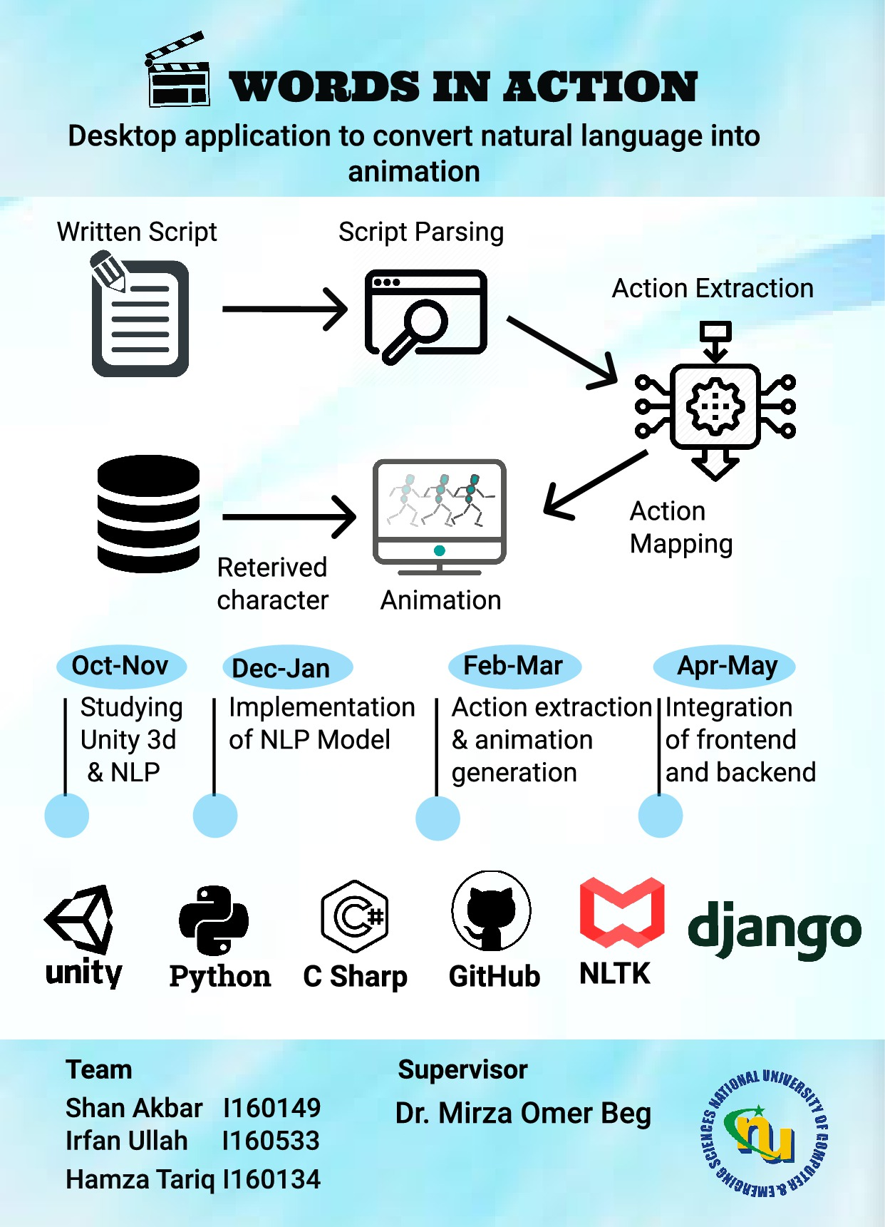
Poster

Slide 14
Work till FYP-1 Final
Implementation of NLP model

Slide 15
Use Cases
Input Text
View Animation
Replay
Pause
Resume

