Slide 1


Chapter 3
Transport Layer
A note on the use of these Powerpoint slides:
We’re making these slides freely available to all (faculty, students, readers). They’re in PowerPoint form so you see the animations; and can add, modify, and delete slides (including this one) and slide content to suit your needs. They obviously represent a lot of work on our part. In return for use, we only ask the following:
Computer Networking: A Top Down Approach
If you use these slides (e.g., in a class) that you mention their source (after all, we’d like people to use our book!)
If you post any slides on a www site, that you note that they are adapted from (or perhaps identical to) our slides, and note our copyright of this material.
Thanks and enjoy! JFK/KWR
All material copyright 1996-2016
J.F Kurose and K.W. Ross, All Rights Reserved
7th Edition, Global Edition
Jim Kurose, Keith Ross
Pearson
April 2016
Transport Layer
2-<number>

Slide 2
Chapter 3: Transport Layer
our goals:
understand principles behind transport layer services:
  multiplexing, demultiplexing
  reliable data transfer
  flow control
  congestion control
learn about Internet transport layer protocols:
  UDP: connectionless transport
  TCP: connection-oriented reliable transport
  TCP congestion control
Transport Layer
3-<number>

Slide 3
Chapter 3 outline
3.1 transport-layer services
3.2 multiplexing and demultiplexing
3.3 connectionless transport: UDP
3.4 connection-oriented transport: TCP
  segment structure
  reliable data transfer
  flow control
  connection management
3.5 TCP congestion control
Transport Layer
3-<number>

Slide 4


















Transport services and protocols
application
transport
network
data link
physical
provide logical communication between app processes running on different hosts
transport protocols run in end systems
  send side: breaks app messages into segments, passes to network layer
  rcv side: reassembles segments into messages, passes to app layer
more than one transport protocol available to apps
  Internet: TCP and UDP
logical end-end transport
application
transport
network
data link
physical
Transport Layer
3-<number>

Slide 5
Transport vs. network layer
network layer: logical communication between hosts
transport layer: logical communication between processes
  relies on, enhances, network layer services
household analogy:
12 kids in Ann’s house sending letters to 12 kids in Bill’s house:
hosts = houses
processes = kids
app messages = letters in envelopes
transport protocol = Ann and Bill who demux to in-house siblings
network-layer protocol = postal service
Transport Layer
3-<number>

Slide 6
Internet transport-layer protocols
reliable, in-order delivery (TCP)
  congestion control
  flow control
  connection setup
unreliable, unordered delivery: UDP
  no-frills extension of “best-effort” IP
services not available:
  delay guarantees
  bandwidth guarantees
application
transport
network
data link
physical
network
data link
physical
network
data link
physical
network
data link
physical
logical end-end transport
network
data link
physical
network
data link
physical
network
data link
physical
network
data link
physical
application
transport
network
data link
physical
Transport Layer
3-<number>

Slide 7
Chapter 3 outline
3.1 transport-layer services
3.2 multiplexing and demultiplexing
3.3 connectionless transport: UDP
3.4 connection-oriented transport: TCP
  segment structure
  reliable data transfer
  flow control
  connection management
3.5 TCP congestion control
Transport Layer
3-<number>

Slide 8

Multiplexing/demultiplexing
multiplexing at sender:
handle data from multiple
sockets, add transport header (later used for demultiplexing)
demultiplexing at receiver:
use header info to deliver
received segments to correct
socket
application
application
P1
P2
application
socket
P3
transport
P4
process
transport
network
transport
network
link
network
link
physical
link
physical
physical
Transport Layer
3-<number>

Slide 9
How demultiplexing works
host receives IP datagrams
  each datagram has source IP address, destination IP address
  each datagram carries one transport-layer segment
  each segment has source, destination port number
host uses IP addresses & port numbers to direct segment to appropriate socket
32 bits
source port #
dest port #
other header fields
application
data
(payload)
TCP/UDP segment format
Transport Layer
3-<number>

Slide 10
Connectionless demultiplexing
recall: when creating datagram to send into UDP socket, must specify
  destination IP address
  destination port #
recall: created socket has host-local port #:
DatagramSocket mySocket1 = new DatagramSocket(12534);
when host receives UDP segment:
  checks destination port # in segment
  directs UDP segment to socket with that port #
IP datagrams with same dest. port #, but different source IP addresses and/or source port numbers will be directed to same socket at dest
Transport Layer
3-<number>

Slide 11
Connectionless demux: example
DatagramSocket serverSocket = new DatagramSocket
(6428);
DatagramSocket mySocket2 = new DatagramSocket
(9157);
DatagramSocket mySocket1 = new DatagramSocket (5775);
application
application
P1
application
P3
P4
transport
transport
network
transport
network
link
network
link
physical
link
physical
physical
source port: 6428
dest port: 9157
source port: ?
dest port: ?
source port: 9157
dest port: 6428
source port: ?
dest port: ?
Transport Layer
3-<number>

Slide 12
Connection-oriented demux
TCP socket identified by 4-tuple:
  source IP address
  source port number
  dest IP address
  dest port number
demux: receiver uses all four values to direct segment to appropriate socket
server host may support many simultaneous TCP sockets:
  each socket identified by its own 4-tuple
web servers have different sockets for each connecting client
  non-persistent HTTP will have different socket for each request
Transport Layer
3-<number>

Slide 13
Connection-oriented demux: example
application
application
P4
P5
P6
application
P3
P2
P3
transport
transport
network
transport
network
link
network
link
physical
link
physical
server: IP address B
physical
host: IP address A
source IP,port: B,80
dest IP,port: A,9157
host: IP address C
source IP,port: C,5775
dest IP,port: B,80
source IP,port: A,9157
dest IP, port: B,80
source IP,port: C,9157
dest IP,port: B,80
three segments, all destined to IP address: B,
dest port: 80 are demultiplexed to different sockets
Transport Layer
3-<number>

Slide 14
Connection-oriented demux: example
threaded server
application
application
application
P4
P3
P3
P2
transport
transport
network
transport
network
link
network
link
physical
link
physical
server: IP address B
physical
host: IP address A
source IP,port: B,80
dest IP,port: A,9157
host: IP address C
source IP,port: C,5775
dest IP,port: B,80
source IP,port: A,9157
dest IP, port: B,80
source IP,port: C,9157
dest IP,port: B,80
Transport Layer
3-<number>

Slide 15
Chapter 3 outline
3.1 transport-layer services
3.2 multiplexing and demultiplexing
3.3 connectionless transport: UDP
3.4 principles of reliable data transfer
3.5 connection-oriented transport: TCP
  segment structure
  reliable data transfer
  flow control
  connection management
3.6 TCP congestion control
Transport Layer
3-<number>

Slide 16
UDP: User Datagram Protocol [RFC 768]
“no frills,” “bare bones” Internet transport protocol
“best effort” service, UDP segments may be:
  lost
  delivered out-of-order to app
connectionless:
  no handshaking between UDP sender, receiver
  each UDP segment handled independently of others
UDP use:
  streaming multimedia apps (loss tolerant, rate sensitive)
  DNS
  SNMP
reliable transfer over UDP:
  add reliability at application layer
  application-specific error recovery!
Transport Layer
3-<number>

Slide 17
UDP: segment header
length, in bytes of UDP segment, including header
32 bits
source port #
dest port #
length
checksum
why is there a UDP?
no connection establishment (which can add delay)
simple: no connection state at sender, receiver
small header size
no congestion control: UDP can blast away as fast as desired
application
data
(payload)
UDP segment format
Transport Layer
3-<number>

Slide 18
UDP checksum
Goal: detect “errors” (e.g., flipped bits) in transmitted segment
sender:
treat segment contents, including header fields, as sequence of 16-bit integers
checksum: addition (one’s complement sum) of segment contents
sender puts checksum value into UDP checksum field
receiver:
compute checksum of received segment
check if computed checksum equals checksum field value:
  NO - error detected
  YES - no error detected. But maybe errors nonetheless? More later ….
Transport Layer
3-<number>

Slide 19
Internet checksum: example
example: add two 16-bit integers
1 1 1 1 0 0 1 1 0 0 1 1 0 0 1 1 0
1 1 1 0 1 0 1 0 1 0 1 0 1 0 1 0 1
1 1 0 1 1 1 0 1 1 1 0 1 1 1 0 1 1
1 1 0 1 1 1 0 1 1 1 0 1 1 1 1 0 0
1 0 1 0 0 0 1 0 0 0 1 0 0 0 0 1 1
wraparound
sum
checksum
Note: when adding numbers, a carryout from the most significant bit needs to be added to the result
* Check out the online interactive exercises for more examples: http://gaia.cs.umass.edu/kurose_ross/interactive/
Transport Layer
3-<number>
Notes:
Kurose and Ross forgot to say anything about wrapping the carry and adding it to low order bit

Slide 20
Chapter 3 outline
3.1 transport-layer services
3.2 multiplexing and demultiplexing
3.3 connectionless transport: UDP
3.4 connection-oriented transport: TCP
  segment structure
  reliable data transfer
  flow control
  connection management
3.5 TCP congestion control
Transport Layer
3-<number>

Slide 21
TCP: Overview RFCs: 793,1122,1323, 2018, 2581
point-to-point:
  one sender, one receiver
reliable, in-order byte steam:
  no “message boundaries”
pipelined:
  TCP congestion and flow control set window size
full duplex data:
  bi-directional data flow in same connection
  MSS: maximum segment size
connection-oriented:
  handshaking (exchange of control msgs) inits sender, receiver state before data exchange
flow controlled:
  sender will not overwhelm receiver
Transport Layer
3-<number>

Slide 22
TCP segment structure
32 bits
URG: urgent data
(generally not used)
counting
by bytes
of data
(not segments!)
source port #
dest port #
sequence number
ACK: ACK #
valid
acknowledgement number
head
len
not
used
U
receive window
A
PSH: push data now
(generally not used)
P
R
S
F
# bytes
rcvr willing
to accept
checksum
Urg data pointer
RST, SYN, FIN:
connection estab
(setup, teardown
commands)
options (variable length)
application
data
(variable length)
Internet
checksum
(as in UDP)
Transport Layer
3-<number>

Slide 23
TCP seq. numbers, ACKs
outgoing segment from sender
sequence numbers:
  byte stream “number” of first byte in segment’s data
acknowledgements:
  seq # of next byte expected from other side
  cumulative ACK
Q: how receiver handles out-of-order segments
  A: TCP spec doesn’t say, - up to implementor
source port #
dest port #
sequence number
acknowledgement number
rwnd
checksum
urg pointer
window size
N
  sender sequence number space
sent
ACKed
sent, not-yet ACKed
(“in-flight”)
usable
but not
yet sent
not
usable
incoming segment to sender
source port #
dest port #
sequence number
acknowledgement number
A
rwnd
checksum
urg pointer
Transport Layer
3-<number>

Slide 24
TCP seq. numbers, ACKs
Host A
Host B
User
types
‘C’
Seq=42, ACK=79, data = ‘C’
host ACKs
receipt of
‘C’, echoes
back ‘C’
Seq=79, ACK=43, data = ‘C’
host ACKs
receipt
of echoed
‘C’
Seq=43, ACK=80
simple telnet scenario
Transport Layer
3-<number>

Slide 25
TCP round trip time, timeout
Q: how to set TCP timeout value?
longer than RTT
  but RTT varies
too short: premature timeout, unnecessary retransmissions
too long: slow reaction to segment loss
Q: how to estimate RTT?
SampleRTT: measured time from segment transmission until ACK receipt
  ignore retransmissions
SampleRTT will vary, want estimated RTT “smoother”
  average several recent measurements, not just current SampleRTT
Transport Layer
3-<number>

Slide 26

TCP round trip time, timeout
EstimatedRTT = (1- α)*EstimatedRTT + α*SampleRTT
exponential weighted moving average
influence of past sample decreases exponentially fast
typical value: α = 0.125
RTT: gaia.cs.umass.edu to fantasia.eurecom.fr
RTT (milliseconds)
sampleRTT
EstimatedRTT
time (seconds)
Transport Layer
3-<number>

Slide 27

TCP round trip time, timeout
timeout interval: EstimatedRTT plus “safety margin”
  large variation in EstimatedRTT -> larger safety margin
estimate SampleRTT deviation from EstimatedRTT:
DevRTT = (1-β)*DevRTT +
β*|SampleRTT-EstimatedRTT|
(typically, β = 0.25)
TimeoutInterval = EstimatedRTT + 4*DevRTT
estimated RTT
“safety margin”
* Check out the online interactive exercises for more examples: http://gaia.cs.umass.edu/kurose_ross/interactive/
Transport Layer
3-<number>

Slide 28
Chapter 3 outline
3.1 transport-layer services
3.2 multiplexing and demultiplexing
3.3 connectionless transport: UDP
3.4 connection-oriented transport: TCP
  segment structure
  reliable data transfer
  flow control
  connection management
3.5 TCP congestion control
Transport Layer
3-<number>

Slide 29
TCP reliable data transfer
TCP creates rdt service on top of IP’s unreliable service
  pipelined segments
  cumulative acks
  single retransmission timer
retransmissions triggered by:
  timeout events
  duplicate acks
let’s initially consider simplified TCP sender:
  ignore duplicate acks
  ignore flow control, congestion control
Transport Layer
3-<number>

Slide 30
TCP sender events:
data rcvd from app:
create segment with seq #
seq # is byte-stream number of first data byte in segment
start timer if not already running
  think of timer as for oldest unacked segment
  expiration interval: TimeOutInterval
timeout:
retransmit segment that caused timeout
restart timer
ack rcvd:
if ack acknowledges previously unacked segments
  update what is known to be ACKed
  start timer if there are still unacked segments
Transport Layer
3-<number>

Slide 31
TCP sender (simplified)
data received from application above
create segment, seq. #: NextSeqNum
pass segment to IP (i.e., “send”)
NextSeqNum = NextSeqNum + length(data)
if (timer currently not running)
start timer
Λ
NextSeqNum = InitialSeqNum
SendBase = InitialSeqNum
wait
for
event
timeout
retransmit not-yet-acked segment with smallest seq. #
start timer
ACK received, with ACK field value y
if (y > SendBase) {
SendBase = y
/* SendBase–1: last cumulatively ACKed byte */
if (there are currently not-yet-acked segments)
start timer
else stop timer
}
Transport Layer
3-<number>

Slide 32
TCP: retransmission scenarios
Host A
Host B
Host A
Host B
SendBase=92
Seq=92, 8 bytes of data
Seq=92, 8 bytes of data
timeout
timeout
Seq=100, 20 bytes of data
ACK=100
X
ACK=100
ACK=120
Seq=92, 8 bytes of data
Seq=92, 8
bytes of data
SendBase=100
SendBase=120
ACK=100
ACK=120
SendBase=120
lost ACK scenario
premature timeout
Transport Layer
3-<number>

Slide 33
TCP: retransmission scenarios
Host A
Host B
Seq=92, 8 bytes of data
Seq=100, 20 bytes of data
timeout
ACK=100
X
ACK=120
Seq=120, 15 bytes of data
cumulative ACK
Transport Layer
3-<number>

Slide 34
TCP ACK generation [RFC 1122, RFC 2581]
event at receiver
arrival of in-order segment with
expected seq #. All data up to
expected seq # already ACKed
arrival of in-order segment with
expected seq #. One other
segment has ACK pending
arrival of out-of-order segment
higher-than-expect seq. # .
Gap detected
arrival of segment that
partially or completely fills gap
TCP receiver action
delayed ACK. Wait up to 500ms
for next segment. If no next segment,
send ACK
immediately send single cumulative
ACK, ACKing both in-order segments
immediately send duplicate ACK,
indicating seq. # of next expected byte
immediate send ACK, provided that
segment starts at lower end of gap
Transport Layer
3-<number>

Slide 35
TCP fast retransmit
time-out period often relatively long:
  long delay before resending lost packet
detect lost segments via duplicate ACKs.
  sender often sends many segments back-to-back
  if segment is lost, there will likely be many duplicate ACKs.
TCP fast retransmit
if sender receives 3 ACKs for same data
(“triple duplicate ACKs”), resend unacked segment with smallest seq #
  likely that unacked segment lost, so don’t wait for timeout
(“triple duplicate ACKs”),
Transport Layer
3-<number>

Slide 36
TCP fast retransmit
Host A
Host B
Seq=92, 8 bytes of data
Seq=100, 20 bytes of data
X
ACK=100
timeout
ACK=100
ACK=100
ACK=100
Seq=100, 20 bytes of data
fast retransmit after sender
receipt of triple duplicate ACK
Transport Layer
3-<number>

Slide 37
Chapter 3 outline
3.1 transport-layer services
3.2 multiplexing and demultiplexing
3.3 connectionless transport: UDP
3.4 connection-oriented transport: TCP
  segment structure
  reliable data transfer
  flow control
  connection management
3.5 TCP congestion control
Transport Layer
3-<number>

Slide 38
TCP flow control
application
process
application may
remove data from
TCP socket buffers ….
application
TCP socket
receiver buffers
OS
… slower than TCP
receiver is delivering
(sender is sending)
TCP
code
flow control
IP
code
receiver controls sender, so sender won’t overflow receiver’s buffer by transmitting too much, too fast
from sender
receiver protocol stack
Transport Layer
3-<number>

Slide 39
TCP flow control
receiver “advertises” free buffer space by including rwnd value in TCP header of receiver-to-sender segments
  RcvBuffer size set via socket options (typical default is 4096 bytes)
  many operating systems autoadjust RcvBuffer
sender limits amount of unacked (“in-flight”) data to receiver’s rwnd value
guarantees receive buffer will not overflow
to application process
RcvBuffer
buffered data
rwnd
free buffer space
TCP segment payloads
receiver-side buffering
Transport Layer
3-<number>

Slide 40
Chapter 3 outline
3.1 transport-layer services
3.2 multiplexing and demultiplexing
3.3 connectionless transport: UDP
3.4 connection-oriented transport: TCP
  segment structure
  reliable data transfer
  flow control
  connection management
3.5 TCP congestion control
Transport Layer
3-<number>

Slide 41
Connection Management
before exchanging data, sender/receiver “handshake”:
agree to establish connection (each knowing the other willing to establish connection)
agree on connection parameters
application
application
connection state: ESTAB
connection variables:
  seq # client-to-server
  server-to-client
  rcvBuffer size
  at server,client
connection state: ESTAB
connection Variables:
  seq # client-to-server
  server-to-client
  rcvBuffer size
  at server,client
network
network
Socket clientSocket =
newSocket("hostname","port number");
Socket connectionSocket = welcomeSocket.accept();
Transport Layer
3-<number>

Slide 42
TCP 3-way handshake
client state
server state
LISTEN
LISTEN
choose init seq num, x
send TCP SYN msg
SYNSENT
SYNbit=1, Seq=x
choose init seq num, y
send TCP SYNACK
msg, acking SYN
SYN RCVD
SYNbit=1, Seq=y
ACKbit=1; ACKnum=x+1
received SYNACK(x)
indicates server is live;
send ACK for SYNACK;
this segment may contain
client-to-server data
ESTAB
ACKbit=1, ACKnum=y+1
received ACK(y)
indicates client is live
ESTAB
Transport Layer
3-<number>

Slide 43
TCP: closing a connection
client, server each close their side of connection
  send TCP segment with FIN bit = 1
respond to received FIN with ACK
  on receiving FIN, ACK can be combined with own FIN
simultaneous FIN exchanges can be handled
Transport Layer
3-<number>

Slide 44
TCP: closing a connection
client state
server state
ESTAB
ESTAB
clientSocket.close()
FIN_WAIT_1
can no longer
send but can
receive data
FINbit=1, seq=x
CLOSE_WAIT
ACKbit=1; ACKnum=x+1
can still
send data
FIN_WAIT_2
wait for server
close
LAST_ACK
FINbit=1, seq=y
TIMED_WAIT
can no longer
send data
ACKbit=1; ACKnum=y+1
timed wait
for 2*max
segment lifetime
CLOSED
CLOSED
Transport Layer
3-<number>

Slide 45
Chapter 3 outline
3.1 transport-layer services
3.2 multiplexing and demultiplexing
3.3 connectionless transport: UDP
3.4 principles of reliable data transfer
3.5 connection-oriented transport: TCP
  segment structure
  reliable data transfer
  flow control
  connection management
3.6 TCP congestion control
Transport Layer
3-<number>

Slide 46
TCP congestion control: additive increase multiplicative decrease
approach: sender increases transmission rate (window size), probing for usable bandwidth, until loss occurs
  additive increase: increase cwnd by 1 MSS every RTT until loss detected
  multiplicative decrease: cut cwnd in half after loss
additively increase window size …
…. until loss occurs (then cut window in half)
AIMD saw tooth
behavior: probing
for bandwidth
cwnd: TCP sender
congestion window size
time
Transport Layer
3-<number>

Slide 47
TCP Congestion Control: details
sender sequence number space
TCP sending rate:
roughly: send cwnd bytes, wait RTT for ACKS, then send more bytes
cwnd
last byte
ACKed
last byte sent
sent, not-yet ACKed
(“in-flight”)
rate
cwnd
sender limits transmission:
cwnd is dynamic, function of perceived network congestion
~
bytes/sec
~
RTT
<
LastByteSent - LastByteAcked
min{cwnd, rwnd}
Transport Layer
3-<number>

Slide 48
TCP Slow Start
Host A
Host B
when connection begins, increase rate exponentially until first loss event:
  initially cwnd = 1 MSS
  double cwnd every RTT
  done by incrementing cwnd for every ACK received
summary: initial rate is slow but ramps up exponentially fast
one segment
RTT
two segments
four segments
time
Transport Layer
3-<number>

Slide 49
TCP: detecting, reacting to loss
loss indicated by timeout:
  cwnd set to 1 MSS;
  window then grows exponentially (as in slow start) to threshold, then grows linearly
loss indicated by 3 duplicate ACKs: TCP RENO
  dup ACKs indicate network capable of delivering some segments
  cwnd is cut in half window then grows linearly
TCP Tahoe always sets cwnd to 1 (timeout or 3 duplicate acks)
Transport Layer
3-<number>

Slide 50
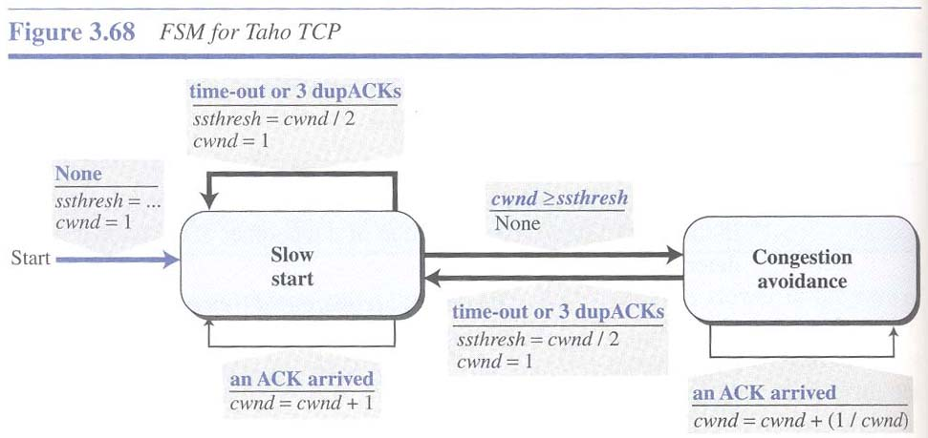
TCP Tahoe FSM
Transport Layer
3-<number>

Slide 51
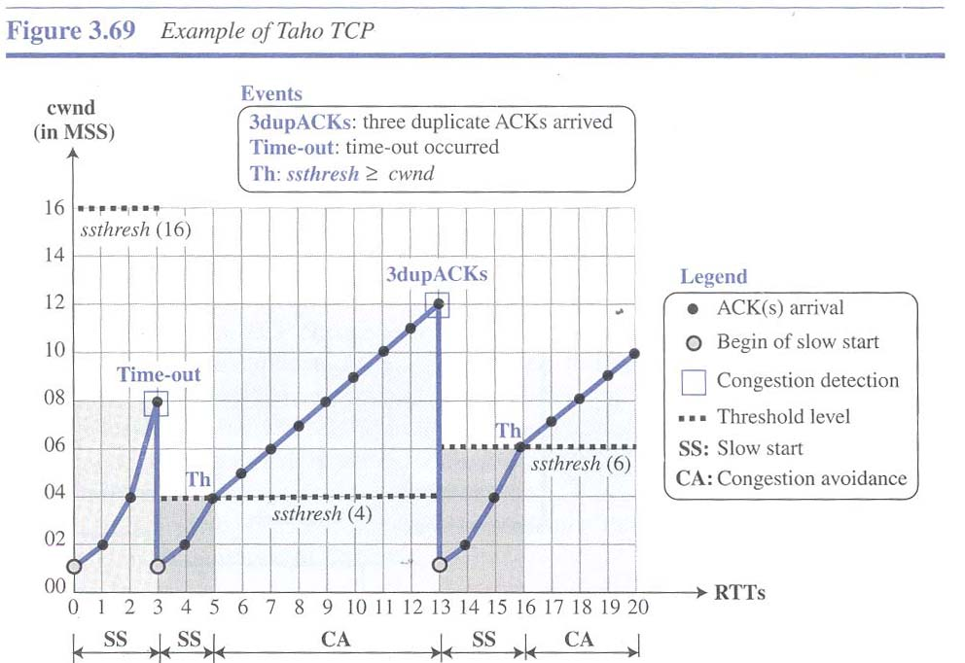
TCP Tahoe Graph
Transport Layer
3-<number>

Slide 52
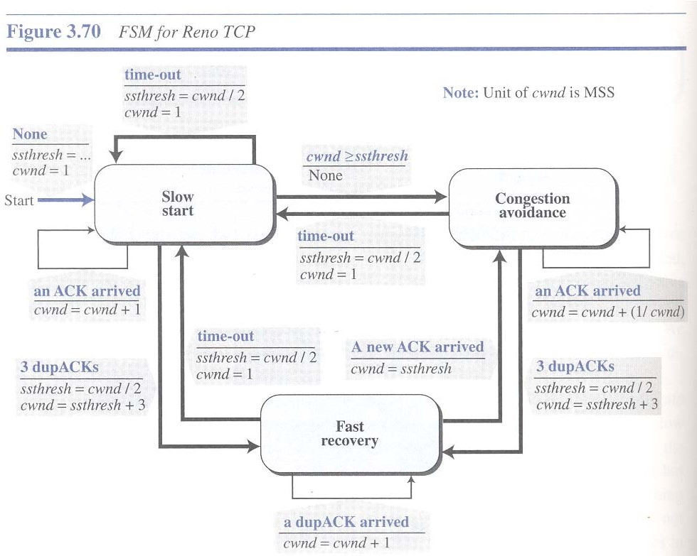
TCP Reno FSM
Transport Layer
3-<number>

Slide 53
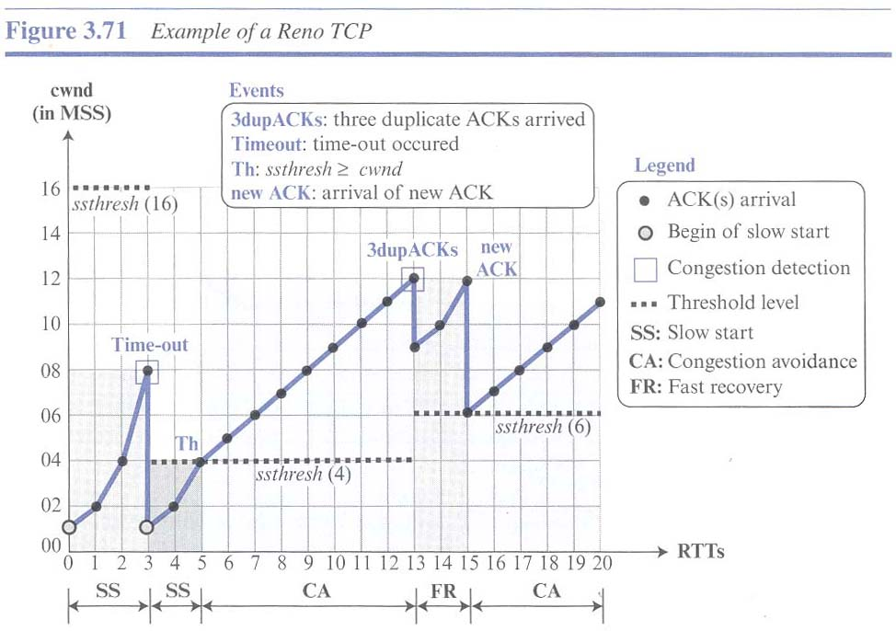
TCP Reno Graph
Transport Layer
3-<number>

Slide 54

Transport Layer
3-<number>

Slide 55
Explicit Congestion Notification (ECN)
network-assisted congestion control:
two bits in IP header (ToS field) marked by network router to indicate congestion
congestion indication carried to receiving host
receiver (seeing congestion indication in IP datagram) ) sets ECE bit on receiver-to-sender ACK segment to notify sender of congestion
source
TCP ACK segment
destination
application
transport
network
link
physical
ECE=1
application
transport
network
link
physical
ECN=11
ECN=00
ECN=11
IP datagram
Transport Layer
3-<number>

Slide 56
Chapter 3: summary
principles behind transport layer services:
  multiplexing, demultiplexing
  reliable data transfer
  flow control
  congestion control
instantiation, implementation in the Internet
  UDP
  TCP
next:
leaving the network “edge” (application, transport layers)
into the network “core”
two network layer chapters:
  data plane
  control plane
Transport Layer
3-<number>

