Slide 1
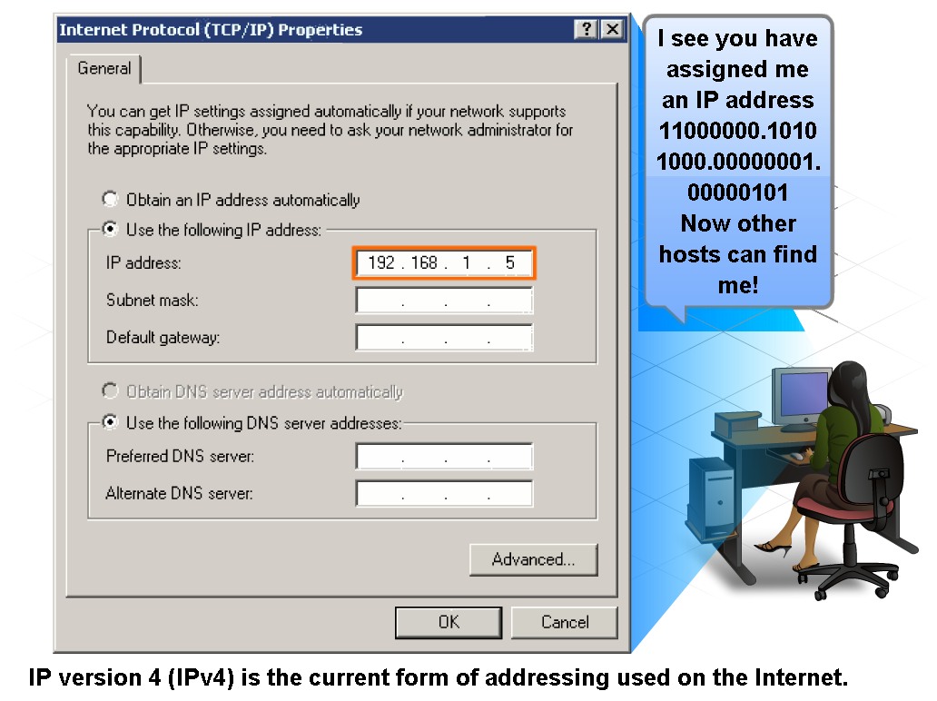
IP Addressing Structure
Describe the dotted decimal structure of a binary IP address and label its parts

Slide 2
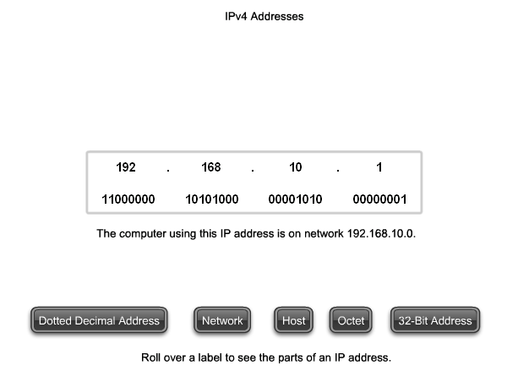
IP Addressing Structure
Describe the general role of 8-bit binary in network addressing and convert 8-bit binary to decimal

Slide 3
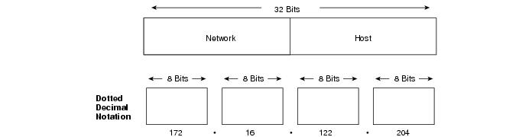
IP Addressing Structure
An IP address consists of 32 bits, grouped into four octets

Slide 4
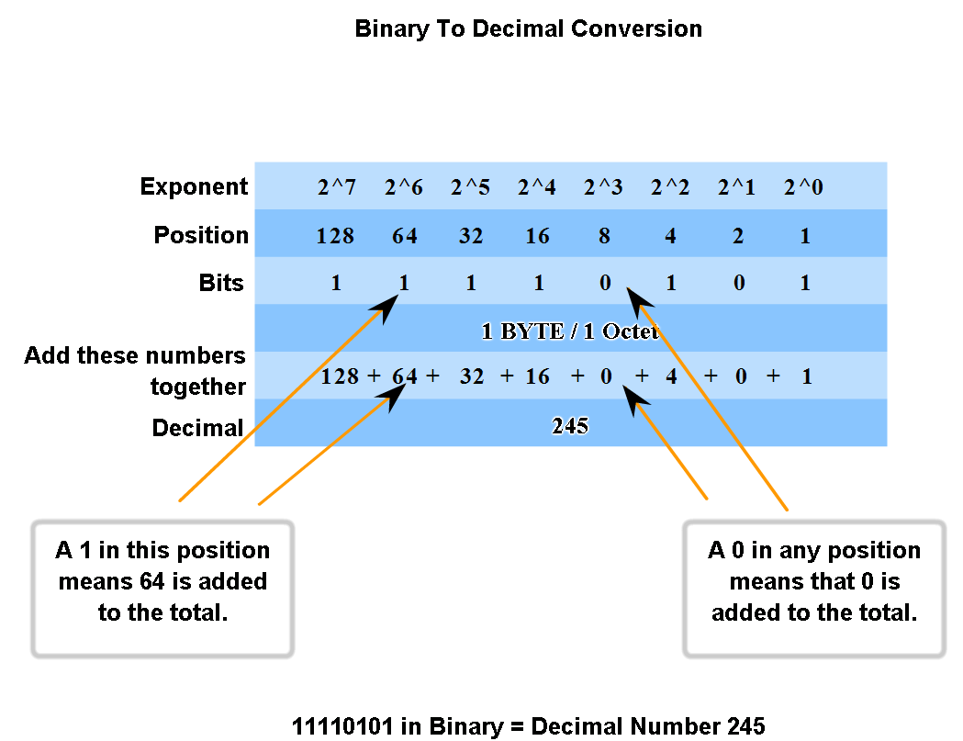
IP Addressing Structure
Practice converting 8-bit binary to decimal

Slide 5
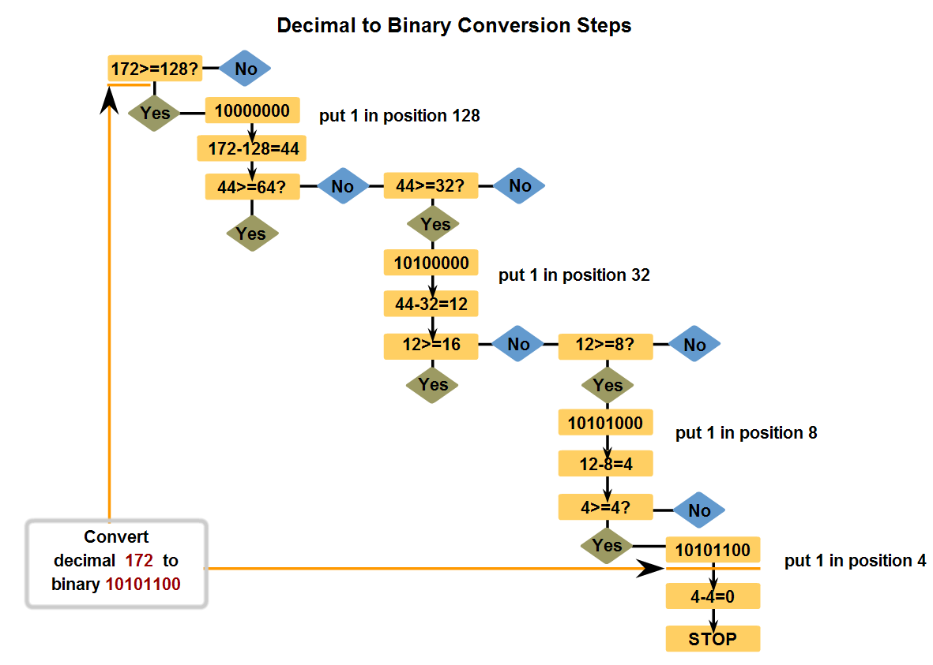
IP Addressing Structure
Convert decimal to 8-bit binary

Slide 6
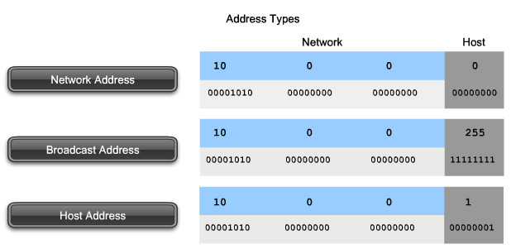
Classify and Define IPv4 Addresses
Name the three types of addresses in the network and describe the purpose of each type

Slide 7
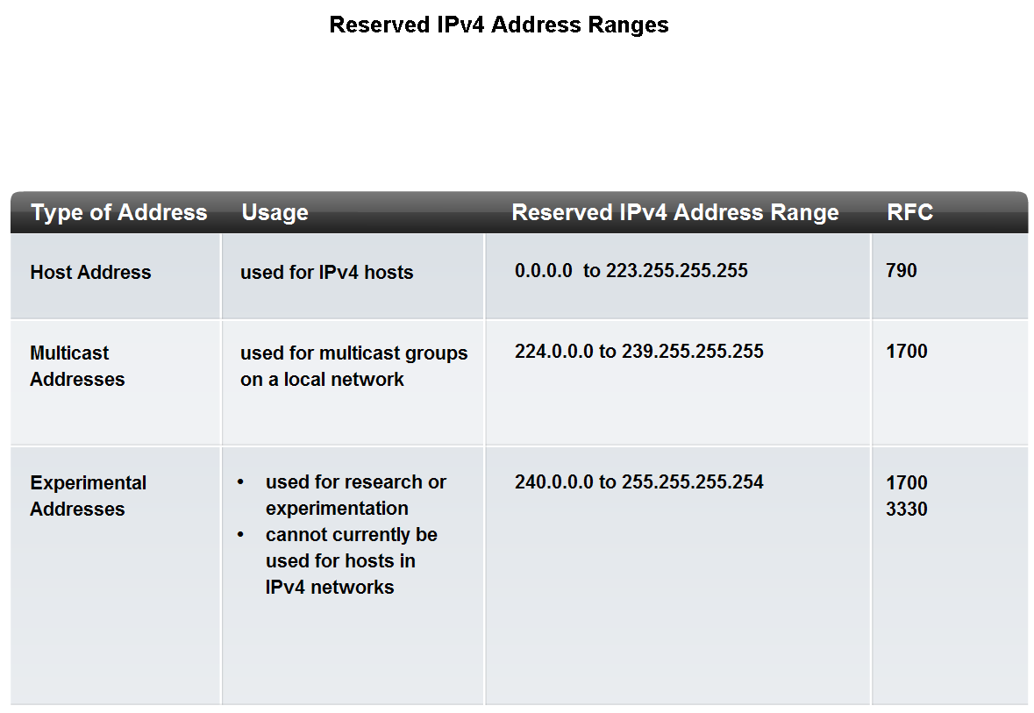
Classify and Define IPv4 Addresses
Identify the address ranges reserved for these special purposes in the IPv4 protocol

Slide 8
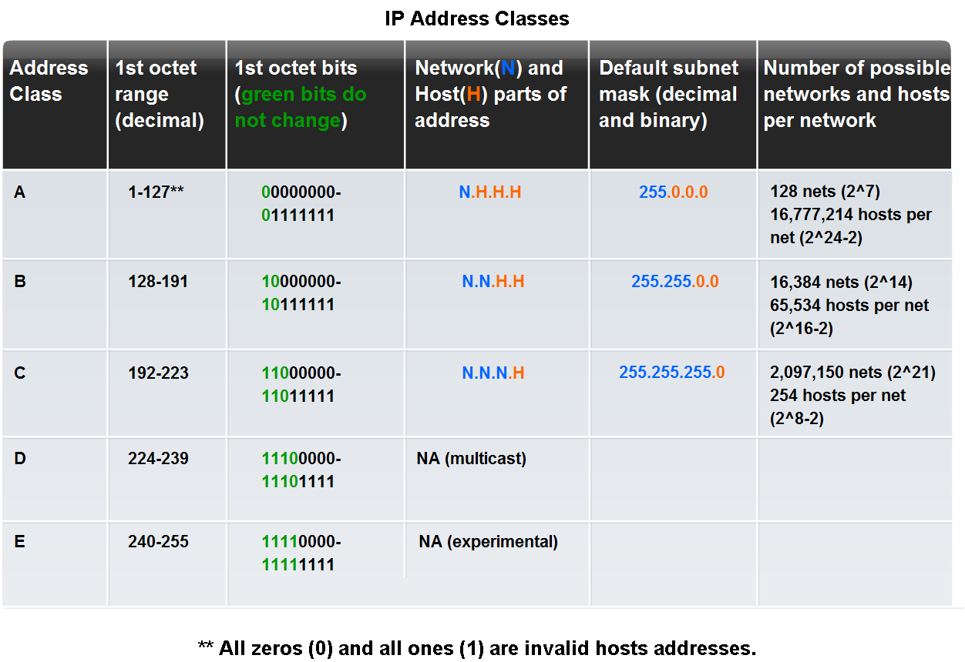
Classify and Define IPv4 Addresses
Identify the historic method for assigning addresses and the issues associated with the method

Slide 9
Subnetting
Used to partition the given address space into smaller, manageable sizes.
IP networks can be divided into smaller networks called subnetworks (or subnets).
Subnetting provides the network administrator with several benefits:
  Extra flexibility
  More efficient use of network addresses
  The capability to contain broadcast traffic (a broadcast will not cross a router).

Slide 10
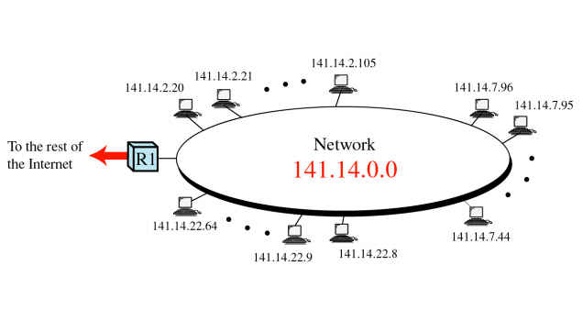
Without Subnetting
The entire network(141.14.0.0) is connected as one LAN

Slide 11
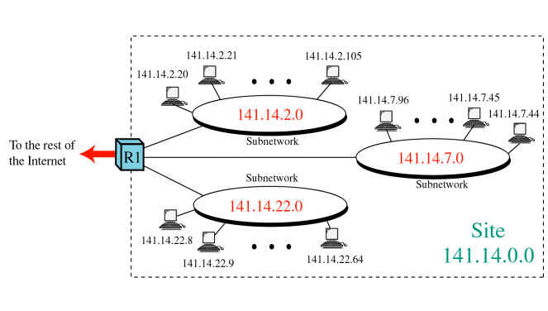
With subnetting
The LAN can be divided into manageable sizes

Slide 12
Types of Subnetting
There are two types of subnetting:
  Static Subnetting
  Variable Length Subnet Mask (VLSM)
Variable length is the more flexible of the two.

Slide 13
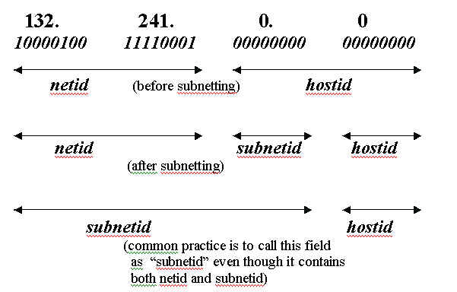
Static Subnetting
A portion of host address bits are used as subnetwork address bits
The "dividing line" between network address and host address parts is shifted variably to the right

Slide 14
Example
Given network of 204.17.5.0/24. Create two network subnet:
Before subnetting:
204.17.5.0 11001100.00010001.00000101.00000000
255.255.255.0 11111111.11111111.11111111.00000000
After subnetting with two subnet
204.17.5.0 11001100.00010001.00000101.00000000
255.255.255.128 11111111.11111111.11111111.10000000
204.17.5.128 11001100.00010001.00000101.10000000
255.255.255.128 11111111.11111111.11111111.10000000

Slide 15
Before and After Subnetting
Before Subnetting (204.17.5.0/24)
After Subnetting (two subnets)
Network Address (NA) | 4th Octet of NA (in binary) | Subnet Mask | First Host | Last Host
204.17.5.0 | x.x.x.00000000 | 255.255.255.0 | 204.17.5.1 | 204.17.5.254
Network Address (NA) | 4th Octet of NA (in binary) | Subnet Mask | First Host | Last Host
204.17.5.0 | x.x.x.00000000 | 255.255.255.128 | 204.17.5.1 | 204.17.5.126
204.17.5.128 | x.x.x.10000000 | 255.255.255.128 | 204.17.5.129 | 204.17.5.254

Slide 16
Before and After Subnetting
Before Subnetting (204.17.5.0/24)
After Subnetting (two subnets)
Network Address (NA) | Total Host (2^{n}-2) | First Host | Last Host | Broadcast
204.17.5.0/24 | 254 | 204.17.5.1 | 204.17.5.254 | 204.17.5.255
Network Address (NA) | Total Host (2^{n}-2) | First Host | Last Host | Broadcast
204.17.5.0 | 126 | 204.17.5.1 | 204.17.5.126 | 204.17.5.127
204.17.5.128 | 126 | 204.17.5.129 | 204.17.5.254 | 204.17.5.255

Slide 17
Subnet mask
A subnet is defined by applying the subnet mask to the IP address
if a bits is "on" (set to 1) in the subnet mask, then that equivalent bit in the address is interpreted as a network bit
if a bits is "off" (set to 0) in the subnet mask, then that equivalent bit in the address is interpreted as a host bit
Standard subnet masks for the 3 classes of addresses
· for a class A address - 255.0.0.0
· for a class B address - 255.255.0.0
· for a class C address - 255.255.255.0

Slide 18
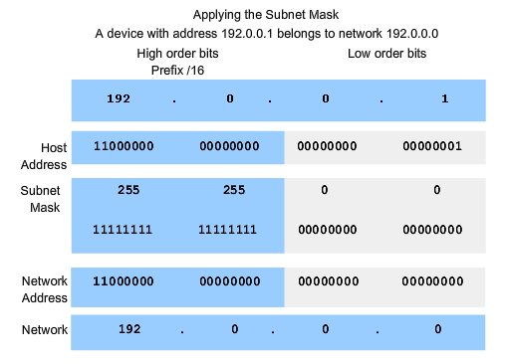
Determine the network portion of the host address and the role of the subnet mask
Use the subnet mask and ANDing process to extract the network address from the IP address

Slide 19
Given network address = 204.17.5.0/24, create 8 subnet!
Network Address (NA) | 4th Octet of NA (in binary) | Subnet Mask | First Host | Last Host
204.17.5.0 | x.x.x.00000000 | 255.255.255.224 | x.x.x.1 | x.x.x.30
204.17.5.32 | x.x.x.00100000 | 255.255.255.224 | x.x.x.33 | x.x.x.62
204.17.5.64 | x.x.x.01000000 | 255.255.255.224 | x.x.x.65 | x.x.x.94
204.17.5.96 | x.x.x.01100000 | 255.255.255.224 | x.x.x.97 | x.x.x.126
204.17.5.128 | x.x.x.10000000 | 255.255.255.224 | x.x.x.129 | x.x.x.158
204.17.5.160 | x.x.x.10100000 | 255.255.255.224 | x.x.x.161 | x.x.x.190
204.17.5.192 | x.x.x.11000000 | 255.255.255.224 | x.x.x.193 | x.x.x.222
204.17.5.224 | x.x.x.11100000 | 255.255.255.224 | x.x.x.225 | x.x.x.254
x.x.x = 204.17.5
Total Host = 2^{n} - 2 = 2⁵-2=30 Host
n = total bit for host id
Total Subnet = 2^{m} = 2³ = 8 Subnet
m = total bit for network id

Slide 20
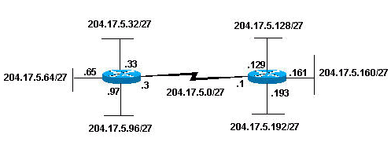
Illustration

Slide 21
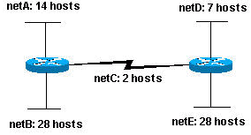
Without VLSM by Example
Given network address = 204.15.5.0/24. Subnet the network in order to create the network with the host requirements shown.

Slide 22
Answer
Based on the figure
  Total subnet based = 5 subnet
  Maximum number of host = 28 host
How many bits needed to create 5 subnet?
  1 bit ? Only 2 subnets created (2¹ subnet)
  2 bits? Only 4 subnets created (2² subnet)
  3 bits? 8 subnets created (2³ subnet). 3 subnet will be unused
Possible assigned subnets:
netA: 204.15.5.0/27 host address range 1 to 30
netB: 204.15.5.32/27 host address range 33 to 62
netC: 204.15.5.64/27 host address range 65 to 94
netD: 204.15.5.96/27 host address range 97 to 126
netE: 204.15.5.128/27 host address range 129 to 158

Slide 23
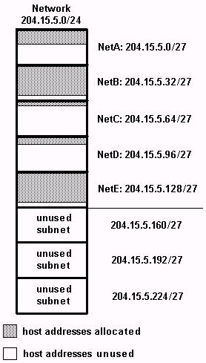
Variable Length Subnet Mask (VLSM)
Actual number of
Host needed :
Left figure shows the use of host address space on each subnet
NetA, NetC, and NetD have a lot of unused host address space
Variable Length Subnet Masks (VLSM) allows you to use different masks for each subnet, thereby using address space efficiently.
14
28
2
7
28

Slide 24
VLSM
Based on the previous example, develop a subnetting scheme with the use of VLSM
  netA: must support 14 hosts
  netB: must support 28 hosts
  netC: must support 2 hosts
  netD: must support 7 hosts
  netE: must support 28 host
Determine what mask allows the required number of hosts.

Slide 25
VLSM
netA: requires a /28 (255.255.255.240) mask to support 14 hosts
netB: requires a /27 (255.255.255.224) mask to support 28 hosts
netC: requires a /30 (255.255.255.252) mask to support 2 hosts
netD*: requires a /28 (255.255.255.240) mask to support 7 hosts
netE: requires a /27 (255.255.255.224) mask to support 28 hosts
* a /29 (255.255.255.248) would only allow 6 usable host addresses, therefore netD requires a /28 mask.

Slide 26
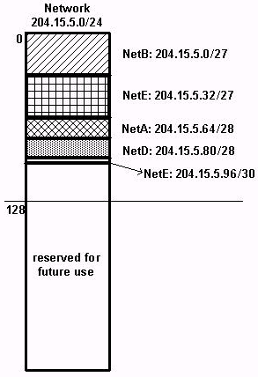
VLSM
The easiest way to assign the subnets is to assign the largest first. For example, you can assign in this manner:
netB: 204.15.5.0/27 host address range 1 to 30
netE: 204.15.5.32/27 host address range 33 to 62
netA: 204.15.5.64/28 host address range 65 to 78
netD: 204.15.5.80/28 host address range 81 to 94
netC: 204.15.5.96/30 host address range 97 to 98

Slide 27
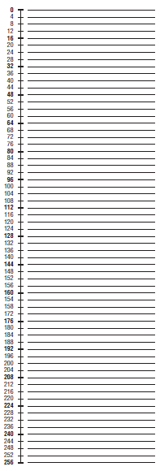
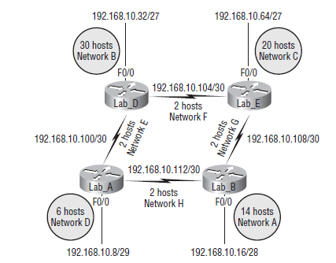
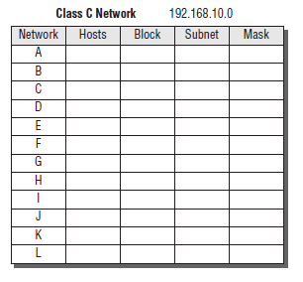
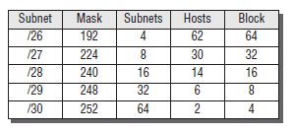
Latihan Soal VLSM

