Slide 1
FACE MASK & EMOTION DETECTION
SUBMITTED BY:
Irfan Khan Patan (18471A0541)
Pujala Charan Mandhata (18471A0543)
Saikam Nagarjun Reddy (18471A0549)

Slide 2

CONTENTS
ABSTRACT
INTRODUCTION
SYSTEM REQUIREMENTS
PROBLEM SPECIFICATION
EXISTING SYSTEM
PROPOSED SYSTEM
DATA COLLECTION
CONVOLUTION NEURAL NETWORK(CNN)
MODEL SPECIFICATION
SCREENHSOTS
CONCLUSION
FUTURE SCOPE

Slide 3

ABSTRACT
Mask Detection:
COVID-19 pandemic has rapidly affected our day-to-day life disrupting the world trade and movements. Wearing a protective face mask has become a new normal. The proposed method detects the face from the image correctly and identifies if it has mask or not.
Emotion Detection:
Emotion Recognition has become the research field of artificial intelligence. With the improvement of cloud computing technology’s ability to perceive human emotions, the interaction between humans and computers has also been improved, especially in human-computer interaction, virtual reality, and computer-assisted application in education.

Slide 4

INTRODUCTION
To curb certain respiratory viral ailments, including COVID-19, wearing a clinical mask is very necessary. WHO stresses on prioritizing medical masks and respirators for health care assistants Therefore, face mask detection has become a crucial task in present global society.
Face mask & emotion detection is used to extract characteristics of face to identify that a person wear a mask or not and to find his emotions like sad, happy, angry, neutral and e.t.c which helps machine’s to interact with the human being.
By using the convolutional neural networks we are going to train the model to classify what label of input we have given.

Slide 5

SYSTEM REQUIREMENTS
Hardware Requirements:
SystemType : Intel Core i3 or above
Cachememory : 4MB(Megabyte)
RAM : 8 gigabyte (GB)
BusSpeed : 5 GT/s DBI2
Number of cores : 2
Number of threads : 4
Software Requirements:
Operating System : Windows 10 Home, 64 bit Operating System
Coding Language : Python
Python distribution : Anaconda, Jupyter or Google Colab.

Slide 6

PROBLEM SPECIFICATION
Face Mask & Emotion detection is a computer technology that determines the location and size of human face in arbitrary (digital) image. The facial features are detected and any other objects like trees, buildings and bodies etc are ignored from the digital image. It can be regarded as a specific case of object class detection, where the task is finding the location and sizes of all objects in an image that belong to a given class. Face detection can be regarded as a more general case of face localization. In face localization, the task is to find the locations and sizes of a known number of faces (usually one). Basically, there are two types of approaches to detect facial part in the given image i.e. feature base and image base approach. Feature base approach tries to extract features of the image and match it against the knowledge of the face features. While image base approach tries to get best match between training and testing images.

Slide 7

EXIXSTING SYSTEM
There are different products in the market for helping the mask & emotion detection concept. Some of them are listed below:
• The mobile app Tap See uses computer vision and crowdsourcing to describe a picture captured webcam in about 10 seconds.
• The main flaws in the previously generated models and projects are the low efficiency and a bit low accuracy.
• To overcome that the specified training models with higher accuracy and consistency are required.
Disadvantages:
May not generate accurate and efficient results
Computation time is very high
Difficulty in maintenance of opencv.
May have disturbances and noise in the visual cameras.
KNN takes less time for training and more time for testing which is not good.

Slide 8

PROPOSED SYSTEM
By using Harcascade Xml file we are going to recognise the face in the given input image.
After finding the face in an input we pass that image to model to clasify which label image is that based upon high priority.
CNN takes less time during validation of image when compared to other algorithms.
Advantages:
1 . Generates accurate and efficient results
2. Over come the shortcomings of sensor-based methods.
3 . Reduces manual work and scalability, manageability of installation.

Slide 9

DATA COLLECTION
One of the main limitations of vision-related tasks is the insufficiency of robust data for evaluating and analysing the suggested method. To find a suitable dataset, we examined datasets that were used in prior studies.
We are taken the data from IEEE official portal with defined pixel values of 60X60 and stored images with respect to their labelled folder.
Based upon the labelled data we are going to train the model which comes under supervised learning to classify mask and emotion upon giving input.
By using this labelled data we are going to classify which label more perfectly fits to our input data.

Slide 10
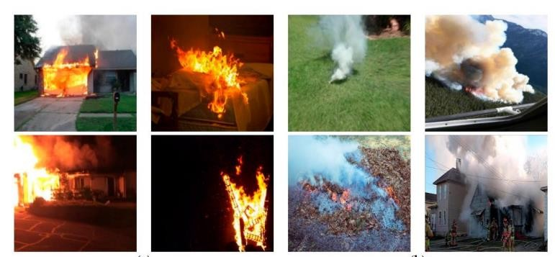
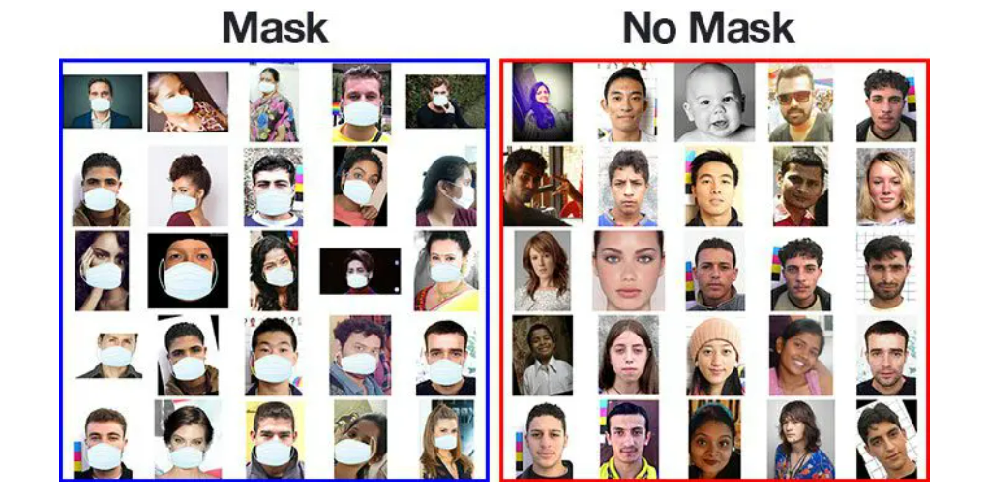

Slide 11


CONVOLUTION NEURAL NETWORK
Convolutional neural networks (CNNs), used primarily in computer vision and image classification applications, can detect features and patterns within an image, enabling tasks, like object detection or recognition. In 2015, a CNN bested a human in an object recognition challenge for the first time.
Convolution Neural Networks are best to operate with deep learning taks and
to detect any kind of object or classification through large amount of dataset.

Slide 12

MODEL SPECIFICATION
Building Blocks of a Convolutional Neural Network.
Convolution - the first building block is the convolution operation. In this step, we will discuss the feature detectors, which basically serve as the neural network's filters. We will also discuss how these filters are learned by the network.
Pooling - in this lesson, we'll cover pooling, and you will learn exactly how it works. Our focus, however, will be on a specific type of pooling i.e. max pooling. However, there are some different pooling's available and we will be discussing them in the next chapter.
Flattening - in this lesson, we will discuss how flattening works and creates an output that converts your input to a vector.
Full Connection - in this lesson, we will see how all of these steps are merged together and how the final predictions are done.

Slide 13
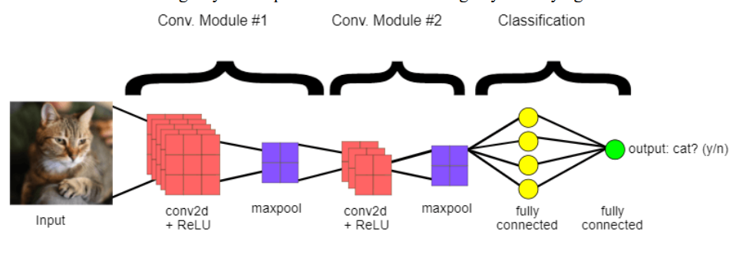

Slide 14
Face detection using harcascade xml:
Object Detection using Haar feature-based cascade classifiers is an effective object detection method proposed by Paul Viola and Michael Jones in their paper, "Rapid Object Detection using a Boosted Cascade of Simple Features" in 2001. It is a machine learning based approach where a cascade function is trained from a lot of positive and negative images. It is then used to detect objects in other images. Here we will work with face detection. Initially, the algorithm needs a lot of positive images (images of faces) and negative images (images without faces) to train the classifier. Then we need to extract features from it. For this, Haar features shown in the below image are used. They are just like our convolutional kernel. Each feature is a single value obtained by subtracting sum of pixels under the white rectangle from sum of pixels under the black rectangle.

Slide 15
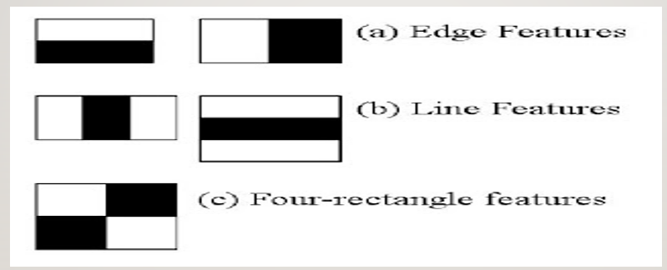
Harcascade xml features extraction:

Slide 16

SCREENSHOTS
HOME SCREEN

Slide 17


ABOUT PAGE:
ABOUT US PAGE:

Slide 18
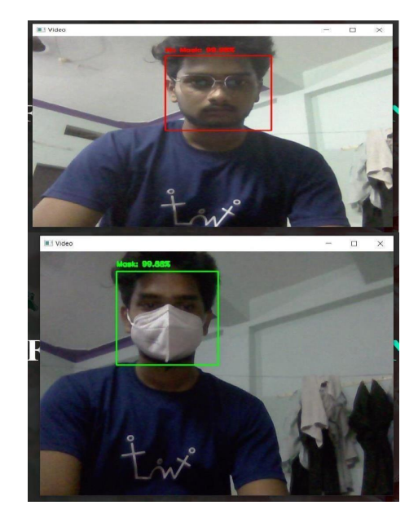
OUTPUT IMAGE:

Slide 19

CONCLUSION
We briefly explained the motivation of the work at first. Then, we illustrated the learning and performance task of the model. Using Deep learning and simplified techniques the method has achieved reasonably high accuracy. It can be used for a variety of applications. Wearing a mask may be obligatory in the near future, considering the Covid-19 crisis. Many public service providers will ask the customers to wear masks correctly to avail of their services. The deployed model will contribute immensely to the public health care system. In future it can be extended to detect if a person is wearing the mask properly or not. The model can be further improved to detect if the mask is virus prone or not i.e. the type of the mask is surgical, N95 or not.

Slide 20

FUTURE SCOPE
Due to time constraints, it was not possible to evaluate each emotion. On this way, it would have been possible to detect which emotions are easier to classify, as well as, which ones are more difficult. Moreover, pre-training on each emotion could lead to a better feature learning. After that, the network could have received this learning (transfer learning). This could have improved on reducing the training time; as well as, minimizing to a higher degree the cost function. Also, using a larger dataset can lead to higher scale training. Training into a larger input space and for more time improves the network accuracy. A larger training scale allows the network to learn more relevant features. If this is not achieved, feature engineering is still required for this task. However, such a dataset might not exist nowadays. Using several datasets might be a solution, but a careful procedure to normalize them is required. Finally, using full dataset for training, pre-training on each emotion, and using a larger dataset seem to have the possibility to improve the network’s performance. Thus, they should be addressed in future research on this topic.

Slide 21


