Slide 1
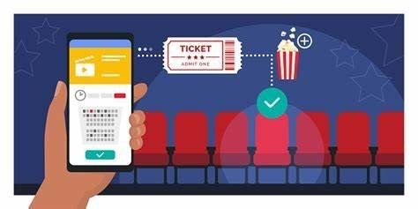
Movie TICKET BOOKING SYSTEM
Done By
Irfan Khan Patan

Slide 2

Need of a Ticket Booking System
Without an online ticket booking system, you have to manually adjust your resources to accommodate for the change.
Without an online booking system, you run the risk of overbooking without which can lead to limited resources to deliver.
If someone makes a booking while you’re out, you can’t immediately see the booking details to prepare accordingly.
Administratively, a payment that requires paperwork often results in getting paid late.

Slide 3
INTRODUCTION
Our online movie ticket booking system is basically made for providing customers an anytime and anywhere service for booking movie tickets and providing information about the movies and their schedule online.
Admin manages this system to insert and delete data such as movie description, movie schedule which will update the related webpage and will be accessible by customers.
This system also reduces workload on customers as it is automatic.
The system also provides complete information of the movie and schedule to the customer, according to which he can book the tickets.
Theater Owner can login and block the tickets for customers who came at theater

Slide 4
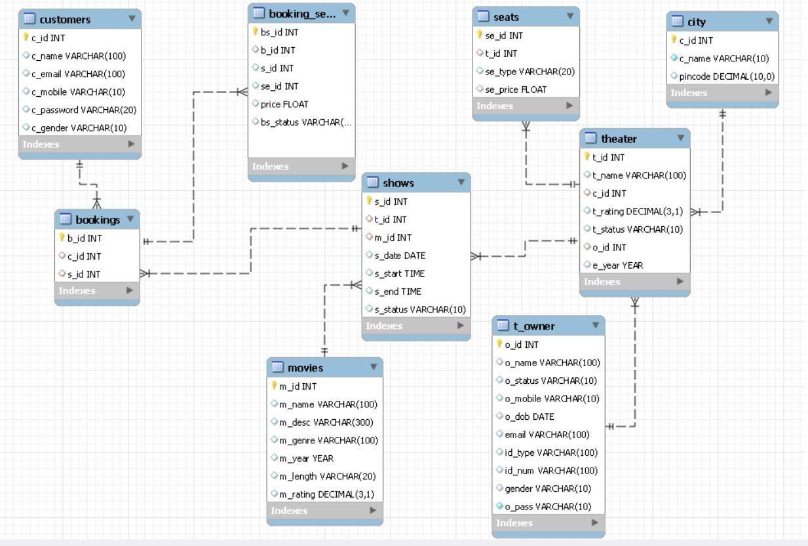
Data Model Diagram
`

Slide 5
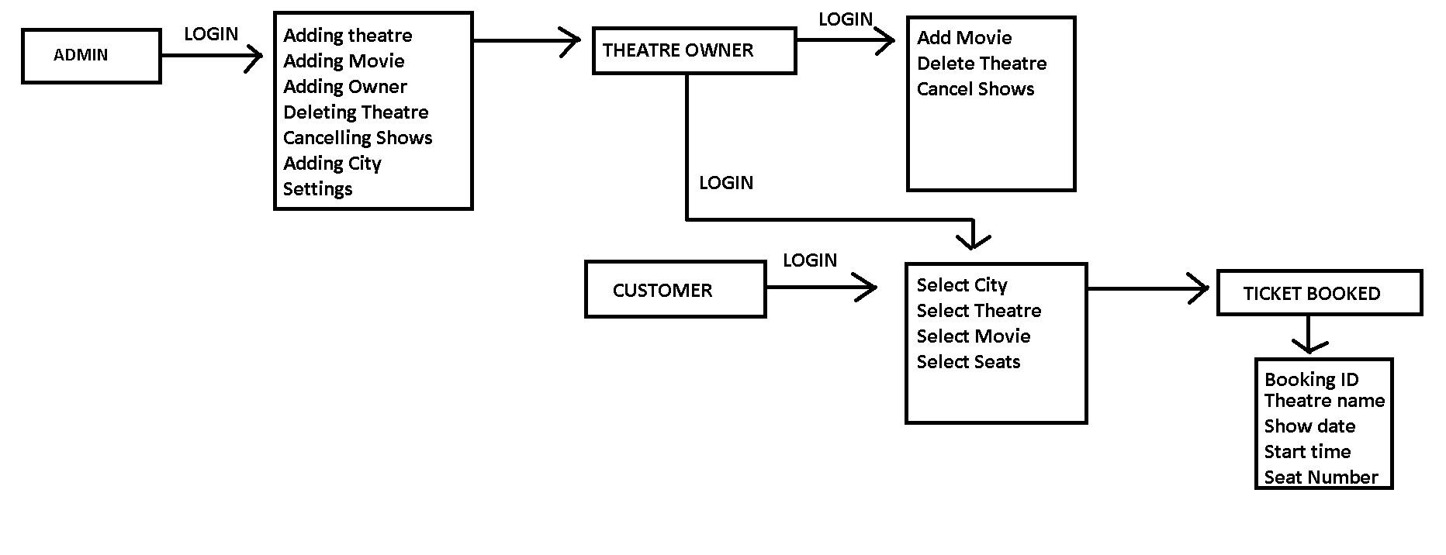
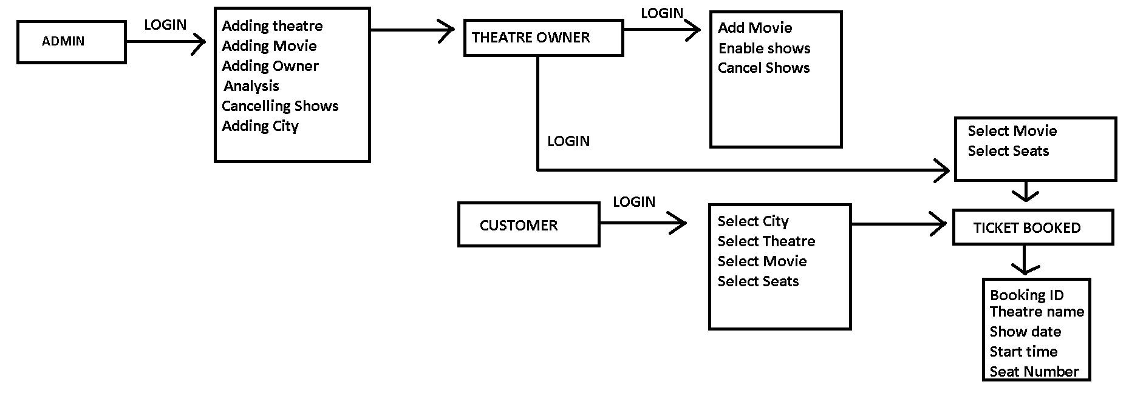
DATA FLOW DIAGRAM

Slide 6
Theater Owner
Some functions and capabilities of the theater owner include:
Add Movie
Add Shows
Enable Shows
Cancel Shows
View Bookings
Using these given tools and techniques the theater owner can modify the functioning of how a theater in a particular city operates.

Slide 7
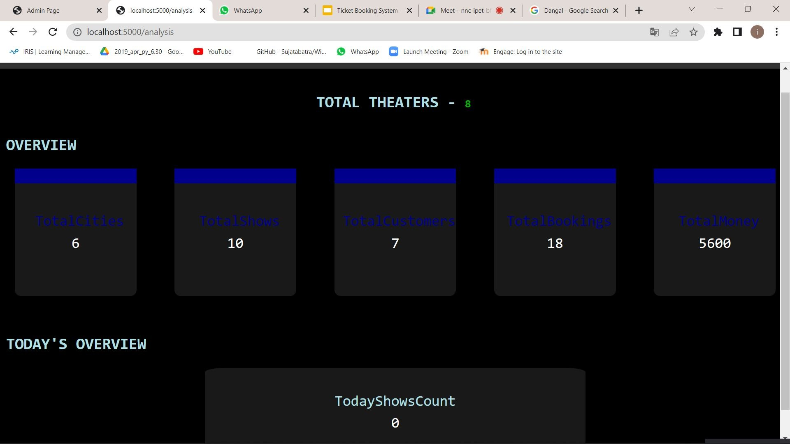
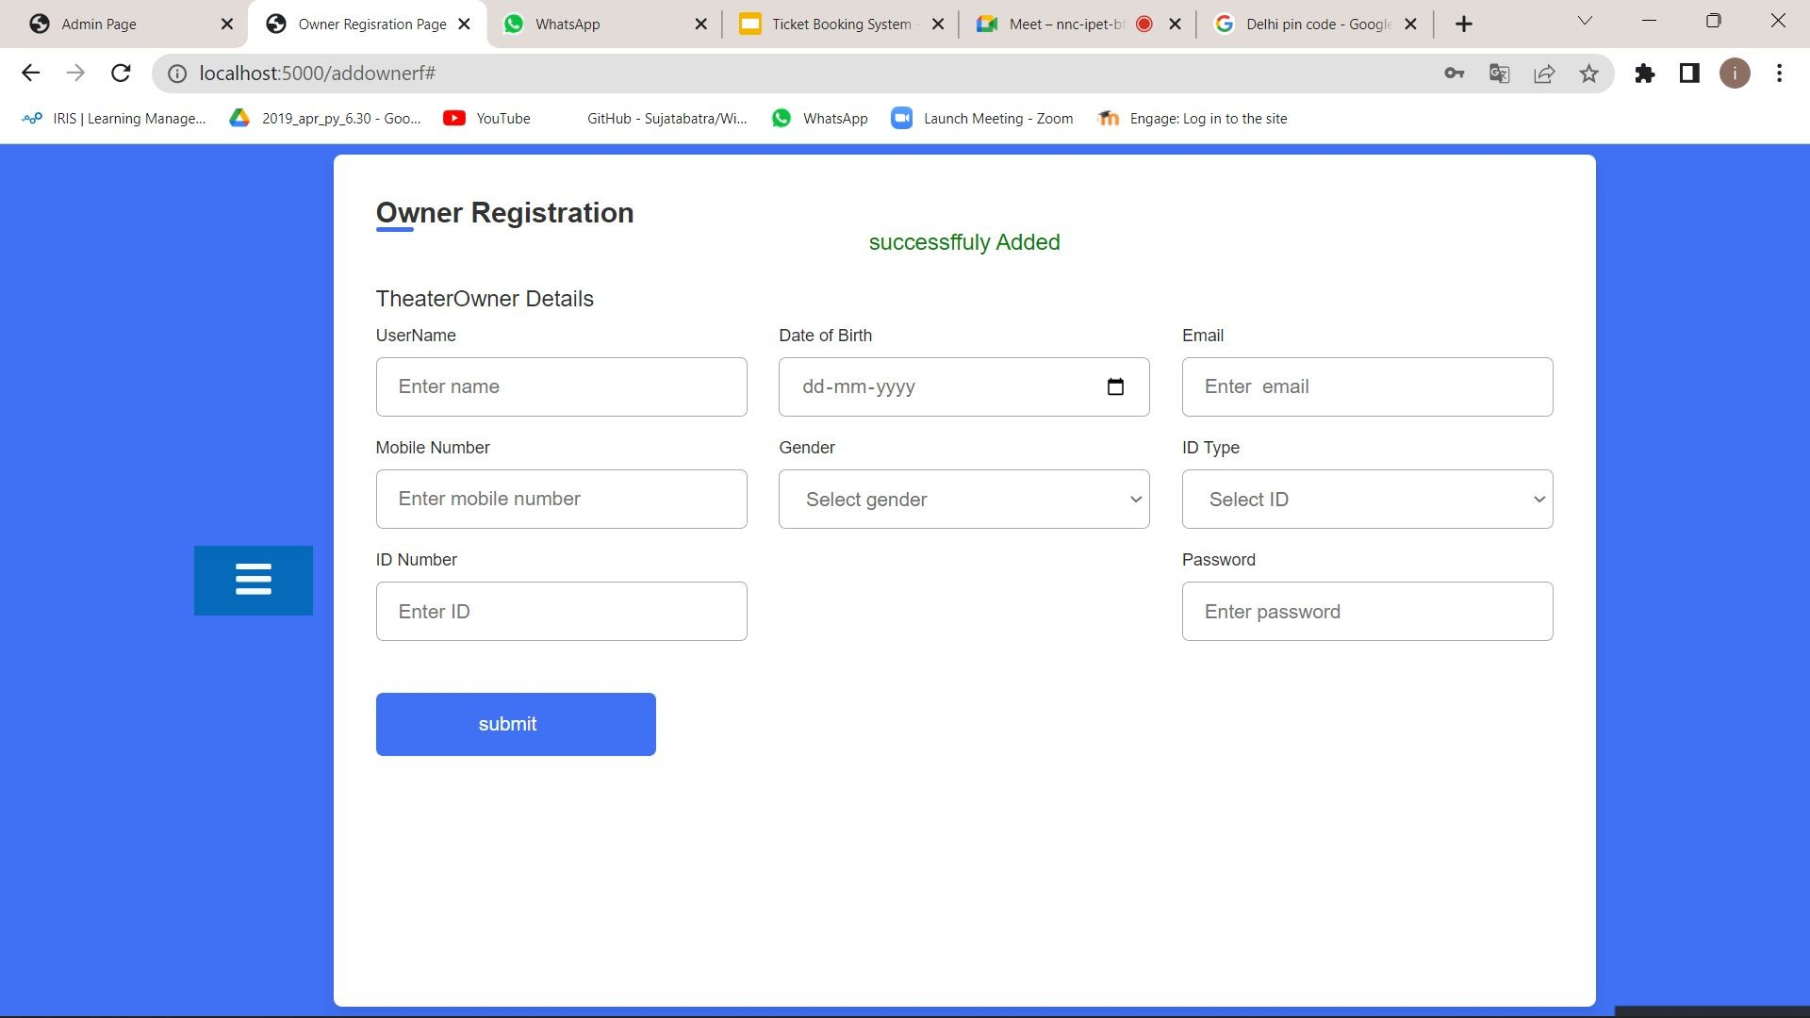
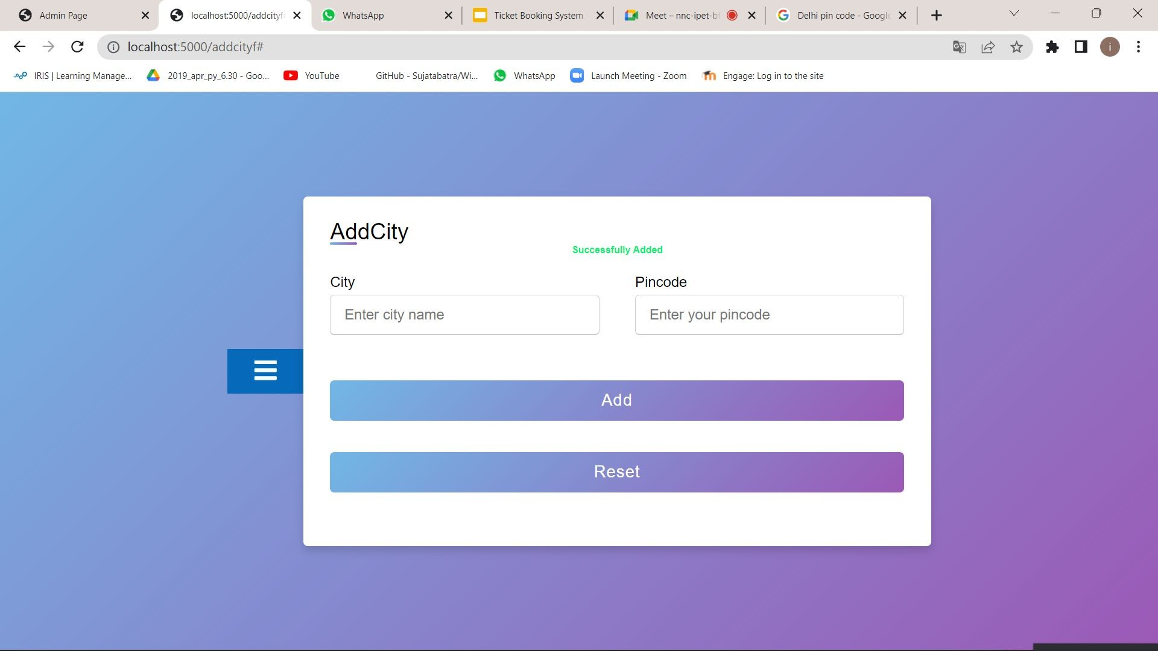
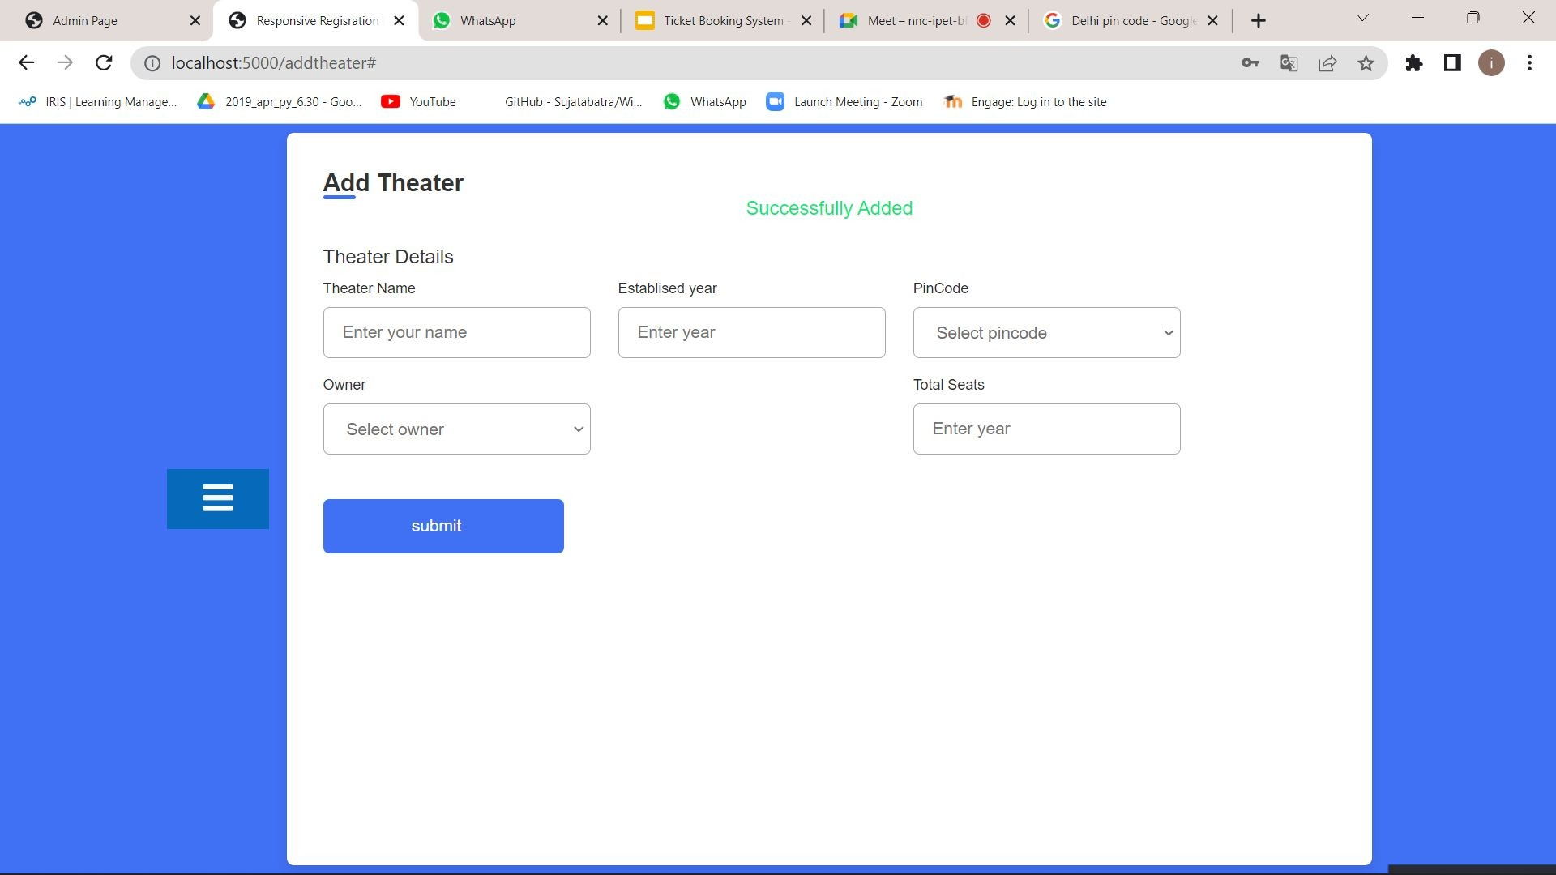
ADMIN

Slide 8


THEATRE OWNER

Slide 9
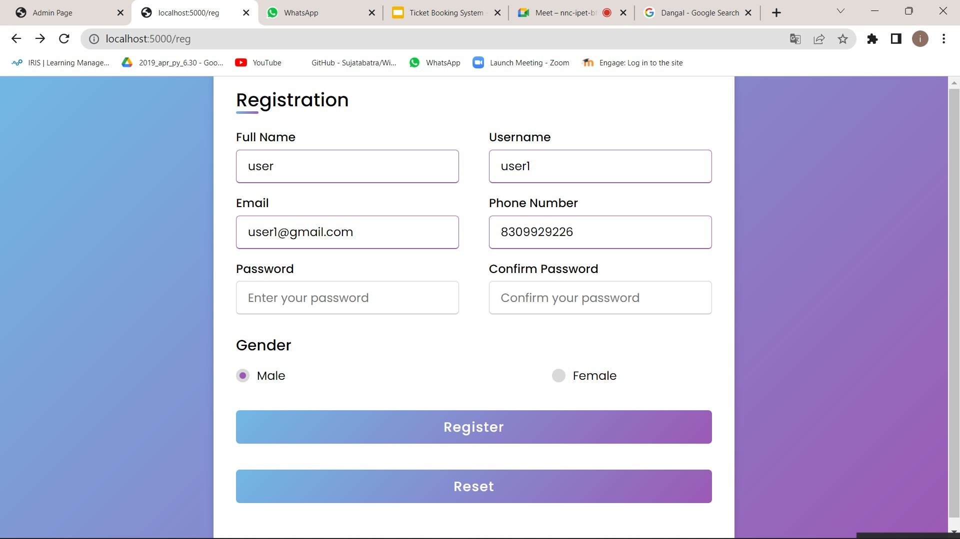
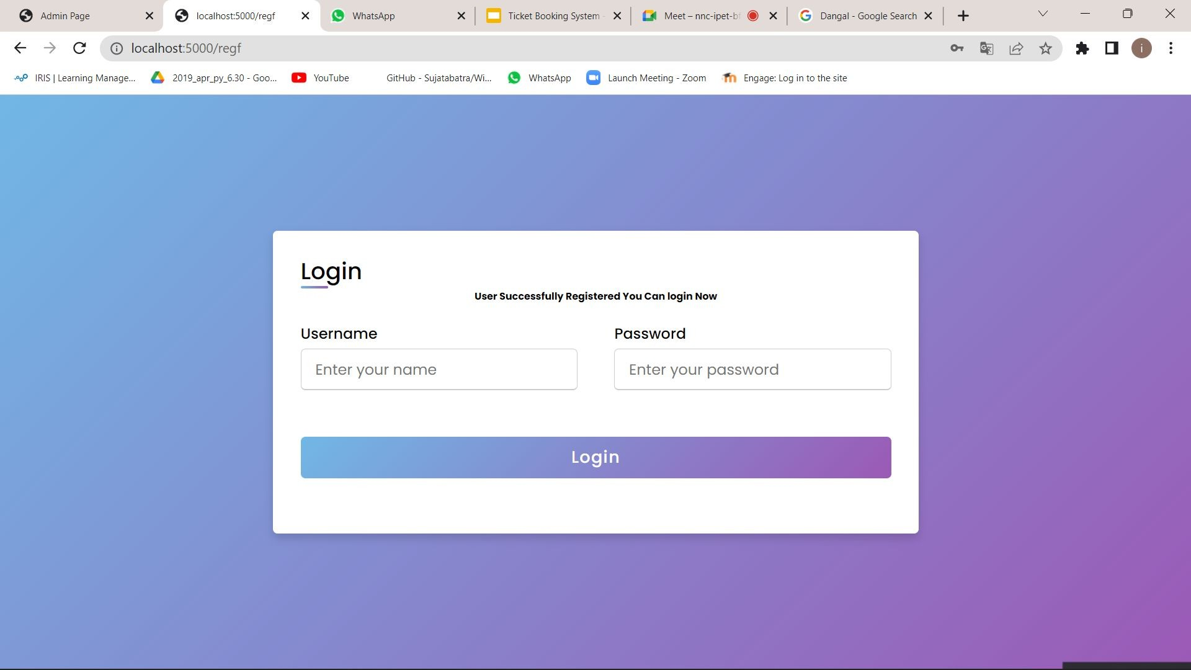
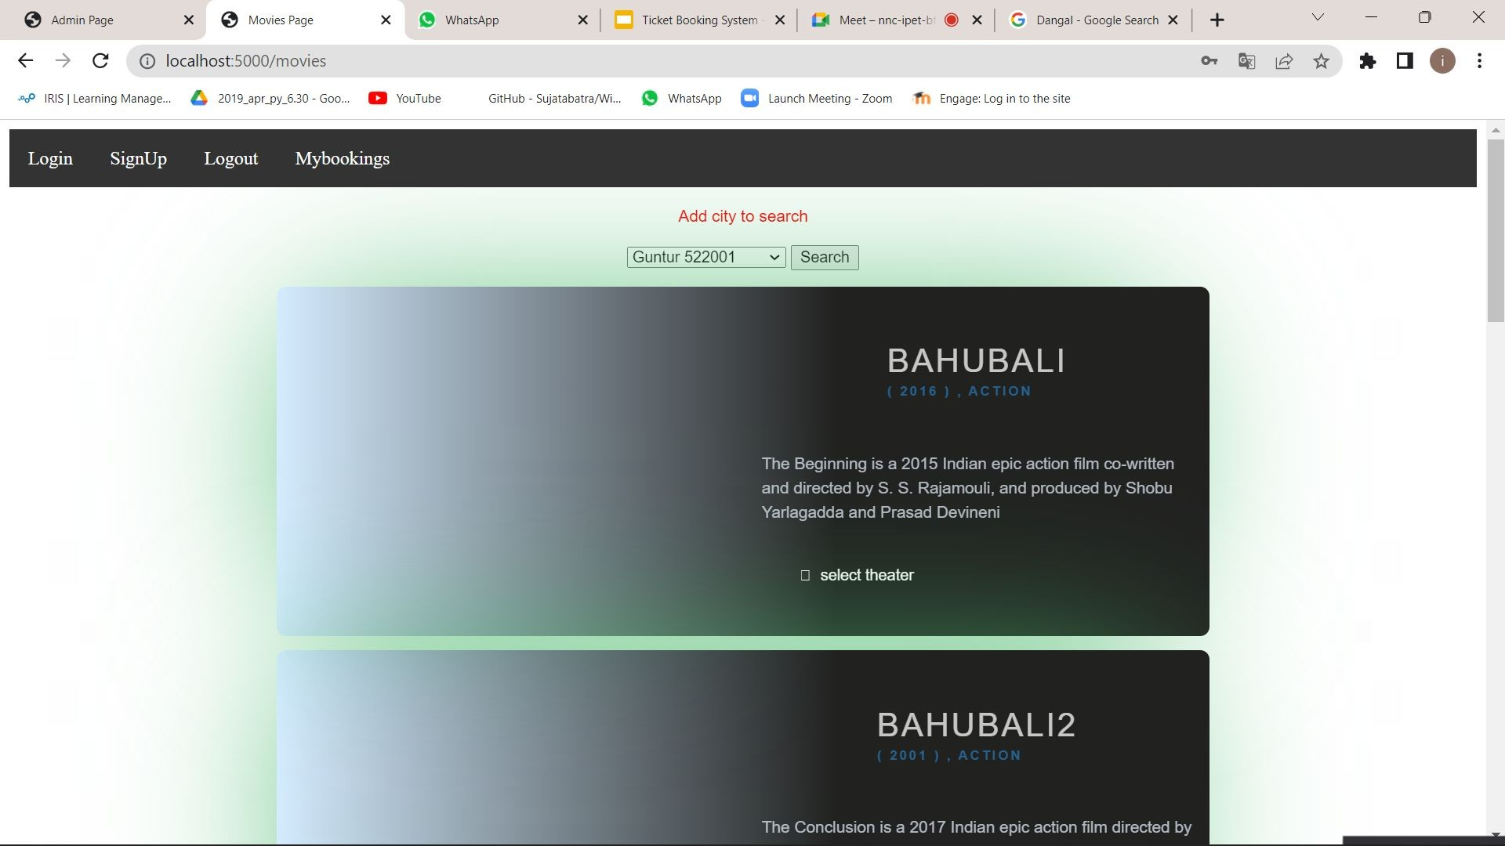
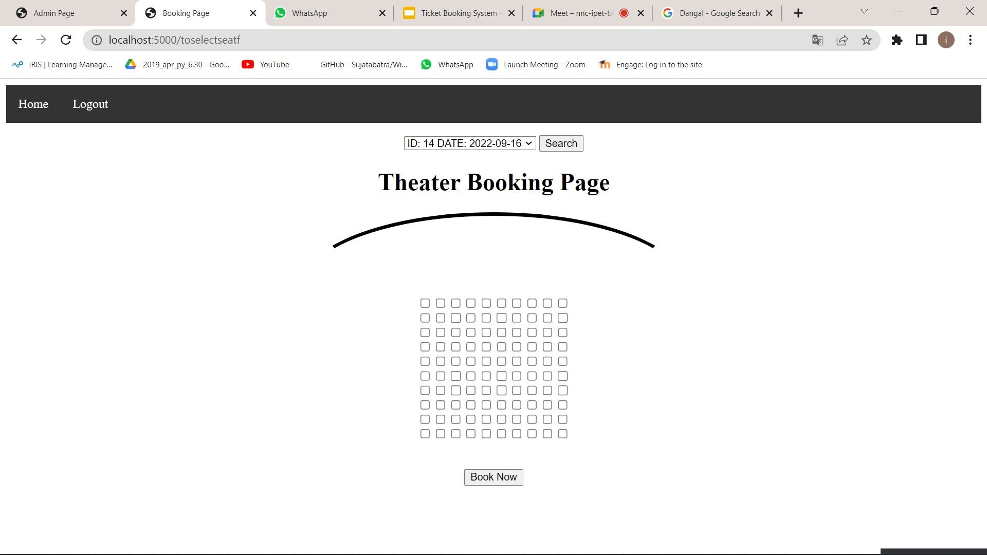
BOOKING SHOWS

Slide 10

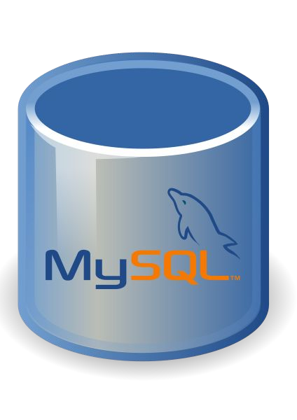


TOOLS/SOFTWARES USED
Front End : MS Visual Studio Code
Web development using flask API of python
Back End : MySQL

Slide 11

OUTCOME
The entertainment sector needs to be modernised and innovated in such a way that it becomes reliable , consistent and promising.
Traditional ways of booking movie tickets is quite tiresome, we have entered a new age where technology dominates and improves human life.
With the help of the system we have implemented, exceptions are reduced and in most cases terminated.
By developing this platform we are hoping to reduce time spent on the process, provide easy data flow, customer pleasure and avoid misunderstandings.
With the help of admin ,support and client portals on the same server we are able to handle large scale operations effectively.

