Slide 1
Good Morning
PROJECT NAME: DB2-2022-2023(Udemy Courses)
(Group Members)
IRFAN ULLAH KHAN (2054601)
Rajmonda Bardhi (2071810)
Anahita Abbaspour (2005495)
Carlos Alcantud Cuesta (2065642)

Slide 2

About this dataset:
This dataset contains information about Udemy courses in the Web Development, business Finance, graphic design and Musical Instrument category, including course title, URL, price, number of subscribers, number of reviews, number of lectures, course level, rating, content duration, published timestamp, and subject.

Slide 3
Domain of the data
Link of the data:
https://www.kaggle.com/datasets/thedevastator/udemy-courses-revenue-generation-and-course-anal
Ontology Name: Udemy-Courses

Slide 4
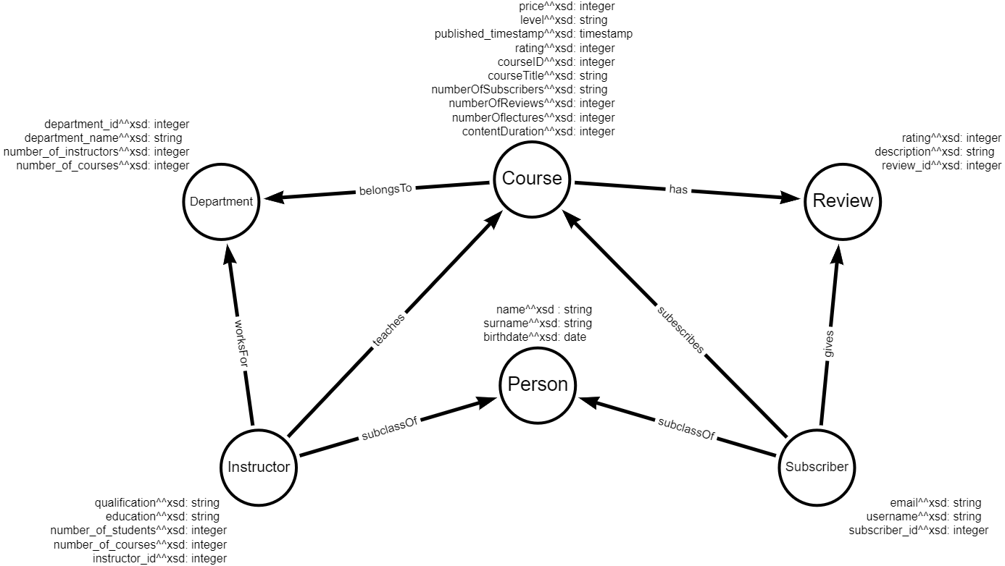
Visual Model

Slide 5
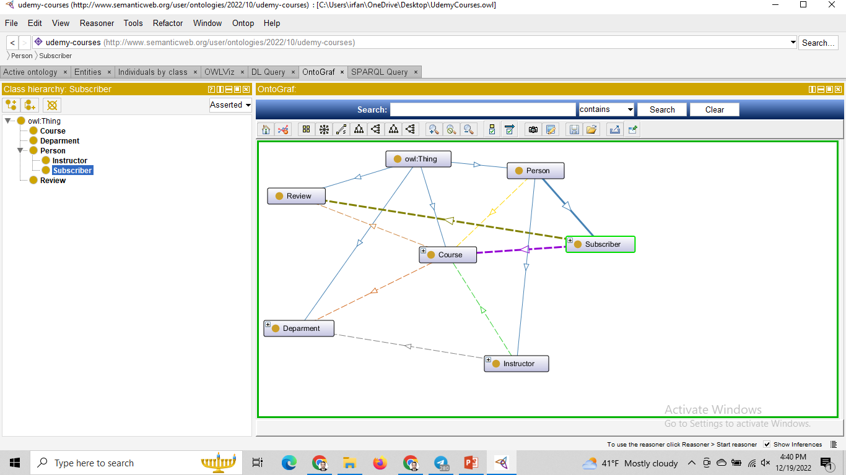
Ontology Graph

Slide 6
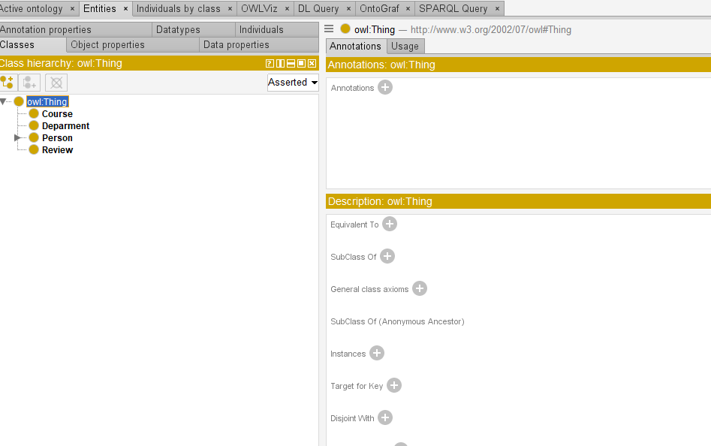
Here we have 4 main classes:
1. Course
2. Department
3. Person (Instructor, Subscriber)
4. Review

Slide 7
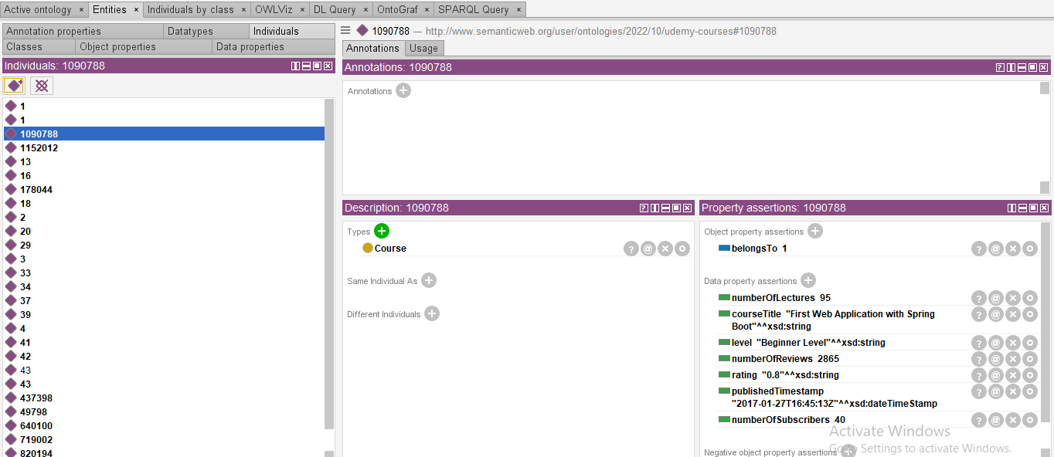
INDIVIDUAL:
Individual name is ‘1090788’ and its type is course.
We can define relationship between individual
For example course is ‘belongTo’ department
And graphically we represent it with Diamonds

Slide 8
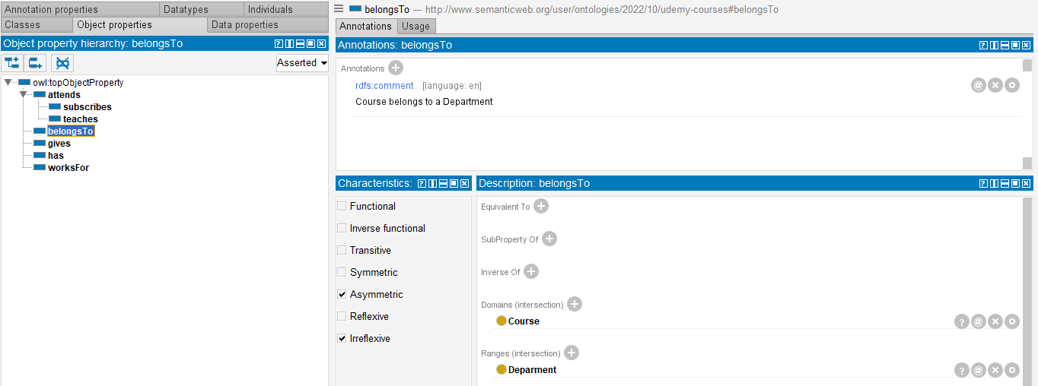
Object Properties:
We have a property called “belongsTo”.
Properties have a binary relations with classes
NO

Slide 9
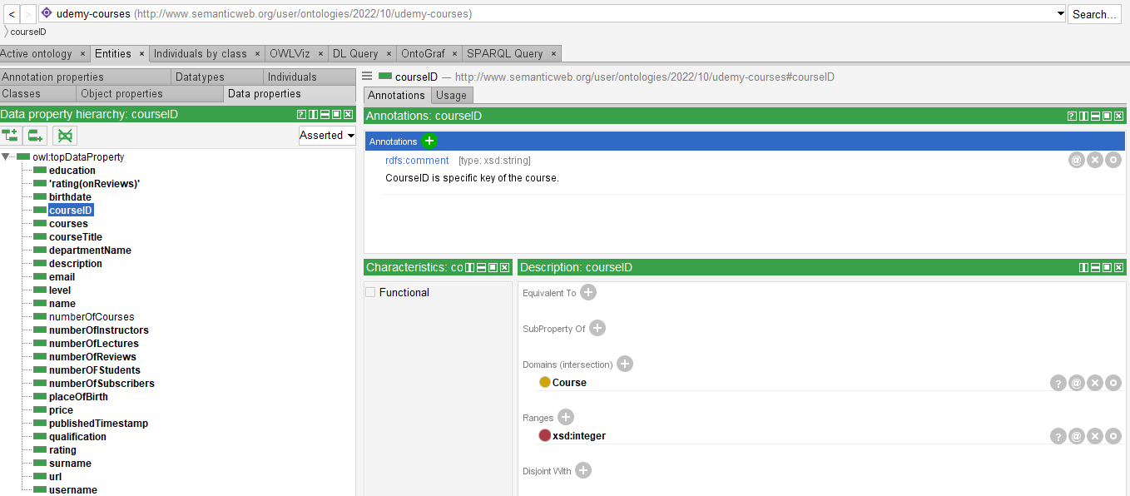
Attributes:
describe the objects in the ontology and it is called data properties

Slide 10
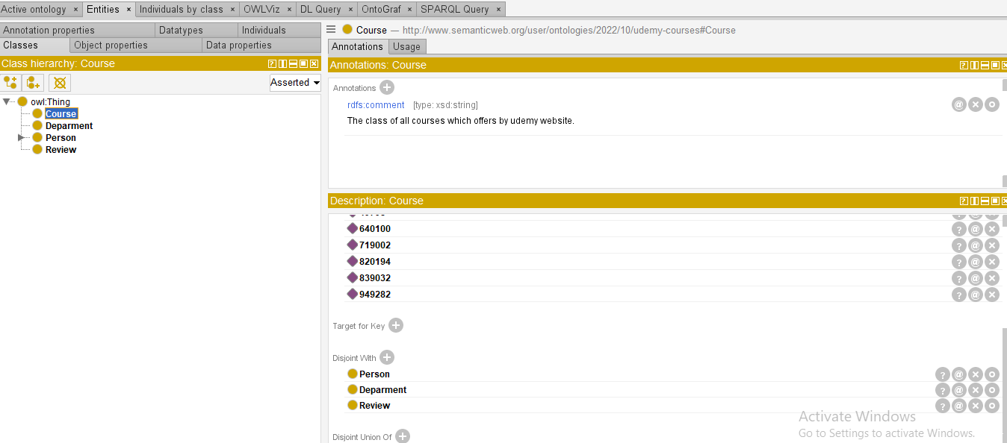
Disjoint:
We must make disjoint from one another if we keep classes separate.

Slide 11
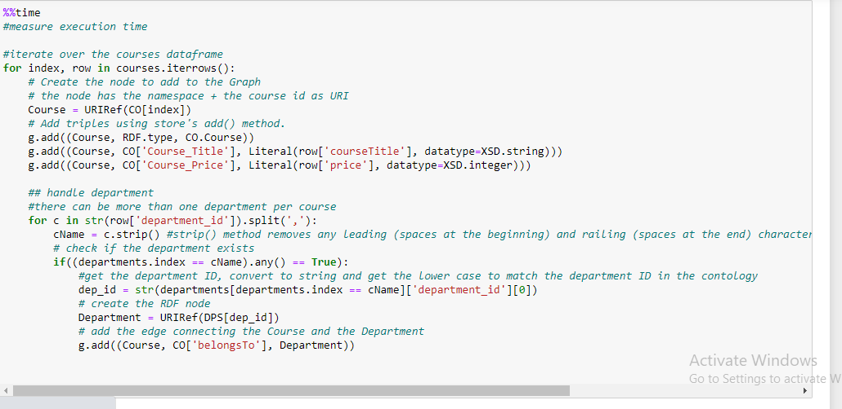
Jupytor:

Slide 12

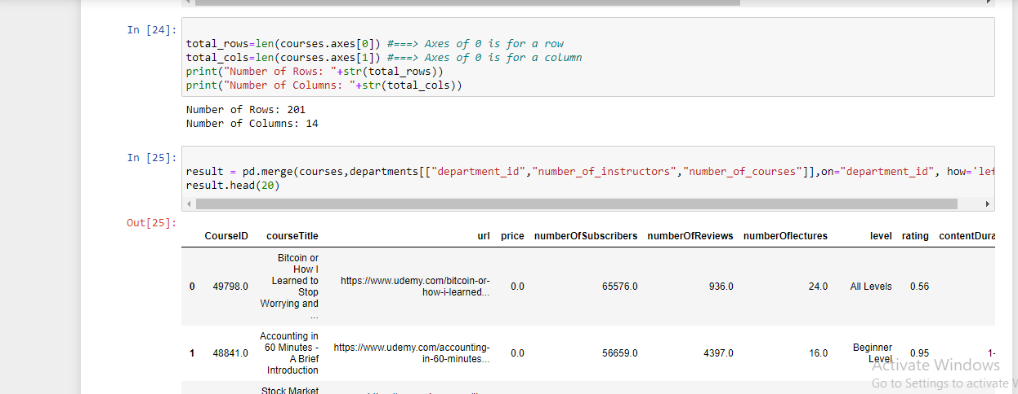
Data Cleaning:
Here we cleaned our data

Slide 13
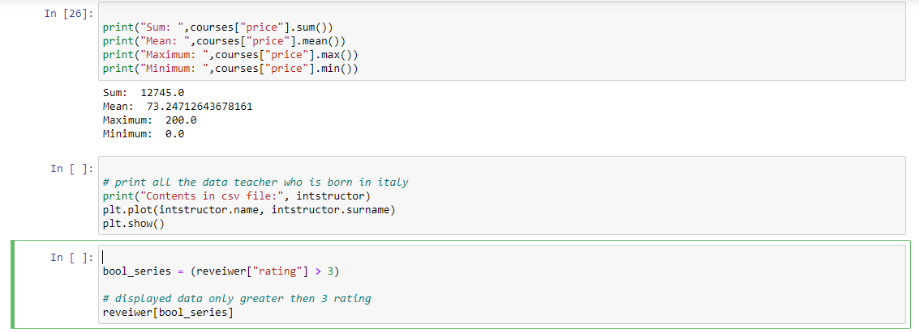

Slide 14
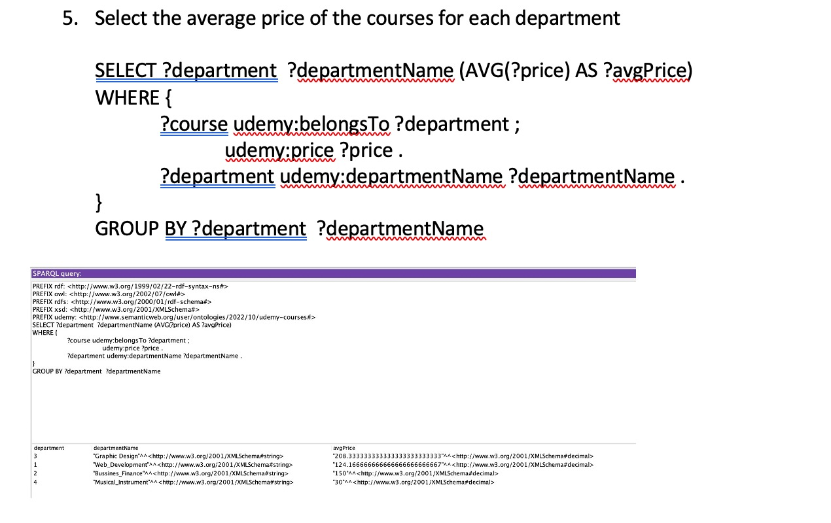
Queries:

Slide 15
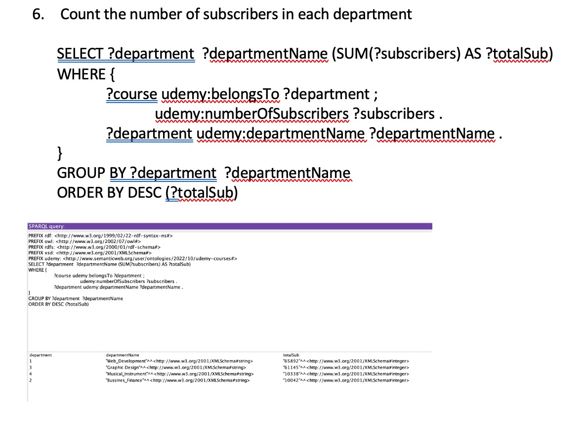
Queries:

Slide 16
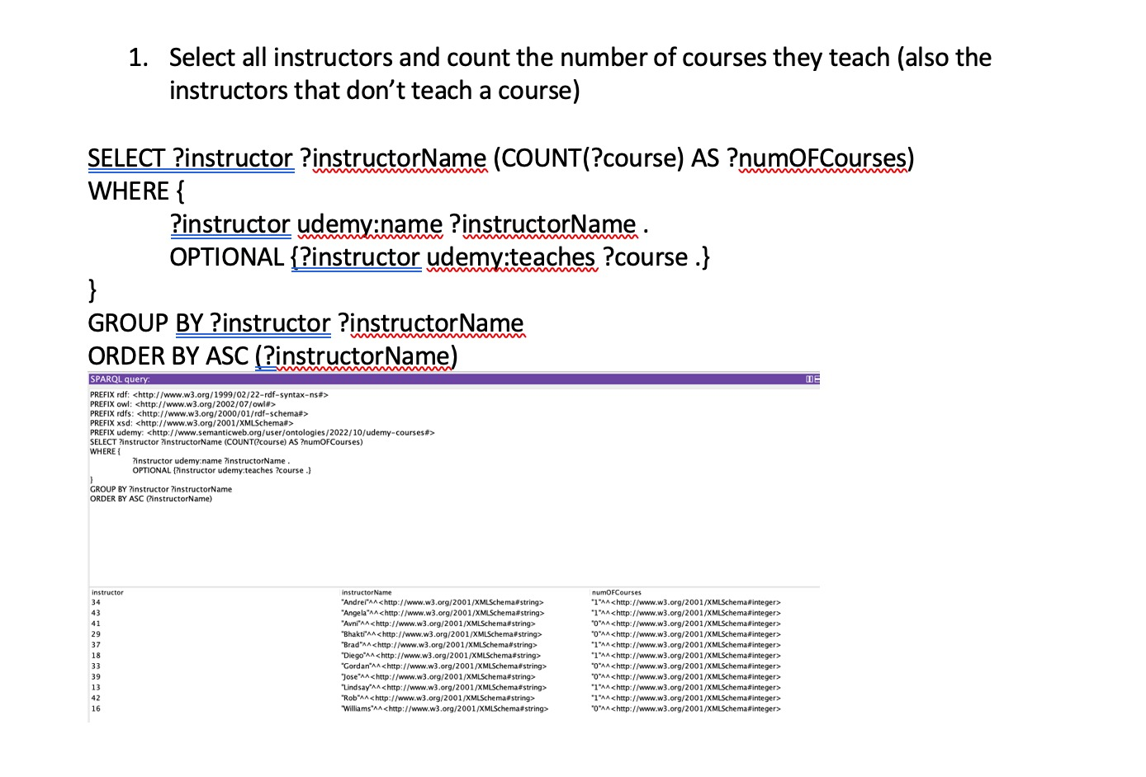
Queries:

Slide 17


THANK YOU FOR YOUR ATTENTION!

