Slide 1
queries

Slide 2
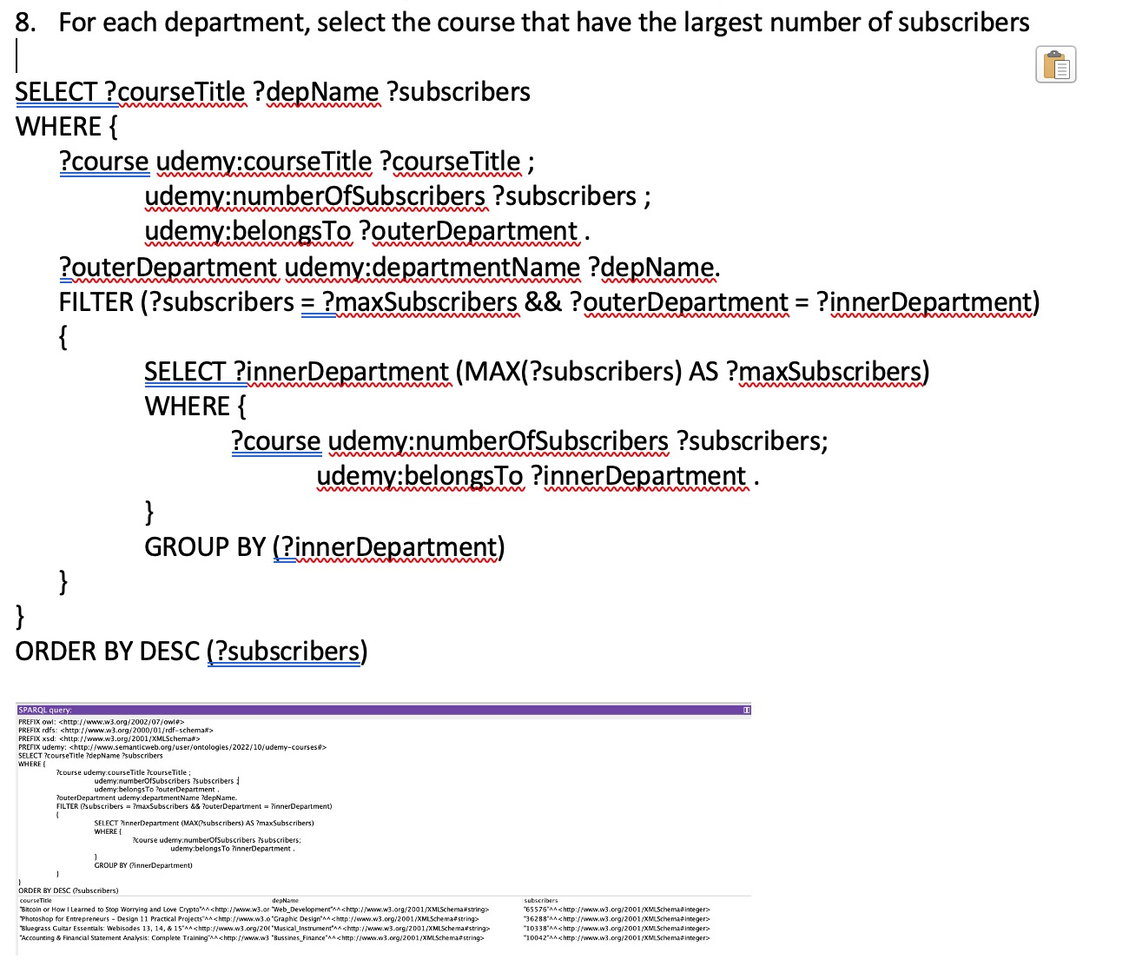
1.

Slide 3
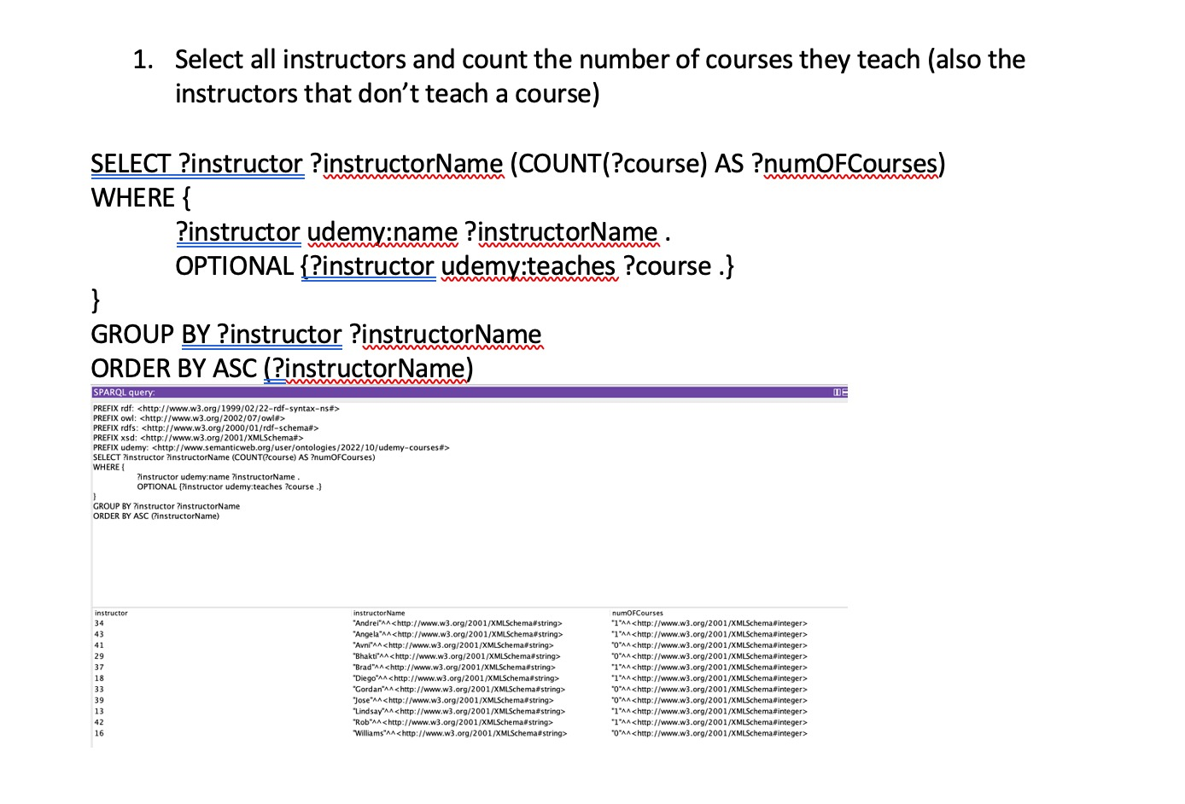
2.

Slide 4
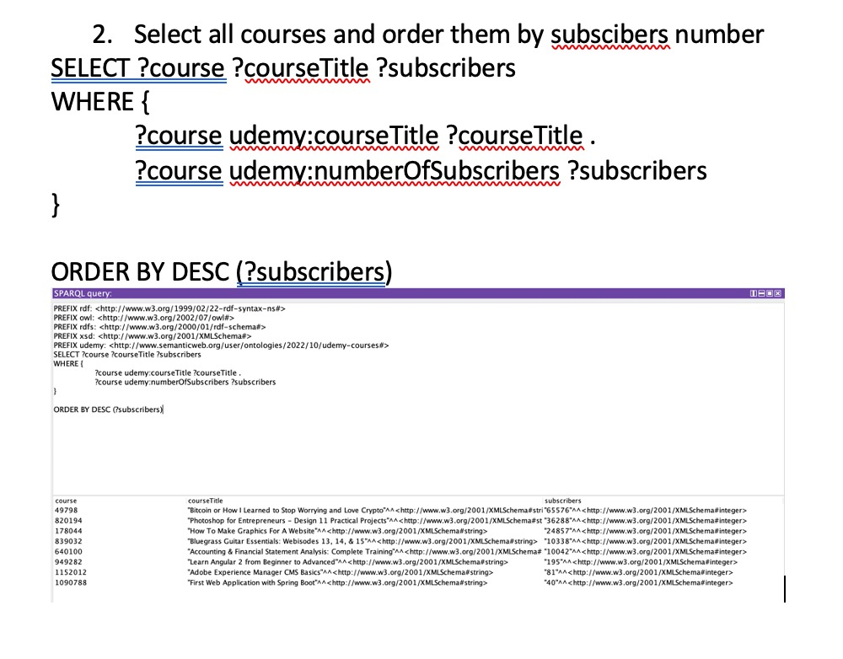
3.

Slide 5
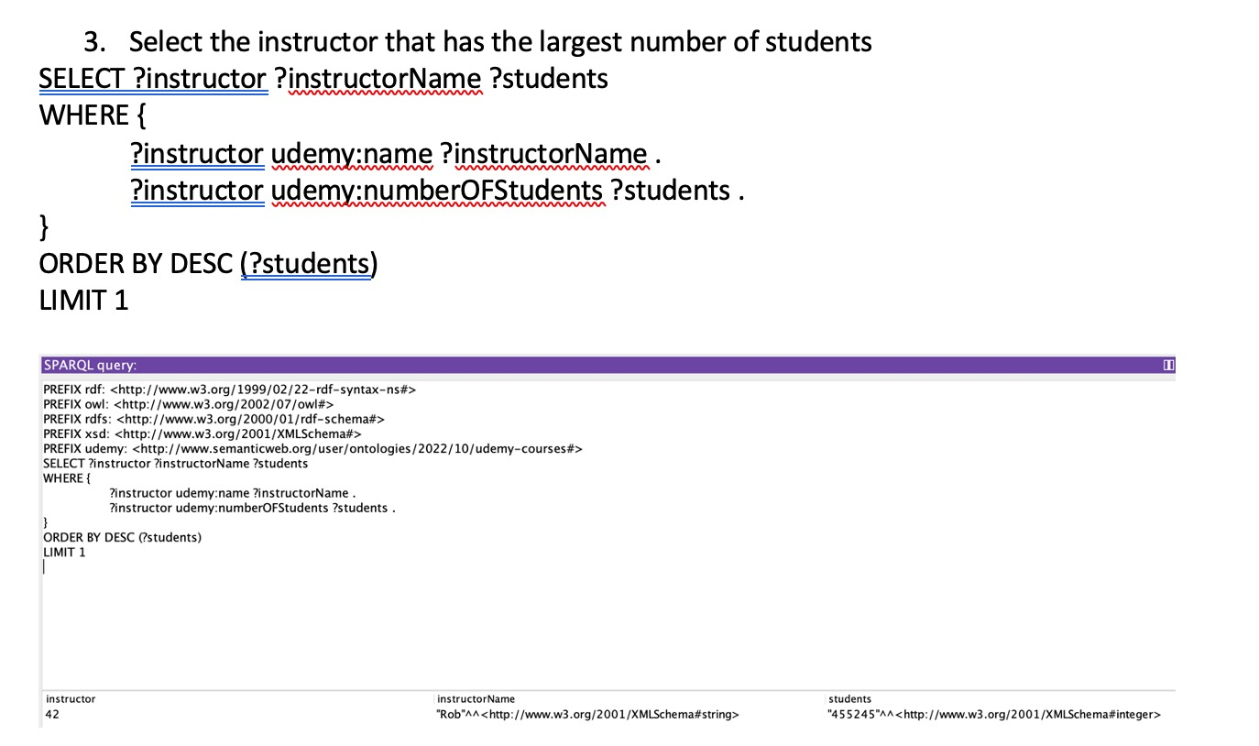
4.

Slide 6
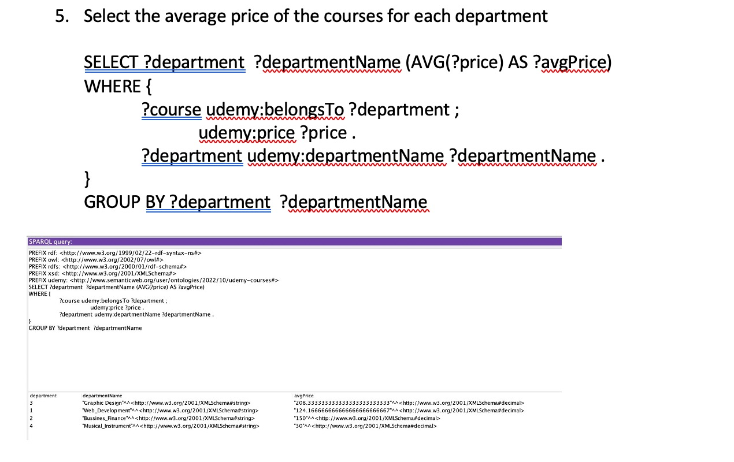
5.

Slide 7
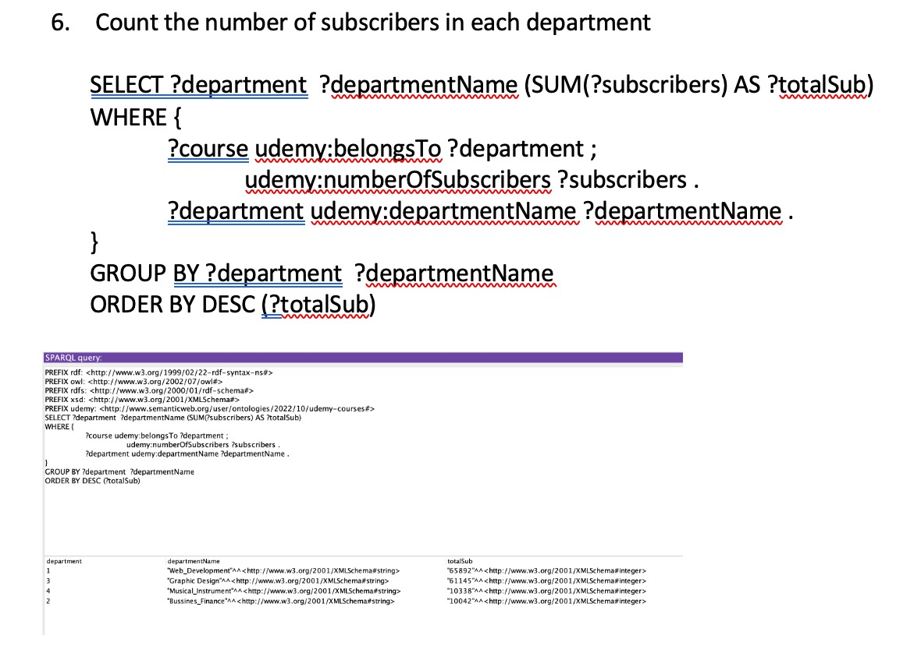
6.

Slide 8
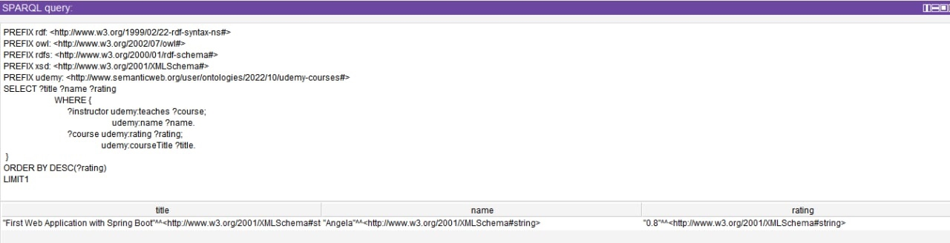
7.

Slide 9
8.
Return information for the person named Davilla:
SELECT ?name ?birthdate ?surname ?num
WHERE {
?instructor udemy:birthdate ?birthdate;
udemy:name ?name;
udemy:surname ?surname;
udemy:numberOFStudents ?num.
FILTER REGEX(?surname, "Davilla")
}

Slide 10
9.
REturn the name of the person who is born in 22/07/1980 and his education is informatic :
SELECT ?name ?birthdate ?surname ?edu
WHERE {
?instructor udemy:birthdate ?birthdate;
udemy:name ?name;
udemy:surname ?surname;
udemy:education ?edu.
FILTER (?birthdate>"22/07/1980" && ?edu= 'Informatics' )
}

