Slide 1
Good Morning
PROJECT NAME: DB2-2022-2023(Udemy Courses)
(Group Members)
IRFAN ULLAH KHAN (2054601)
Rajmonda Bardhi (2071810)
Anahita Abbaspour (2005495)
Carlos Alcantud Cuesta (2065642)

Slide 2

About this dataset:
This dataset contains information about Udemy courses from different departments, and also information about the subscribers and instructors of each course.

Slide 3
Domain of the data
Link of the data:
https://www.kaggle.com/datasets/thedevastator/udemy-courses-revenue-generation-and-course-anal
Ontology Name: Udemy-Courses

Slide 4
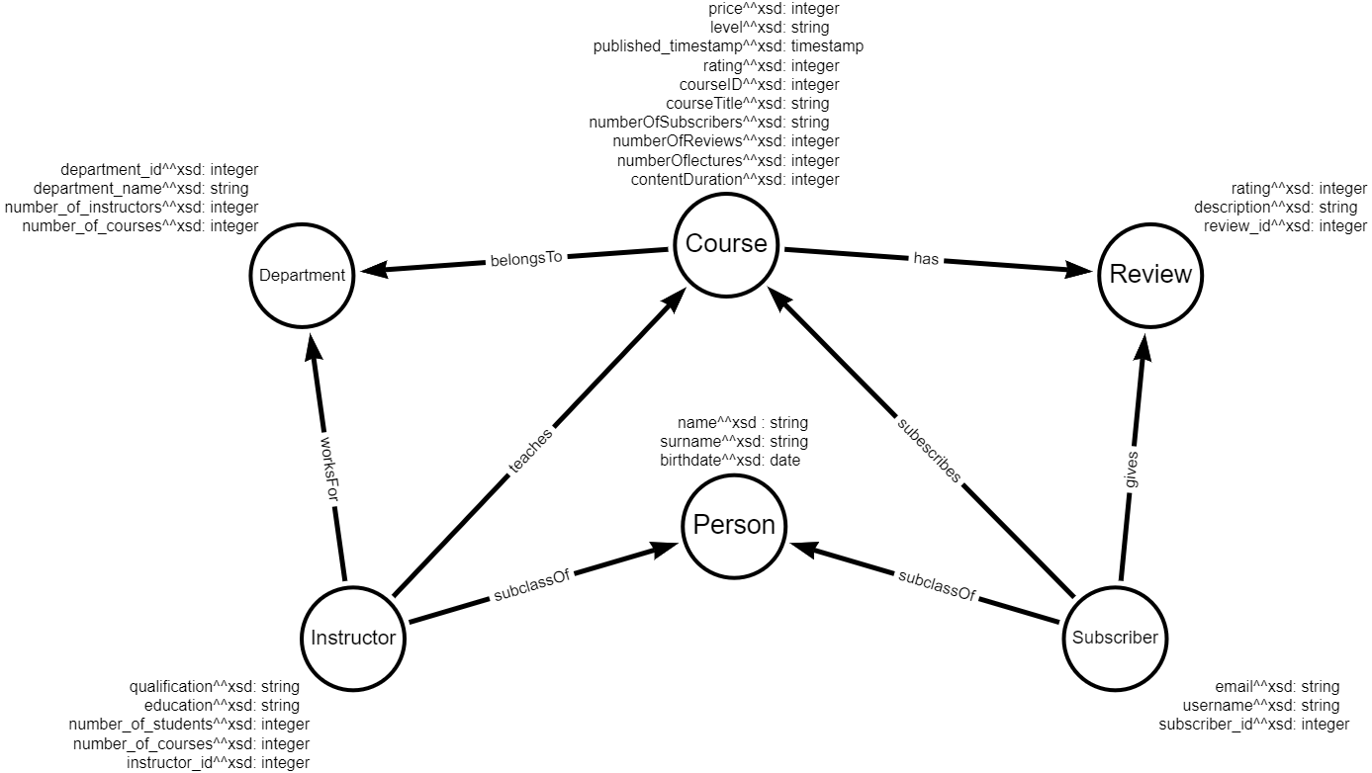
Visual Model

Slide 5
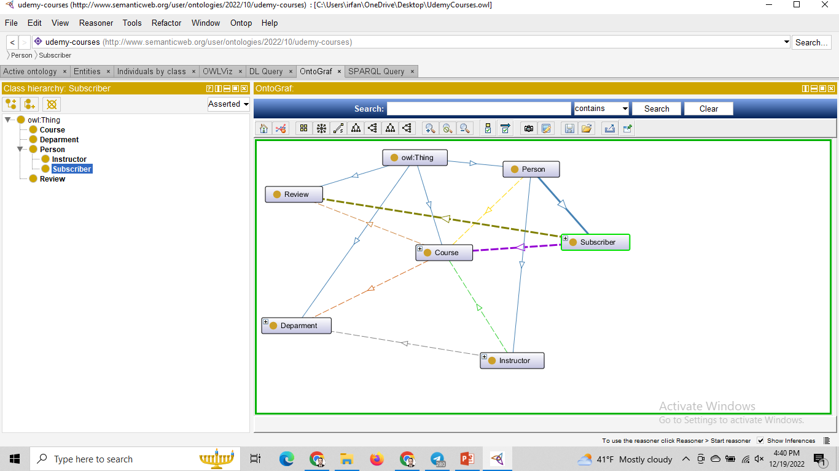
Ontology Graph

Slide 6
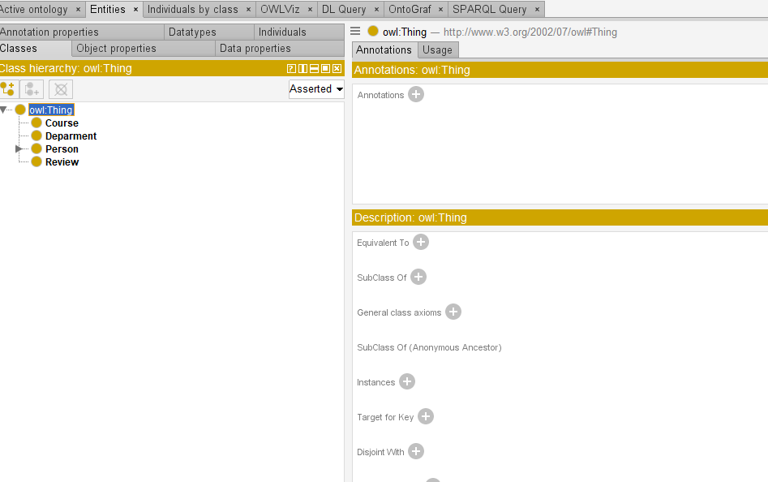
Here we have 4 main classes:
1. Course
2. Department
3. Person (Instructor, Subscriber)
4. Review

Slide 7
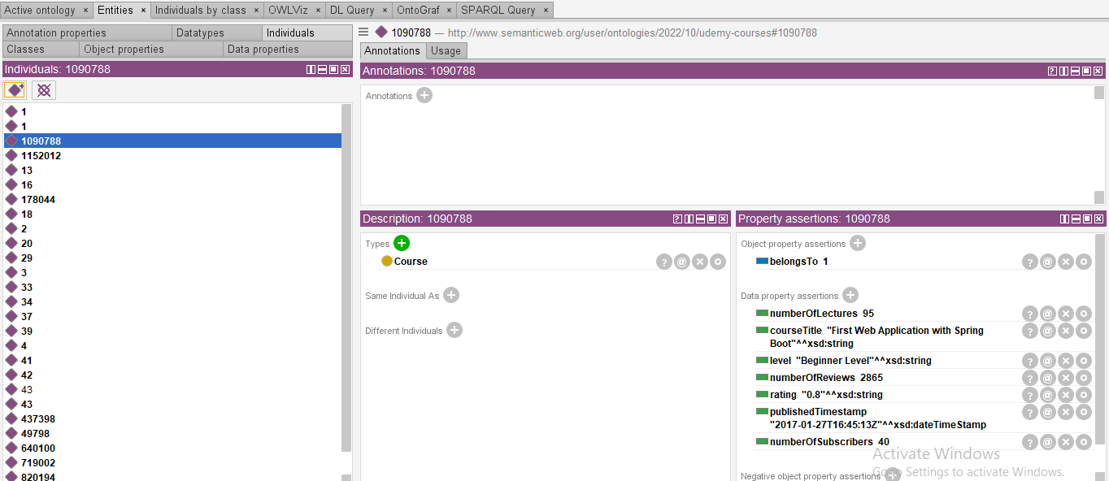
INDIVIDUAL:
Individual name is ‘1090788’ and its type is course.
We can define relationship between individual
For example course is ‘belongTo’ department
And graphically we represent it with Dimands

Slide 8
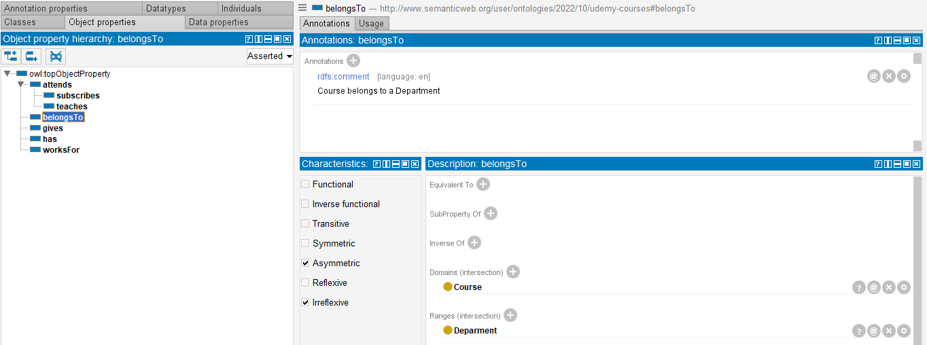
Properties:
We have a property called “belongsTo”
NO

Slide 9
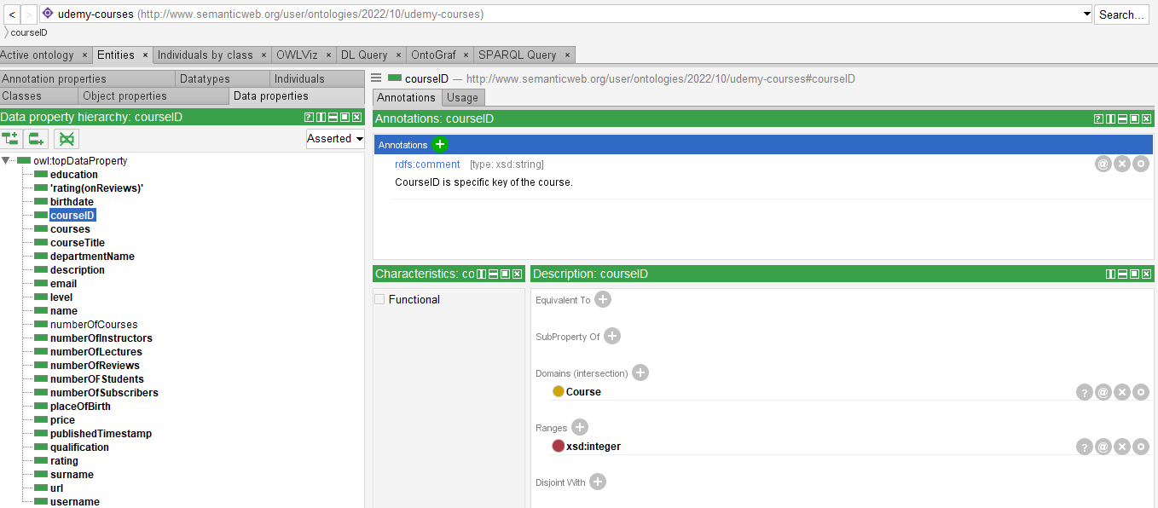
Attributes:
Describe the objects in the ontology and they are called data properties

Slide 10
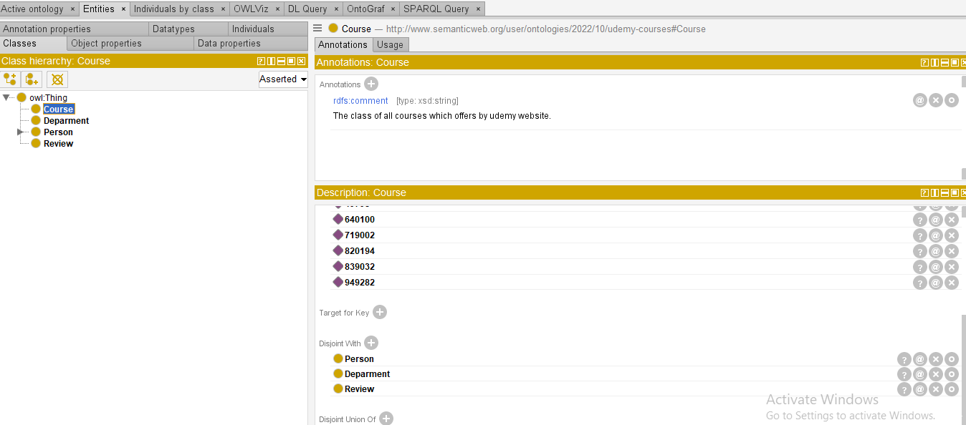
Disjoint:
We must make disjoint from one another if we keep classes separate.

Slide 11
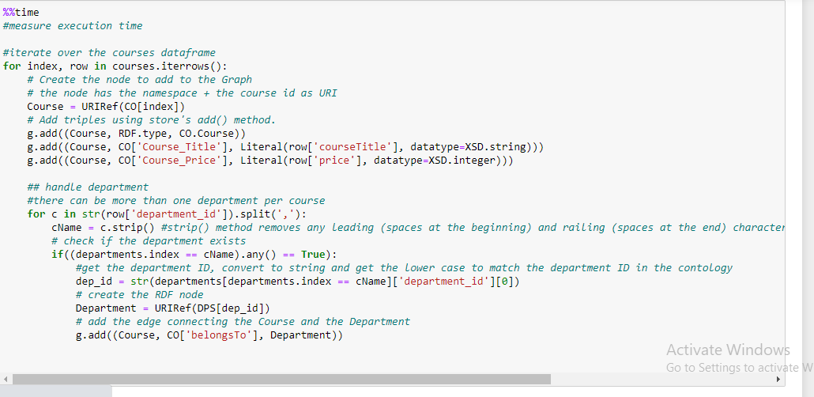
Jupytor:

Slide 12

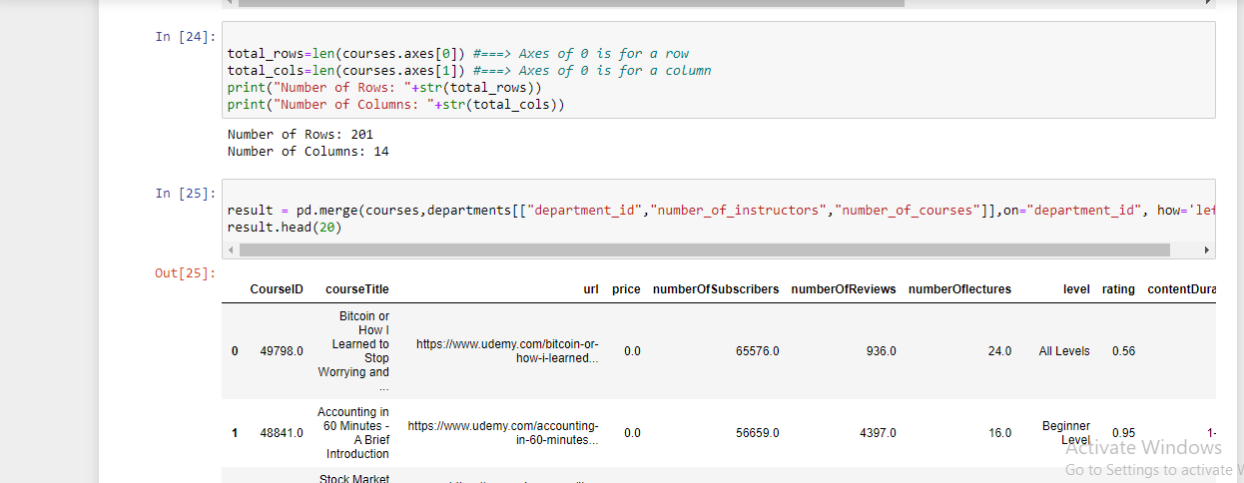
Data Cleaning:
Here we cleaned our data

Slide 13
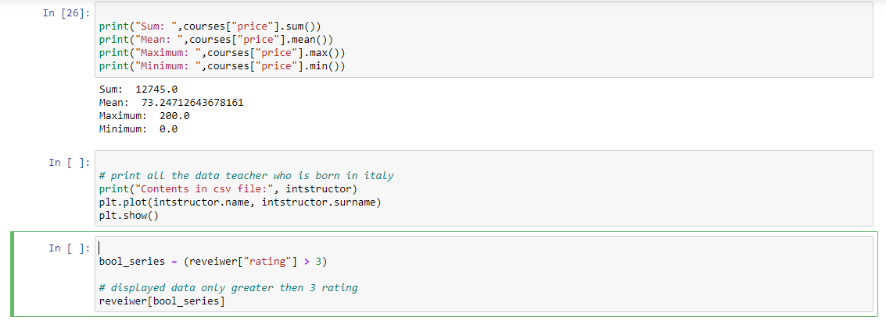

Slide 14
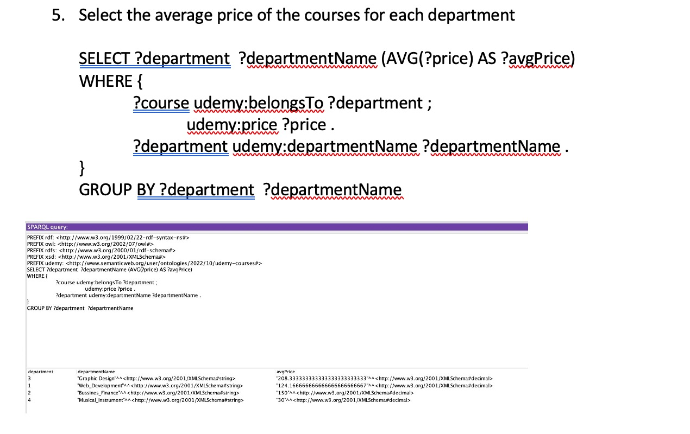
Queries:

Slide 15
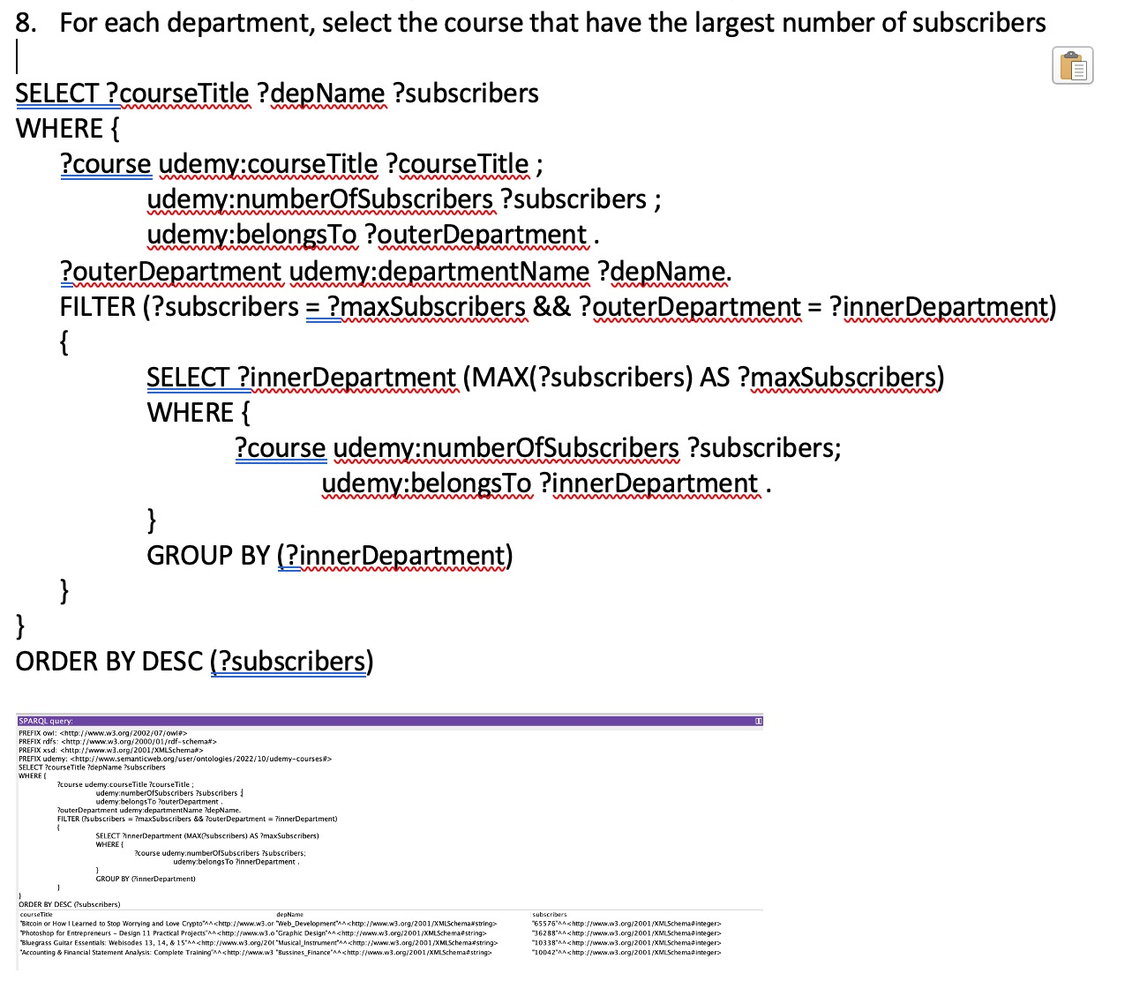
Queries:

Slide 16
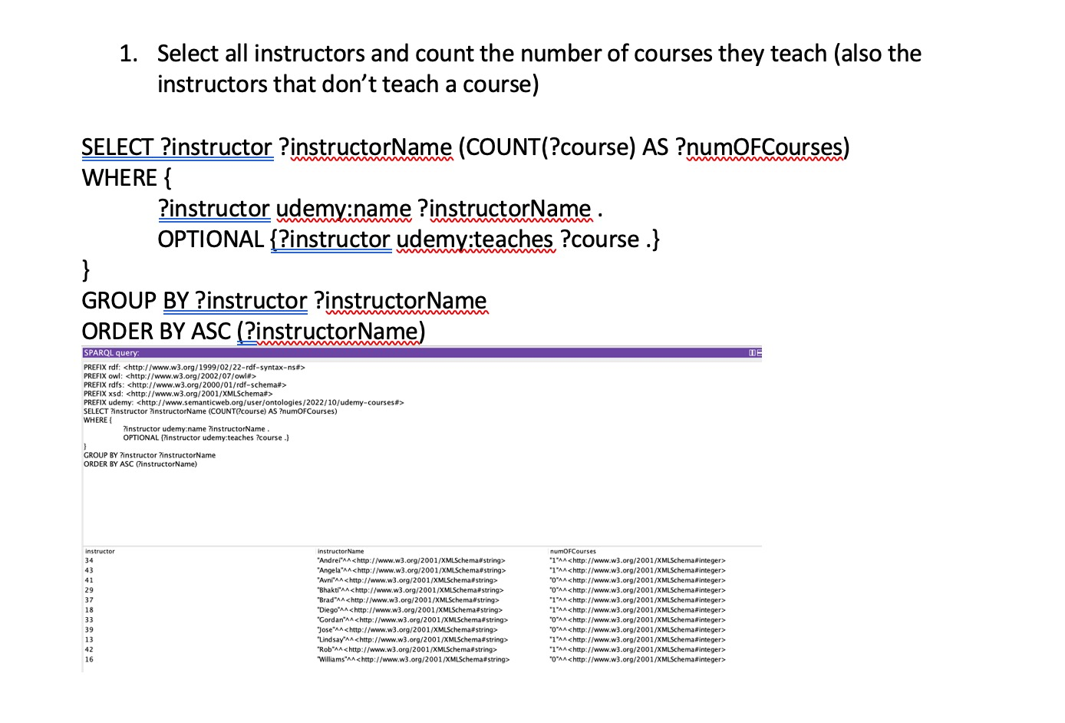
Queries:

Slide 17
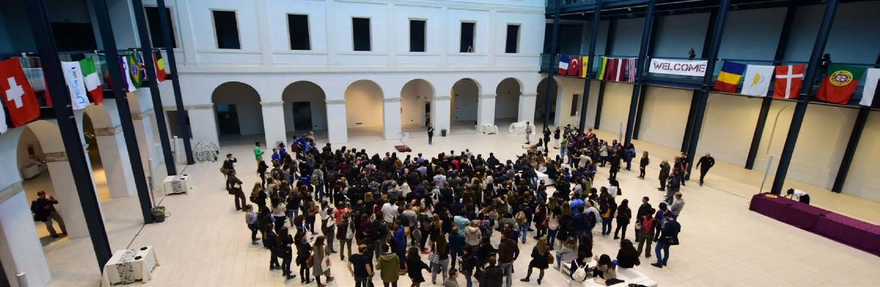

THANK YOU FOR YOUR ATTENTION!

