Slide 1





DATABASE 2
Arwa Fahoud: 2109672
Irfan Ullah Khan: 2054601
Zain Ul Abedin: 2006128

Slide 2
Presentation Outline
Domain
03
Dataset
04
Ontology
05
Ontology (Enumerated Classes)
06
Ontology (Constraints)
07
Data Congestion
10
SPARQL Queries
11
Analyzation
17
Questions
21

Slide 3
Domain
The goal is to model major football competitions, clubs competing in them, football games and players appearances, positions, the events they are involved in (cards, substitutions, goals) and their market value.

Slide 4
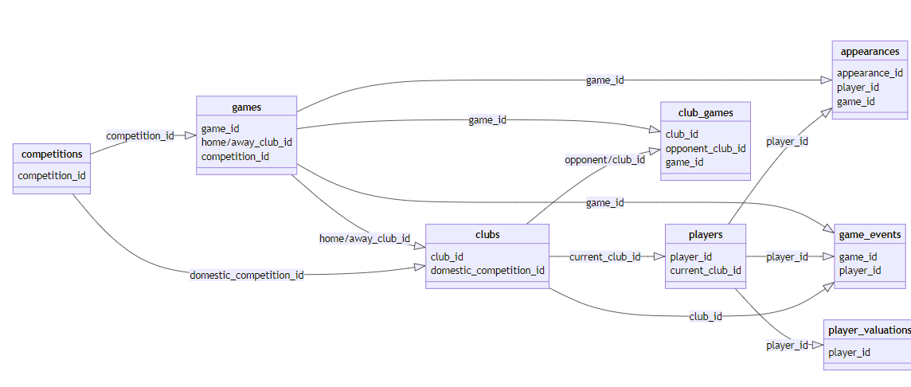
Dataset
It’s an Open Dataset, with data from Kaggle.com
https://www.kaggle.com/datasets/davidcariboo/player-scores
Basically this data collected from Transfermarket website https://www.transfermarkt.co.uk/

Slide 5
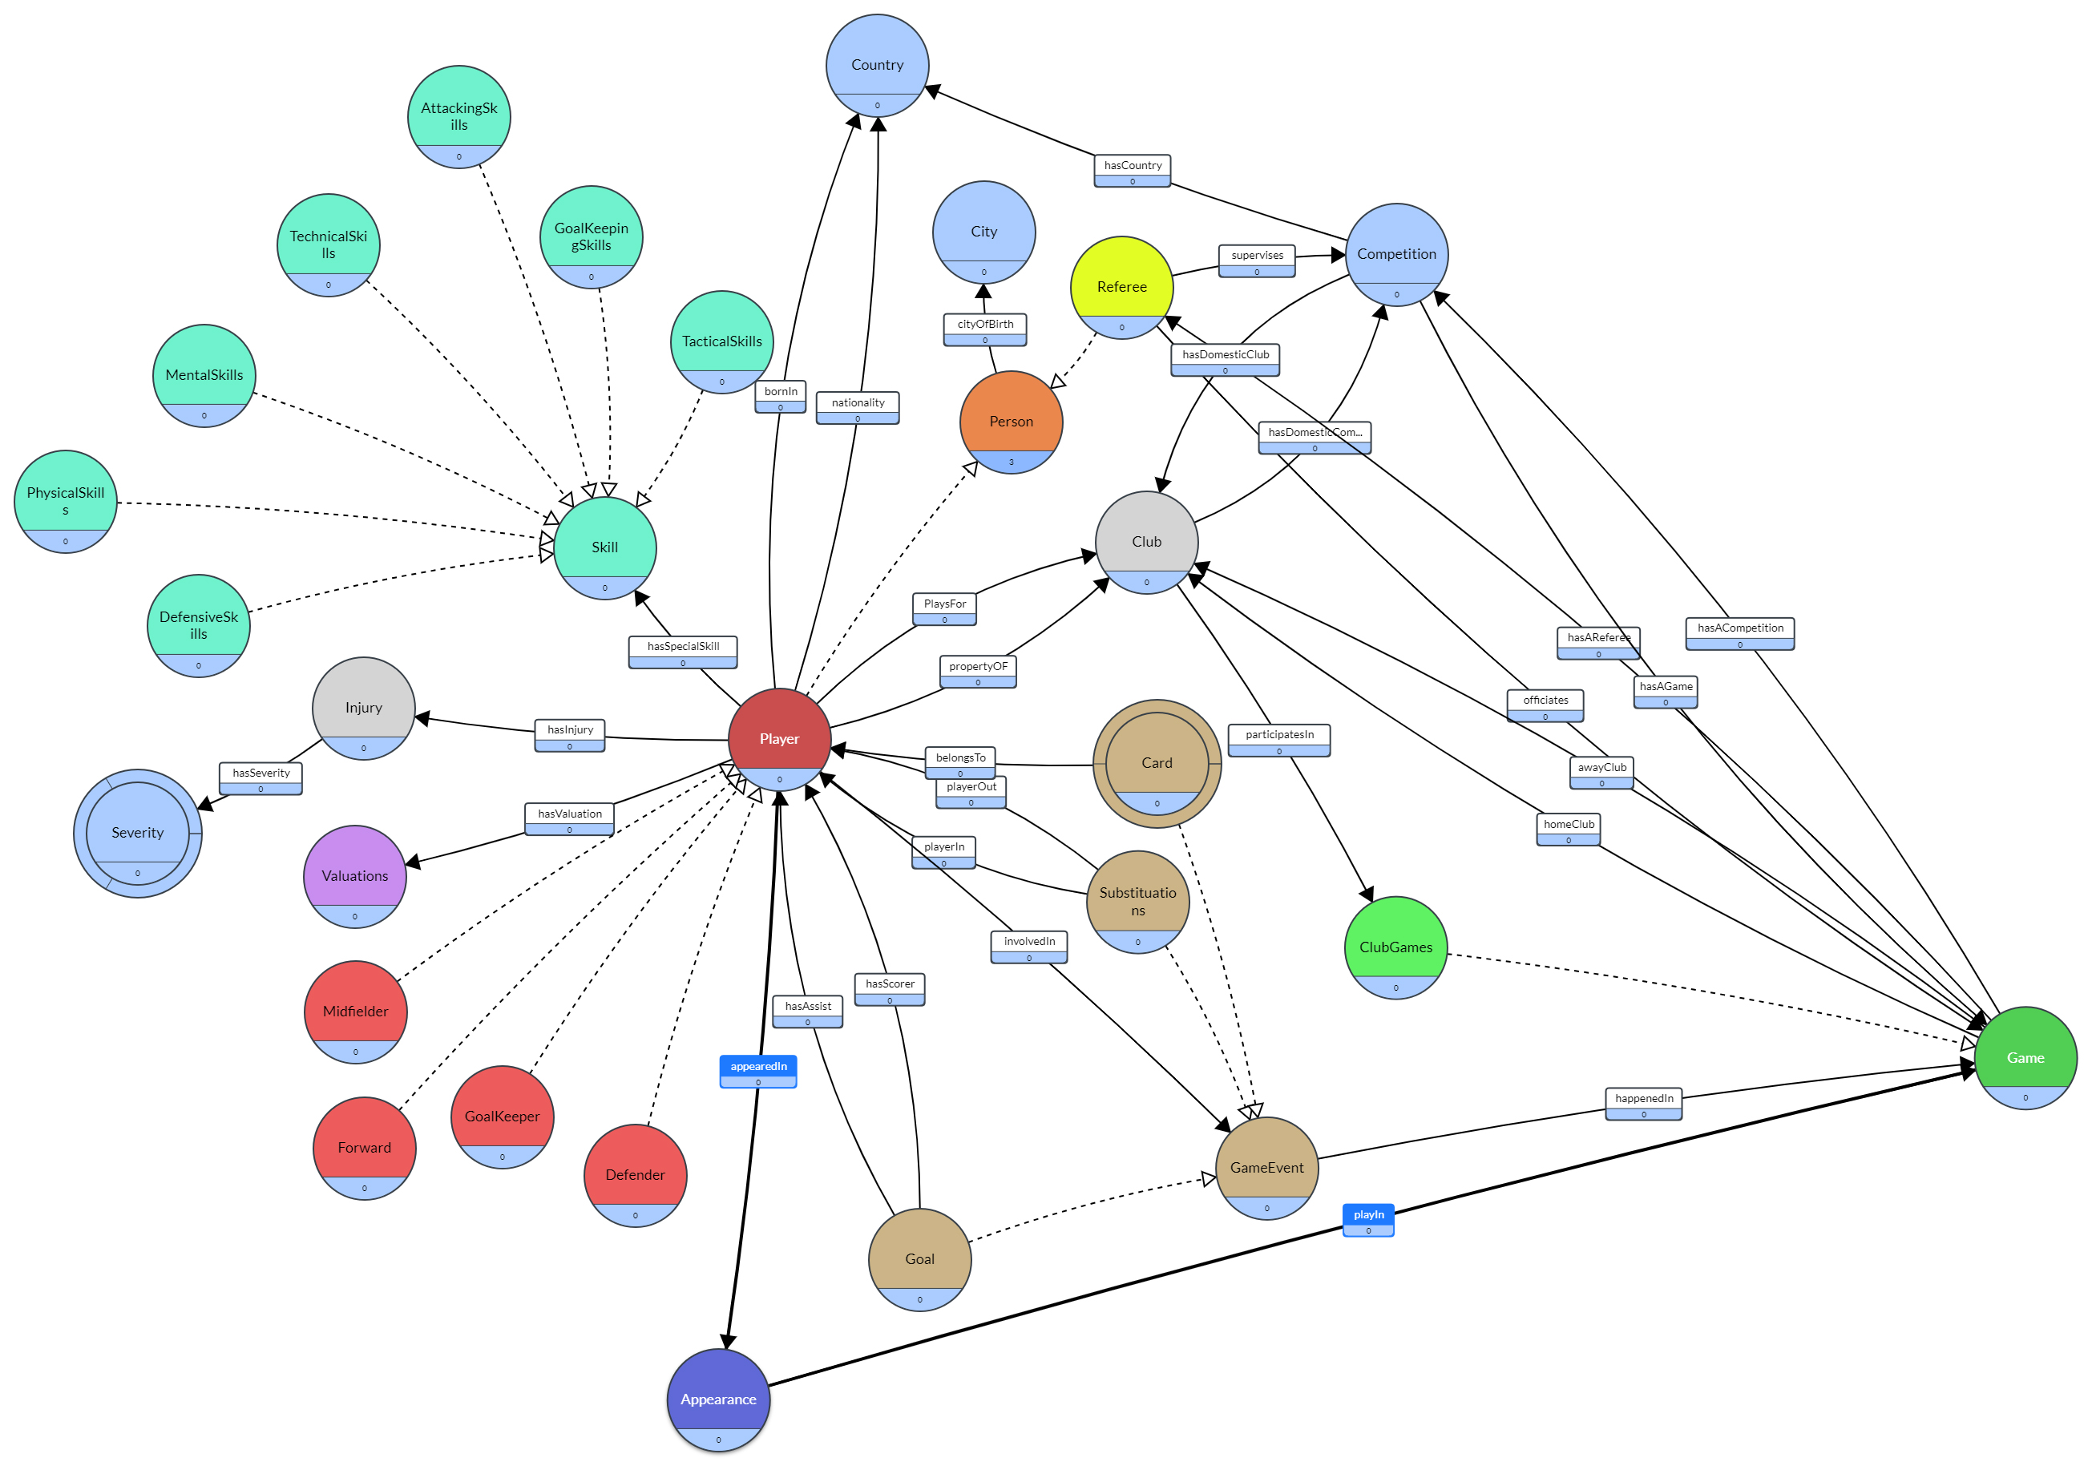
Ontology

Slide 6
Ontology (Enumerated Classes)
Card
RedCard
YellowCard
Severity
Mild
Moderate
Severe

Slide 7
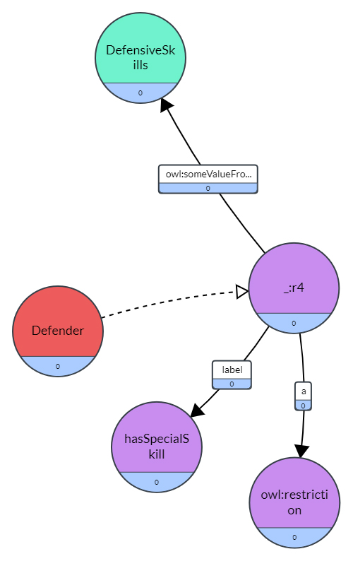
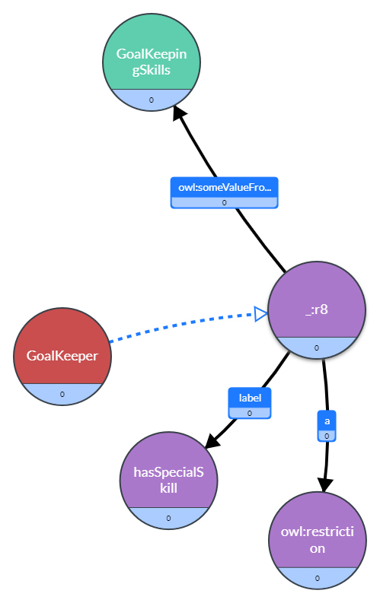
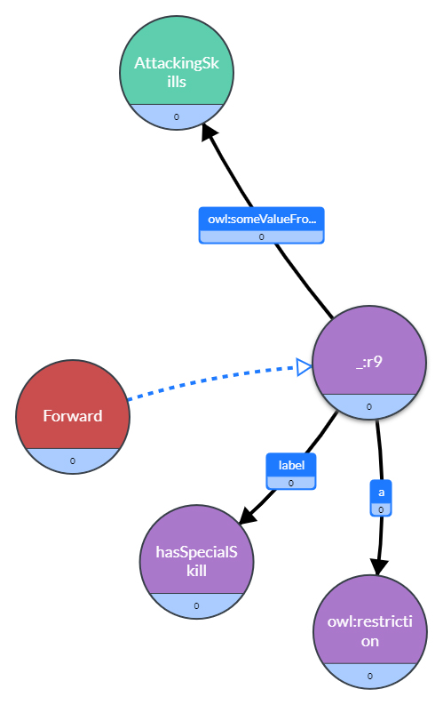
Ontology (Constraints)

Slide 8
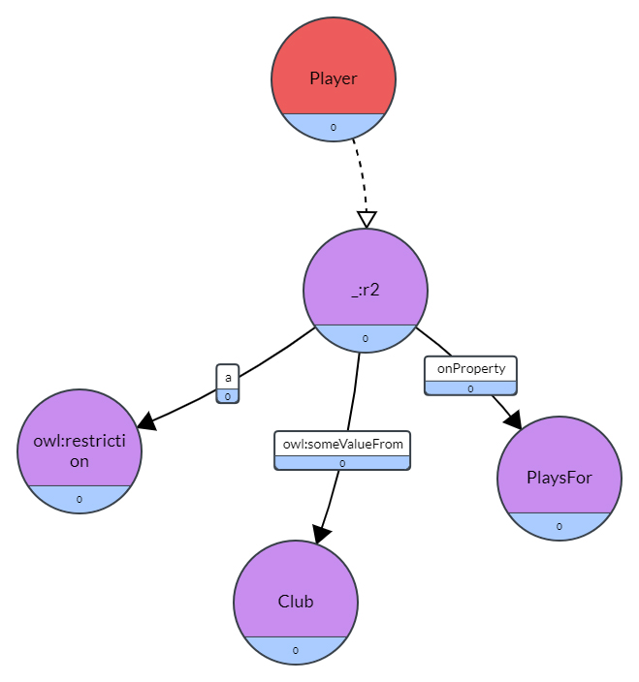
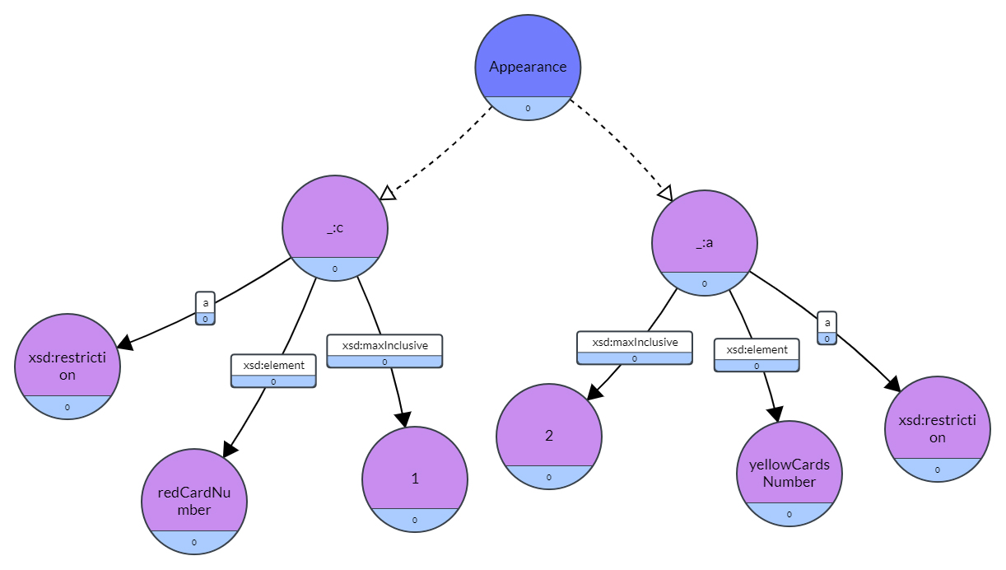
Ontology (Constraints)

Slide 9
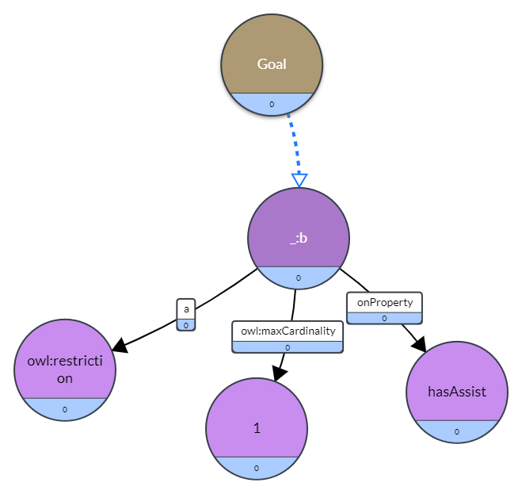
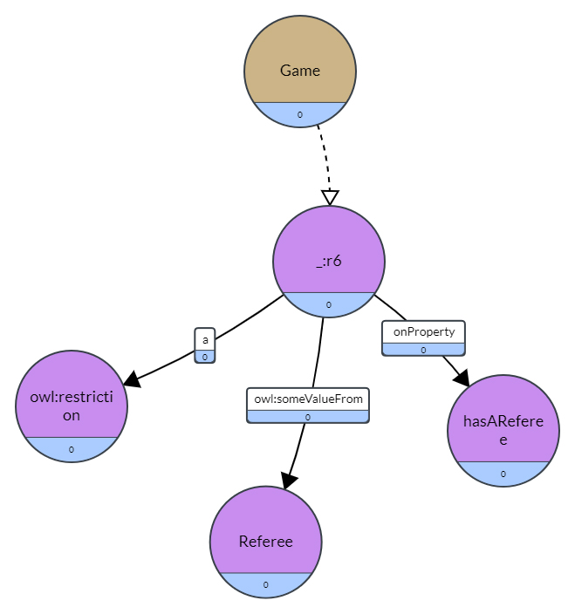
Ontology (Constraints)

Slide 10

Data Congestion
We faced empty cells in data attributes like :
Average age
Foreigners percentage
Player’s height
Player’s market value
We faced inconsistency in date format:

Slide 11
SPARQL Queries
We provided ten SPARQL queries:
The top ten players who participated the most in the football games.
The players who scored or assisted more than 300 goals.
Is the market value of Real Madrid players is higher than the market value of Bayren München.
For each club get the name and birthdate of the oldest player.
Return the names of the clubs which have less than 13 players and compete against each other in the same domestic league competition.
Return the number of the games that Arsenal club won since 2022.
Retrieve the names of the players who scored more than 30 goals in the competitions that happened after 2019 and were born after 1987

Slide 12
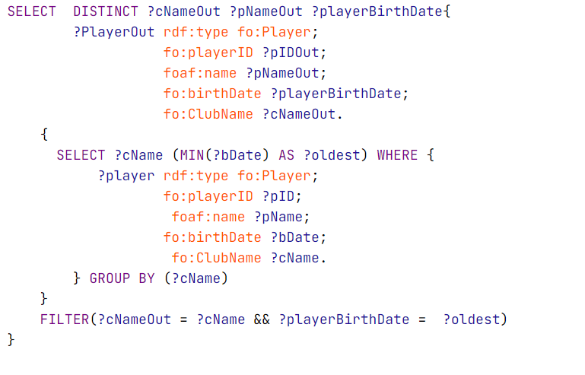
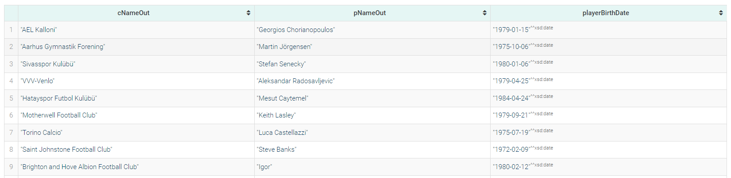
For each club get the name and birthdate of the oldest player.

Slide 13
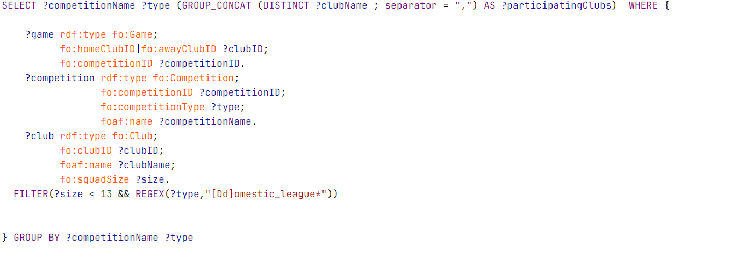
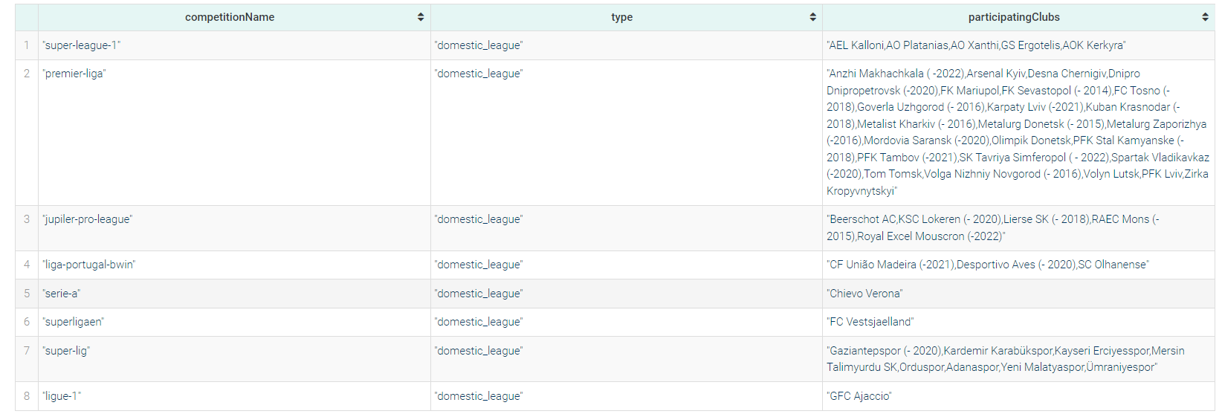
Return the names of the clubs which have less than 13 players and compete against each other in the same domestic league competition.

Slide 14
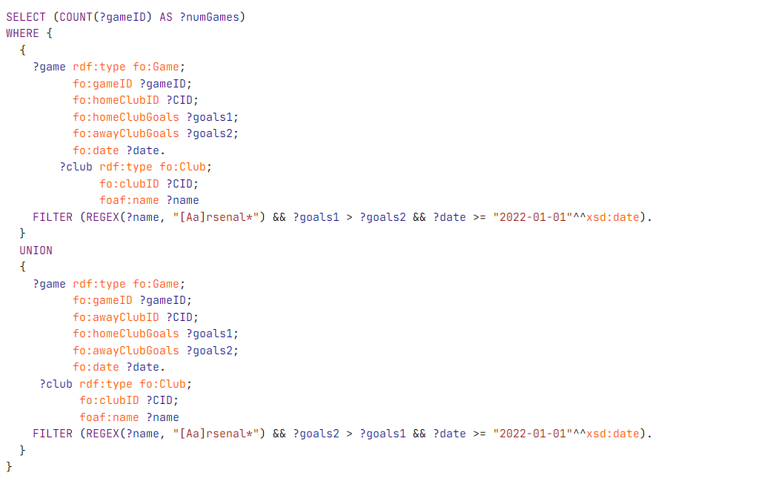
Return the number of the games that Arsenal club won since 2022

Slide 15
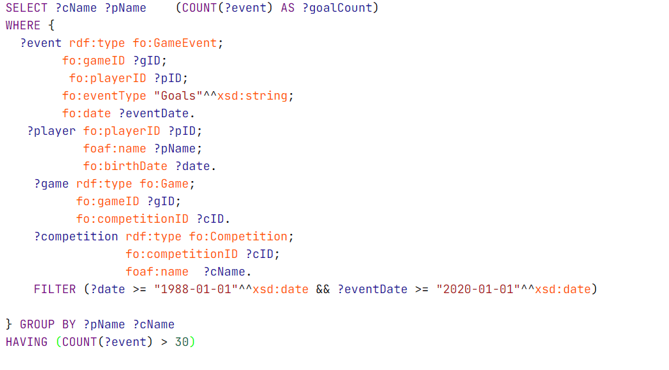
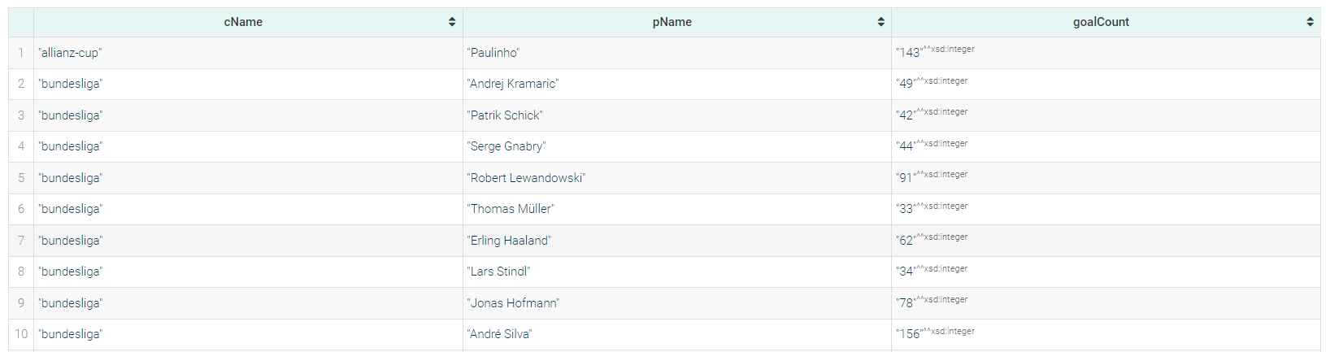
Retrieve the names of the players who scored more than 30 goals in the competitions that happened after 2019 and were born after 1987 .

Slide 16
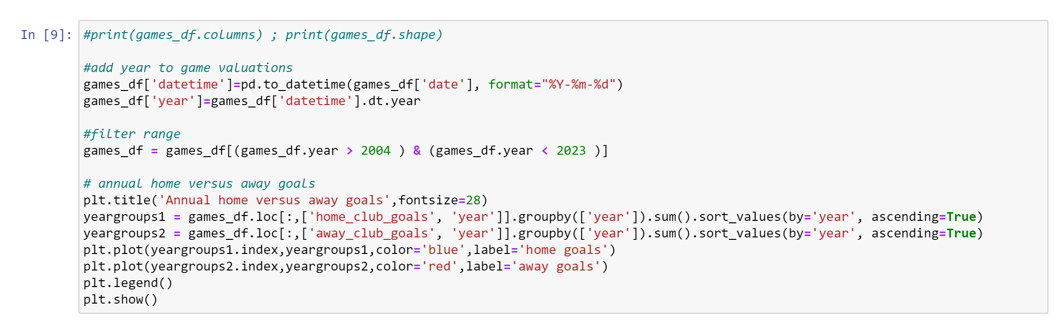
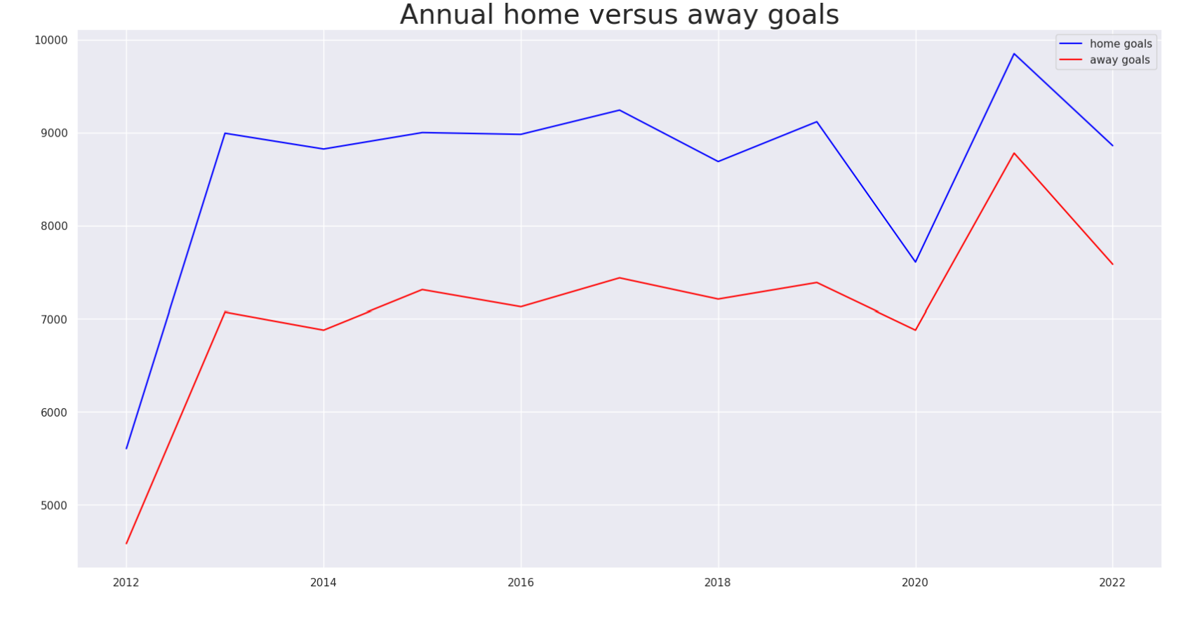
Analyzation

Slide 17
Analyzation
Player Data Visualization: Explorator data visualizations relating to players who's last season played was 2022 or 2023 with a market value of greater that 10 million euros.
We used some useful libraries for creating graphs like,
import matplotlib.pyplot as plt

Slide 18
Analyzation
First, We removed those players who have no market values
players_df1 =
players_df[players_df.highest_market_value_in_eur.isnull()
== False]

Slide 19
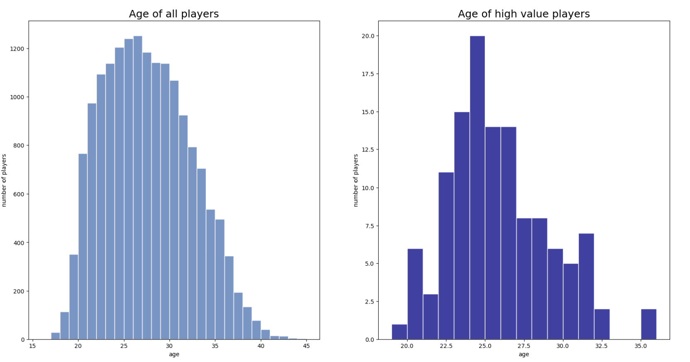
Analyzation

Slide 20
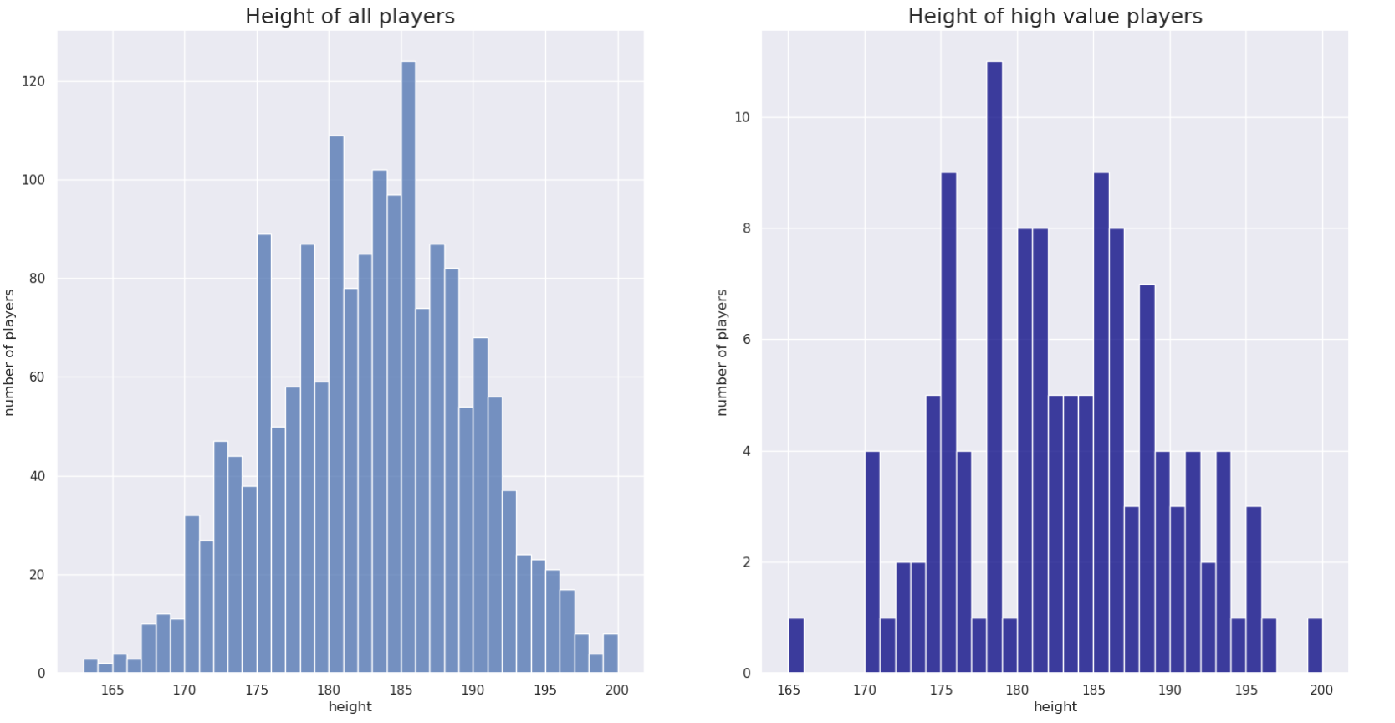
Analyzation

Slide 21
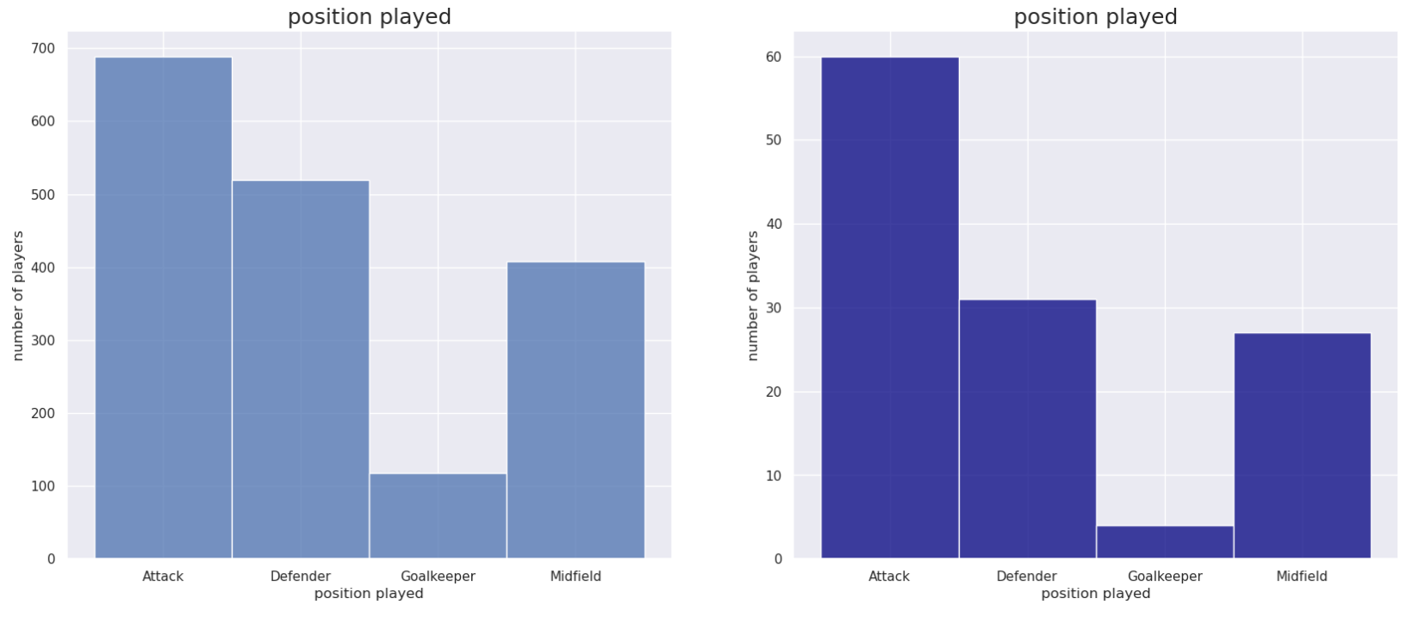
Analyzation

Slide 22
Analyzation
Observations on player data visualizations
Generally the distributions of age is a skewed normal
distribution and height is a normal distribution.
Distributions amongst high value players appear to
be reflective of values within the entire dataset.

Slide 23
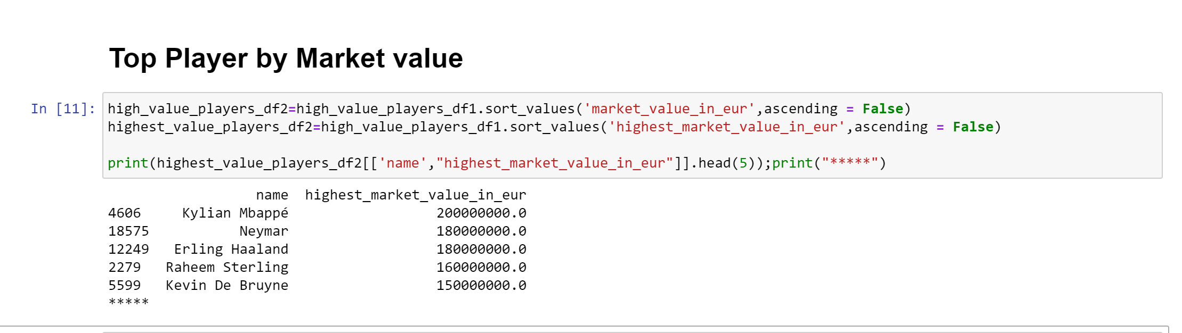
Highest market value

Slide 24




Questions?

