Slide 1


PROJECT PRESENTATION
THREE USER ROLES
Smart Portal Management for Students
ADMIN
TEACHER
SMART PORTAL
Project Type: Student Management Portal
Purpose: Centralized management of students, teachers, courses, assignments, attendance, fees, notifications and AI support.
STUDENT
“One Smart Portal for Complete Student Management”
Notes:
Introduce the project: a centralized Smart Portal for student management. Explain the three login roles — Admin, Teacher, Student — and that everything connects to one portal.

Slide 2














Project Objectives
SLIDE 02
Centralize student & teacher information
Separate Admin, Teacher & Student logins
Simplify assignment creation & submission
Automate attendance using Geofencing
01
02
03
04
Secure & organized fee management
WhatsApp alerts to students & parents
AI chatbot support for students & teachers
Reduce manual work, improve communication
05
06
07
08
WHAT THESE OBJECTIVES DELIVER
One Central Database
Less Manual Work
Parents Stay Informed
All modules share the same data
Attendance and reminders automated
Instant WhatsApp updates
Notes:
Walk through the eight objectives briefly. Emphasise automation: geofencing attendance, WhatsApp notifications, AI chatbot.

Slide 3









Major Modules of the System
SLIDE 03
THE THREE LOGIN ROLES
Admin Mgmt
Fees & Payment
Course & Batch
Admin
Complete data manipulation and management of the whole portal.
Student Mgmt
SMART PORTAL
Assignments
Teacher
Assignments, batches, courses and student-related activities.
Teacher Mgmt
WhatsApp Alerts
Geofencing
Student
Registration, dashboard, assignments, marks, attendance and fees.
AI Chatbot
Fees: Full Payment or Monthly Installment
Reminders sent before every due date
AI chatbot open to all three roles
Notes:
Show the nine modules around the central Smart Portal node, then summarise what each of the three roles can do.

Slide 4


System Flow Chart
SLIDE 04
START
Open Smart Portal
Select Login Type
Admin / Student / Teacher
Central Database
ADMIN
STUDENT
TEACHER
Admin Login
Student Login
Teacher Login
Dashboard
NEW USER
EXISTING USER
Teacher Dashboard
Registration Form
Login ID & Password
Manage Students / Teachers / Courses / Batches / Assignments / Fees / Attendance
Manage Assignment / Batch / Course / Teacher Details
Registration ID Generated
Student Dashboard
WhatsApp Enquiry Details
Personal Details / Assignments / Marks / Attendance / Fees / AI Chatbot
Database
View Submissions
Notes:
Explain the flow: open portal, select login type, then the three separate paths. Note the student path splits into New User and Existing User.

Slide 5











Smart Attendance Using Geofencing
SLIDE 05
YES
INSIDE RANGE — ATTENDANCE MARKED
Student approaches the class
Attendance link sent on WhatsApp
Student clicks the link & logs in
Clicks “Mark Attendance”
Attendance stored in database
Inside Geofence Range?
System checks GPS location
PARENT RECEIVES WHATSAPP MESSAGE
“Your child has arrived at class.”
NO
OUTSIDE RANGE — NOT MARKED
Attendance link is NOT sent
Attendance not recorded
Parent alerted: “Your child has not arrived at class.”
Location verification
Reduces proxy attendance
Automated parent updates
Faster attendance process
Notes:
Explain the location check. Inside the geofence, the attendance link goes to WhatsApp and the parent is informed the child arrived. Outside, no link and the parent is told the child has not arrived.

Slide 6
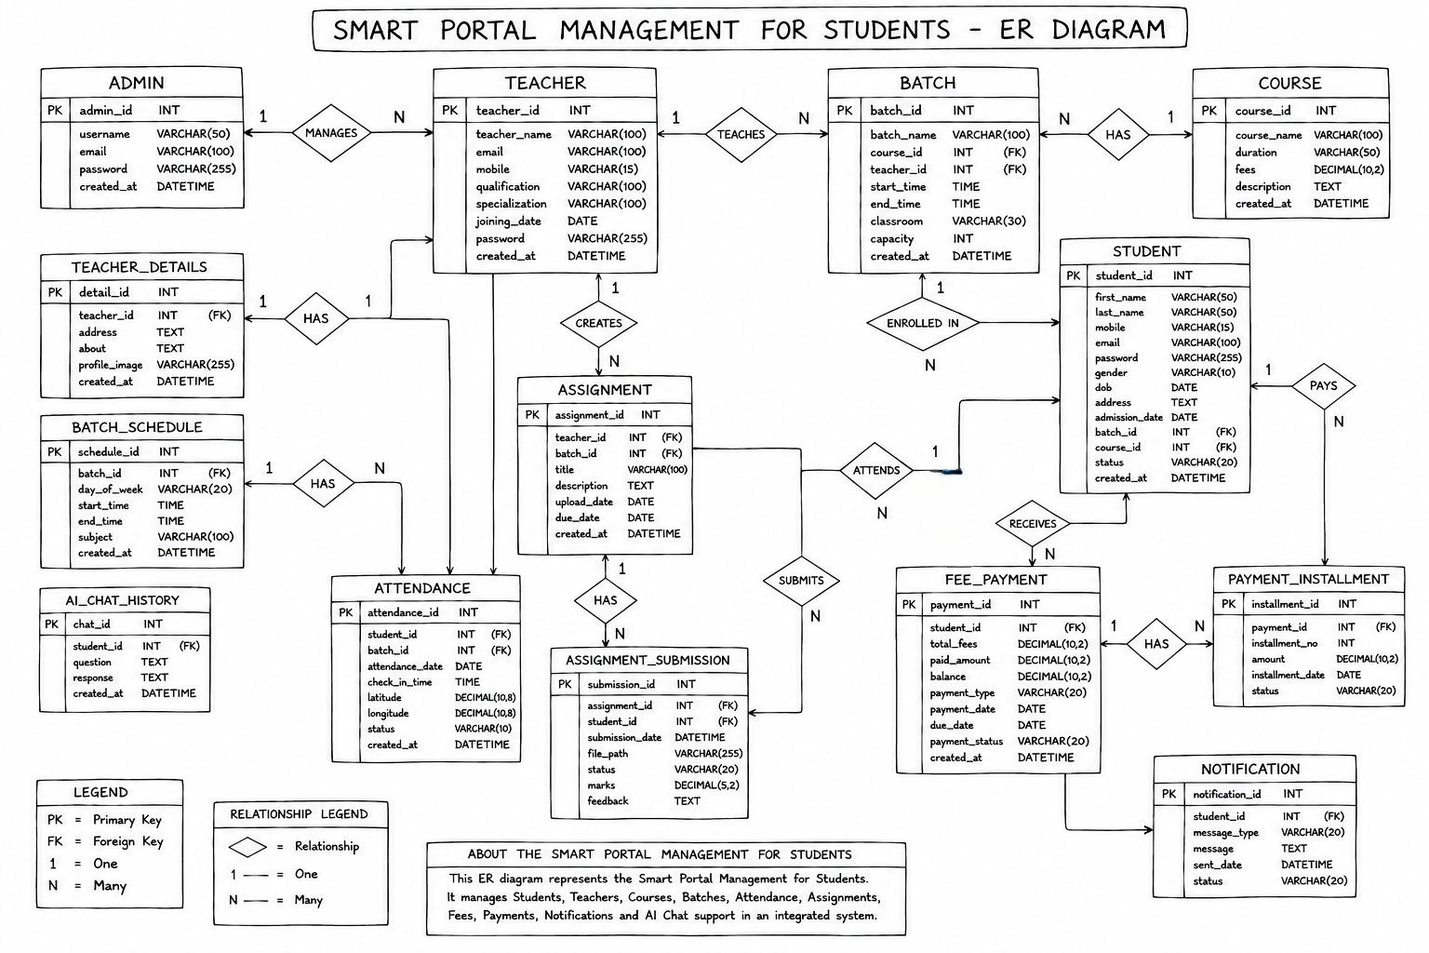
Entity Relationship (ER) Diagram
14 Entities Linked
SLIDE 06
Database structure of the Smart Portal — entities, attributes, primary keys, foreign keys and relationships.
Admin | Teacher | Teacher_Details | Batch | Batch_Schedule | Course | Student | Attendance | Assignment | Assignment_Submission | Fee_Payment | Payment_Installment | Notification | AI_Chat_History
Notes:
Explain that the ER diagram shows the database structure: entities, attributes, primary keys, foreign keys and relationships between modules.

Slide 7
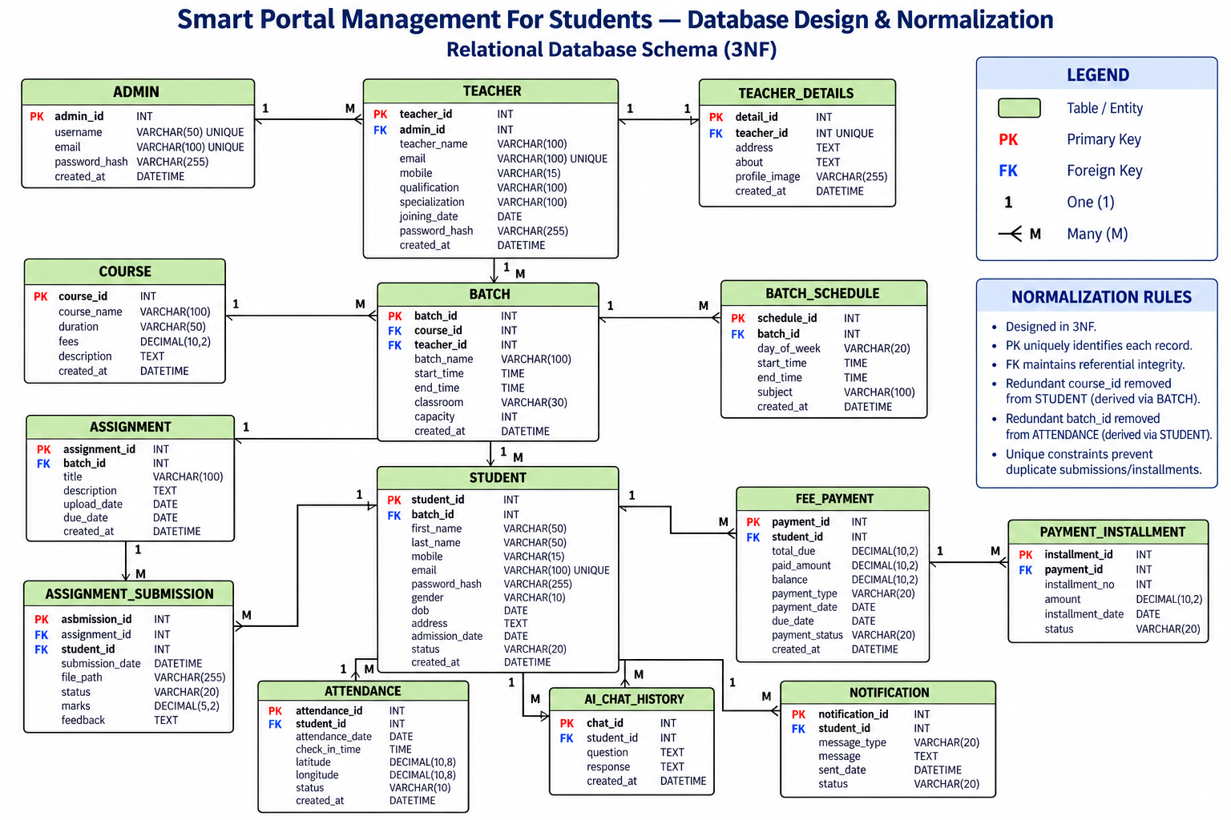
Database Design And Normalization
SLIDE 07
Notes:
Explain that the ER diagram shows the database structure: entities, attributes, primary keys, foreign keys and relationships between modules.

Slide 8
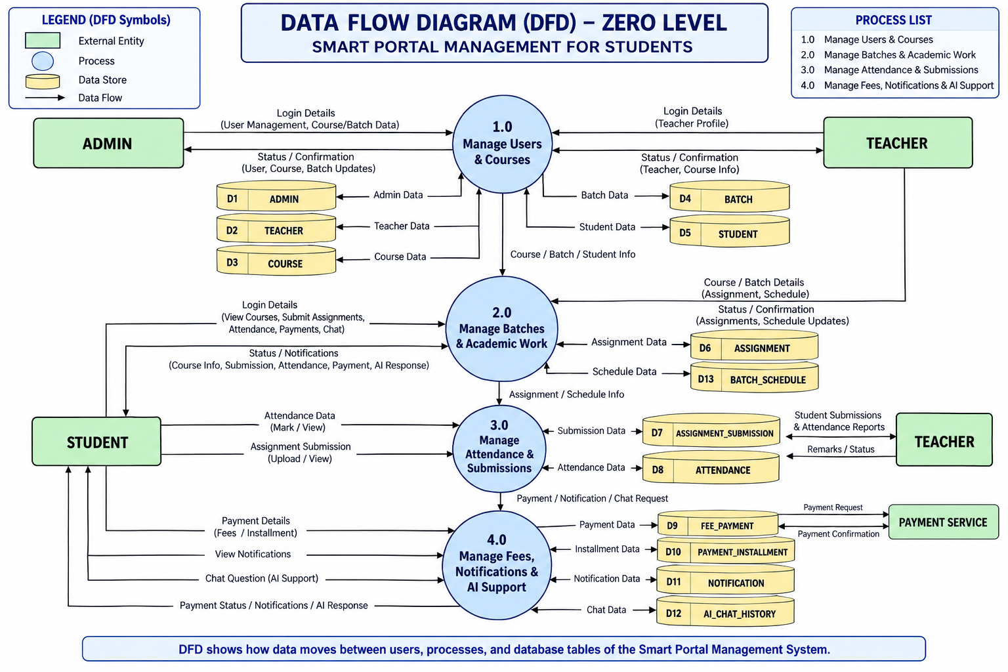
Data Flow Diagram (DFD) – Zero Level
SLIDE 08
Notes:
Explain that the ER diagram shows the database structure: entities, attributes, primary keys, foreign keys and relationships between modules.

Slide 9
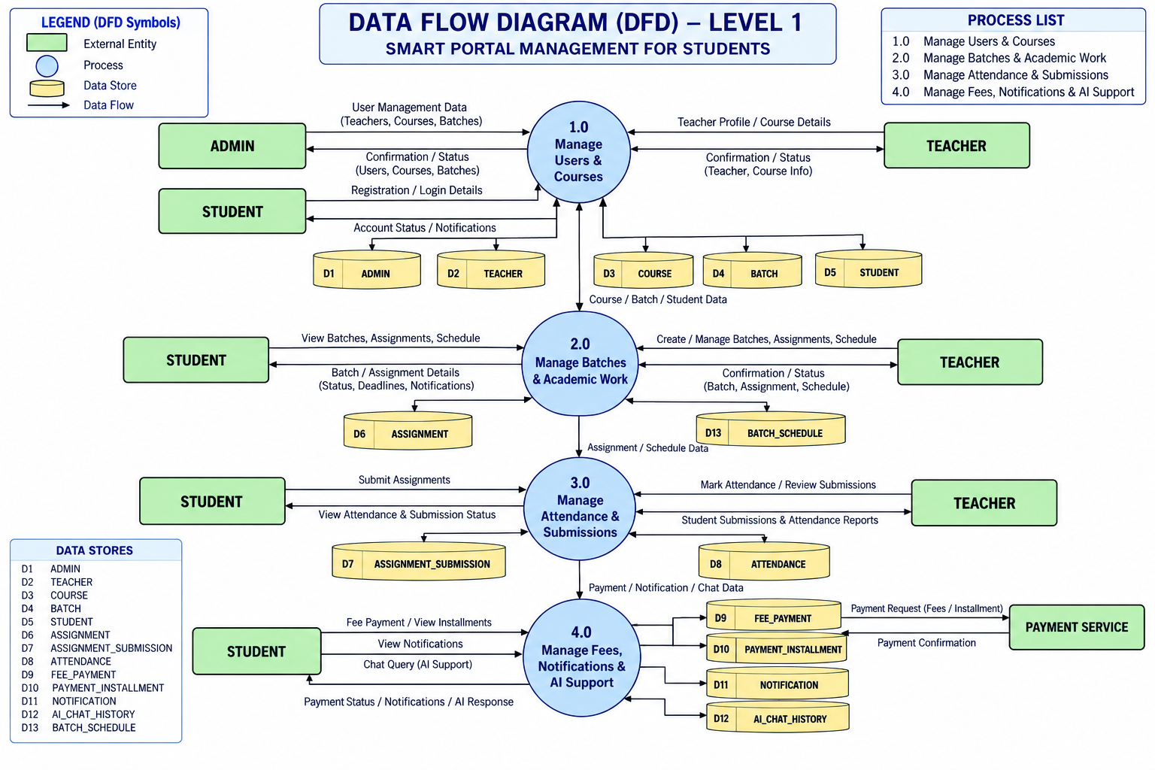
Data Flow Diagram (DFD) – Level 1
SLIDE 09
Notes:
Explain that the ER diagram shows the database structure: entities, attributes, primary keys, foreign keys and relationships between modules.

Slide 10
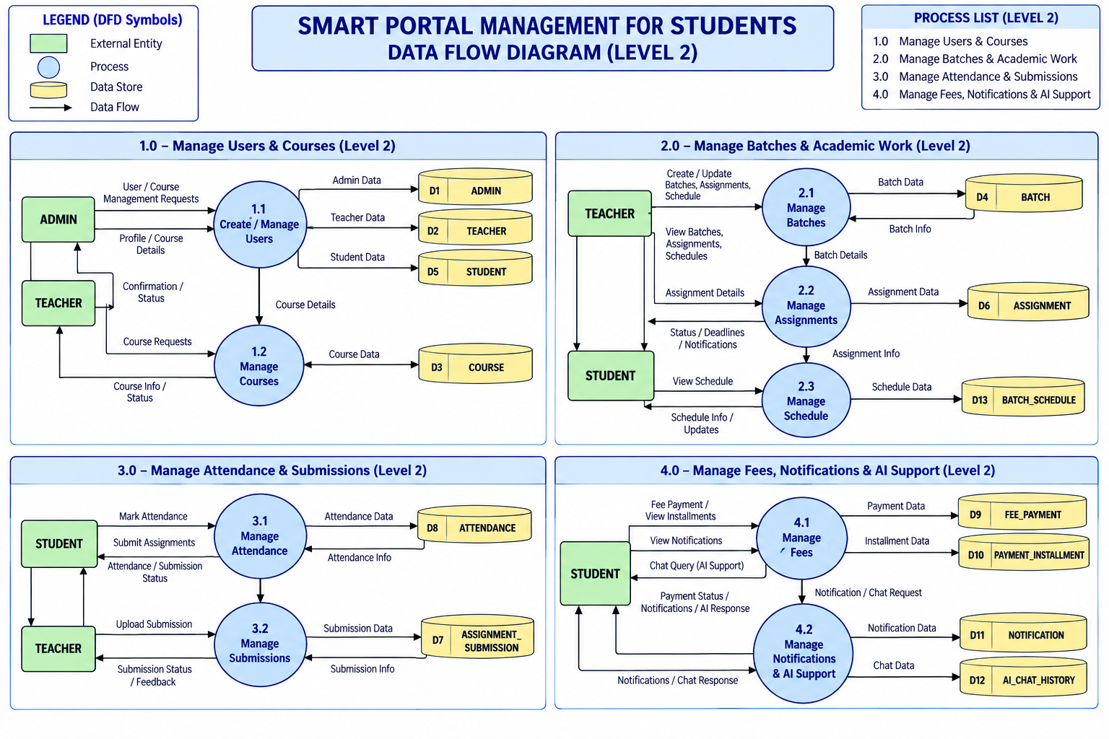
Data Flow Diagram (DFD) – Level 2
SLIDE 10
Notes:
Explain that the ER diagram shows the database structure: entities, attributes, primary keys, foreign keys and relationships between modules.

Slide 11

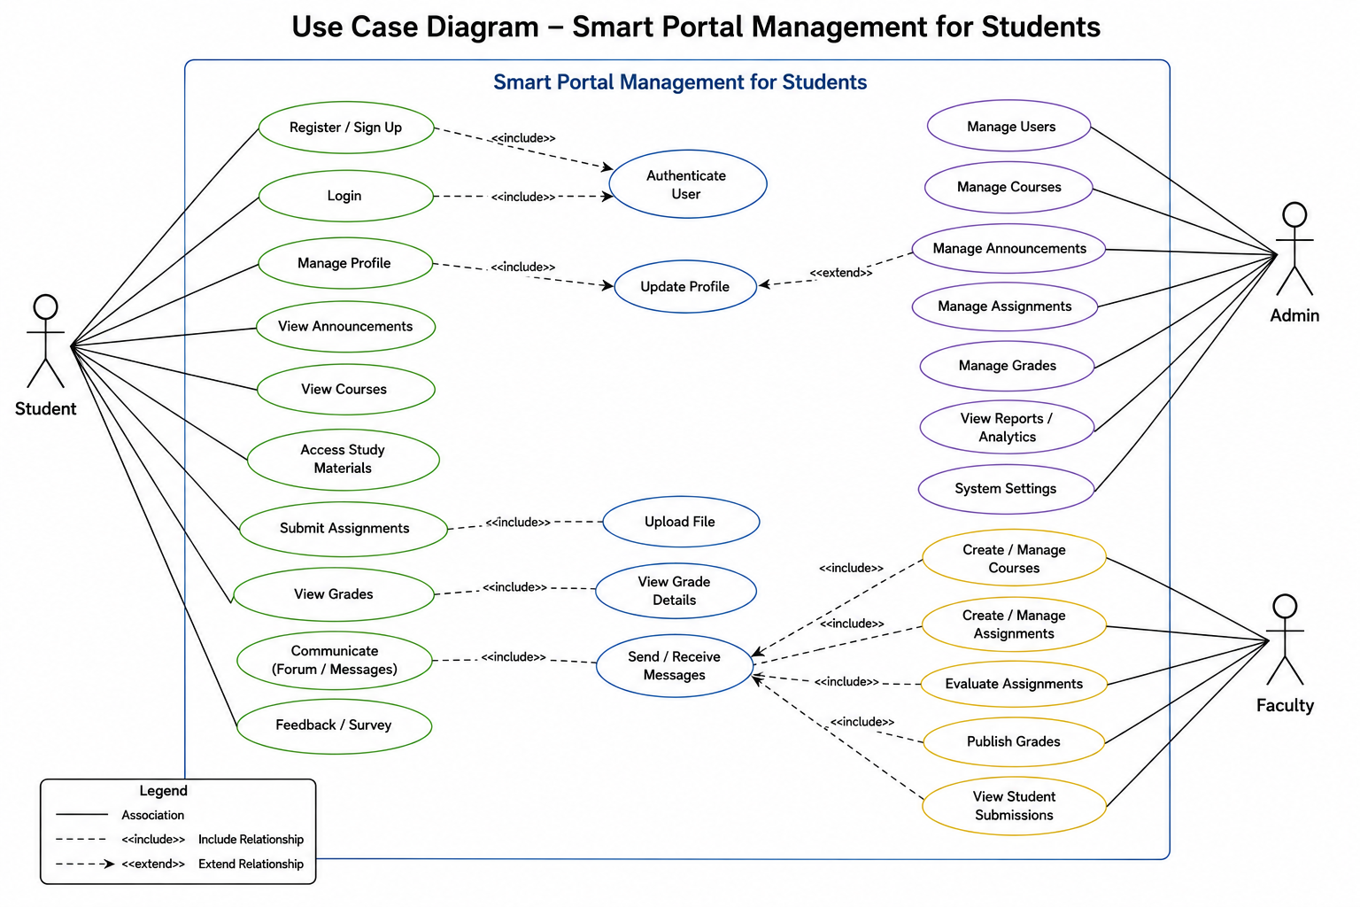
Use Case Diagram
SLIDE 11

Slide 12
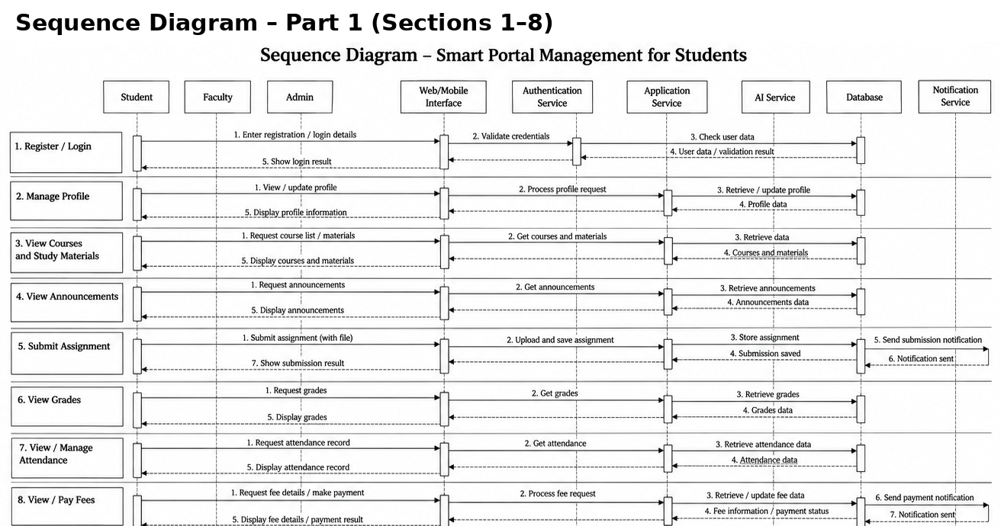
Sequence Diagram
SLIDE 12

Slide 13
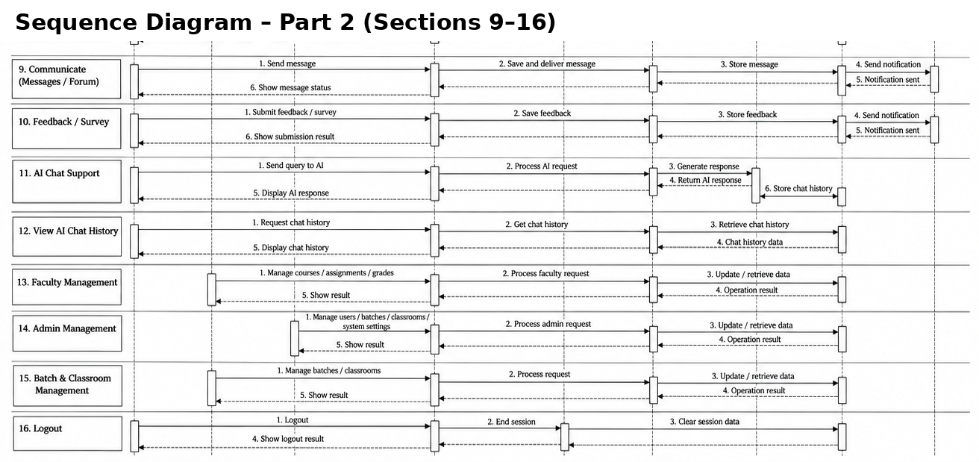
Sequence Diagram
SLIDE 13

Slide 14
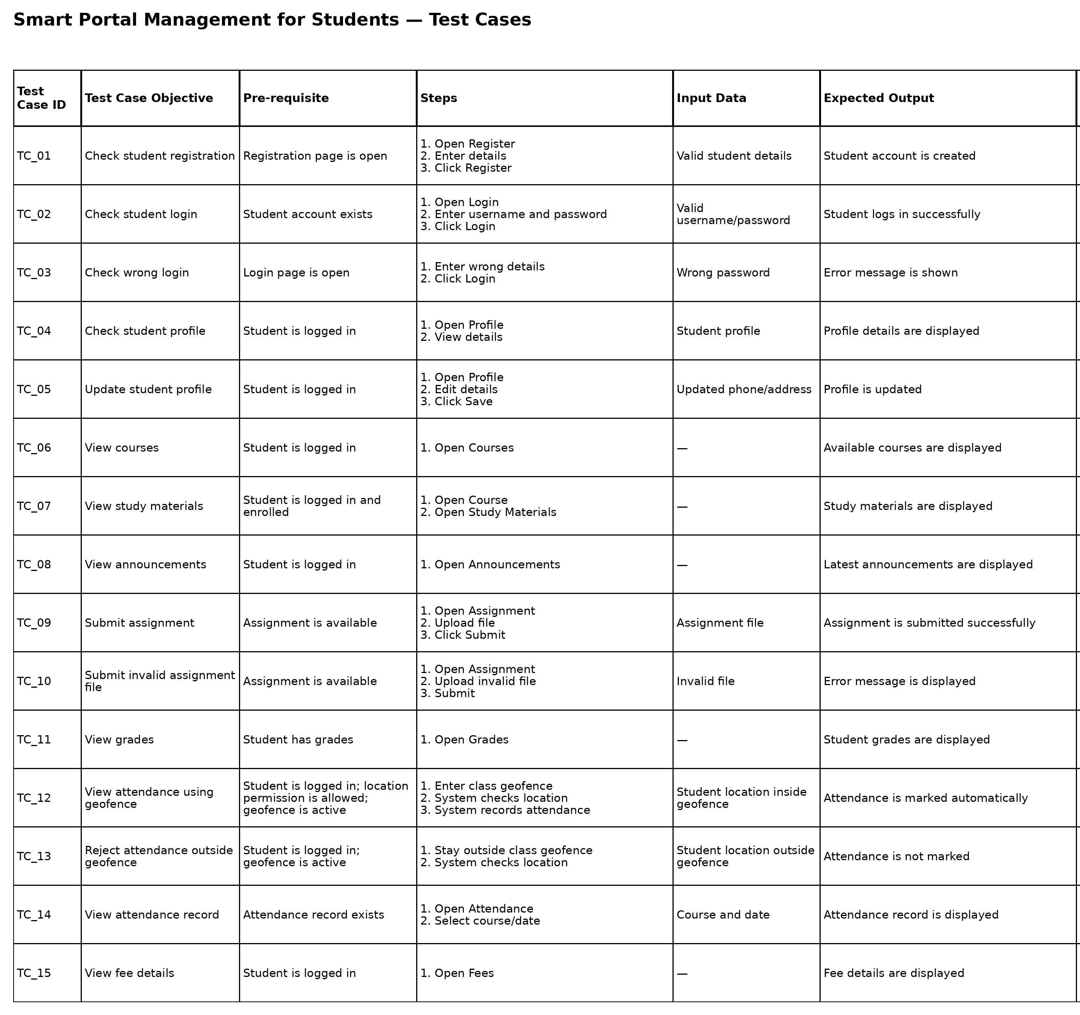
Test Cases
SLIDE 14

Slide 15
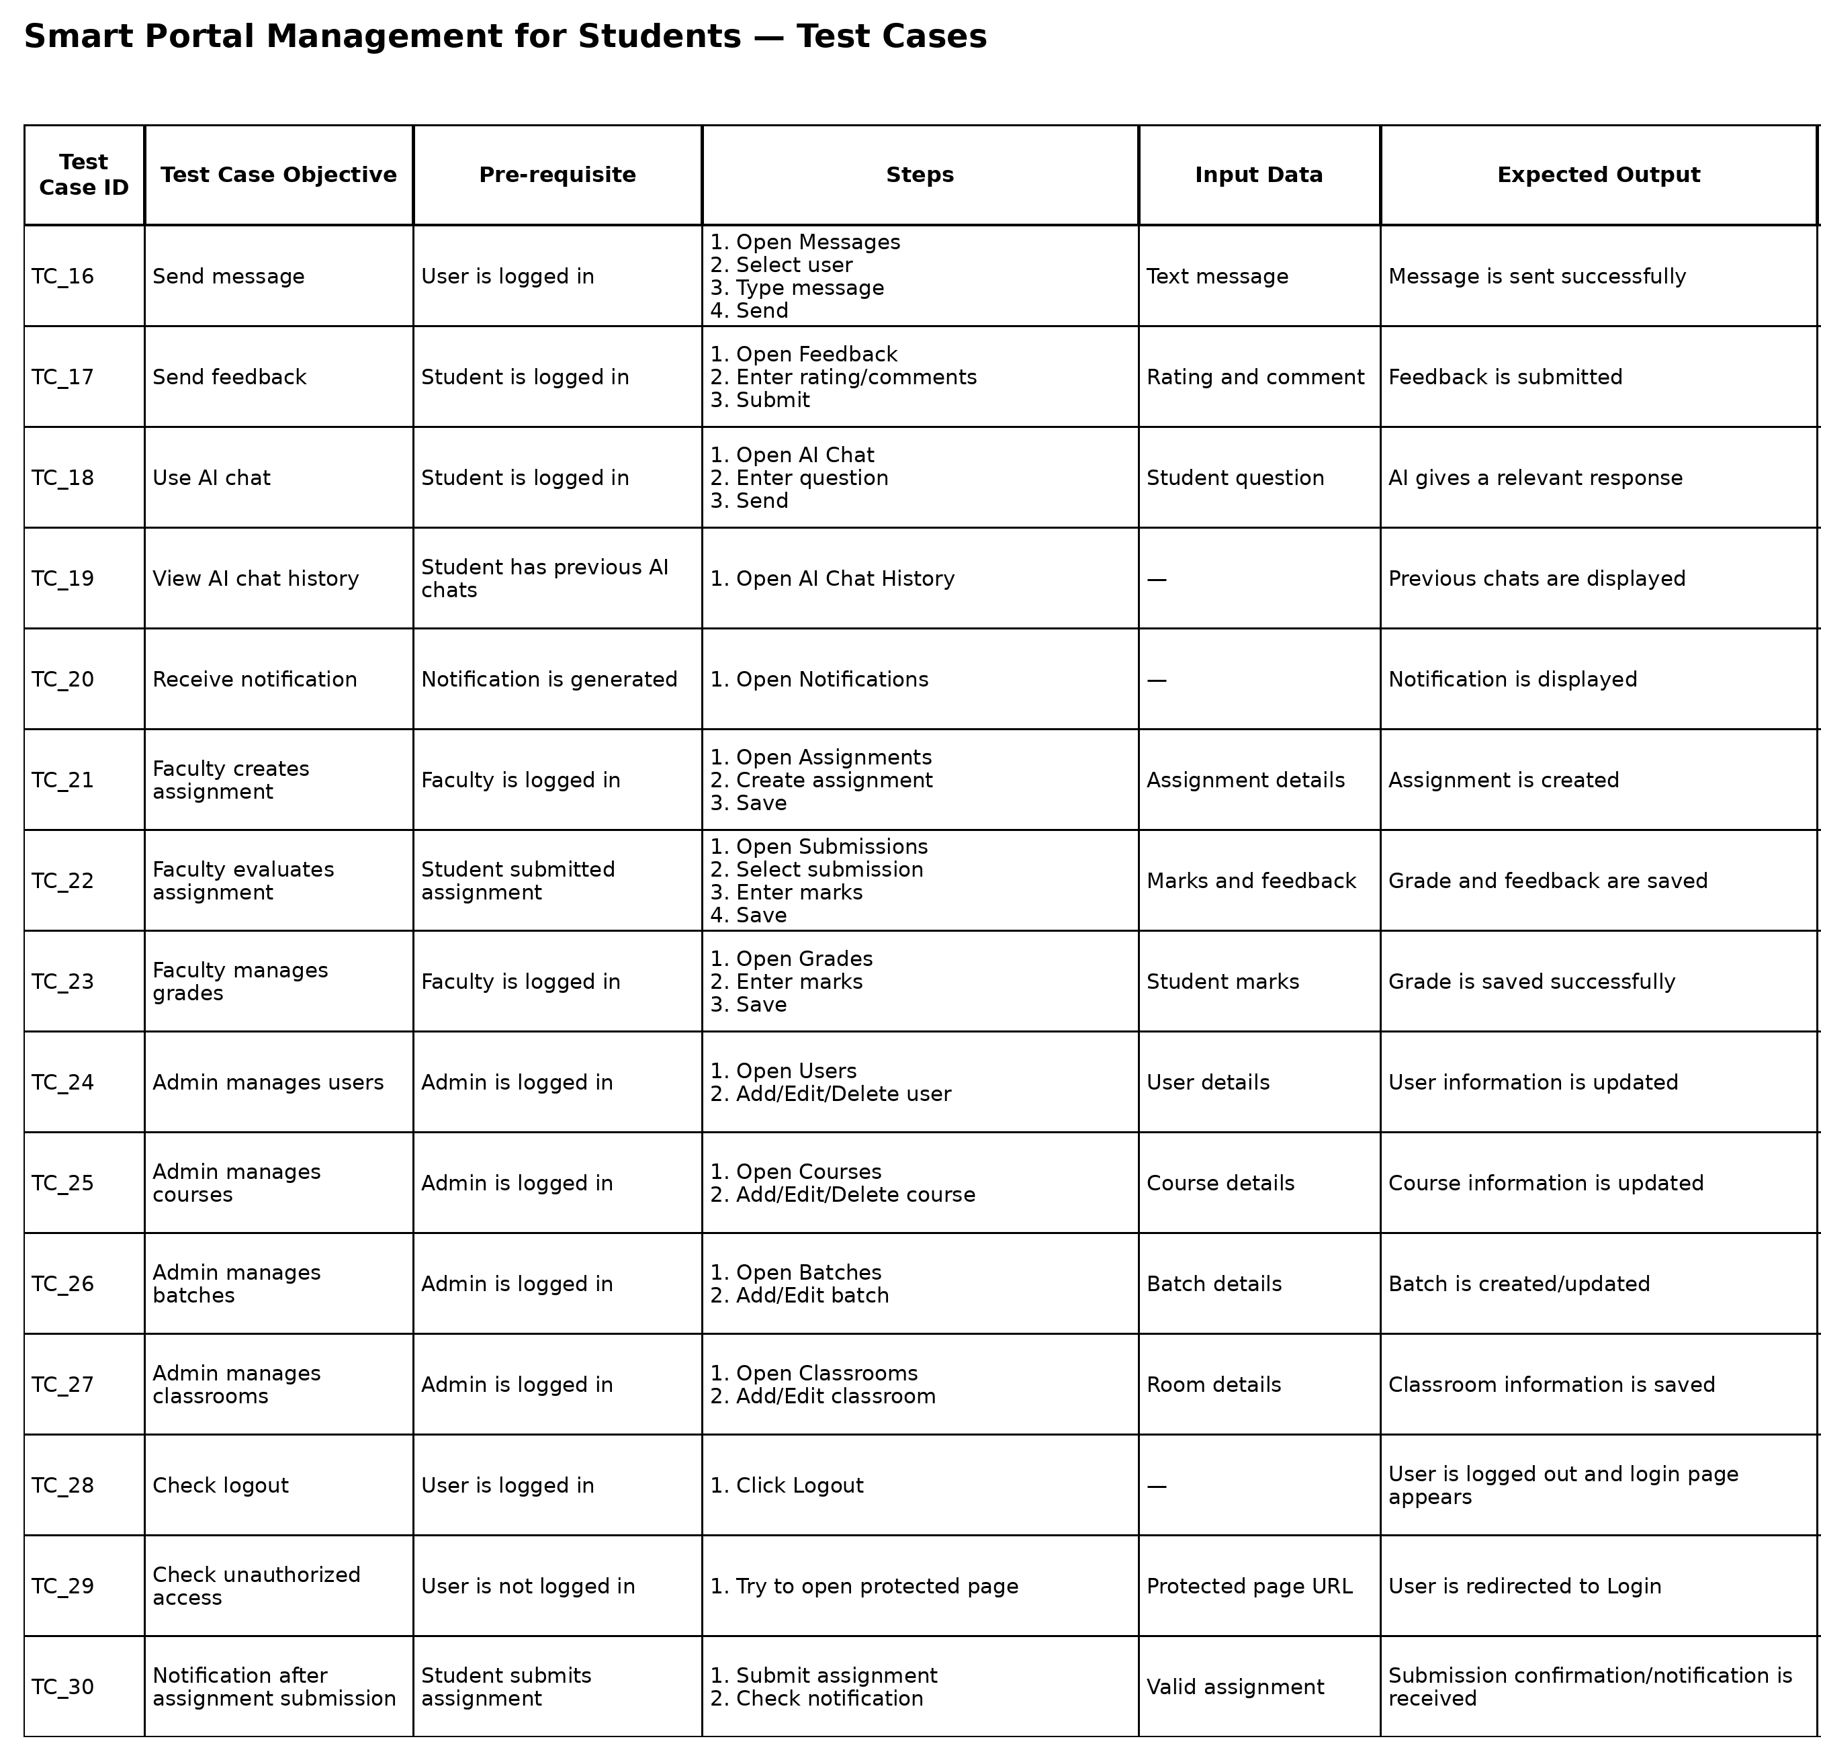
Test Cases
SLIDE 15

Slide 16
Limitations & Future Scope
SLIDE 16
Limitations
5 POINTS
Future Scope
6 POINTS
Requires internet connectivity for online portal functions.
Face recognition-based attendance.
WhatsApp alerts depend on WhatsApp/API service availability.
Mobile application for Android and iOS.
Advanced AI-based student assistance.
Geofencing accuracy depends on GPS/location accuracy.
Online payment gateway integration.
AI chatbot responses may not always be perfectly accurate.
Advanced analytics and performance reports.
Initial setup and maintenance need technical support.
Improved parent dashboard with real-time alerts.
“The Smart Portal aims to make student management faster, smarter, and more connected.”
Notes:
Be honest about the limitations, then present the future scope to show the project can grow. Close with the tagline.

