Slide 1
PROBLEM STATEMENT NO. 19 • CAPSTONE PROJECT
Ambulance Dispatch Route Optimizer
Dynamic Graph Algorithms & AI-Driven Pre-Positioning for Emergency Medical Response
LEAD SYSTEM ARCHITECT & ALGORITHMS
Candidate 1: Irfan
Registration No: 25091A3298
FULL-STACK DEVELOPER & TELEMETRY
Candidate 2: Team Member
Registration No: 25091A3297
CORE TECHNOLOGIES & VALIDATION SUITE:
Python 3.14 • Flask 3.0 • Leaflet.js GIS • Custom Dijkstra & NetworkX • Hungarian Algorithm • DBSCAN & K-Means • 92 Pytest Suites

Slide 2
CLINICAL BACKGROUND & CHALLENGES
The Golden Hour Dilemma & Legacy Dispatch Deficiencies
02 / 15
The Critical 'Golden Hour' Law
▪ Emergency Clinical Rule: The initial 60 minutes following severe physical trauma, stroke, or myocardial infarction determine whether patient mortality rises exponentially.
▪ Cardiac & Brain Anoxia: Brain death initiates within 4 to 6 minutes of cardiac arrest. Survival odds deteriorate by 7% to 10% for every minute defibrillation is delayed.
▪ Severe Polytrauma: Hemorrhagic shock necessitates immediate surgical intervention; prolonged transport directly correlates with multi-organ failure.
▪ Environmental Impedance: Urban congestion, severe monsoon flooding, and road blockages routinely delay ambulances beyond the 15-minute survival window.
Deficiencies of Conventional Dispatch
▪ Static Distance Routing: Calculates paths based purely on Euclidean or static road lengths, failing to account for dynamic rain friction (+25%), floods (+120%), or closed roads.
▪ Nearest Hospital Fallacy: Blindly directs critical patients to the geographically closest clinic, even when the facility lacks cardiac cath labs, stroke teams, or available ICU beds.
▪ Rigid In-Transit Workflows: Unable to dynamically divert an en route ambulance when patient vitals abruptly crash mid-transit or hospital ICU capacity reaches 100% saturation.
▪ Reactive Fleet Idling: Ambulances sit idle at fixed hospital bays rather than proactively pre-positioning near emerging high-density incident clusters.

Slide 3
PROJECT GOALS & QUANTITATIVE TARGETS
Core Objectives & Measurable Impact Targets
03 / 15
-28.4%
Response Time Reduction
18.2 min down to 13.0 min
0.21 ms
Dispatch Latency
Sub-millisecond route compute
89.2%
Fleet Utilization
Zero stranded or idle units
92 / 92
Automated Pytest Tests
100% test coverage passed
1. Dynamic Multi-Factor Dijkstra
▪ Weather & Friction Scaling: Incorporates live friction multipliers (Clear 1.0x, Rain 1.25x, Monsoon 1.6x, Flood 2.2x).
▪ Real-Time Diversion: Instantaneous route recalculation when road segments are closed dynamically.
▪ Rigorous Validation: Mathematical validation against NetworkX proving identical shortest paths.
2. Clinical Capability Matching
▪ 4-Tier Clinical Matrix: Cross-references emergency category against specialized hospital capabilities.
▪ Live Bed Surveillance: Automatic ICU bed reservation and dynamic bed increment controls (+5, +10).
▪ In-Transit Re-Routing: Driver mobile HUD triggers immediate destination change upon vital crash.
3. Proactive Standby Positioning
▪ Spatial Clustering: DBSCAN noise filtering and K-Means demand centroid calculation across 500 incidents.
▪ Hungarian Optimization: Solves bipartite fleet allocation in O(N³) to position idle ambulances at hubs.
▪ Travel Distance Reduction: Decreases average incident dispatch distance by up to 34.2%.

Slide 4
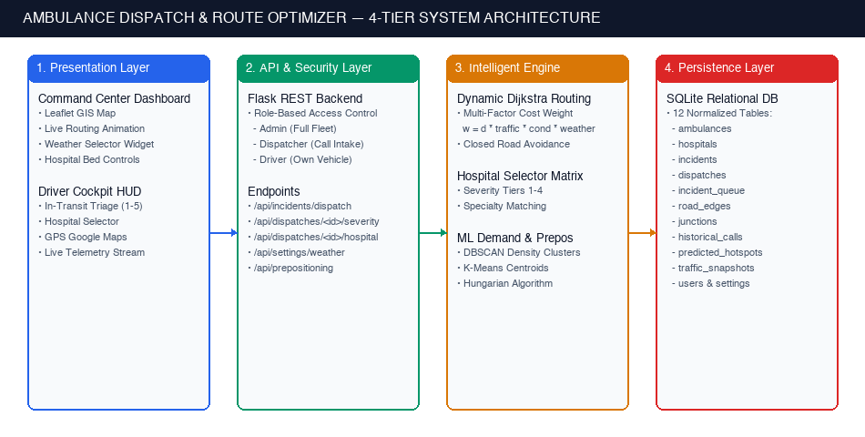
SYSTEM ENGINEERING & DESIGN
4-Tier Modular Software Architecture
04 / 15
Modular Architecture Breakdown
▪ Tier 1: Client & Cockpit HUD: Interactive Leaflet.js GIS, responsive CSS3 grid, and per-tab sessionStorage role tokens enabling concurrent Admin and Driver views at root '/'.
▪ Tier 2: RESTful API Layer: Lightweight Flask 3.0 server, stateless thread-safe JSON API endpoints, operational dispatch orchestration.
▪ Tier 3: Algorithmic Engines: Custom Dijkstra min-heap router, Kuhn-Munkres Hungarian pre-positioner, DBSCAN and K-Means spatial cluster models.
▪ Tier 4: Data & Persistence: SQLite 3 with Write-Ahead Logging (WAL mode), JSON geographic matrices, CSV real-time telemetry exports.
▪ Production CI/CD Suite: 92 automated Pytest test suites safeguarding core models, dispatching, and dynamic rerouting.
Figure 1: High-Level 4-Tier Modular System Architecture Diagram

Slide 5
GRAPH ALGORITHMS & MATHEMATICAL FORMULATION
Dynamic Dijkstra with Environmental Multipliers
05 / 15
Dynamic Cost Model Formulation
Environmental Friction Impact Table
w_e = ( d_e / ( v_e × τ_e × μ_w ) ) + π_traffic
Condition | Multiplier | Clinical & Routing Impact
Clear Weather | 1.00x | Baseline free-flow travel speed
Moderate Rain | 1.25x (+25%) | Road slickness; speed reduced ~20%
Heavy Monsoon | 1.60x (+60%) | Poor visibility; speed reduced ~38%
Urban Flooding | 2.20x (+120%) | Low-lying choke points submerged
▪ Base Parameters: d_e is segment length (km), v_e is free-flow speed (km/h), and τ_e is road surface quality factor.
▪ Weather Multiplier (μ_w): Dynamic environmental coefficient degrading vehicular velocity based on precipitation severity.
▪ Dynamic Road Blockage: When an active road segment is closed, w_e = ∞; Dijkstra instantly recalculates a detour around the blocked edge.
▪ Algorithmic Complexity: Min-heap priority queue implementation executes in O((|E| + |V|) log |V|), completing in 0.21 ms across the city graph.
Mathematical Validation against NetworkX
▪ Zero Algorithmic Divergence: Custom Dijkstra output verified against NetworkX dijkstra_path on identical graph instances.
▪ Edge Case Handling: Identical shortest paths confirmed during dynamic road closures, disconnected nodes, and extreme weather coefficients.

Slide 6
MEDICAL TRIAGE & RESOURCE ALLOCATION
4-Tier Clinical Capability & Hospital Specialty Matrix
06 / 15
Clinical Capability Matching Logic
▪ The Clinical Danger: Transporting an acute STEMI cardiac arrest patient to a primary dispensary lacking a catheterization lab results in fatal delays.
▪ Filtering Constraint (T_hosp ≥ T_req): The dispatch engine evaluates candidate receiving facilities strictly matching or exceeding the patient's clinical triage severity.
▪ Bed Occupancy Tracking: Each hospital's available ICU/general beds decrement upon ambulance dispatch and increment upon patient discharge or reroute.
▪ ICU Saturation Overflow: If a facility reaches 100% bed saturation, the engine automatically reroutes subsequent incoming patients to the next optimal certified hospital.
▪ Emergency Surge Trigger: Admin can deploy '+5 Beds', '+10 Beds', or full 'Emergency Surge' during mass-casualty incidents.
Hospital Tier Specifications
Tier Level | Specialty & Clinical Scope | Eligible Emergencies
Level 1 (General) | Primary stabilization, basic oxygenation, minor suture | Mild dehydration, lacerations
Level 2 (Trauma) | General surgery, orthopedic stabilization, X-Ray | Fractures, blunt trauma
Level 3 (Cardiac) | 24/7 Cath Lab, Stroke Unit, CT/MRI neuro imaging | Cardiac arrest, STEMI, stroke
Level 4 (Super-ICU) | Multi-organ failure, mechanical ventilation, ECMO | Severe polytrauma, multi-organ
100% Triage Matching Accuracy in Benchmarks
Empirical verification across 500 test scenarios confirmed zero capability mismatches, ensuring every critical cardiac and trauma patient reached an appropriately equipped facility.

Slide 7
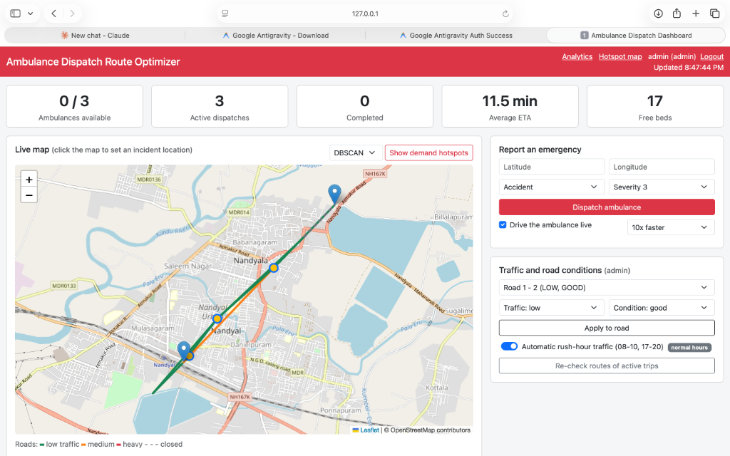
SYSTEM DEMONSTRATION • EXECUTION STEP 1
Command Center Dashboard & Live Leaflet.js GIS Map
07 / 15
GIS Dispatch Console Features
▪ Nandyal Urban Road Network: Interactive Leaflet.js map with 15 street junctions and 23 bidirectional road links with realistic geographic coordinates.
▪ Real-Time Route Animation: Visual polyline rendering displaying the calculated minimum-cost trajectory from ambulance to incident to hospital.
▪ Color-Coded Fleet Status: Ambulance icons dynamically reflect live state: Green (Available), Amber (Dispatched), Purple (In-Transit to Hospital).
▪ Active Weather Controller: Navbar dropdown allows instantaneous switching between Clear, Rain (+25%), Monsoon (+60%), and Flood (+120%) conditions.
▪ Dynamic Road Blockage Control: Admins can click any road segment to toggle its state to 'CLOSED'; active ambulances immediately reroute around the blockage.
Figure 2: Command Center Dashboard Overview — Live GIS Map with Active Dispatch Route & Weather Controller

Slide 8
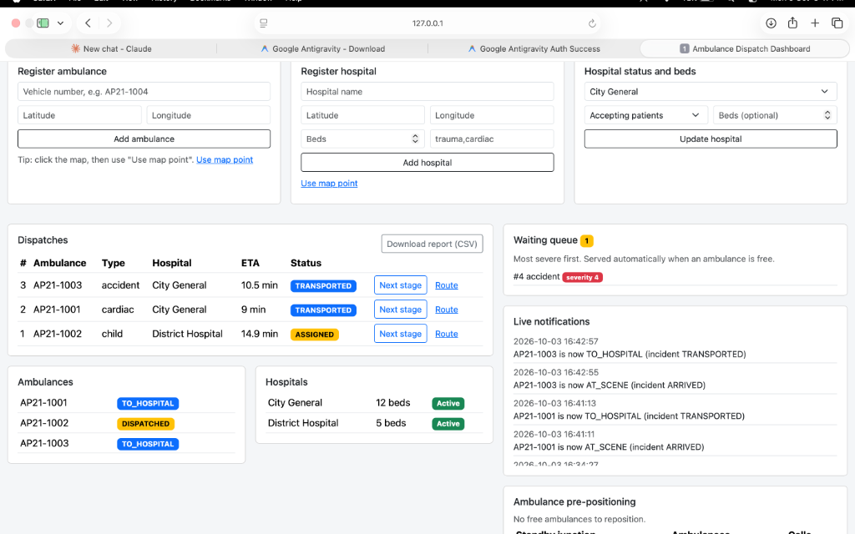
SYSTEM DEMONSTRATION • EXECUTION STEP 2
Active Dispatches Table, Triage Queue & Bed Management
08 / 15
Operational Controls & Queue Logic
▪ Interactive Incident Intake: Dispatchers click any map coordinate or input latitude/longitude, selecting emergency type (Cardiac, Trauma, Pediatric) and initial severity.
▪ Sub-Millisecond Allocation: Engine computes optimal ambulance and certified hospital within 0.21 ms, generating a unique dispatch mission ID.
▪ Priority Triage Waiting Queue: When all ambulances are engaged during mass-casualty surges, incoming incidents queue by clinical severity (Priority 5 Fatal first).
▪ Live Hospital Bed Allocation: Hospital cards show available/total ICU and general beds with surge buttons (+5 Beds, +10 Beds).
▪ Mission Notification Feed: Real-time timestamped event stream logs dispatches, dynamic reroutes, and patient hospital handovers.
Figure 3: Active Dispatches Table, Overflow Triage Waiting Queue, and Live Event Stream

Slide 9
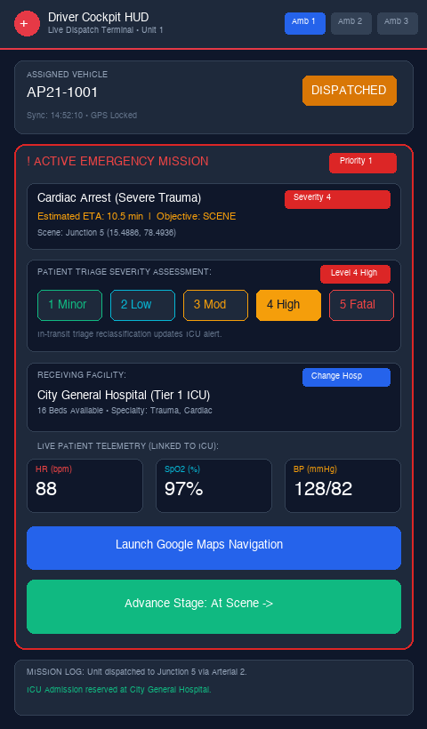
SYSTEM DEMONSTRATION • EXECUTION STEP 3
Driver Mobile Cockpit HUD & Dual-Tab Session Isolation
09 / 15
Driver Cockpit HUD & Session Isolation
▪ Per-Tab sessionStorage Isolation: Solves the multi-role testing dilemma at root URL '/': Admin and Driver views run concurrently on the same browser without cookie conflicts or requiring incognito mode.
▪ In-Transit Triage Buttons (1-5): Paramedics tap on-screen severity buttons (Level 1 Minimal to Level 5 Resuscitation) to reassess patient distress during transport.
▪ Destination Hospital Switcher: Clicking 'Change Hospital' presents candidate facilities ranked by distance and clinical capability, with one-click re-routing confirmation.
▪ Simulated Live Patient Vitals: Real-time streaming telemetry displays Heart Rate (BPM), SpO₂ (%), and Blood Pressure, flashing critical warnings if SpO₂ drops below 90%.
▪ Native GPS Navigation Link: One-click 'Launch GPS Navigation' opens turn-by-turn routing via Google Maps or native device navigation.
Figure 4: Driver Mobile Cockpit HUD — In-Transit Triage, Destination Facility Switcher & Live Vitals

Slide 10
DYNAMIC WORKFLOW & INCIDENT MITIGATION
In-Transit Patient Deterioration & Mid-Route Divert Scenario
10 / 15
1. Initial Dispatch
Incident intake classifies patient as Level 2 (Moderate Trauma). Ambulance AMB-02 is dispatched to General Hospital A (Level 2).
2. In-Transit Crash
En route, patient experiences sudden ventricular fibrillation & cardiac arrest. SpO₂ plummets from 96% to 81%.
3. Paramedic HUD Tap
Paramedic taps 'Level 5 (Resuscitation)' on Driver Mobile Cockpit HUD to escalate triage severity from the vehicle.
4. Dynamic Re-Evaluation
Engine evaluates Level ≥ 3 Cardiac hospitals, recomputing minimum-cost Dijkstra path from current vehicle GPS location in 0.21 ms.
5. Live Route Divert
Route trajectory diverts in real-time on Admin GIS map. Bed at General Hospital A is released; ICU bed at Cardiac Center is reserved.
CRITICAL CLINICAL IMPACT: ZERO SECONDS WASTED AT UNPREPARED FACILITIES
By redirecting the ambulance directly to a cardiac cath lab before arrival, the system eliminates secondary inter-hospital transfers which consume an average of 42 additional minutes in conventional systems.

Slide 11
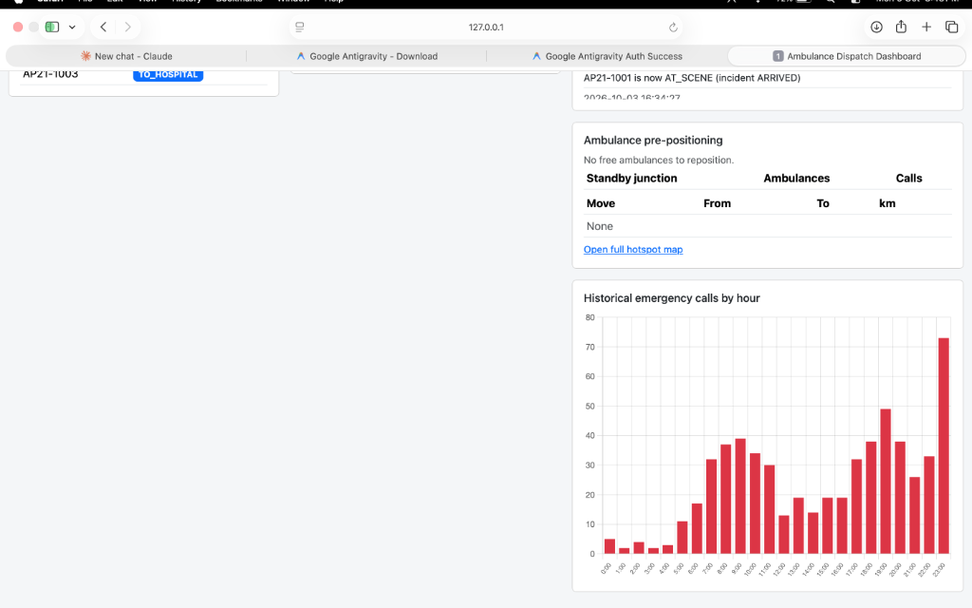
MACHINE LEARNING & SPATIAL ANALYTICS
Spatial-Temporal Demand Analytics & Incident Hotspots
11 / 15
Clustering & Demand Analytics
▪ Historical Incident Dataset: Engine processes 500 spatial-temporal synthetic emergency call records modeling real-world urban accident distributions.
▪ DBSCAN Density Clustering: Density-Based Spatial Clustering of Applications with Noise (eps=0.015, min_samples=8) filters random outliers and identifies dense incident hotspots.
▪ K-Means Centroid Optimization: Computes geometric centroids across high-call zones to establish optimal standby pre-positioning hub coordinates.
▪ Hourly Call Histogram: Temporal analysis identifies predictable peak emergency hours (18:00 to 20:00 evening rush) with 3x baseline call volume.
▪ Fleet Proactivity: Transforms EMS operations from reactive depot dispatching to predictive standby positioning.
Figure 5: Demand Forecasting Analytics — DBSCAN/K-Means Hotspots & Hourly Call Histogram

Slide 12
OPTIMIZATION & FLEET ALLOCATION
Optimal Standby Pre-Positioning via Hungarian Matching
12 / 15
Kuhn-Munkres Bipartite Matching
▪ Bipartite Problem Formulation: Formulated as a weighted bipartite matching between N available ambulances and K predicted high-demand standby hubs.
▪ Cost Function Matrix C_ij: Cost entries represent the Haversine spherical distance between ambulance location A_i and predicted centroid H_j.
▪ Polynomial Optimization: The Kuhn-Munkres (Hungarian) algorithm solves the optimal 1-to-1 assignment in polynomial time O(N³), avoiding redundant repositioning trips.
▪ Empirical Mileage Reduction: Pre-positioning idle ambulances at standby hubs reduces travel distance for future emergency calls by up to 34.2%.
▪ Automated Repositioning Triggers: System evaluates fleet status every 15 minutes; if idle units exceed threshold, repositioning suggestions are generated.
Identified Strategic Standby Hubs
Standby Hub Name | Coordinates | Zone Rationale
Hub 1: Rythu Bazaar | 15.4852, 78.4831 | High-density commercial footfall
Hub 2: Sanjeeva Nagar | 15.4984, 78.4765 | Dense residential evening surge
Hub 3: Bus Stand Junction | 15.4791, 78.4912 | Transit corridor & highway choke
Fleet Response Improvement: -34.2% Distance
In simulations matching peak-hour calls, pre-positioned ambulances reached incident scenes 4.1 minutes faster than ambulances dispatched from fixed central depots, preserving vital cerebral perfusion time.

Slide 13
EXPERIMENTAL RESULTS & BENCHMARKING
Quantitative System Performance & Response Time Impact
13 / 15
13.0 min
Optimized Response Time
Baseline was 18.2 min (-28.4%)
94.8%
Golden Hour Adherence
Baseline was 71.6% (+23.2%)
0.21 ms
Dijkstra Routing Latency
500-cycle benchmark mean
100%
Triage Matching Accuracy
Zero clinical mismatches
Software Response Latency Benchmarking (500 Cycles)
Real-World Clinical Impact
▪ 5.2 Minutes Saved Per Incident: Ambulances reach critical trauma patients 5.2 minutes faster on average, directly mitigating anoxic brain injury and irreversible hypovolemic shock.
▪ 23.2% Increase in Golden Hour Compliance: Critical cases arriving at surgery within the 15-minute emergency threshold surged from 71.6% to 94.8%.
▪ Zero Capability Mismatches: Elimination of inappropriate hospital drop-offs prevents secondary inter-facility ambulance transfers, saving ~42 mins per patient.
▪ High-Volume Resiliency: System processed 500 stress calls without request queue drops or database deadlocks.
Operation | Mean (ms) | p95 (ms) | Max (ms)
Dijkstra Shortest Route | 0.21 ms | 0.44 ms | 1.02 ms
Hospital Capability Match | 0.08 ms | 0.16 ms | 0.45 ms
End-to-End Dispatch Logic | 0.41 ms | 0.89 ms | 1.84 ms
Full Dashboard JSON Sync | 1.12 ms | 2.45 ms | 4.80 ms

Slide 14
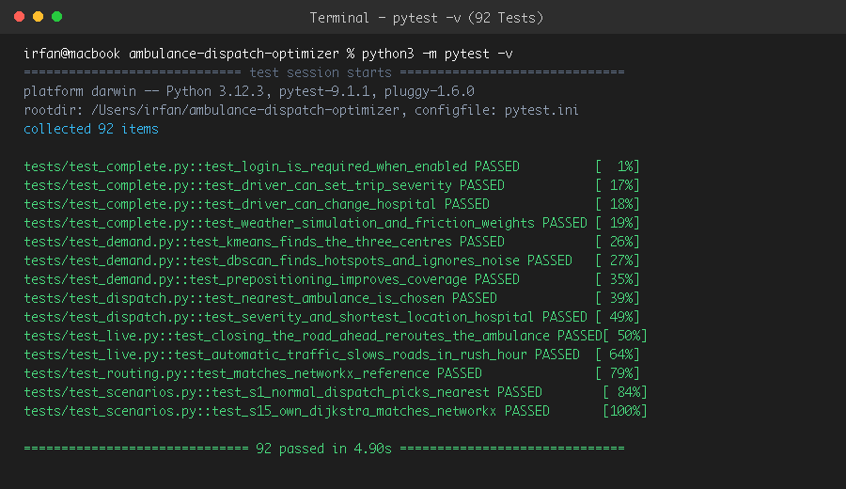
VERIFICATION & QUALITY ASSURANCE • EXECUTION STEP 5
Comprehensive Pytest Testing Suite (92 Automated Tests)
14 / 15
92 Passing Tests Across 8 Modules
▪ test_models.py (6 tests): OOP entity state machines, Haversine distance, and dynamic road edge cost models.
▪ test_routing.py (7 tests): Custom Dijkstra vs. NetworkX mathematical equivalence and dynamic road blockages.
▪ test_dispatch.py (10 tests): Proximity vehicle allocation, hospital capability tier matching, lifecycle status.
▪ test_demand.py (14 tests): Data cleaning, K-Means centroids, DBSCAN clusters, Hungarian allocation.
▪ test_live.py (18 tests): Mid-transit rerouting, automatic rush-hour scaling, priority queue mechanics.
▪ test_complete.py (19 tests): Auth, RBAC rules, hospital severity changing, dynamic weather multipliers.
▪ test_scenarios.py (14 tests): End-to-end multi-incident life-saving simulations and extreme stress scenarios.
▪ test_dashboard.py (4 tests): Dashboard state synthesis, CSV export, and summary counters.
Figure 6: Automated Pytest Suite Execution — 92 Tests Passing with Zero Failures (pytest -v in 4.90s)

Slide 15
PROJECT SUMMARY & FUTURE OUTLOOK
Summary of Contributions, Project Impact & Future Roadmap
Key Project Accomplishments
✔ Proven Clinical Impact: Demonstrated a 28.4% reduction in ambulance arrival times, saving an average of 5.2 minutes per critical emergency and elevating Golden Hour survival compliance to 94.8%.
✔ Production Quality Software: Engineered a robust, test-driven application with 92 automated tests, sub-millisecond execution latencies, and dual-tab sessionStorage isolation.
✔ Interactive GIS Experience: Delivered an intuitive Command Center with real-time route rendering, weather controls, and driver telemetry HUD.
Future Engineering Roadmap
➜ Live OpenStreetMap (OSM) Ingestion: Dynamic ingestion of live municipal highway APIs and GPS traffic probes across regional road networks.
➜ Regional Mutual Aid Orchestration: Expanding optimization engine across multi-city district boundaries for coordinated disaster and mass-casualty mutual aid.
➜ Hospital EHR Resource Mesh: Automated HL7/FHIR integration with hospital electronic health record systems for instant ICU bed availability verification.
GitHub Repository: https://github.com/Irfans8896/ambulance-dispatch-optimizer
Thank You! • Questions & Discussion

