Slide 1




SOFTWARE PROJECT LAB-I
Project Proposal Presentation
Project Name:
BookMate
Irfanul Haque ID: ASH1925021M
Year-02,Term-01
:irfanul2515@student.nstu.edu.bd
https://github.com/Irfanul1925021

Slide 2
Supervised By:
2
BookMate - Automated Library Assistant Tool
Md Hasan Imam Shahed Lecturer
Institute of Information Technology
Noakhali Science & Technology University
: hasan.imam@nstu.edu.bd

Slide 3

INTRODUCTION
3
An automated tool which will help readers to select popular books and assist librarian to add or remove book according to the assumption & statistical report
BookMate
Library Assistant Tool

Slide 4

PROJECT GOAL
4
Solve real-world problems (Readers as well as librarian problems)
Recommend books effectively for readers as well librarian/Bookshop owner
Analyze 200+ books data for recommendation
Combine different types of functionality in a single application.

Slide 5

MOTIVATION
5
Readers ask questions frequently to the librarian about books which is a manual process.
It's nearly impossible to store the record of readers choice .
No such automated tool in the existing manual system.
Applying BI(Business Intelligence) effectively to take correct decisions.

Slide 6
6
FEATURES
Book Recommendation
Graphical view of raw data
Assumption of Reader's Demand
Personalized
Another Library
Default
Adding/Removing Book Based on Recommendation

Slide 7













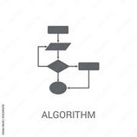
GRAPHICAL DIAGRAM
7
BookMate
Statistical Analysis
Reader
Librarian
Default Recommendation
Recommended Books For Reader
Organize Books
Data Visualization
Writer Wise
TypeWise
Showing all
Recommended for adding books
Recommended for removing books
books informatio

Slide 8
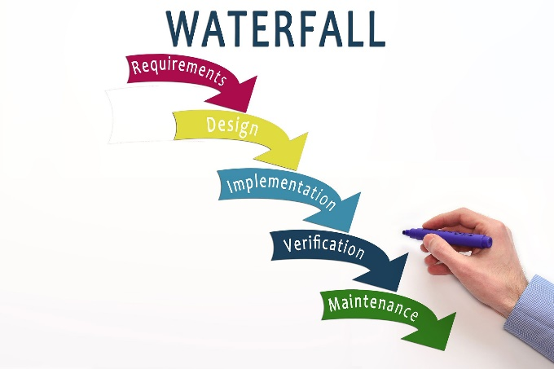




8
Models ,Tools & Languages
Model
Languages
Tools
→Requirements are fixed
→As requirements are very well understood so easy to manage
Java
JavaFx Framework
IntelliJ(IDE)
Eclipse(IDE)

Slide 9
Proposed Timeline
9
Submission
Integration & Testing
Implementation
System Design
Requirements Gathering
Project Proposal
09-Jun
16-Jun
22-Jun
7-July
28-August
15-Jun

Slide 10

CHALLENGES
10
Designing ,modeling, and Planning for UI of the project through Java FX
Understanding decision support systems and planning for implementation
Experiment and Analyze the huge number of data and bring the best output.
Completely new Idea as well as it will be challenging.
Careful while using file handling for lots of data

Slide 11
Question & Answering
11

Slide 12
12

