Slide 1
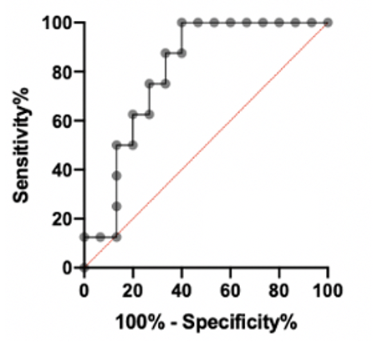


pCR vs no pCR
Patients
Features
$\sqrt{utDNA∗TF99}$
Age
Sex
Race
Smoking
Urothelial
NAC
MIBC
Random forest with LOOCV

