Slide 1
Autogene
Modification

Slide 2
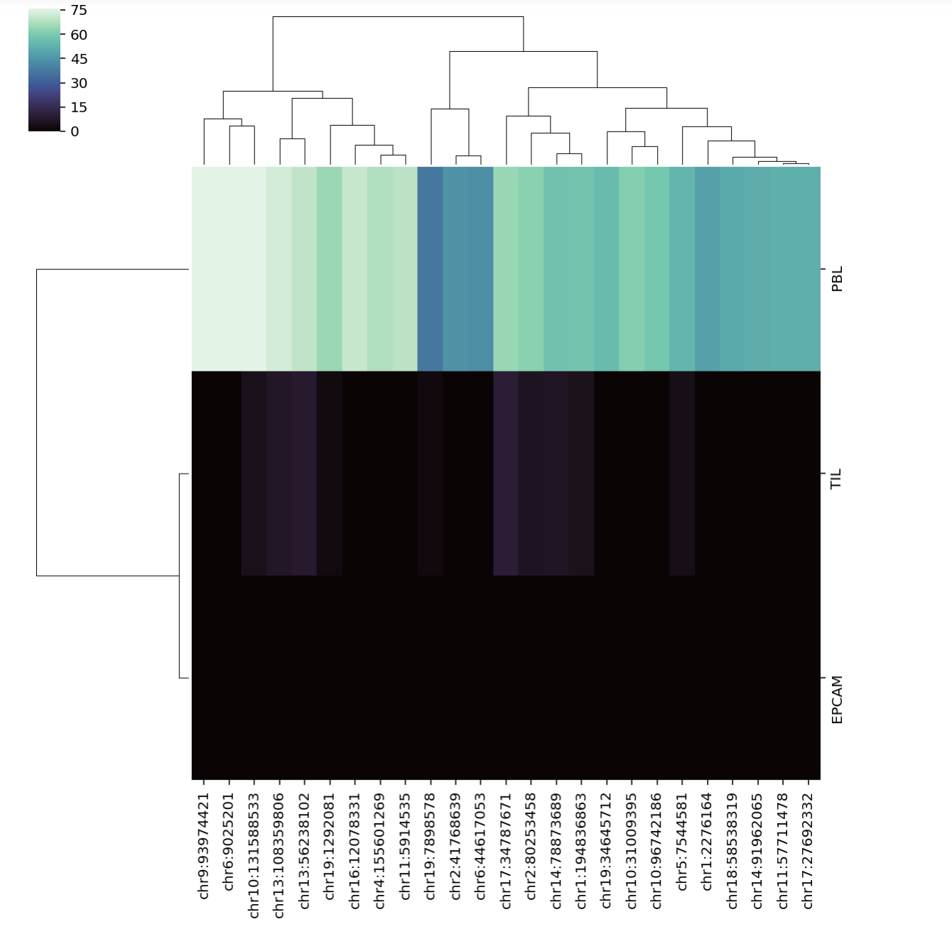
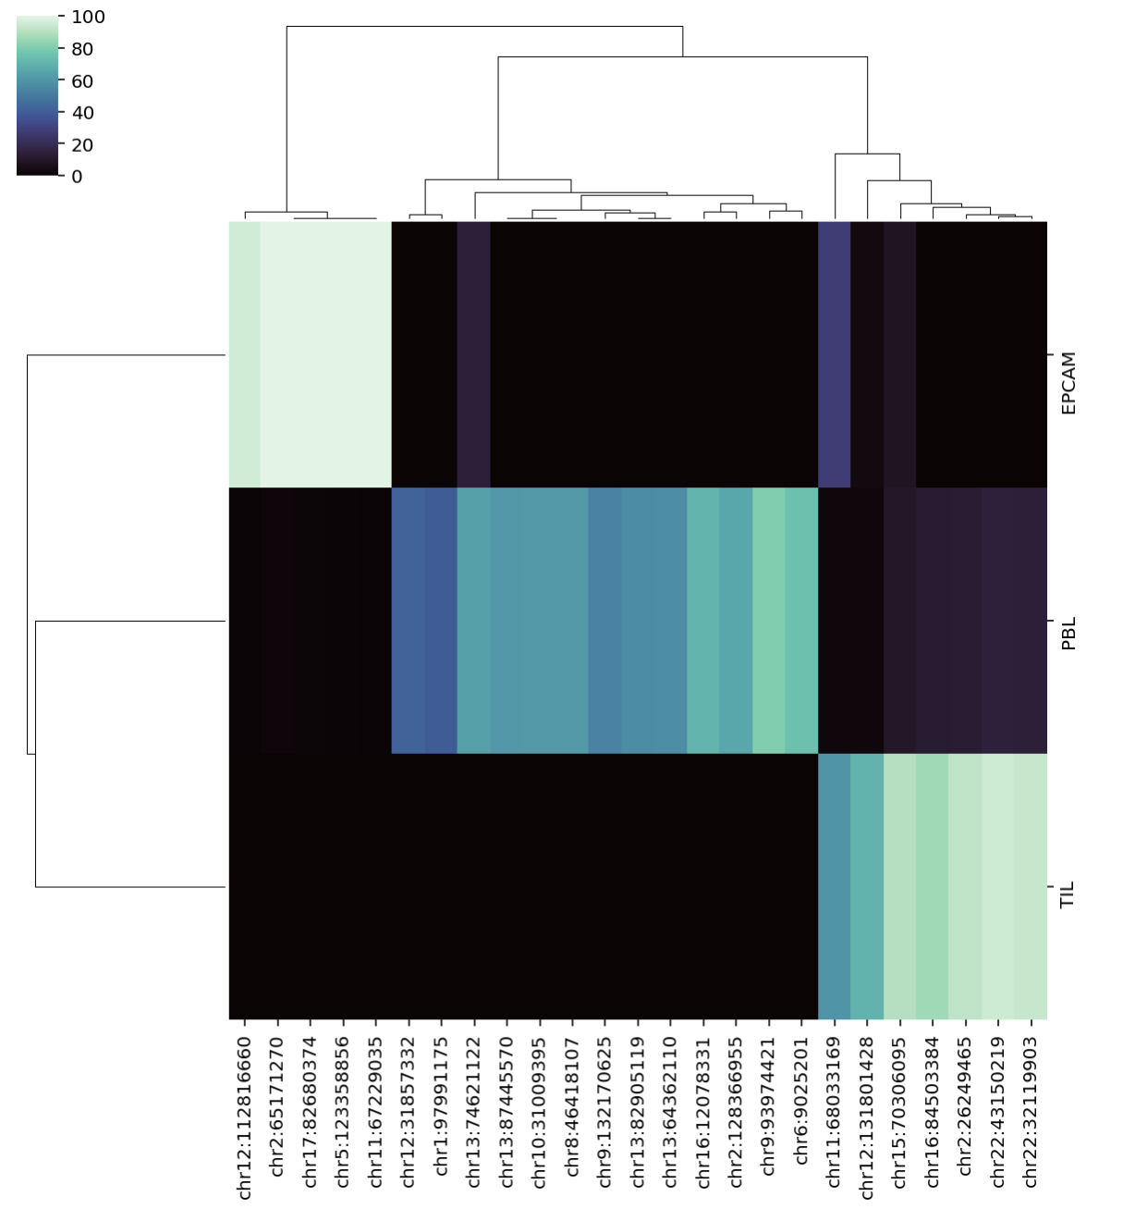
Theoretical Issue
Correlation = 0.2596
Condition number = inf
Correlation = 1.4
Condition number = 1.14

Slide 3
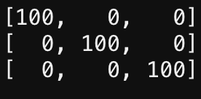
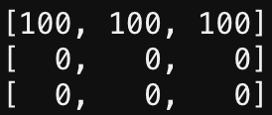
Correlation vs condition number
Correlation = 1.5
Condition number = 1
Correlation/covariance = 0
Condition number = inf
Good SM
Bad SM
Cell type
CpG
CpG

Slide 4
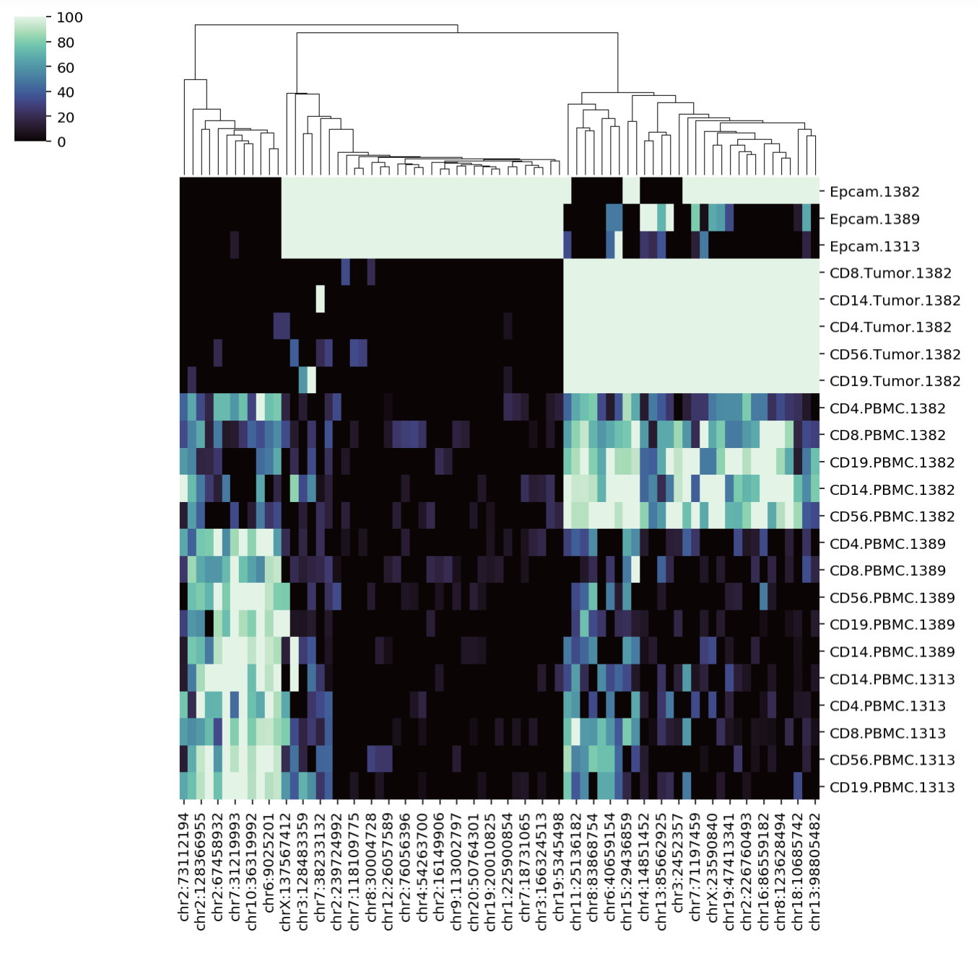
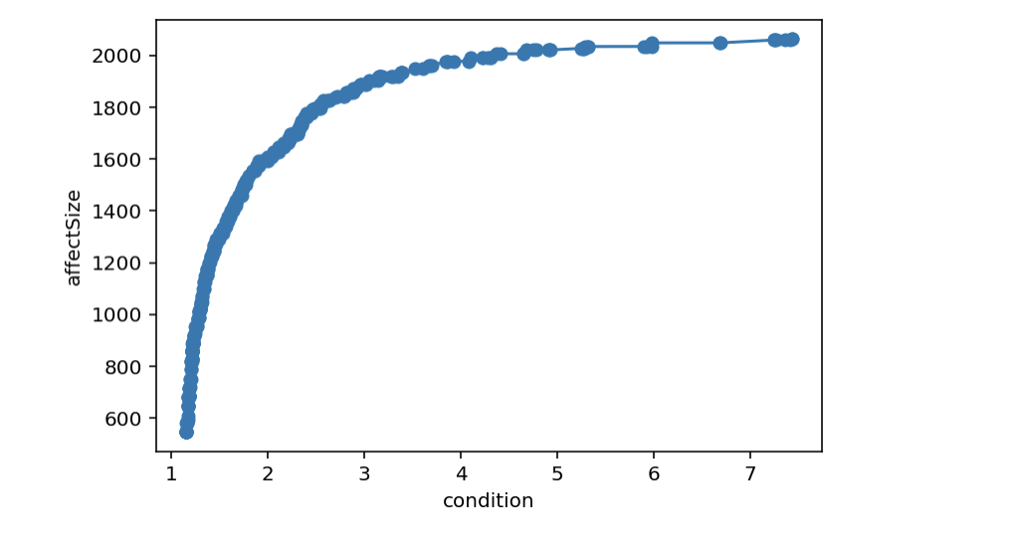
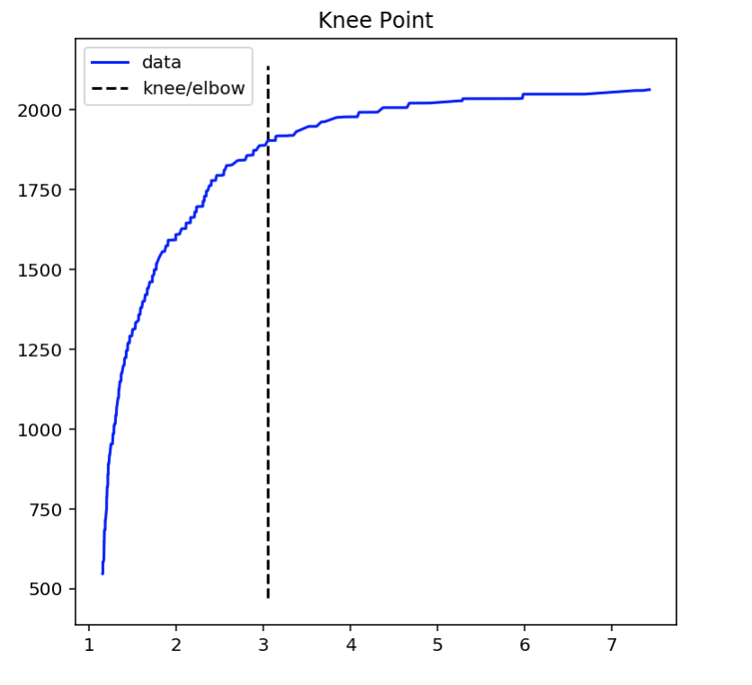
Choosing the real output
Population size=100

Slide 5
Deconvolution Result
Bug in Effect Size?

Slide 6
Effect size
For Every compartment c and for each CpG i Effect_{ci}=mean_{ci}/std_{ci}
Effect Size distance of the matrix= total pairwise Euclidean distance of of Effect_{ci}

Slide 7
EPCAM
AutoGene
Original SM
Ground Truth
Ground Truth

Slide 8
TIL
AutoGene
Original SM
Ground Truth
Ground Truth

Slide 9
SM for PBL, EPCAM

Slide 10
EPCAM_PBL_SM
cfDNA

Slide 11
original SM (PBL,EPCAM)
cfDNA

Slide 12
Side by Side comparison
cfDNA CpG using PBL EPCAM SM
cfDNA CpG using original SM (PBL,EPCAM)

Slide 14
Pearson Correlation
Avg using PBL EPCAM SM
Avg using original SM (PBL,EPCAM)

Slide 15
Spearman Correlation
Avg using PBL EPCAM SM
Avg using original SM (PBL,EPCAM)

Slide 16
What is a Better Signature Matrix?
Condition number= 2.245
Distance= 524.26
Condition number= 1.13
Distance= 631.325
EPCAM_PBL_SM
original SM (PBL,EPCAM)
Need a better approach
Prior Knowledge of mixture (Gaussian Process?)
Which CpG will provide better result?
Number of CpG?

Slide 17
Original SM (PBL,EPCAM)
Deconvolution
Average
Notes:
Pearson

Slide 18
Supp

Slide 19
What is a Better Signature Matrix?
Condition number= 2.245
Distance= 524.26
Condition number= 1.13
Distance= 631.325
Correlation=-0.99
Correlation=-0.886
EPCAM_PBL_SM
original SM (PBL,EPCAM)
Need a better approach

