Slide 1
Generating MHB from Blueprint Data

Slide 2
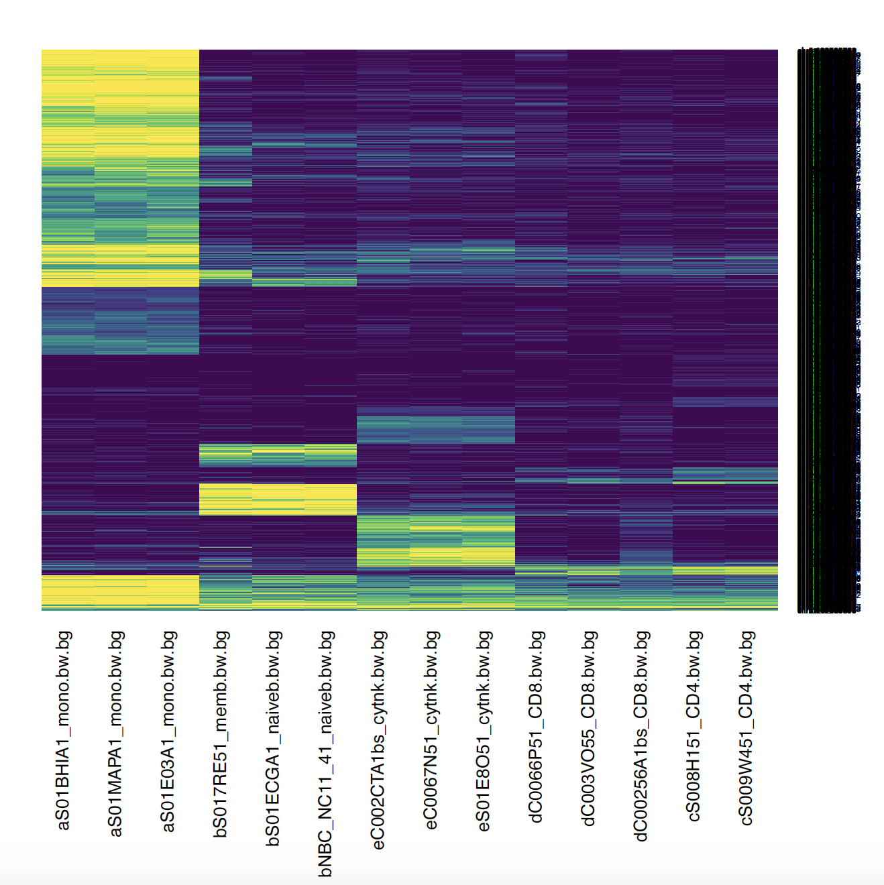
List of randomly Sampled CpG : CD8 CD4 separated (No Fold Change Cutoff)
Mono
B Cell
NK
CD8
CD4
Read Counting

Slide 3
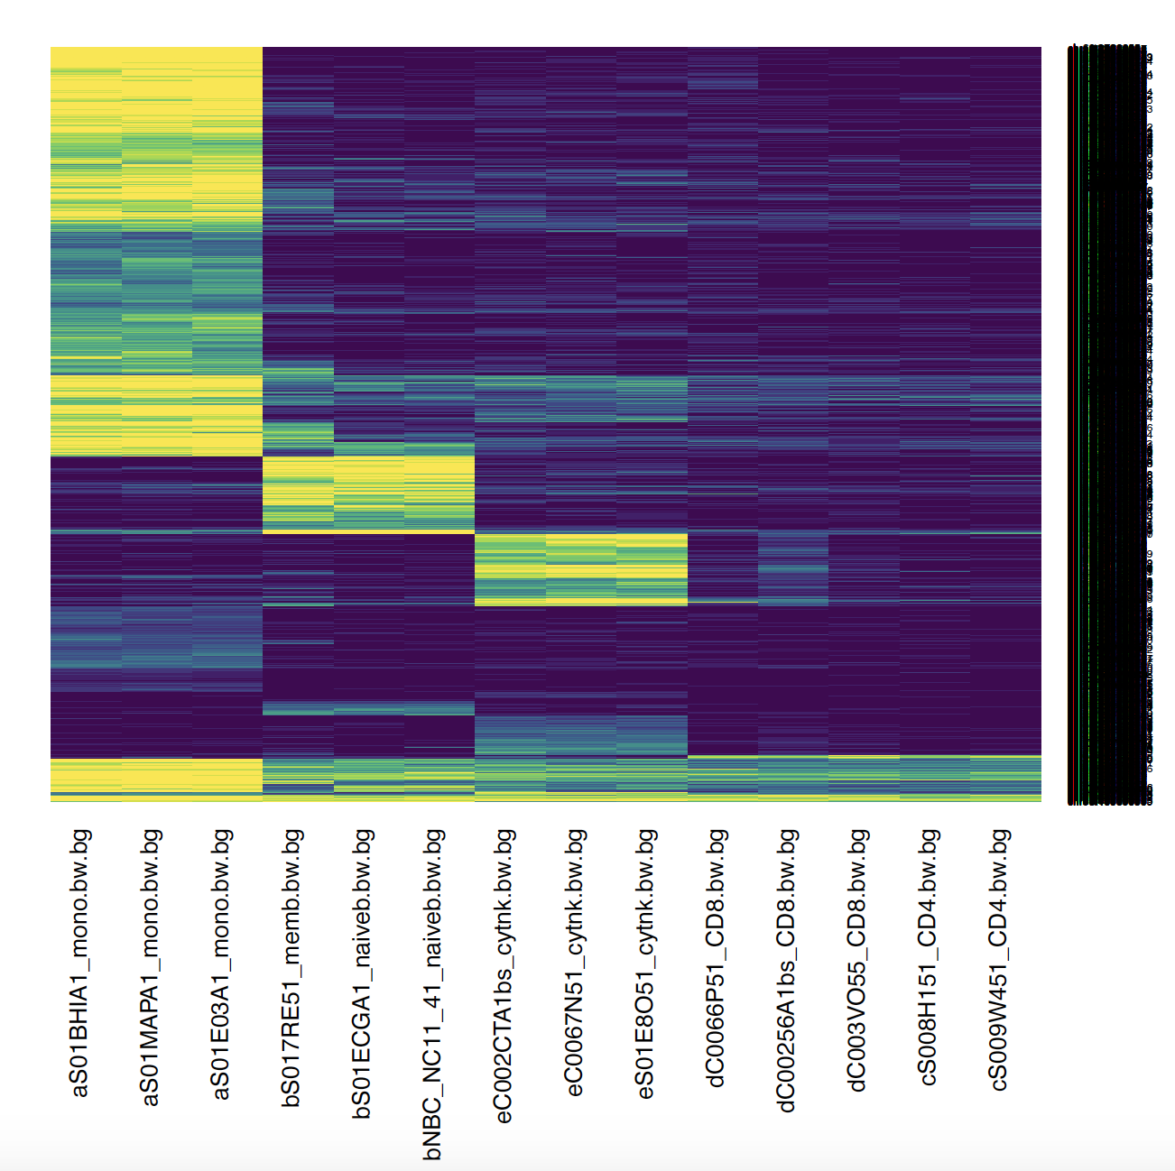
List of randomly Sampled CpG : CD8 CD4 combined (No Fold Change Cutoff)
Mono
B Cell
NK
CD8
CD4
Read Counting

Slide 4
Comparison CD4 CD8 merged
Read Counting
(Using long list of CpG)
MHB-per-Read Counting
(Using MONOD2 MHB)
Traditional
(Using WGBS Single CpG SM)
(Using 450k Single CpG SM)

Slide 5
Brief Method
Identify all differentially methylated CpGs (Reference CpGs) by t-test – no fold-change cutoff
For every read (consisting at least 2 CpG from the reference), determine the cell type based on reference CpGs.
Normalize the count
Down sampling: bedtools merge within 600 bp. After merging exclude singletons. Randomly choose 1000 “merged cpg”. Subset the bam file corresponding to these 1000 “merged cpg”.

Slide 6
Comparison CD4 CD8 separated
Read Counting
(Using long list of CpG)
Traditional
(Using WGBS Single CpG SM)
Traditional
(Using 450k Single CpG SM)

Slide 7
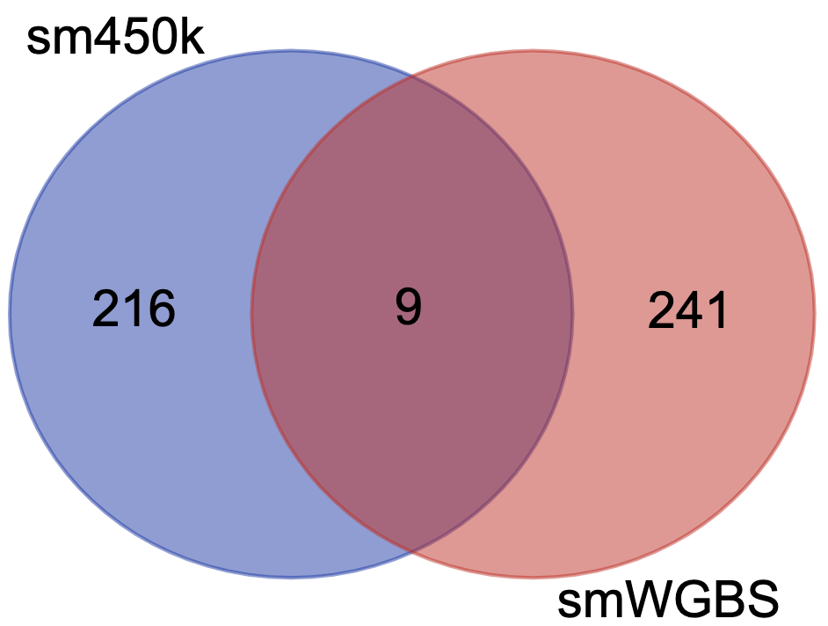
450k vs WGBS Single CpG Resolution
Only 450k pos
WGBS
Mono
B Cell
NK
CD4
CD8
Mono
B Cell
NK
CD4
CD8
Not in 450k

Slide 8
Corresponding CpG in Bulk PBMC
Using 450k pos SM
Using WGBS SM

