Slide 1
Noise Analysis with MHB

Slide 2
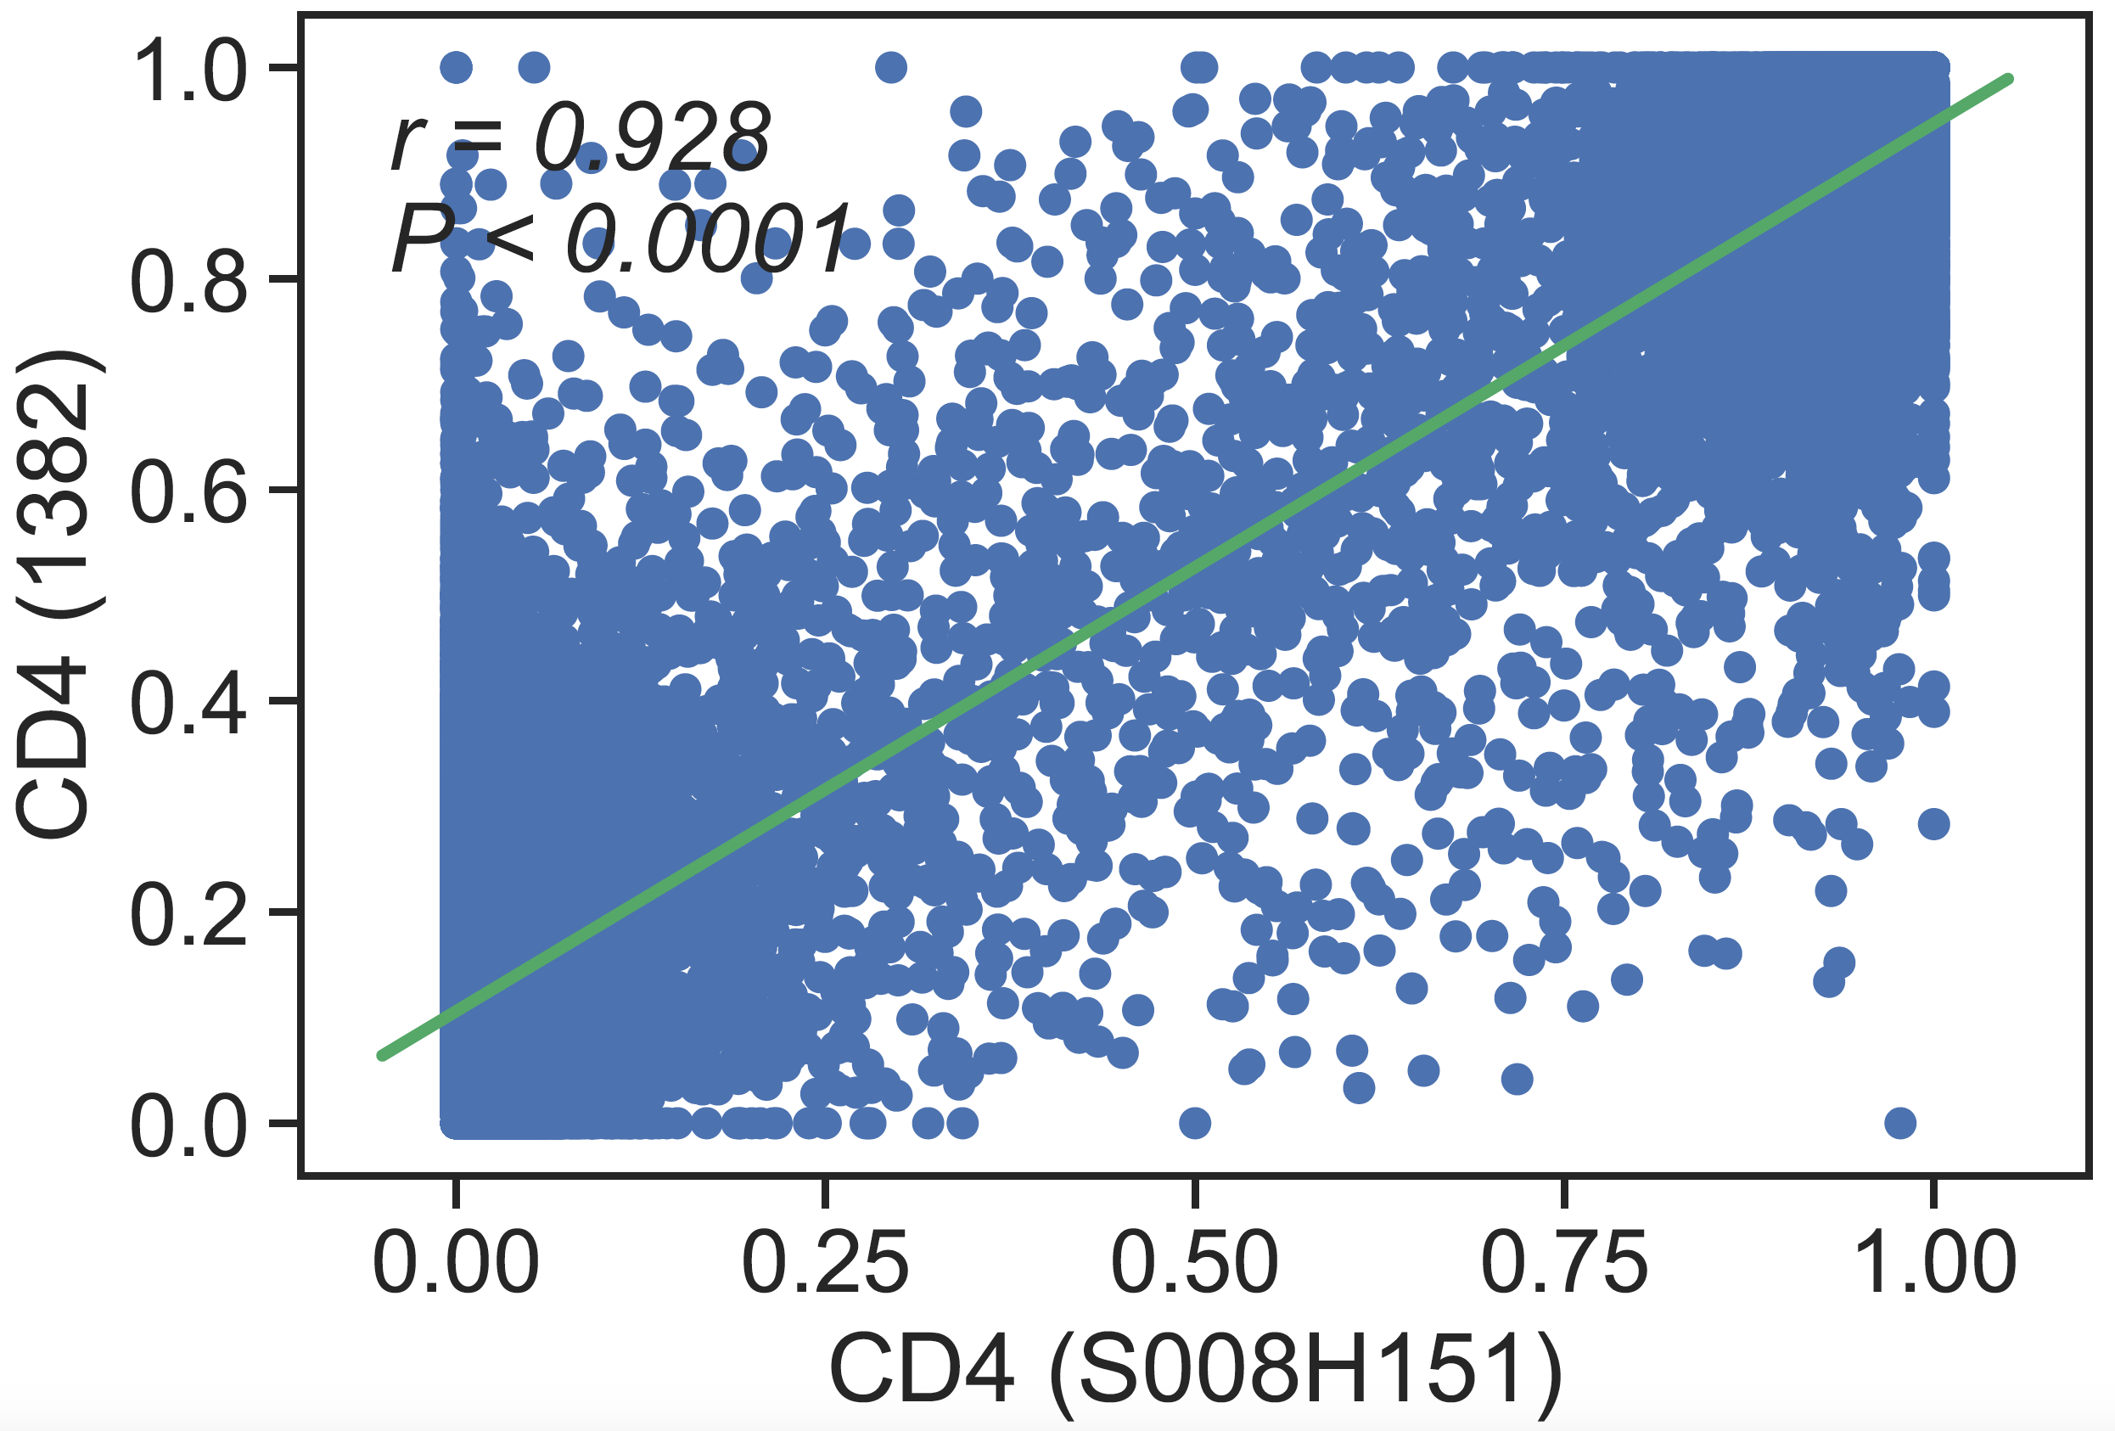
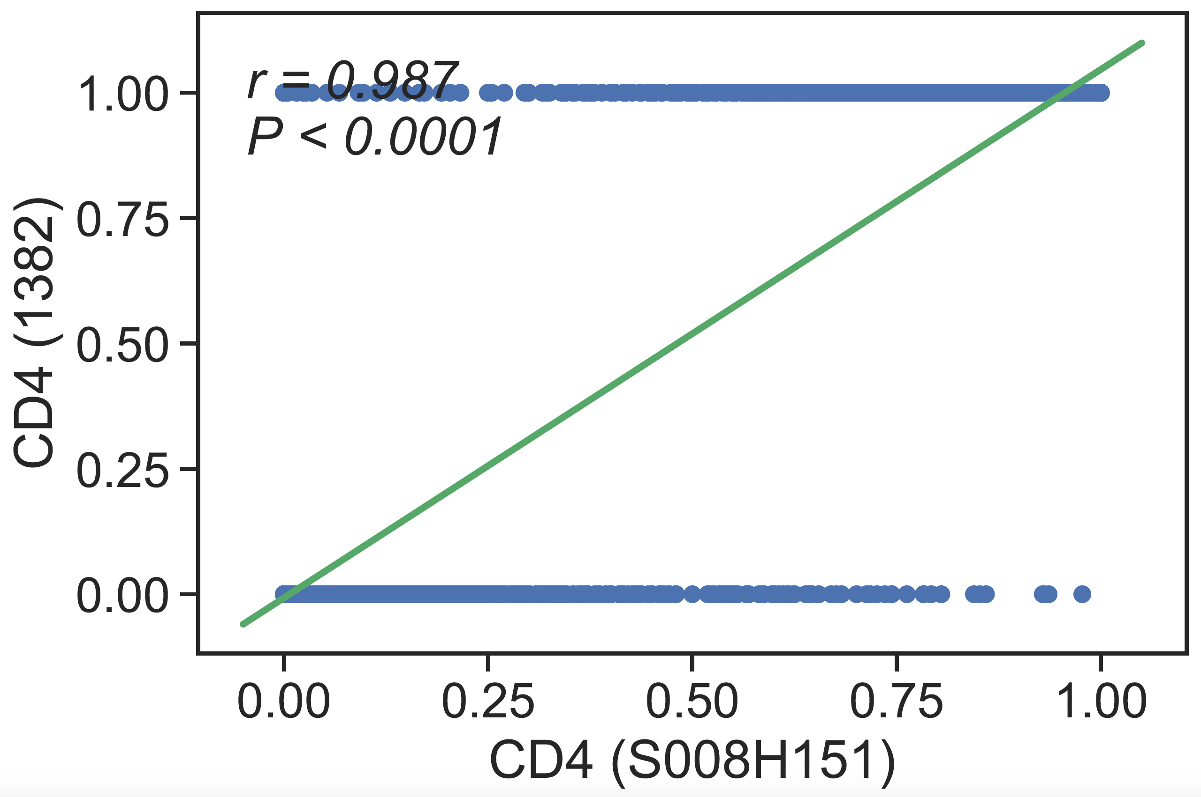
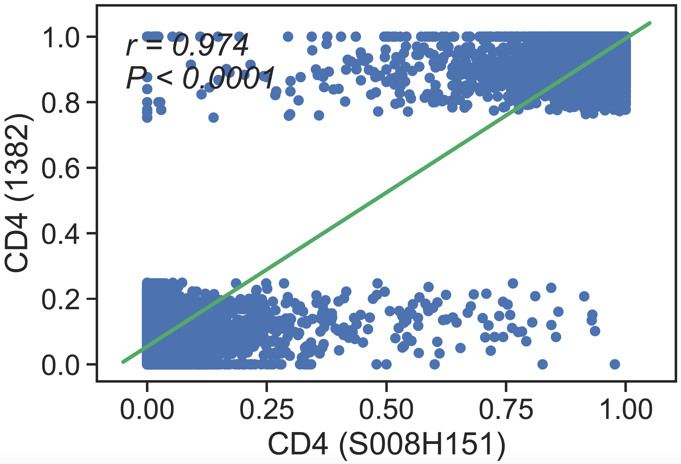
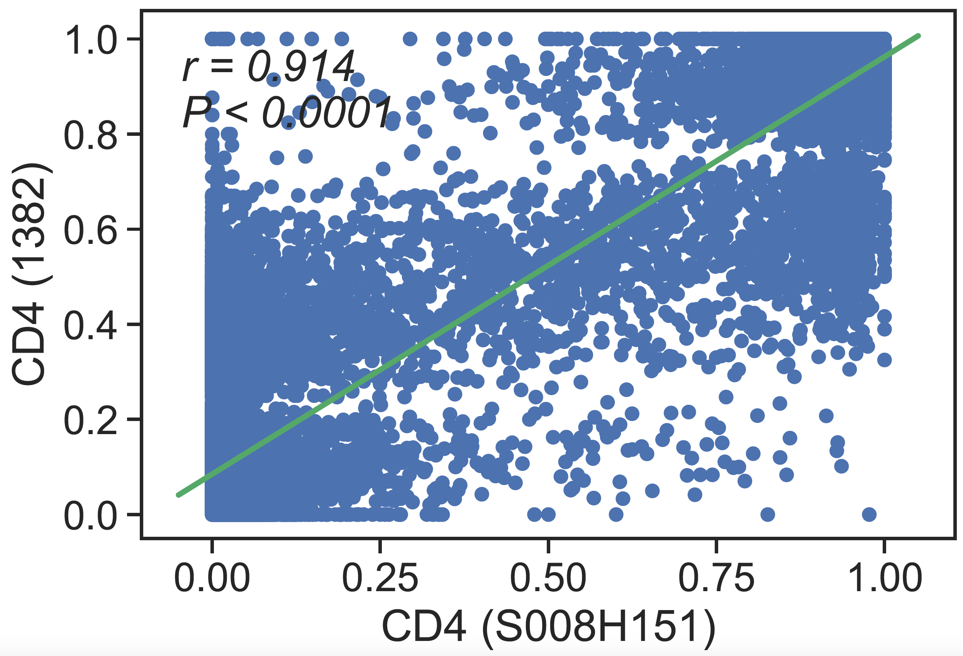
Default
Comparison of Different Methods
Mean rule
Majority Rule
Majority Rule
(Including Intermediate MHB)
IF mean is >0.75 or <.25:
collapse it to 1 or 0
ELSE:
remove the block
Partition CpGs in 3 groups (.25,.75)
IF largest group falls in [0,.25) or (.75,1]:
Take mean of the largest group
ELSE:
remove the block
This Study
Blueprint

Slide 3
*Correlation with paired Blueprint Data
Comparison of Different Methods

