Slide 1
MHB Based DMR
(at least 3 CpG)
DMR based on Blueprint Data
Corresponding MHB in This Study (Default)
Corresponding MHB in This Study (0.25/0.75 Majority Rule)
Mono
B Cell
NK
CD4
CD8
Mono
B Cell
NK
CD4
CD8
Mono
B Cell
NK
CD4
CD8

Slide 2
Underlying CpG (at least 3 CpG MHB)
Blueprint
This Study
Mono
B Cell
NK
CD4
CD8
Mono
B Cell
NK
CD4
CD8

Slide 3
MHB Based DMR
(at least 2 CpG)
DMR based on Blueprint Data
Corresponding MHB in This Study (Default)
Corresponding MHB in This Study (0.5/0.5 Majority Rule)
Mono
B Cell
NK
CD4
CD8
Mono
B Cell
NK
CD4
CD8
Mono
B Cell
NK
CD4
CD8

Slide 4
Underlying CpG (at least 2 CpG MHB)
Blueprint
This Study
Mono
B Cell
NK
CD4
CD8
Mono
B Cell
NK
CD4
CD8

Slide 5
Single CpG Resolution (Previous 450k position Blueprint SM)
Blueprint
This Study
Mono
B Cell
NK
CD4
CD8
Mono
B Cell
NK
CD4
CD8

Slide 6
Comparison of Blueprint SM
Single CpG Resolution (450k pos)
MHB (at least 2 CpG)
MHB (at least 3 CpG)
Mono
B Cell
NK
CD4
CD8
Mono
B Cell
NK
CD4
CD8
Mono
B Cell
NK
CD4
CD8

Slide 7
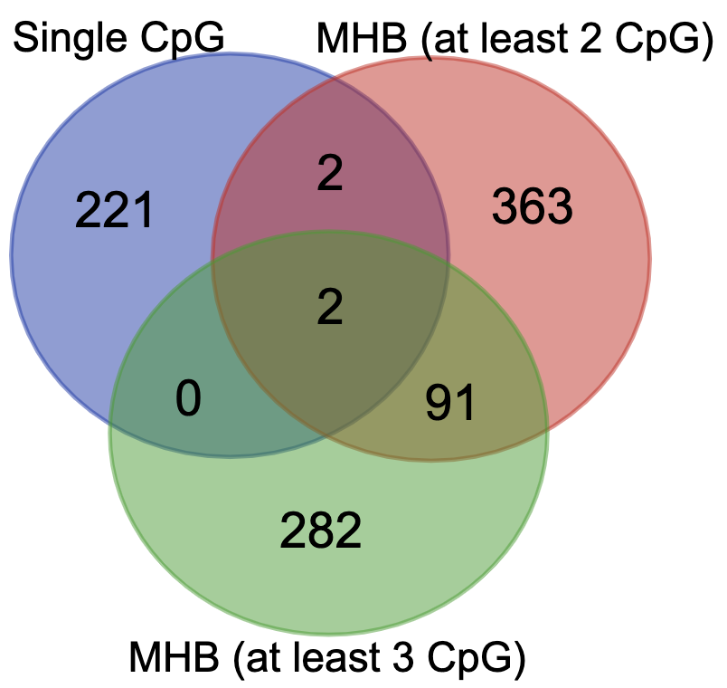
Comparison of Blueprint SM Overlapping CpG
220 CpG not covered by MHB
Smaller block => Higher discriminatory power?

Slide 8
Is MHB missing important Blocks?
Number of CpG within +65 bp (Median Size of MHB)

Slide 9
Is MHB missing important Blocks?
Significant Block
(MHB resolution)
(NOT covered by MHB)
Mono
B Cell
NK
CD4
CD8
Mono
B Cell
NK
CD4
CD8
Significant CpG
(Single CpG resolution)
Potential Missing Block?

Slide 10
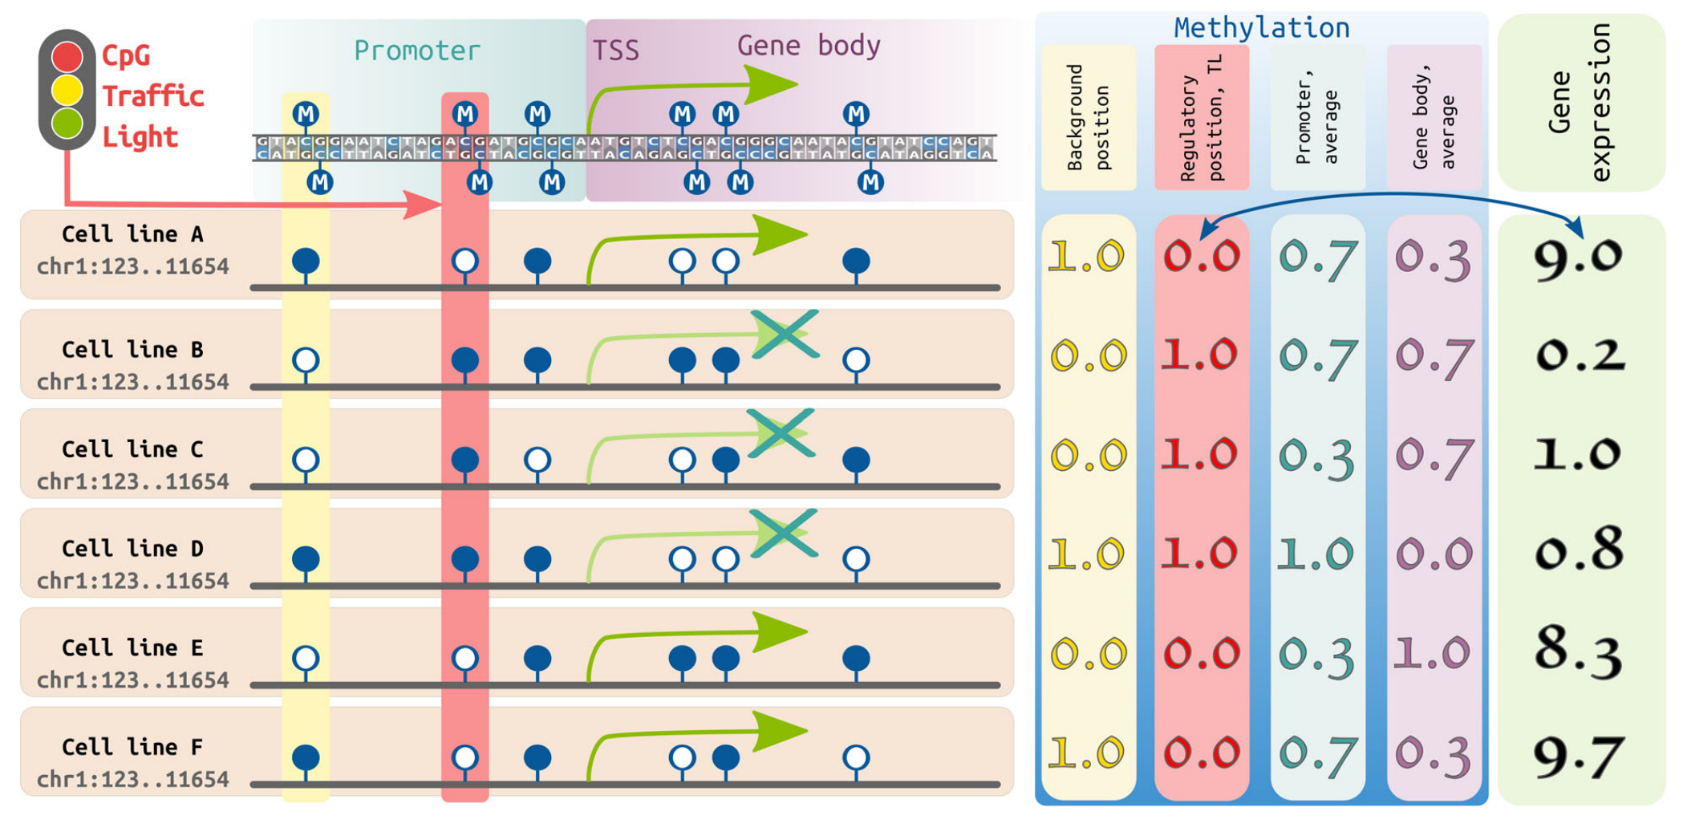
Is MHB missing important CpG?
﻿CpG traffic lights are markers of regulatory regions in human genome, BMC Genomics (2019)

Slide 11
Supp

Slide 12
Covered by MHB but not considered as DMR
Significant CpG
(Single CpG resolution)

Slide 13
Is MHB missing important Blocks?
Significant Block
(MHB resolution)
(NOT covered by MHB)
Mono
B Cell
NK
CD4
CD8
Mono
B Cell
NK
CD4
CD8
Significant CpG
(Single CpG resolution)
Potential Missing Block?

Slide 14
Is MHB missing important Blocks?

