Slide 1
Analysis with Methylation Haplotype Block (MHB)
Guo et al., Nature Genetics (2017)

Slide 2
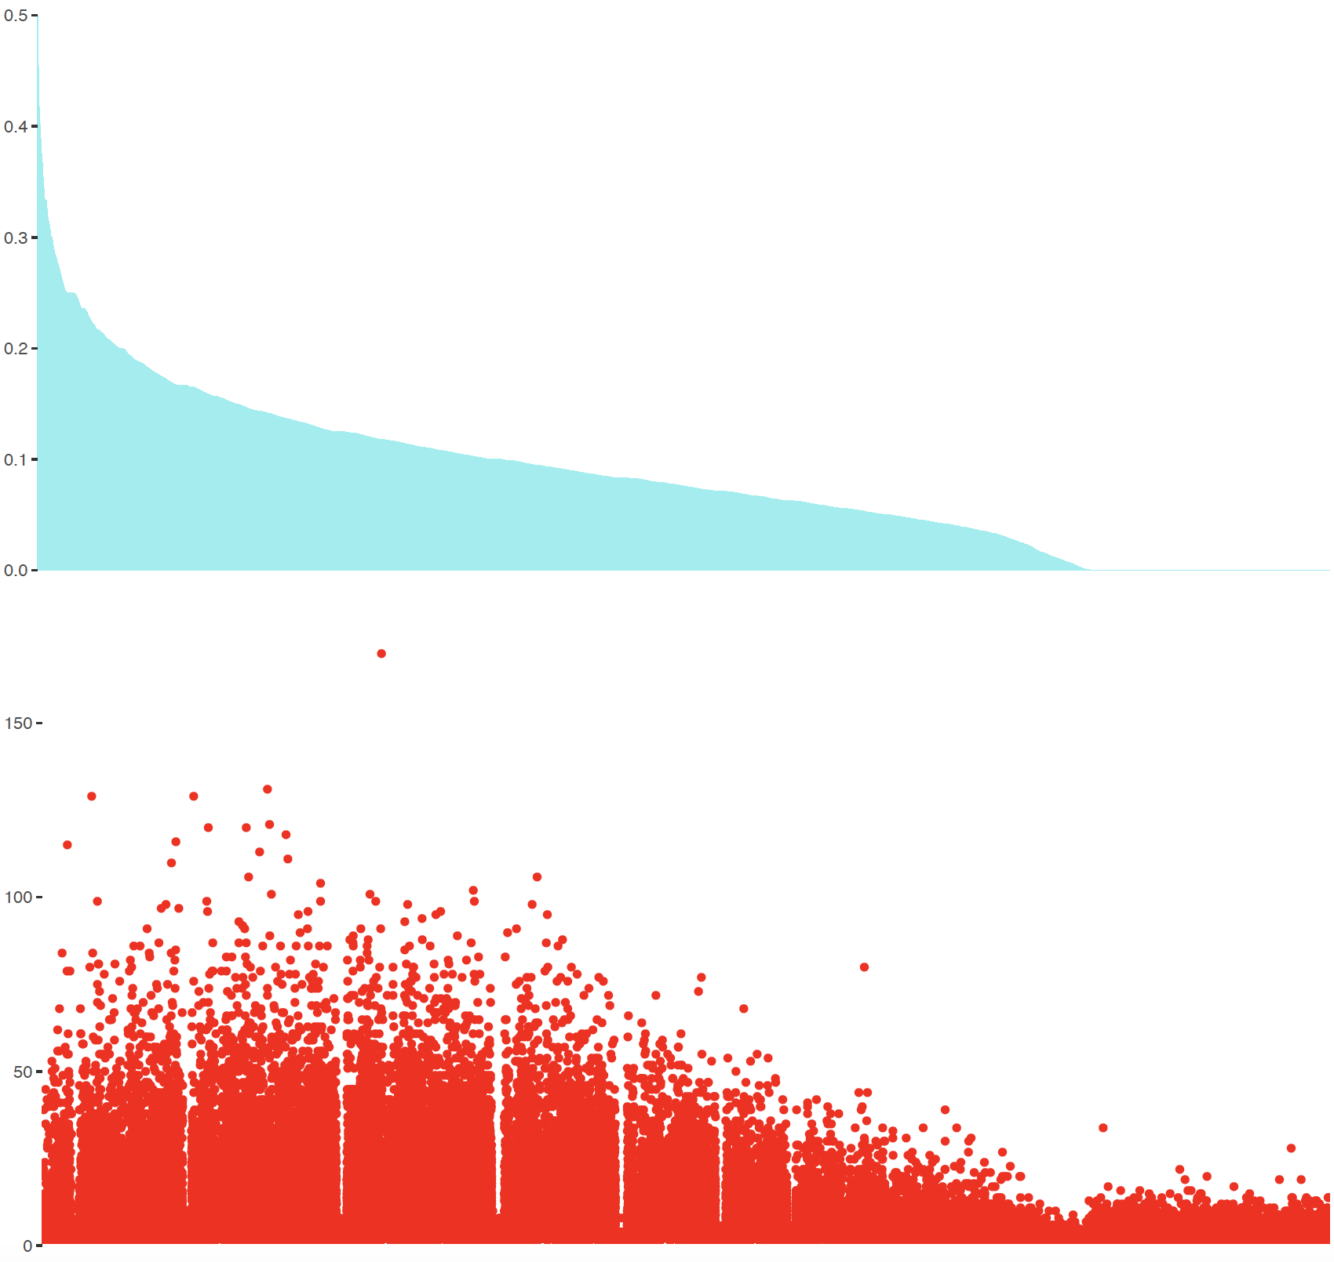

Performance of Methylation Haplotype Block (MHB)
This Study (PBMC B cell)
Blueprint (PBMC Memory B cell)
Standard Deviation (STD)
Number of CpG
MHB
MHB
Notes:
1382 and C003N351_memb

Slide 3
Performance of Methylation Haplotype Block (MHB)
*Considering Common MHB

Slide 4
Noise Analysis using MHB
Data:
Purified PBMC
Bulk PBMC
Bulk Tumor
Healthy cfDNA
*Considering Common MHB

Slide 5
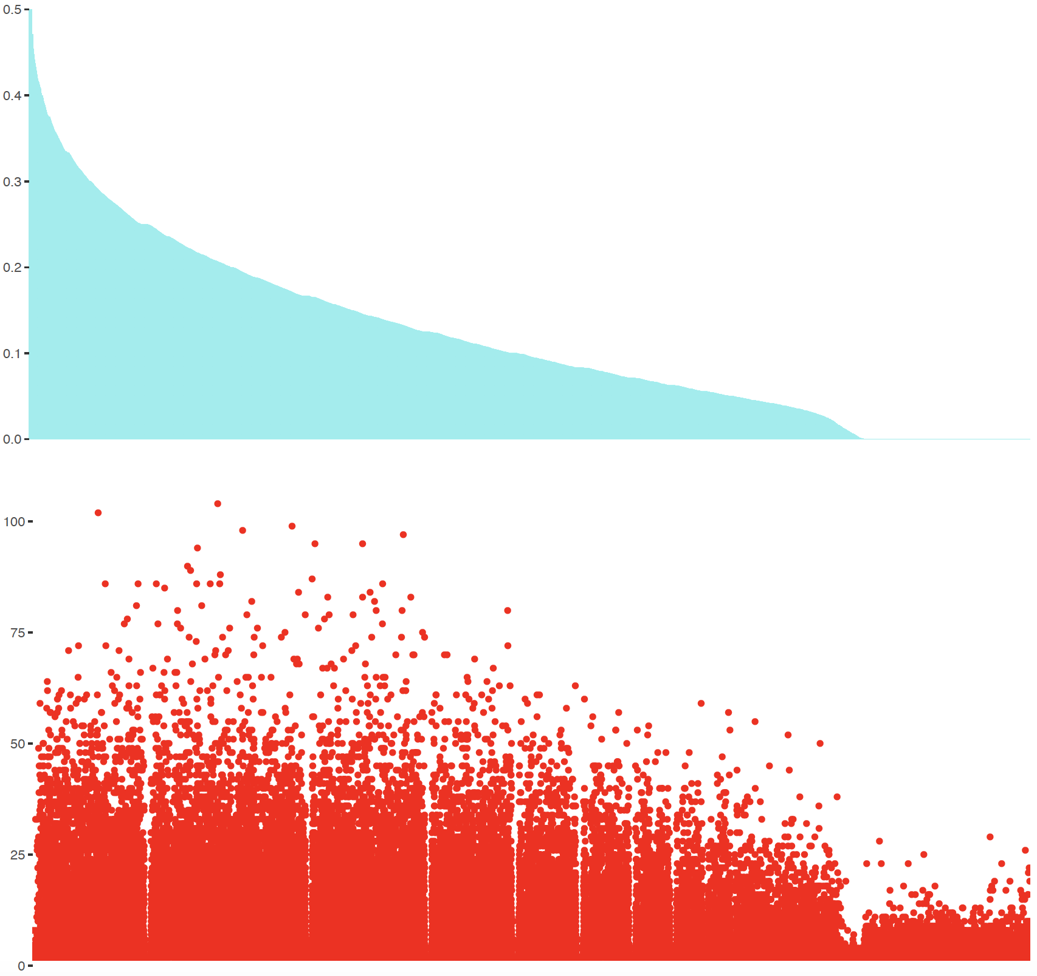
Methylation Haplotype Block (MHB) vs Random Block
This Study (PBMC B cell)
This Study ( PBMC B cell )
Standard Deviation (STD)
Number of CpG
MHB
Random Block

Slide 6

Methylation Haplotype Block (MHB) vs Random Block
Blueprint (PBMC Memory B cell)
Blueprint (PBMC Memory B cell)
Standard Deviation (STD)
Number of CpG
MHB
Random Block

Slide 7
Methylation Haplotype Block (MHB) vs Random Block
Should we use MHB for generating Block Level SM?

Slide 8
Supp

Slide 9
*all MHB

