Slide 1
Read counting on new batch
Notes:
All 3 cpg

Slide 3
Healthy
Healthy cfDNA

Slide 4
TIL max fragment <=170

Slide 5
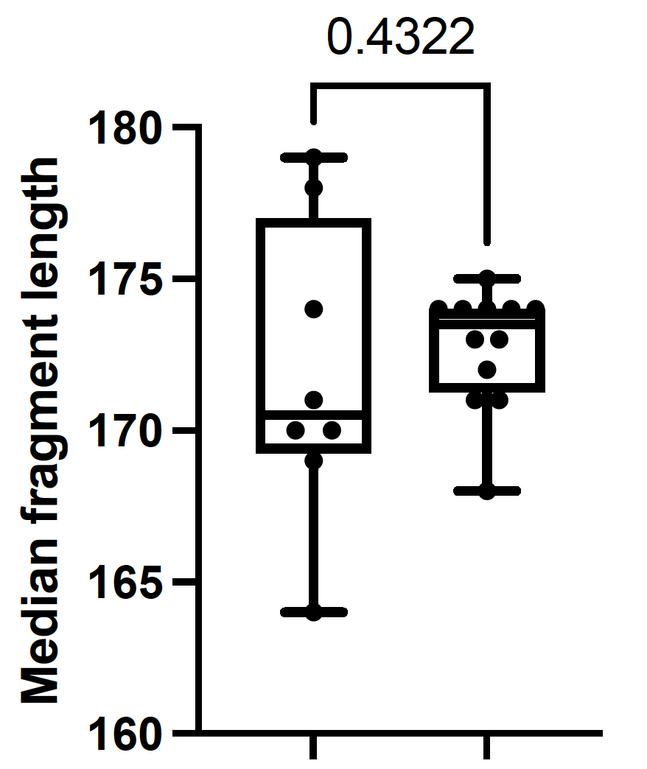
old
new

