Slide 1
PELT performance

Slide 2
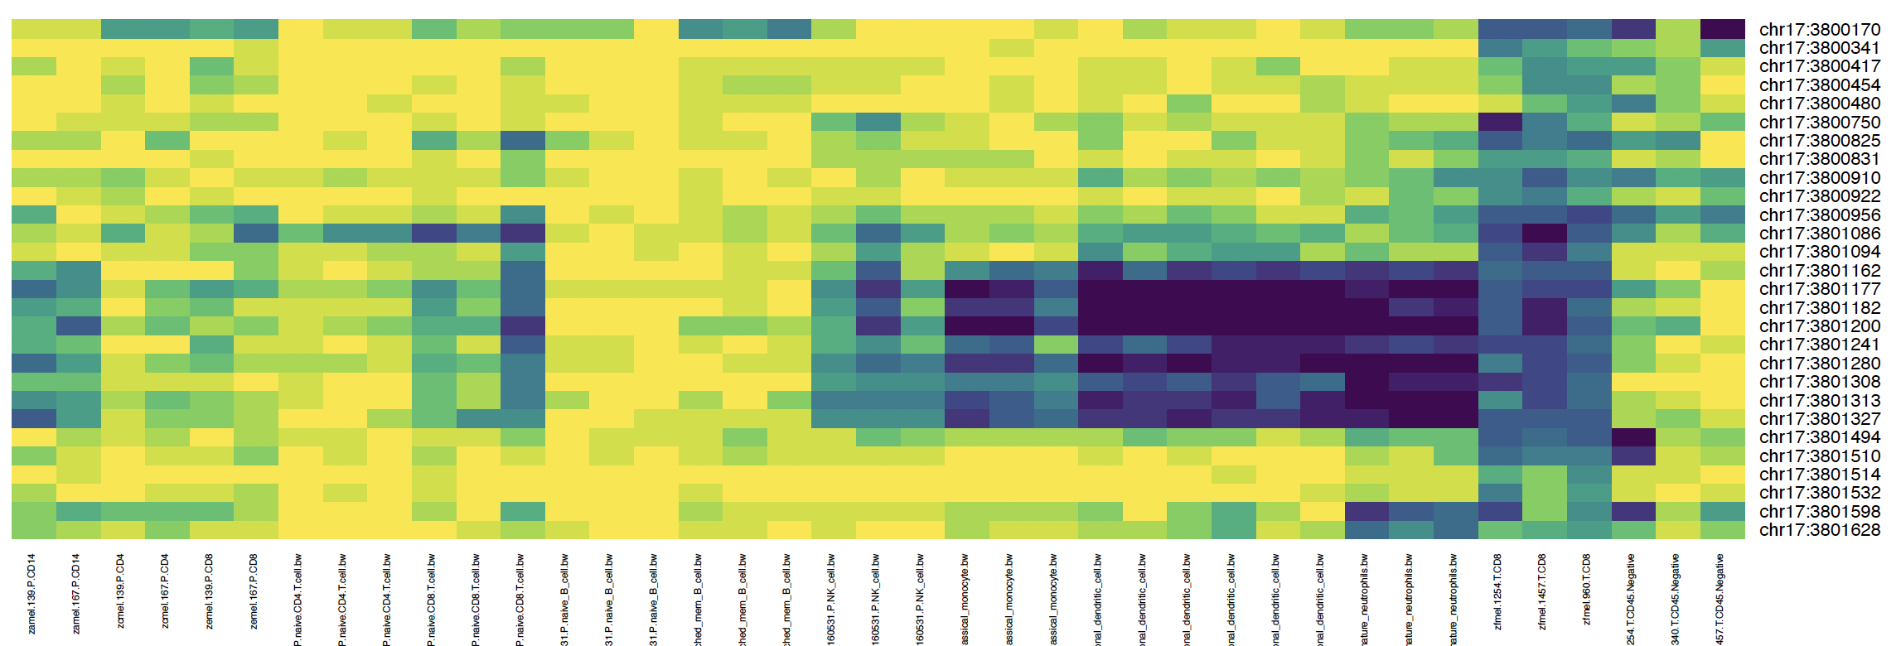
ITGAE DMR
This study
PBL
Blueprint
This study
CD4
CD8
nB
cB
NK
Mn, iDC, mDC, Neu
TIL
Mel Tum

Slide 3
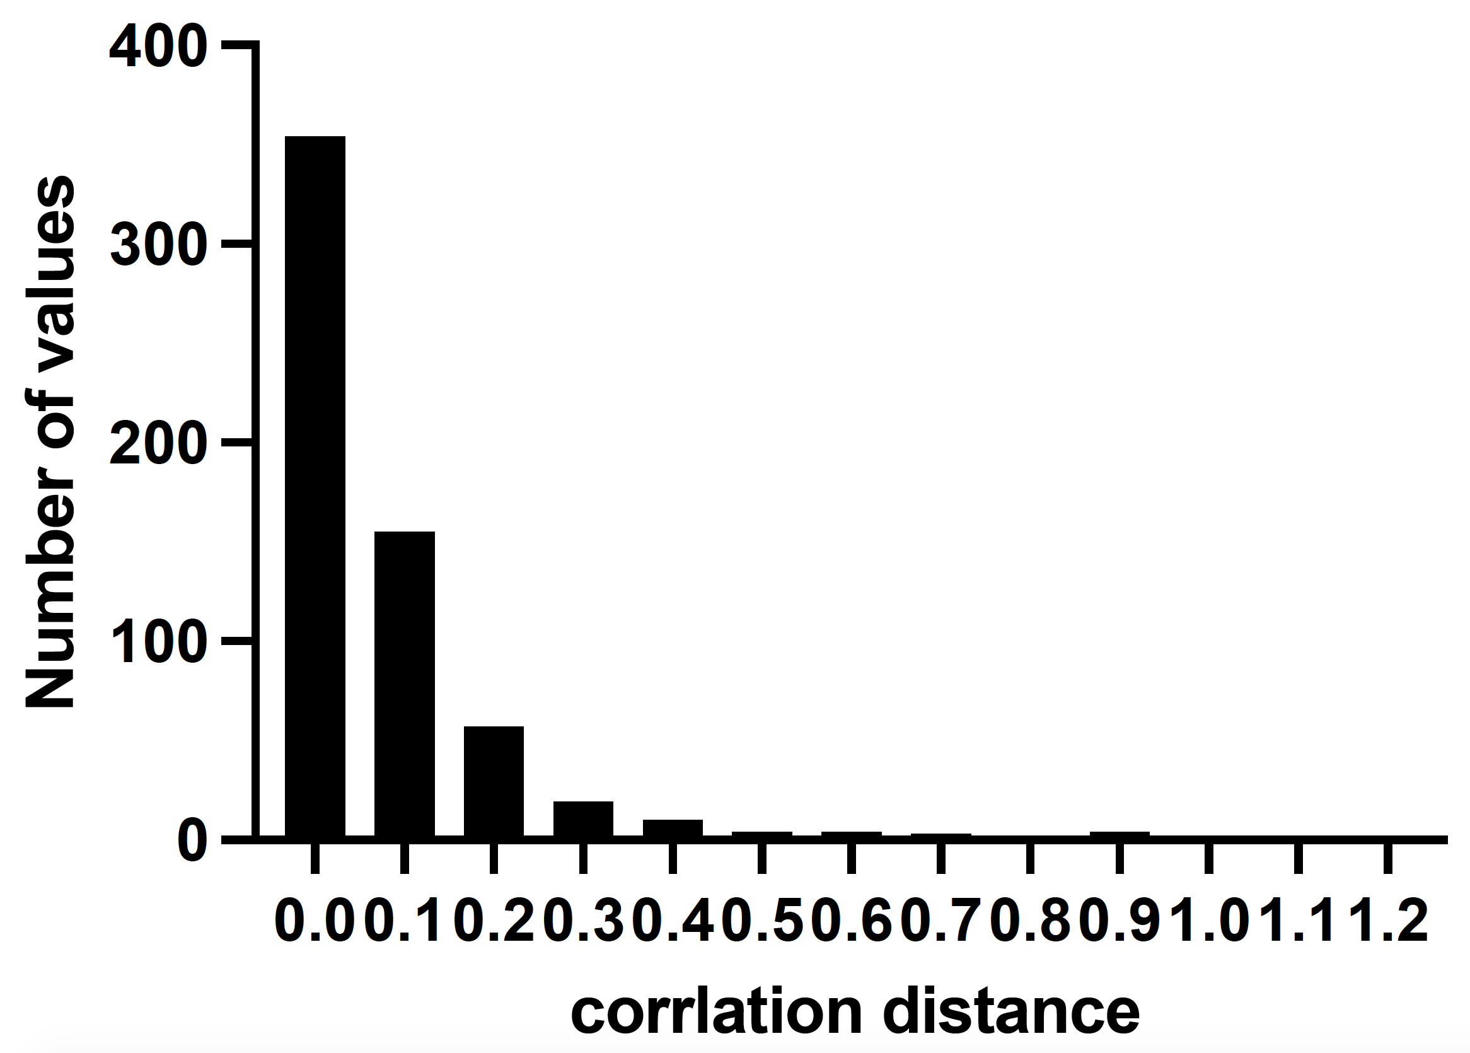
Correlation distance between parent and child DMRs

Slide 4
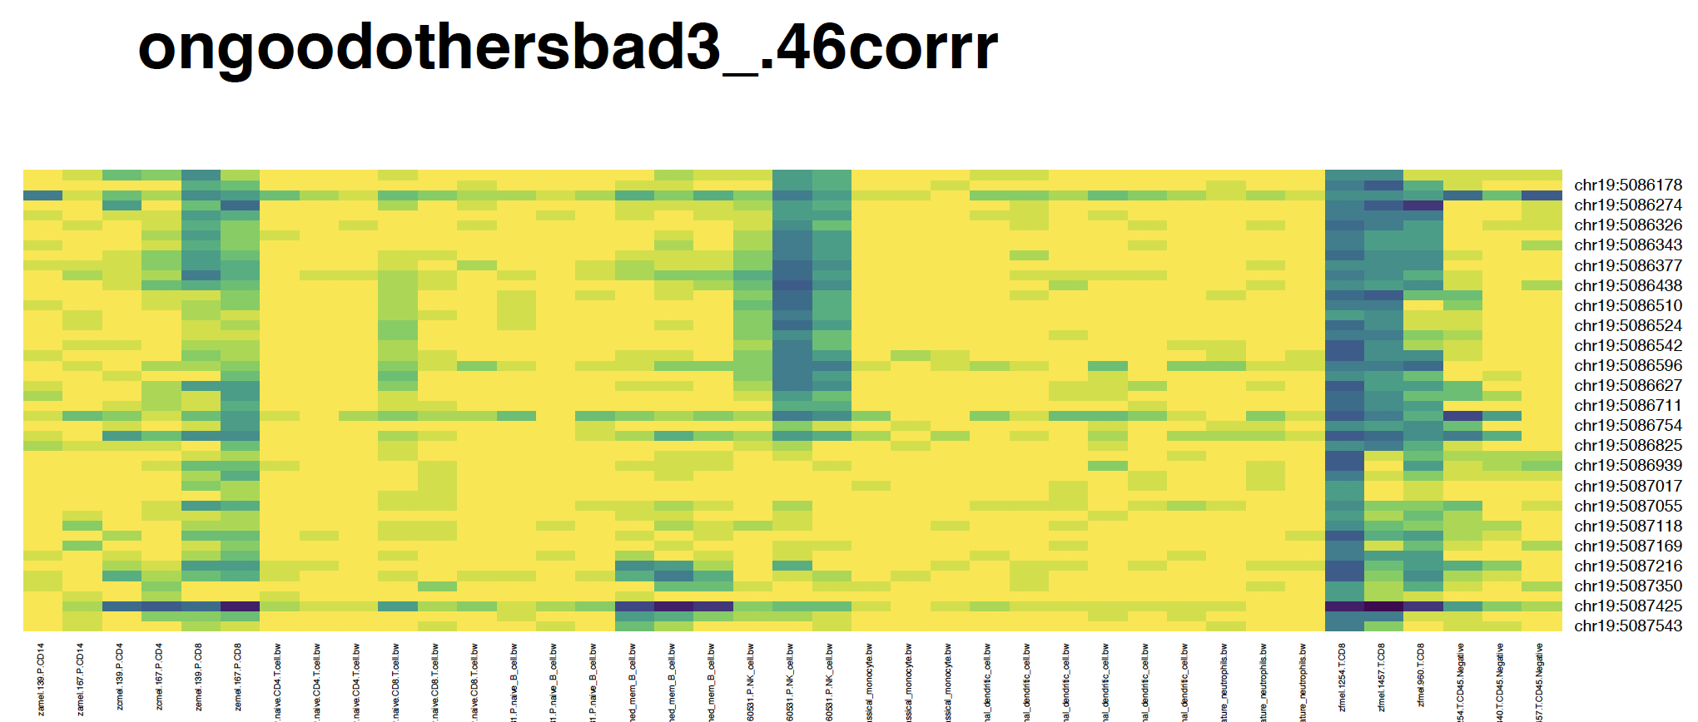
This study
PBL
Blueprint
This study
CD4
CD8
nB
cB
NK
Mn, iDC, mDC, Neu
TIL
Mel Tum
.03
.46

Slide 5
Merging PELT DMRs
Find the most similar adjacent 2 PELT DMRs (if < 0.1)
Combine them
Update correlation distance
If all distances > = 0.1, stop
Else go to step 1

Slide 6
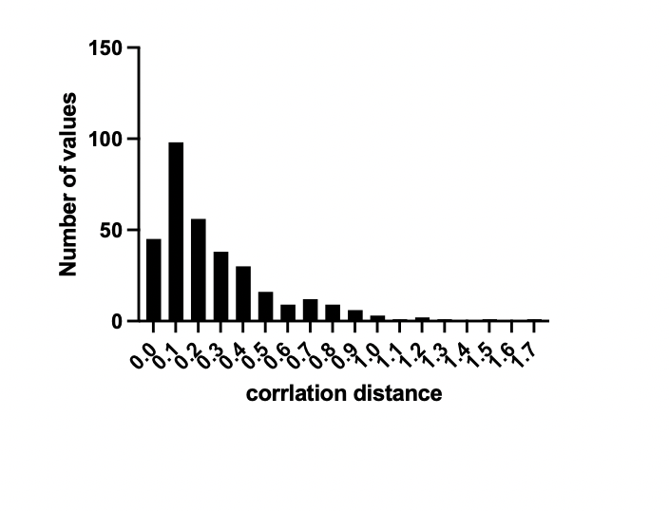
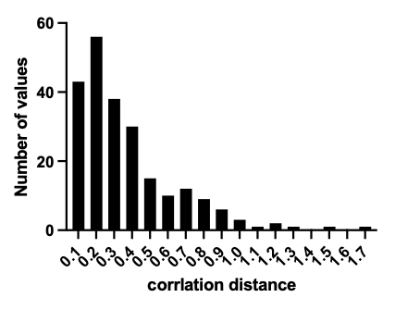
Correlation distance between adjacent children
Before merging
After merging
#segmented parent DMR = 285
#segmented parent DMR = 204
Correlation distance = 1 - correlation

Slide 7
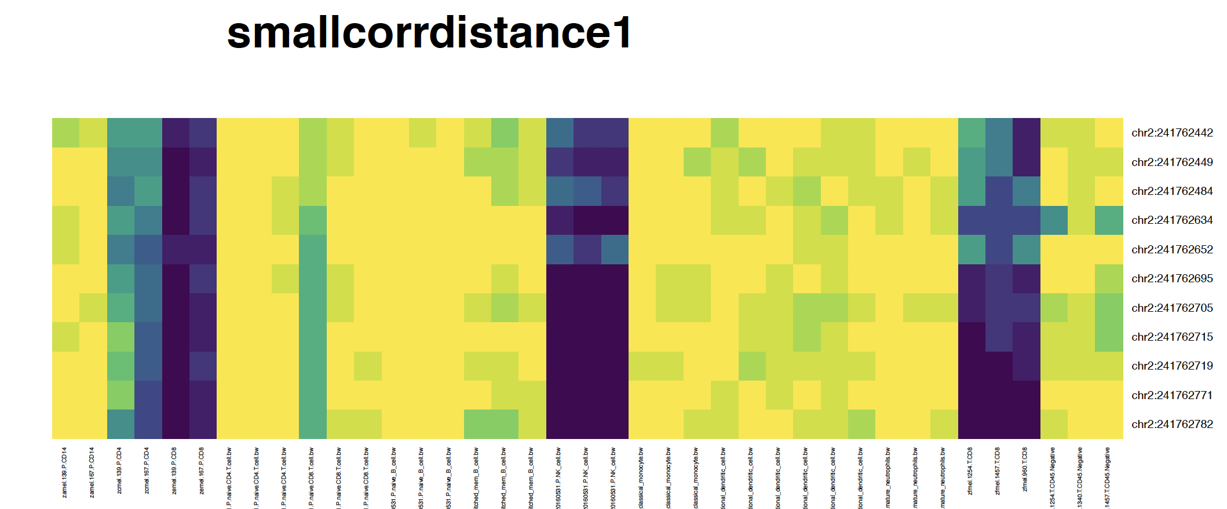
This study
PBL
Blueprint
This study
CD4
CD8
nB
cB
NK
Mn, iDC, mDC, Neu
TIL
Mel Tum
.002
Correlation distance = 1 - correlation

Slide 8
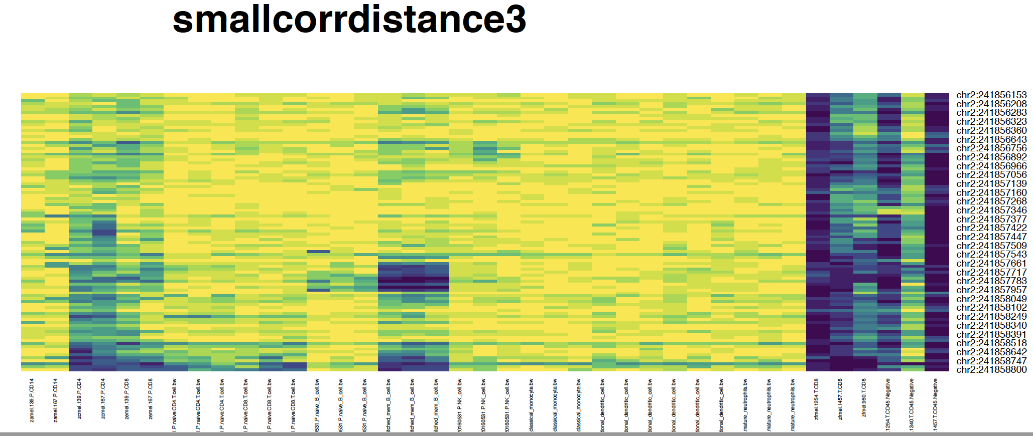
This study
PBL
Blueprint
This study
CD4
CD8
nB
cB
NK
Mn, iDC, mDC, Neu
TIL
Mel Tum
.008
.29
.15
Correlation distance = 1 - correlation

Slide 9
This study
PBL
Blueprint
This study
CD4
CD8
nB
cB
NK
Mn, iDC, mDC, Neu
TIL
Mel Tum
.008
.284
.15
Correlation distance = 1 - correlation

Slide 10
How to rank PELT DMRs?
How to estimate p value?

Slide 11
Read counting on PELT DMRs

Slide 12
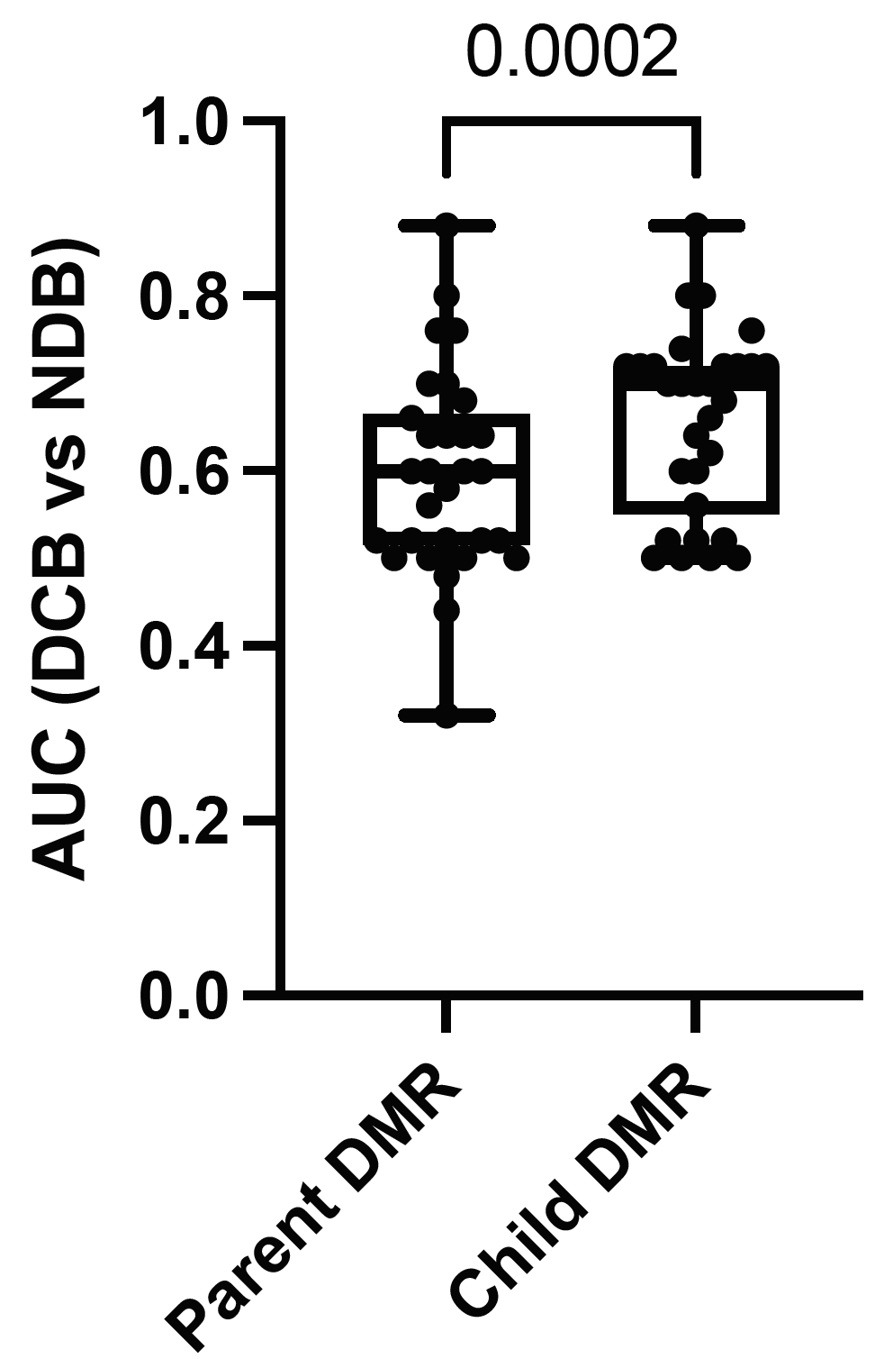
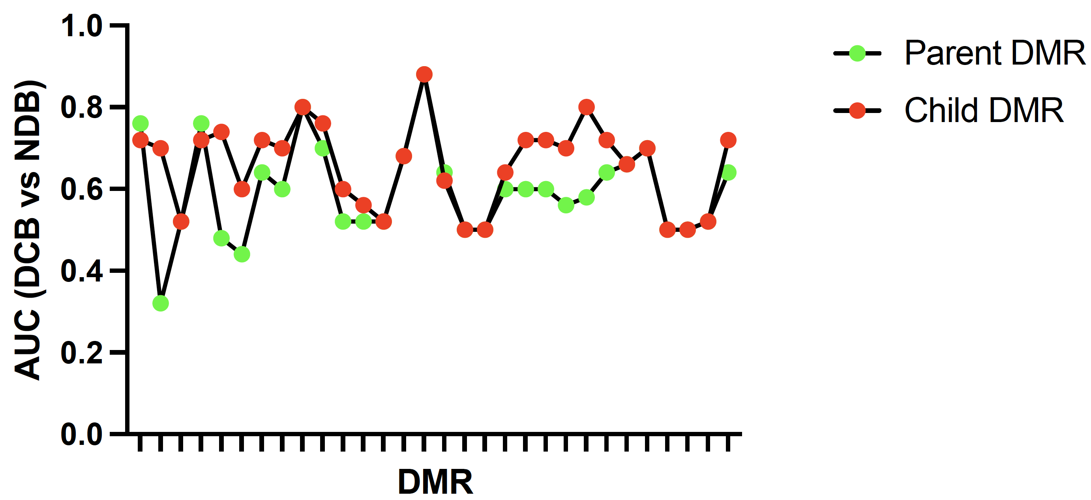

Slide 13
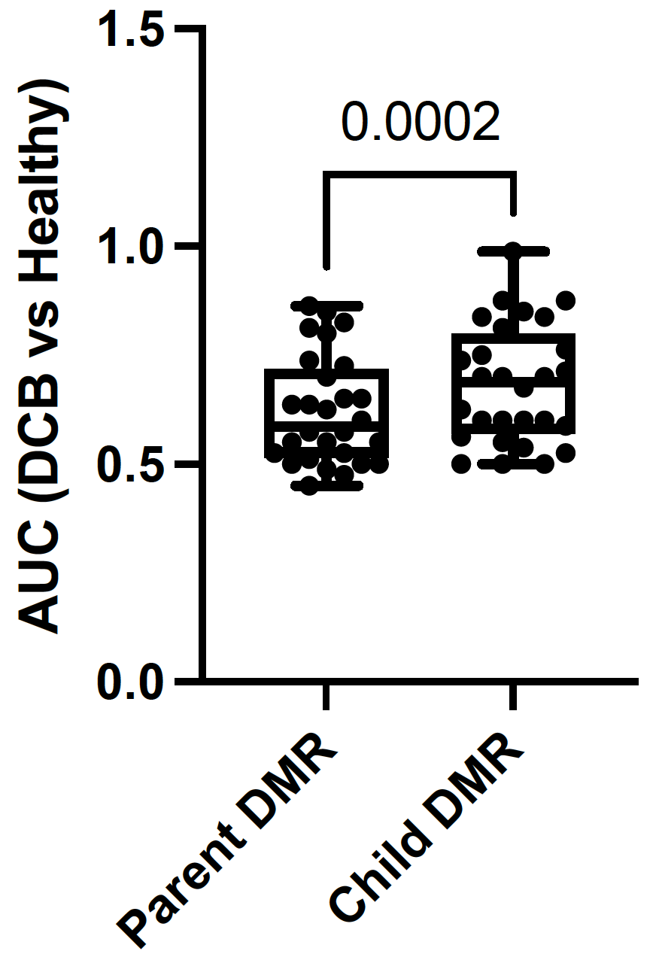
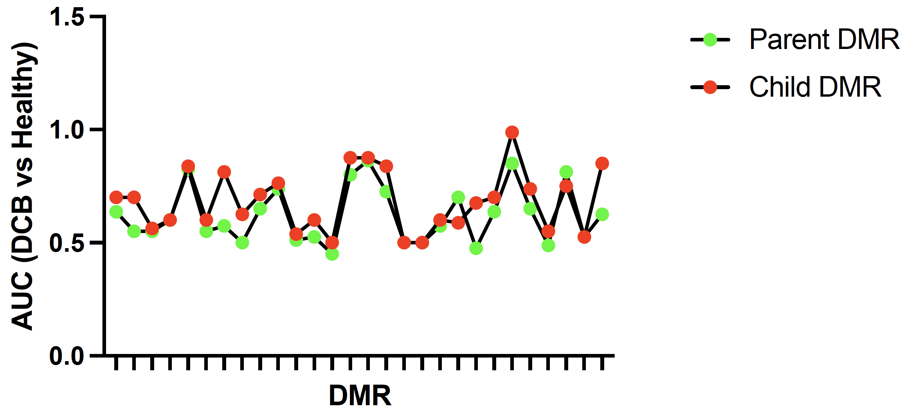

Slide 14
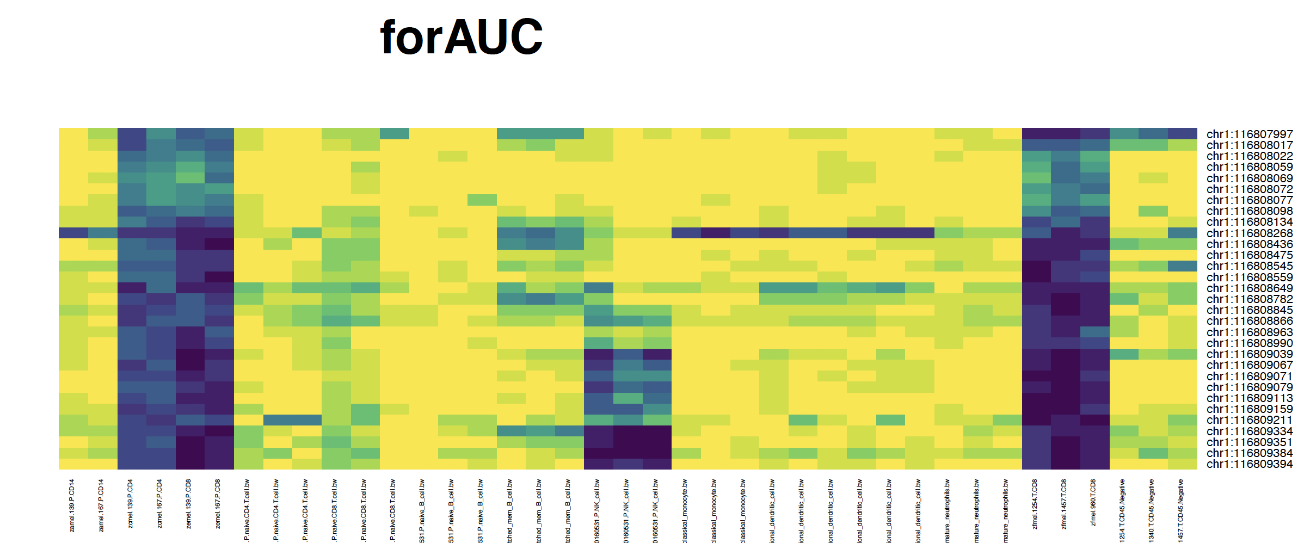
Not Merged
AUC
DCB vs NDB = .56
This study
PBL
Blueprint
This study
CD4
CD8
nB
cB
NK
Mn, iDC, mDC, Neu
TIL
Mel Tum
0.7
.01
.56
.51
.52

Slide 15
