Slide 1
Inferring Cellular Abundance by Read Counting
Notes:
Pivotal cpg, min cpg 3

Slide 2
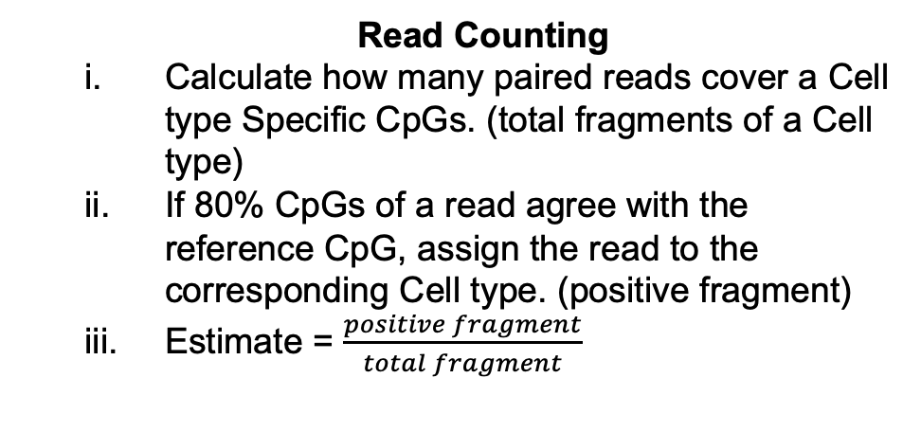
Method (Review)
Reference Generation
Downshifting issue
Get a long list of CpG using loose cutoff
Take x single CpG (pivotal CpG) from each cell type.
Include the surrounding CpGs (from step 1) within 150 bp.
Read Counting
Calculate how many paired reads cover a Cell type Specific CpGs. (total fragments of a Cell type)
If 80% CpGs of a read agree with the reference CpG, assign the read to the corresponding Cell type. (positive fragment)
Estimate = $\frac{positive fragment}{total fragment}$
#Pivotal CpG = 100
#minimum CpG in a fragment = 3

Slide 3
CpG Recovery in purified samples (last week’s slide)
#Pivotal CpG = 100
Minimum 1 CpG in a fragment
Minimum 2 CpG in a fragment
Minimum 3 CpG in a fragment

Slide 4
Performance on New Lane’s Bulk PBMC (Depth ~ 30x, input ~ 100ng)
#Pivotal CpG = 100
Minimum 3 CpG in a fragment
Absolute Counting (no scaling)
Absolute Counting (after scaling)
slope = 0.55
slope = 0.86
CCC = 0.79
CCC = 0.92
*Scaling factor calculated from slide 2

Slide 5
Performance on Previous Lane’s Bulk PBMC (Depth ~ 15x, input ~ 25ng)
#Pivotal CpG = 100
Minimum 3 CpG in a fragment
Absolute Counting (no scaling)
Absolute Counting (after scaling)
slope = 0.4
slope = 0.69
CCC = 0.5
CCC = 0.82
*Scaling factor calculated from slide 2

Slide 6
Performance on Both Lanes’ PBMC
#Pivotal CpG = 100
Minimum 3 CpG in a fragment
Absolute Counting (no scaling)
Absolute Counting (after scaling)
Relative Counting
slope = 0.45
slope = 0.74
slope = 0.77
ccc = 0.59
ccc = 0.86
ccc = 0.93
*Scaling factor calculated from slide 2

Slide 7
Next
Linkage Group specific scaling factor (WIP)
Revisit Reference with EpCAM (WIP)
Parser for blueprint bam file

